Slide 1
MEC 3040: Bioenergy
Module 1: Introduction to Bioenergy
1.1: What is bioenergy
1.2: Current & projected energy use
1.3 : Forms of bioenergy
1.4: Bioenergy feedstock materials
1.5: Bioenergy co-products
1.6: Drivers of bioenergy use & development
1.7: The bioenergy debate
1.8: Is bioenergy sustainable?
1.9: Bioenergy vs. food debate

Slide 2
1.2: Current & projected energy use

Slide 3
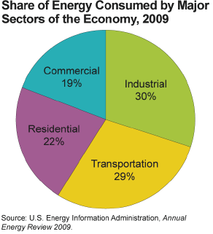
Current US energy use
US energy uses can generally be divided into rough thirds:
1/3 for industry & manufacturing;
1/3 for transportation; and
1/3 for commercial & residential use.
BIOEN1

Slide 4
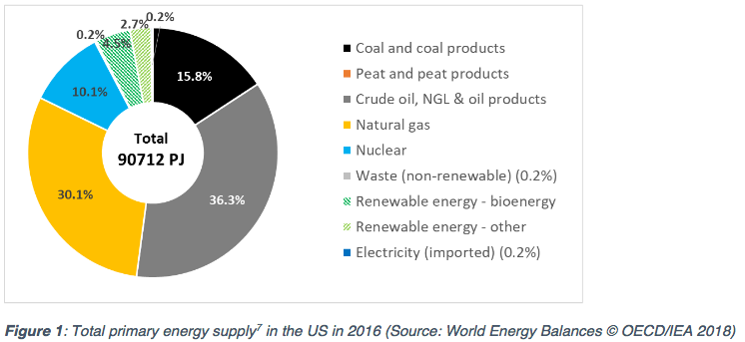
US primary energy sources (2016)
Recent changes (2011 – 2016) in US primary energy sources:
Coal down 6%
NG up 4%
RE up 1%
https://www.ieabioenergy.com/wp-content/uploads/2018/10/CountryReport2018_UnitedStates_final.pdf

Slide 5
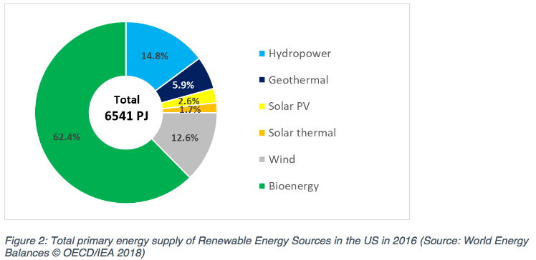
Most primary RE is bioenergy (2016)
Bioenergy overall only increased from 3.0 to 4.5% from 2005 to 2013 with little change since then.
https://www.ieabioenergy.com/wp-content/uploads/2018/10/CountryReport2018_UnitedStates_final.pdf

Slide 6
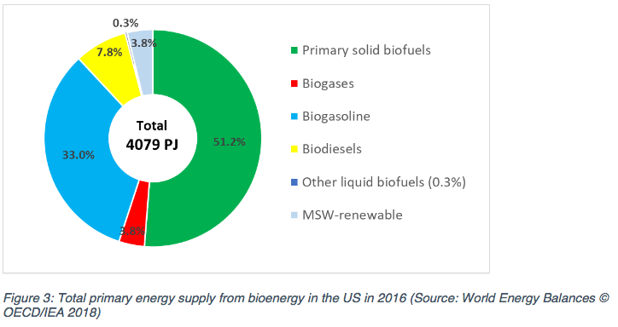
Primary bioenergy is ½ biomass (2016)
https://www.ieabioenergy.com/wp-content/uploads/2018/10/CountryReport2018_UnitedStates_final.pdf

Slide 7
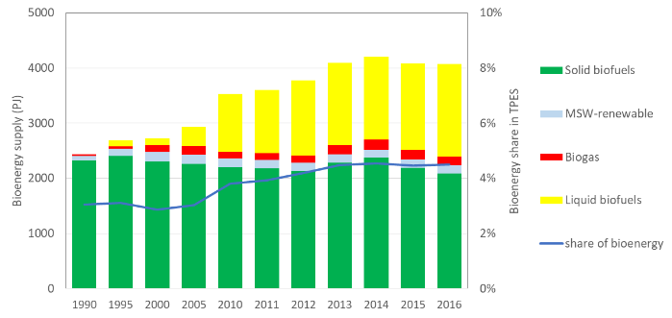
Gains due to liquid biofuel (2016)
Changes in forms of bioenergy with time: 1990 – 2016
Note that liquid biofuels account for all of the increase.
And that means bioethanol.
https://www.ieabioenergy.com/wp-content/uploads/2018/10/CountryReport2018_UnitedStates_final.pdf

Slide 8
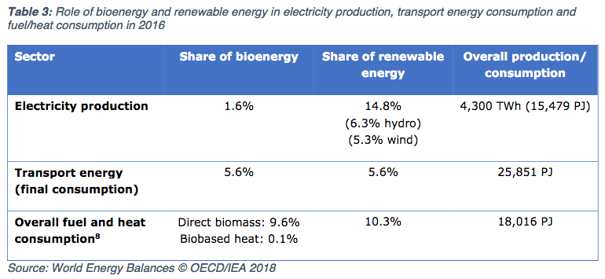
Bioenergy: heat ~ power > transport
RE power: 80% is hydro and wind; only 10% is biomass
Transportation energy: 5.6% is biofuel
Heating: about 10% from biomass
https://www.ieabioenergy.com/wp-content/uploads/2018/10/CountryReport2018_UnitedStates_final.pdf

Slide 9
Current global energy use
In 2007 & 2008, global energy use favored fossil fuels over biofuels, 10:1
Fossil fuel 500 EJ*
Biomass 50 – 54 EJ
Traditional use 35 – 43 EJ
Power generation 6.4 EJ
Transportation 2.6 EJ
What is bioenergy’s potential?
The World Bioenergy Association estimates that biofuels could produce:
1,135 – 1,548 EJ by 2050.
* What’s an EJ? Exajoule = one qunitillion = 10¹⁸ power
Rosillo-Calle & Johnson (2010)

Slide 10
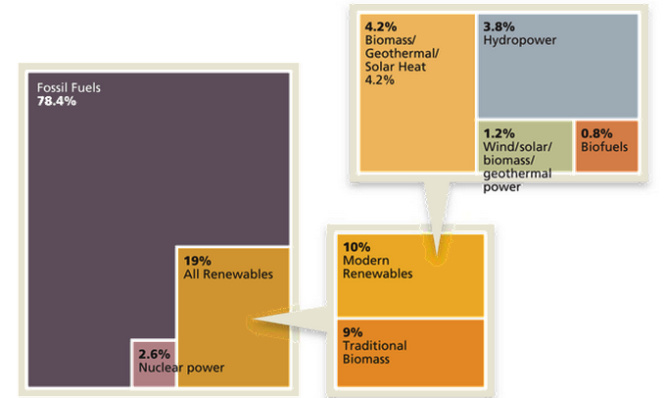
Current global energy use
Estimated RE Share of Global
Final Energy Consumption
http://www.renewableenergyworld.com/articles/2015/02/outlook-for-bioenergy-2015-whats-in-store-for-this- versatile-renewable-energy-feedstock.html

Slide 11
Breakdown of biomass use in US
In 2010, US biomass use looked like this:
46% was wood or wood-derived
43% was biofuel, mainly ethanol
11% was derived from municipal waste
BIOEN1
EIA @www.eia.doe.gov and www.repp.org/bioenergy/link6.htm;
www.extension.org/pages/Biomass_Feedstocks_and_Energy_Independence

Slide 12
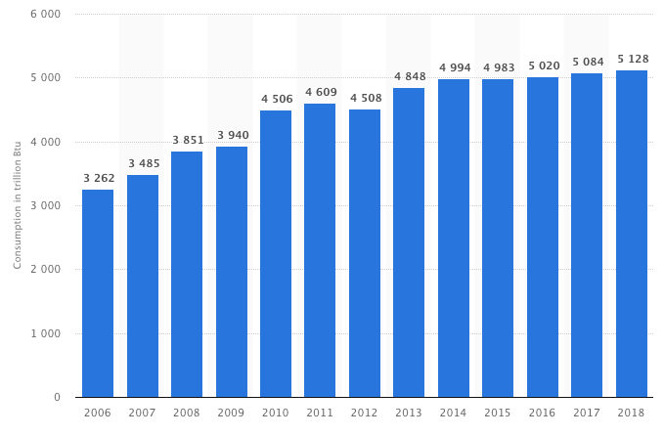
Biomass energy use is static in the US
From 2000 to 2018, electricity produced from biomass hasn’t increased.
https://www.statista.com/statistics/183429/biopower-generation-by-source-in-the-united-states-from-2000/

Slide 13
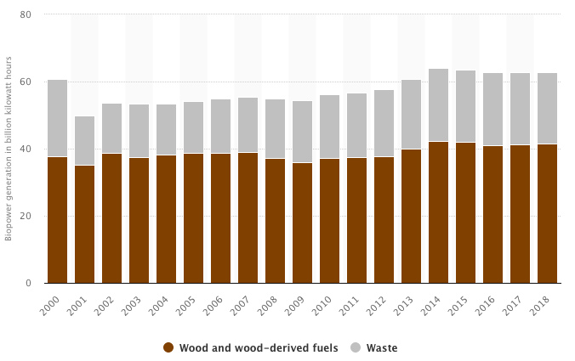
Biopower is static in the US
From 2000 to 2018, electricity produced from biomass hasn’t increased.
https://www.statista.com/statistics/183429/biopower-generation-by-source-in-the-united-states-from-2000/

Slide 14
How will US energy use change?
If recent changes to state & federal policies¹ hold, then by 2035:
Total energy use will increase;
Fossil fuel use will decrease from 84 to 78%; and
Renewable energy use will increase from 10 to 14%.
Natural gas use will increase as we exploit shale gas deposits via fracking.
NG prices are forecast to fall and stay low for some time.
Coal will continue to dominate electric generation, though new plants are not likely to be built.
Renewable energy targets have been set by 29 states and include wind, solar, hydropower and biomass (though biomass targets are very small).
BIOEN1
1 = CAFÉ standards, EISA, RFS, RFP, ARRA

Slide 15
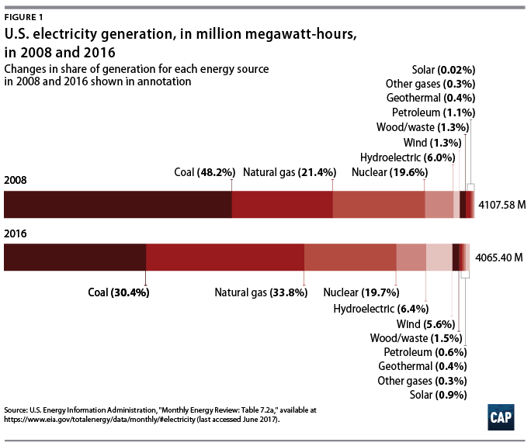
Obama administration on biofuels?
Under the Obama administration, renewable energy and natural gas made great gains.
Biomass gains were more modest:
Renewable Fuel Standard (RFS)
Biomass Crop Assistance program
Biofuels Working Group
https://www.americanprogress.org/issues/green/reports/2017/06/29/435281/americas-clean-energy-success-numbers/
https://en.wikipedia.org/wiki/Energy_policy_of_the_Barack_Obama_administration

Slide 16
Trump administration on biofuels?
August 2019: granted exemptions from the requirement for adding bioethanol
to 31 of 40 small refineries.
“Iowa’s Republican Senator Chuck Grassley said the EPA had “screwed” the U.S. ethanol industry and farmers by granting the waivers.” - Reuters
December 2018: reauthorization of the Farm Bill, including Rural Energy for American Program (REAP) and Biomass Crop Assistance Program
- Established Interagency Biogas Opportunities Task Force
- But didn’t fund several of these programs as suggested
“The Trump administration endorsed burning trees and other biomass to produce energy on Thursday, vowing to promote a practice some scientists have declared more environmentally devastating than coal-fired power.” – Bloomberg News
April 2018: replaced Clean Power Plan with the Affordable Clean Energy Rule
- Allows co-gen (addition of biomass to coal) to ‘reduce emissions’
http://biomassmagazine.com/articles/15838/trump-signs-2018-farm-bill

Slide 17
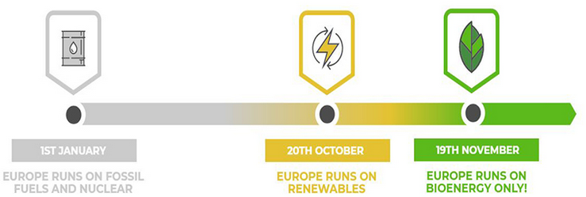
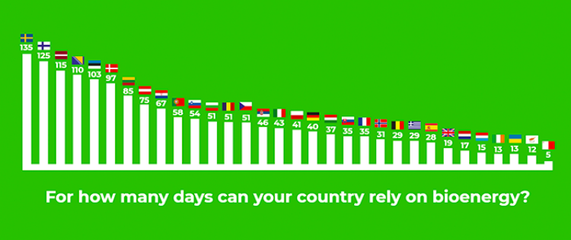
EU-28 (+4): annual days of bioenergy
43 days
U.S.
https://bioenergyinternational.com/opinion-commentary/poland-celebrates-national-bioenergy-day-2018
https://bioenergyinternational.com/markets-finance/biomass-can-heat-cool-power-and-transport-eu-28-for-43-days

