Slide 1
MEC 3040: Bioenergy
Module 1: Introduction to Bioenergy
1.1: What is bioenergy
1.2: Current & projected energy use
1.3 : Forms of bioenergy
1.4: Bioenergy feedstock materials
1.5: Bioenergy co-products
1.6: Drivers of bioenergy use & development
1.7: The bioenergy debate
1.8: Is bioenergy sustainable?
1.9: Bioenergy vs. food debate

Slide 2
1.4: Bioenergy feedstock materials

Slide 3
Bioenergy feedstock & supply chain
Bioenergy feedstock: biomass-derived material that can be converted to energy using microbes, heat, chemicals or some combination thereof
Some amount of conversion (aka ‘refining’) is usually required to turn feedstock into use-ready biofuel.
Processing (refining) often involves densification (or aggregation) to make transport of feedstock easier and cheaper.
biomass
biofuel
energy for use
processing
refining
use
(often combustion)
supply chain / value chain
trees
cordwood, chips, pellets
heat, CHP, electricity
soybean plants
oil, biodiesel
heat, transportation fuel
Dahiya (2015)

Slide 4
Types of bioenergy feedstock materials
woody
non-woody
lignocellulose
sugar
starch
cellulose/
lignocellulose
fats
Dahiya (2015)

Slide 5
Feedstock sources
forests
agriculture
waste
whole-tree chips
short-rotation woody crops
sawmill residues
perennial lignocellulosic crops
construction wastes
bole chips
municipal wastes
bark chips
lignocellulosic residues
oil / fat waste
sugars / starches
landfill gas
oils
municipal solid waste
Dahiya (2015)

Slide 6
Biomass feedstock availability
We’ll discuss each feedstock material in more detail as this course proceeds, but let’s look at some general conclusions about biomass availability here.
The 2005 report, ‘Biomass as Feedstock for a Bioenergy and Bioproducts Industry: the Technical Feasibility of a Billion-Ton Annual Supply’ prepared by DOE & USDA made these conclusions:
We have enough biomass to replace 30% of US petroleum use by 2030.
Biomass harvests could be increased from 2005’s 473 million to 1.1 billion dry tons annually with modest changes to land management practices.
2011 update decreased estimates of forest & crop residue resources, but increased the potential of energy crops.
Because biomass feedstock materials are not energy dense, transportation to processing plants affects the cost of feedstock and profitability of growing bioenergy feedstock.
Willingness to grow bioenergy crops may be limited by distance from processing plants.
Bioenergy Primer 1; BIOEN1

Slide 7
Ethanol feedstock availability
The 2008 report, ’90-Billion Gallon Biofuel Deployment Study’ prepared by Sandia National Lab and General Motors R&D Center looked at availability of feedstock for ethanol production.
hitectransportation.org/news/2009/Exec_Summary02-2009.pdf
90 billion gallons of biomass ethanol could be produced annually.
15 billion gallons from corn; and
75 billion gallons from cellulosic biomass, mainly perennial energy crops
Requiring 48 million acres of land now characterized as ‘idle, pasture of non-grazed forest’.
In order for cellulosic ethanol to become commercially viable:
Biomass producers will need consistent & reliable markets;
Production contracts to help ensure supply; &
Supportive policy to encourage development.
While cellulosic biomass doesn’t take food from the hungry, farmers can’t sell cellulosic biomass crops for food if the energy demand / market drops.
Bioenergy Primer 1; BIOEN1

Slide 8
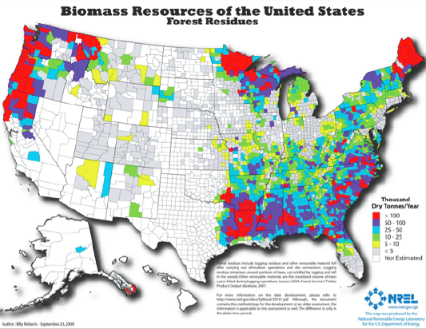
Forest-based feedstock sources
BIOEN1

Slide 9
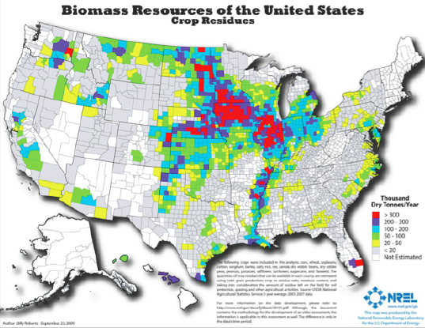
Agricultural residue sources
BIOEN1

Slide 10
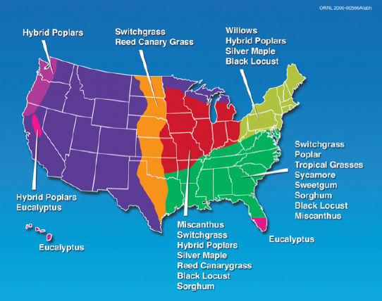
Agricultural sources: perennial crops
BIOEN1

Slide 11
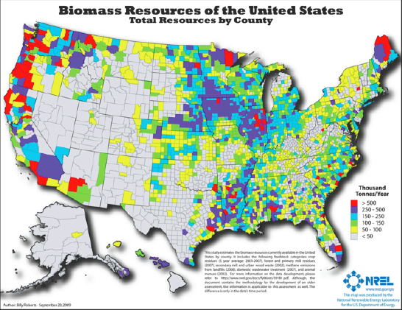
Total biomass sources
BIOEN1

Slide 12
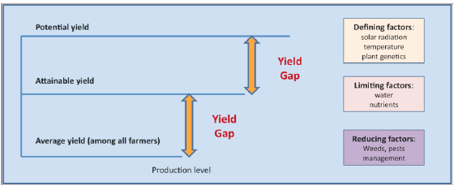
Biomass yields
The term yield can mean different things. Average yields are conservative estimates based on averages across producers and years. Attainable yields & potential yields can be obtained if all factors are optimized:
Nutrients (can be controlled to some extent)
Water
Weather
Pests & management
BIOEN1

Slide 13
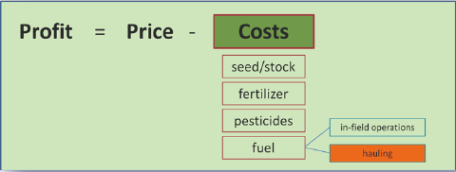
Biomass profits?
Typically, agricultural profits depend on the price paid for the crop and the combined cost of producing that crop.
The costs of hauling the crop to the buyer / processor must also be considered as a cost to the producer. So, producers will choose their crops, in part, on their distance from buyers or processing plants.
Biomass is an attractive crop to produce only when processing plants are close enough to limit the costs of hauling and allow profit.
BIOEN1

Slide 14
Biomass supply chain
source
biomass
processing
use / market
forests
tops & branches
small-diameter pulpwood
small understory trees
bark
power
heat
steam
biofuels
chemicals
annual crop residues
perennial energy crops
hybrid willow / poplar
densification
agriculture
all crop starches / sugar
construction materials
sawmill residue
cardboard & paper
waste
manure
food processing waste
food waste
BIOEN1

Slide 15
Feedstock by conversion process
thermal conversion
thermochemical conversion
biochemical conversion
chemical conversion
lignocellulose
lignocellulose
lignocellulose
organic wastes
fats / oils / grease
sugars starches (crops)
densification
torrefication
fermentation
gasification
combustion
anaerobic digestion
trans-esterification
pyrolysis
charcoal
methanol
syngas
bio-oil
power heat
steam
bio-coal
syngas
ethanol
biogas or biomethane
biodiesel
BIOEN1

