Slide 1
MEC 3040: Bioenergy
Module 1: Introduction to Bioenergy
1.1: What is bioenergy
1.2: Current & projected energy use
1.3 : Forms of bioenergy
1.4: Bioenergy feedstock materials
1.5: Bioenergy co-products
1.6: Drivers of bioenergy use & development
1.7: The bioenergy debate
1.8: Is bioenergy sustainable?
1.9: Bioenergy vs. food debate

Slide 2
1.9: The food vs. fuels debate

Slide 3
Intersection of food & energy systems
In 2007 – 2008, crop and food prices soared around the globe, causing shortages in underprivileged areas. Why?
Futures trading
Higher fossil fuel prices
Building of grain reserves
Agricultural price supports & subsidies
Growing demand / increased populations
Use of food crops for ethanol production
Many food crops can be used as feedstock for bioenergy & chemical production.
Growing human populations increase the demand for food and energy..
Should we increase the supply of these crops? Can we?
Should we decrease the demand for food or energy? Can we?
As of 2009, ethanol production consumed 30% of the US corn crop, double the use of corn for fuel in 2006.
BIOEN1; Thurow & Kilman (2009)

Slide 4
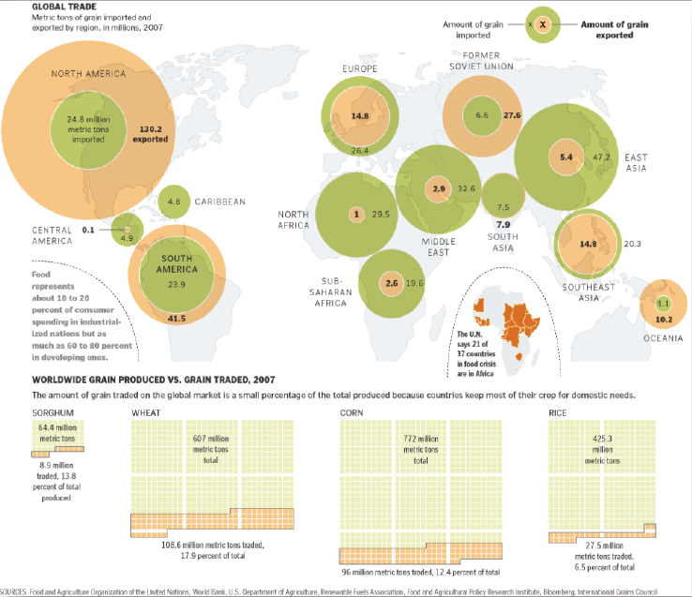
Global grains trading
Global patterns of grain production vs.
consumption
BIOEN1

Slide 5
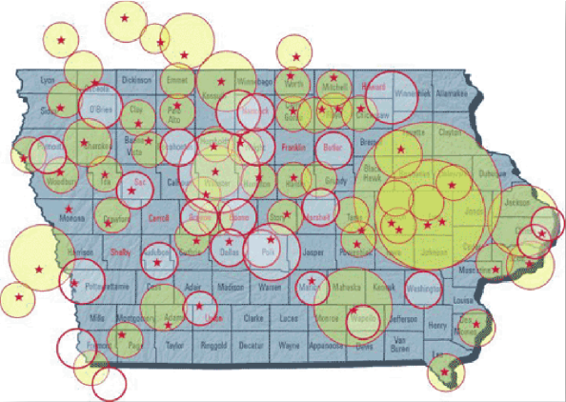
Corn for food or ethanol?
Planned corn processing and ethanol plants (stars) and corn producing areas (circles) in Iowa (2006).
Overlapping circles indicate where competition may increase food prices.
BIOEN1

Slide 6
References
BIOEN 1 - 4: Bioenergy & sustainability course series (March 2012)
fyi.uwex.edu/biotrainingcenter
Bioenergy Primer, chapters 1 & 2, EPA
http://www.epa.gov/statelocalclimate/documents/pdf/bioenergy_chapter1.pdf
http://www.epa.gov/statelocalclimate/documents/pdf/bioenergy_chapter2.pdf
Boyle (2004) Renewable energy: power for a sustainable future, 2/e, Oxford University Press, UK, ISBN: 0-19-926178-4
Dahiya, A (ed) (2015) Bioenergy: Biomass to biofuels, Academic Press, Waltham, MA, ISBN: 978-0-12-407909-0
Rosillo-Calle, F, Johnson, F.X., eds (2010) Food versus fuel: an informed introduction to biofuels. Zod Books, London & New York
Thorow, R. & Kilman, S. (2009) Enough: why the world’s poorest starve in an age of plenty, Public Affairs, NY, NY

