Slide 1
MEC 3040: Bioenergy
Module 3B: Wood pellet heating
3.8: Wood pellets & current use
3.9: Two wood pellet heat case studies
3.10: Bulk delivery
3.11: Pellet stoves
3.12: Pellet boilers
3.13: Air emissions, permitting & ash
3.14: Economics of wood pellet heating
3.15: Recent wood pellet projects

Slide 2
3.8: Wood pellet heating systems

Slide 3
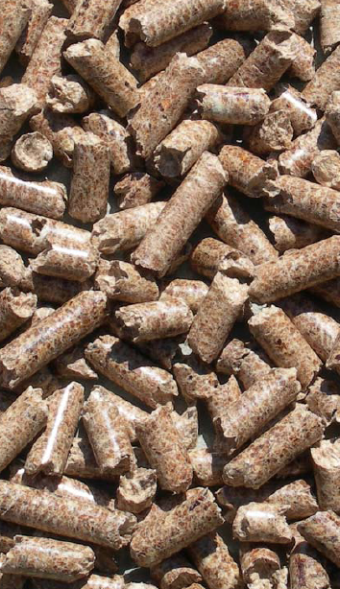
What are wood pellets?
Pellets are compressed by-products from the forest products industry.
Uniformly sized: ¼ - 5/16” in diameter and 1 – 1 ½ inches long;
Easy to store; &
Easy to use.
Available in:
40-lb bags; or
Bulk delivery
Because the moisture content of wood must be lowered before pellets can be made, the energy content of pellets is higher than other forms of wood biomass.
6% moisture
7,750 Btu per pound
Three grades classified by amount of ash produced:
Premium: <1% ash
Standard: 1-2% ash
Industrial: > 3% ash
Wood pellet heating: a reference on wood pellet fuels & technology for small commercial & institutional systems

Slide 4
Current use of wood pellet heating
As of 2007, 800,000 US homes used wood pellet stoves or furnaces for heating.
And use of pellet heat for larger buildings is increasing in Europe, and more slowly in the US:
Municipal or federal buildings;
Schools & colleges;
Housing complexes;
Office buildings, etc.,; &
Greenhouses.
In these larger settings pellets are delivered and stored in bulk for use by large boiler systems.
Wood pellet heating: a reference on wood pellet fuels & technology for small commercial & institutional systems

Slide 5
Ideal candidate for wood pellet heating
Buildings:
between 10,000 – 50,000 square feet;
use electricity or fossil fuel for space heating and hot water;
or are new construction;
with heating loads of 0.25 – 1.5 million Btu per hour.
Buildings should have:
Centralized hot water heat distribution;
Space for bulk wood pellets near the boiler; &
Access for delivery to the silo.
Ideally, pellet users should be no more than 50 miles from the supplier to control delivery charges.
Wood pellet heating: a reference on wood pellet fuels & technology for small commercial & institutional systems

Slide 6
3.9: Two pellet heating case studies

Slide 7
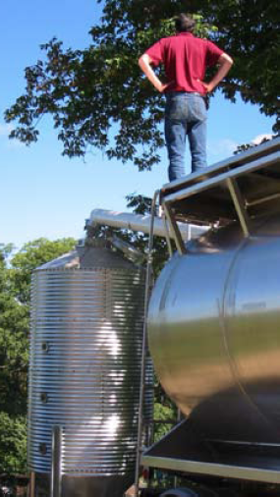
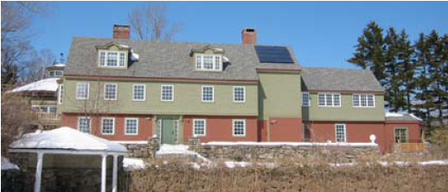
Case study: Harris Center (NH)
The Harris Center for Conservation Education provides educational programs and serves as a local land trust.
10,000 SF heated space
Nine-ton silo
Annual use of 10 – 15 tons
75 minutes per week
45% fuel cost savings (2007)
Wood pellet heating: a reference on wood pellet fuels & technology for small commercial & institutional systems

Slide 8
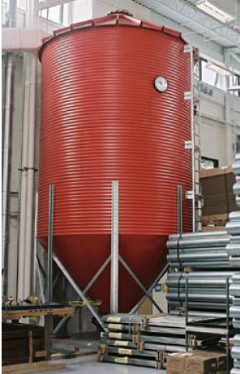
Case study: NRG Systems (VT)
NRG Systems makes wind-measurement equipment for the wind power industry.
Note that the building is so efficient that its heating load is smaller than expected for a building of this size.
46,000 SF heated space
30-ton silo (just 30-tons per year)
Fuels two residential scale 140,000 Btu/hour boilers
15 minutes per day
Offset 4,735 gallons of propane annually
Wood pellet heating: a reference on wood pellet fuels & technology for small commercial & institutional systems

Slide 9
3.10: Bulk delivery

Slide 10
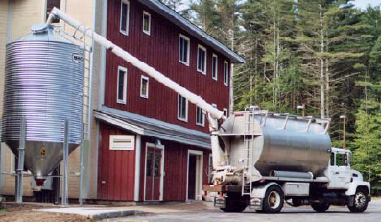
Bulk delivery considerations
Bulk delivery is very convenient for the user as most storage systems automatically feed pellets to the stove or boiler and require little work by the users.
However, bulk delivery and storage require a reliable supplier. When finding a supplier consider the following issues:
Delivery distance: less than 50 miles optimally;
Commitment to the bulk market;
Guarantee of a reliable supply;
Quality of pellets: avoid pellets produced from construction & demolition waste and be sure that pellet quality is compatible with the heating equipment you choose.
Wood pellet heating: a reference on wood pellet fuels & technology for small commercial & institutional systems

Slide 11
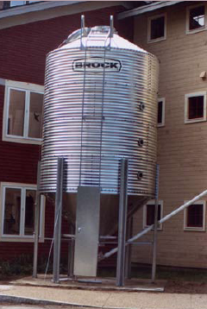
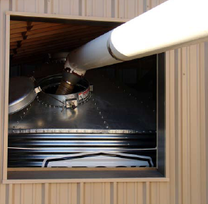
Sizing a pellet storage silo
Consider installing a silo capable of storing more than the pellet delivery truck used by your supplier, maybe 1.5x larger.
This will allow you to accept delivery before the current supply of pellets is depleted.
Silos are available in increments of 10, 15, 25 or 35 tons.
Use a minimum silo size of 15 tons for small commercial or institutional boilers.
While most silos are located outside of the building they supply, they can be housed in structures.
Wood pellet heating: a reference on wood pellet fuels & technology for small commercial & institutional systems

Slide 12
3.11: Pellet stoves vs boilers

Slide 13
Pellet stoves vs. boilers
Stoves are designed to provide heat for residential buildings.
Generally, pellets are loaded by hand.
Boilers are designed to provide heat for larger buildings.
Fed from pellet silos; &
More automated and controlled.
Wood pellet heating: a reference on wood pellet fuels & technology for small commercial & institutional systems

Slide 14
Pellet stove considerations
Proper sizing is critical to ensure good stove performance.
Oversized stoves will be run at low temperatures, causing air emissions.
Undersized stoves won’t provide sufficient heat.
Rule of thumb?
2,000 SF home can be heated with a stove rated at 60,000 Btu
1,300 SF home can be heated with a stove rated at 42,000 Btu
Some municipalities restrict use of wood burning because of concerns about air emissions, so check before planning on using wood.
Today, EPA certification helps consumers lower air emissions.
Wood pellets are the cleanest burning wood fuel.
Location of pellet stoves influences how efficiently they heat homes.
Place the stove in the room used most often.
Use fans or blowers to move warm air to other areas.
energy.gov/energysaver/wood-and-pellet-heating

Slide 15
Pellet stoves are efficient
Pellet stoves have very high combustion and heating efficiencies.
EPA certified stoves are in the 70 – 83% range.
Heating capacities are between 8,000 and 90,000 Btu per hour.
The cost of pellet stoves is $1,700 – 3000.
Installation is less expensive when the stove can be vented directly out of the room without a chimney or flue.
Wood pellet appliances are available as:
Freestanding stoves; or
Fireplace inserts.
Most are fed via a pellet hopper that stores 35 – 130 pounds of pellets.
Refilled about once per day.
Most are fed via a timer but several have thermostats that govern feed rate.
Maintenance:
Weekly cleaning;
100 kWh / month to run fans, controls & pellet feeders
energy.gov/energysaver/wood-and-pellet-heating

Slide 16
Fireplace inserts
High-efficiency fireplace inserts function like stoves, but fit into the masonry or hearth of a fireplace.
For most efficient heating, installation of fireplace inserts is critical.
The insert must be as air-tight as possible; &
Approved insulation must be used to fill any gaps.
The chimney should be cleaned regularly
energy.gov/energysaver/wood-and-pellet-heating

Slide 17
3.12: Pellet boilers

Slide 18
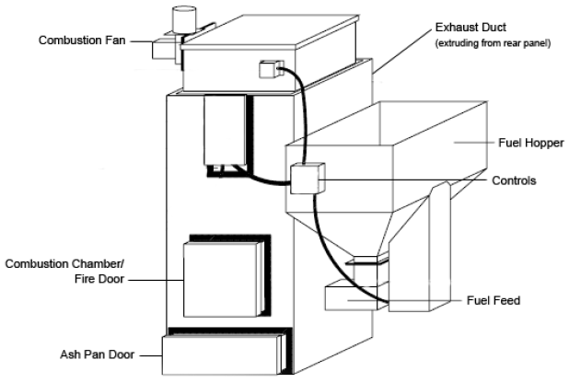
Wood pellet boilers
or auger from storage
Wood pellet heating: a reference on wood pellet fuels & technology for small commercial & institutional systems

Slide 19
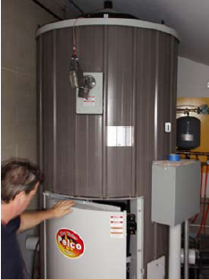
Boiler components (1)
Combustion chamber (fire door) Where pellets are burned to produce heat.
Accessible via fire door.
Combustion fan
Provides air to the combustion chamber.
Primary controls
Controls flow of pellets & air into the combustion chamber & reads boiler & exhaust temperatures.
Fuel hopper & feed system
Automatic conveyer from storage bin; or
Feed system from a manual fuel hopper.
Exhaust duct
Combustion exhaust gases are removed via a duct in the rear of the system & then through a chimney.
Wood pellet heating: a reference on wood pellet fuels & technology for small commercial & institutional systems

Slide 20
Boiler components (2)
OPTIONAL
Ash removal system
Automatic soot-cleaning system
Connections:
The exhaust system connects to a new or existing high-temperature chimney.
The boiler connects to the buildings hot water heat distribution system.
Wood pellet heating: a reference on wood pellet fuels & technology for small commercial & institutional systems

Slide 21
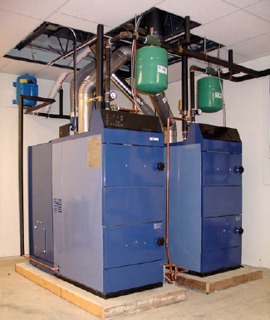
Sizing a boiler system
Any boiler system should be sized to produce enough heat to meet the peak demands of the building.
Peak demand depends on:
Building size;
Building efficiency; and
Climate.
For new buildings, consult a mechanical or building engineer or a heating system consultant or contractor.
For existing buildings, gather several seasons of heating fuel bills & data on climate like number of heating degree days.
If possible, weatherize the building before installing a new heating system.
Wood pellet heating: a reference on wood pellet fuels & technology for small commercial & institutional systems

Slide 22
More than one building?
Wood pellet boilers can be used to heat small district systems: several buildings located close to one another.
The boiler is located in the most central building.
Buried hot water distribution pipes connect to the other buildings.
Creation of small districts tend to maximize cost savings as a single boiler system needs to be purchased, installed and maintained.
Wood pellet heating: a reference on wood pellet fuels & technology for small commercial & institutional systems

Slide 23
Operating & maintenance?
Wood pellet boilers are relatively simple systems, but they will require more maintenance than traditional fossil fuel or electric heating systems.
Usually estimated as 15 – 30 minutes of operator time per day
For a bit more of a capital investment boiler systems can include components that automate some cleaning and save time.
Weekly tasks:
Empty ash containers;
Monitor temperatures, fuel use;
Check settings & alarms.
Annual tasks:
Grease augers, gear boxes, other moving parts;
Check for wear on conveyors, augers, motors, & gear boxes.
Wood pellet heating: a reference on wood pellet fuels & technology for small commercial & institutional systems

Slide 24
3.13: Air emissions, permitting & ash

Slide 25
Air emissions?
Like all fuels, wood produces a number of air emissions:
Particulate matter (PM);
Carbon monoxide (CO);
Nitrogen oxides (NOx); &
Sulfur oxides (SOx)
← Increased with wood vs. fossil fuel
← Decreased with wood vs. fossil fuel
Partial emissions data for wood pellets from a Danish study.
lb / million Btu | PM10 | CO | NOx | SOx
Wood pellet boiler | NA | 0.51 | 0.272 | NA
Wood chip boiler | 0.1 | 0.73 | 0.165 | 0.0082
Oil boiler | 0.014 | 0.035 | 0.143 | 0.5
Propane boiler | 0.004 | 0.021 | 0.154 | 0.016
Natural gas boiler | 0.007 | 0.08 | 0.09 | 0.0005
Wood pellet heating: a reference on wood pellet fuels & technology for small commercial & institutional systems

Slide 26
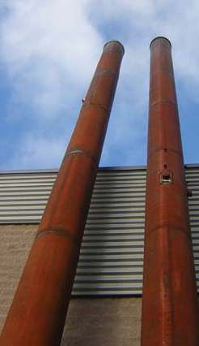
Permitting pellet boilers in MA
MA has air emission regulations that all combustion equipment must meet.
Boilers larger than 3 million Btu / hour need an operating permit.
Smaller boilers do not need this permit.
However, MA Department of Environmental Protection (DEP) may require plan approval for boilers.
Contact the DEP during the planning phase and before you purchase a boiler.
Plan approval may require installation of emissions control technology.
Wood pellet heating: a reference on wood pellet fuels & technology for small commercial & institutional systems

Slide 27
Ash
MA considers wood ash from commercial or institutional sources to be a solid waste and it may therefore be subject to hazardous waste rules.
However, only ash from pellets made from construction and demolition debris is subject to such regulation.
In MA, the DEP Bureau of Waste Prevention-Business Compliance Division must issue a “beneficial use determination” in order to approve any use of ash from pellet boilers.
Potential beneficial uses of ash?
Fertilizer for lawns or athletic fields;
Soil amendment; &
Composting.
Inappropriate use may lead to accumulation of excess nutrients and nutrient runoff.
Wood pellet heating: a reference on wood pellet fuels & technology for small commercial & institutional systems

Slide 28
3.14: Economics of wood pellets

Slide 29
Heating fuel equivalencies
One ton of wood pellets equals:
120 gallons of heating oil;
170 gallons of propane;
16,000 cubic feet of natural gas; or
4,775 kWh of electricity.
A price of $200/ton for pellets is the equivalent of these fuel prices:
$1.67 per gallon for heating oil;
$1.18 per gallon for propane;
$12.50 per 1000 cubic feet for natural gas; or
$0.04 per kWh for electricity.
Over the last 20 years, only natural gas has been competitive with wood pellets.
Wood pellet heating: a reference on wood pellet fuels & technology for small commercial & institutional systems

Slide 30
Calculating potential fuel cost savings
Step 1: Calculate total fuel use and costs.
(total fuel units used annually)(current fuel price) = current annual fuel bill
(5,000 gallons of heating oil)($2.03/gallon) = $10,150
Step 2: Calculate how many tons of pellets will be required to replace current fuel.
total fuel units used annually = tons * $price = $ annual pellet cost
fuel units per ton year ton
5,000 gallons of heating oil = (41.67 tons)($260/ton) = $10,833.33
120 gallons/ton
Step 3: Calculate potential fuel savings
Potential cost savings = $ annual pellet cost - $ current annual fuel bill
$10,150 - $10,833 = - $683
Wood pellet heating: a reference on wood pellet fuels & technology for small commercial & institutional systems

Slide 31
Economic analysis of wood pellet heat
When are pellet boilers cost effective? Life cycle cost (LCC) or analysis incudes fuel costs, inflation rates, projected costs and calculates the net present value (NPV) of savings over the life of the pellet boiler system.
Spreadsheet-based LCC analysis tools are available from:
BERC
National Resources Canada (RETScreen)
Universities of Wisconsin and Alaska
Select architects & engineers
Wood pellet heating: a reference on wood pellet fuels & technology for small commercial & institutional systems

Slide 32
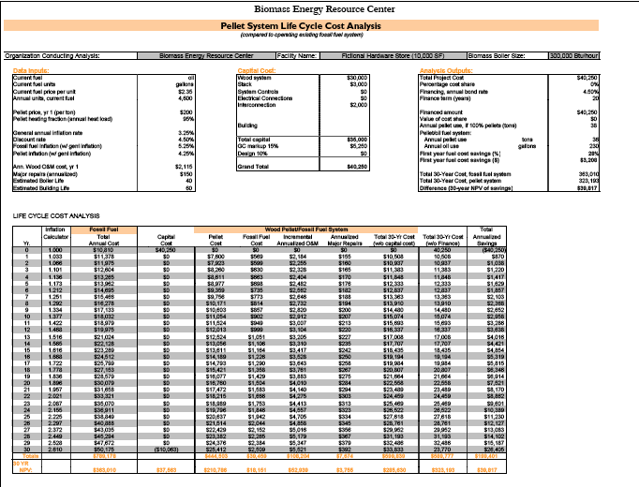
BERC LCC
Wood pellet heating: a reference on wood pellet fuels & technology for small commercial & institutional systems

Slide 33
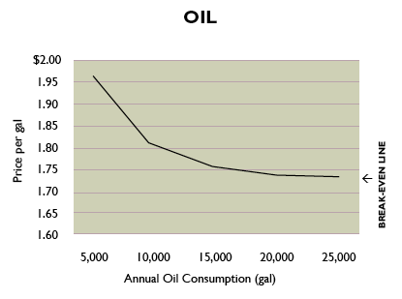
Plot LCC of wood vs. alternate fuel
The line on the graph represents the break-even point: where the wood pellet system costs as much as it saves over the 30-year life of the system.
wood pellets are cost effective
wood pellets are not cost effective
Wood pellet heating: a reference on wood pellet fuels & technology for small commercial & institutional systems

Slide 34
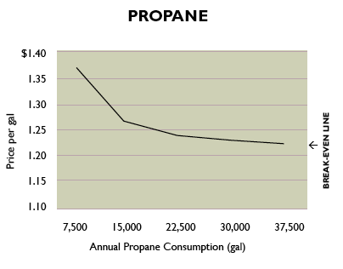
Plot LCC of wood vs. alternate fuel
The line on the graph represents the break-even point: where the wood pellet system costs as much as it saves over the 30-year life of the system.
wood pellets are cost effective
wood pellets are not cost effective
Wood pellet heating: a reference on wood pellet fuels & technology for small commercial & institutional systems

Slide 35
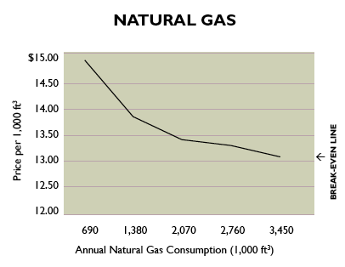
Plot LCC of wood vs. alternate fuel
The line on the graph represents the break-even point: where the wood pellet system costs as much as it saves over the 30-year life of the system.
wood pellets are cost effective
wood pellets are not cost effective
Wood pellet heating: a reference on wood pellet fuels & technology for small commercial & institutional systems

Slide 36
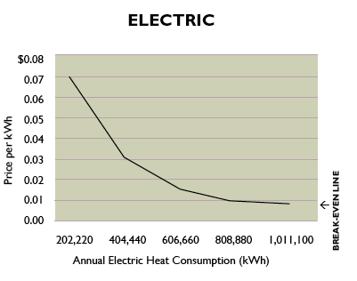
Plot LCC of wood vs. alternate fuel
The line on the graph represents the break-even point: where the wood pellet system costs as much as it saves over the 30-year life of the system.
wood pellets are cost effective
wood pellets are not cost effective
Wood pellet heating: a reference on wood pellet fuels & technology for small commercial & institutional systems

Slide 37
Detailed LCC analysis?
Complete wood pellet systems typically cost $75,000 – 100,000 per million Btu.
Includes:
System equipment & installation;
Fuel storage & handling system & installation;
Construction;
Site costs;
Chimney equipment & installation;
Emissions permit or control equipment;
Professional fees (like engineering); and
Connection of controls & piping to existing heat distribution system.
LCC analysis should include O&M costs:
30’ per day for the staff who operates the system; &
Routine parts and or service.
Wood pellet heating: a reference on wood pellet fuels & technology for small commercial & institutional systems

Slide 38
Fictional LCC: hardware store
A hardware store is located within 50 miles of a wood pellet distribution center. The store is roughly 10,000 SF and uses 4,600 gallons of heating oil per year at an average cost of $2.35 per gallon. This is an annual heating cost of $10,810. The cost of pellets is $200 per ton, delivery charges included.
LCC calculates the total project cost, including fuel, at $39,817 and shows that the store would save $3,208 (28%) during the first year of operation.
This translates to $45,000 over 30 years.
This LCC analysis suggests going forward with installation.
Wood pellet heating: a reference on wood pellet fuels & technology for small commercial & institutional systems

Slide 39
Fictional LCC: Town Hall
The Town Hall is a municipal building located within 50 miles of a wood pellet distribution center. The building houses a variety of town offices within its 30,000 SF. The space is heated by one central boiler. The price of oil is $2.35 per gallon. Pellets would cost $200 per ton.
LCC shows that the Town Hall would require 110 tons of pellets per year and that a pellet system would cost $124,200.
First-year fuel savings would be 28 percent.
This translates to $211,722 over 30 years.
This LCC analysis suggests going forward with installation.
Wood pellet heating: a reference on wood pellet fuels & technology for small commercial & institutional systems

Slide 40
3.15: Recent wood pellet projects

Slide 41
Windham Wood Heat Initiative
The Windham Wood Heat Initiative seeks to help Windham county schools & municipal buildings to:
Reduce heating costs;
Create an advanced wood-heating hub; and
Strengthen local forest economies.
How? The initiative covers 25% of project costs up to $75,000.
Funded by $1.6 million from the Clean Energy Development Fund via Vermont Yankee decommissioning.
Impact? Converting 20 buildings to wood fuel should retain $3 million in the local economy over the 25-year lifespan of the heating systems.
But fossil fuel prices are low!
Yes, but they are forecast to fluctuate and rise while wood energy prices should stay far more stable and contribute to the local economy.
www.businessvermont.com/two-school-buildings-stay-warm-with-local-renewable-heat-from-wood

Slide 42
Two WWHI schools
The boiler of Brattleboro’s Esteyville Elementary School failed in September 2015.
WWHI fast-tracked the project to switch to wood heat within the heating season.
Wood pellets replace 1,100 gallons of fuel oil; and
Add $3,700 to the local economy each year.
Students are learning about carbon footprints.
Brattleboro’s Academy School switched from oil heat to wood pellets.
Oil use was reduced by 15,000 gallons; and
$50,000 was added to the local economy.
www.businessvermont.com/two-school-buildings-stay-warm-with-local-renewable-heat-from-wood

