Slide 1
MEC 3040: Bioenergy
Module 6: Biodiesel basics to sustainability
6.1: Brief overview of biodiesel
6.2: What’s oil anyway?
6.3: The viscosity problem
6.4: Biodiesel statistics
6.5: Transesterification basics
6.6: ‘Renewable diesel’ and ‘bio-jet’
6.7: Biodiesel sustainability?

Slide 2
6.7: Biodiesel sustainability?

Slide 3
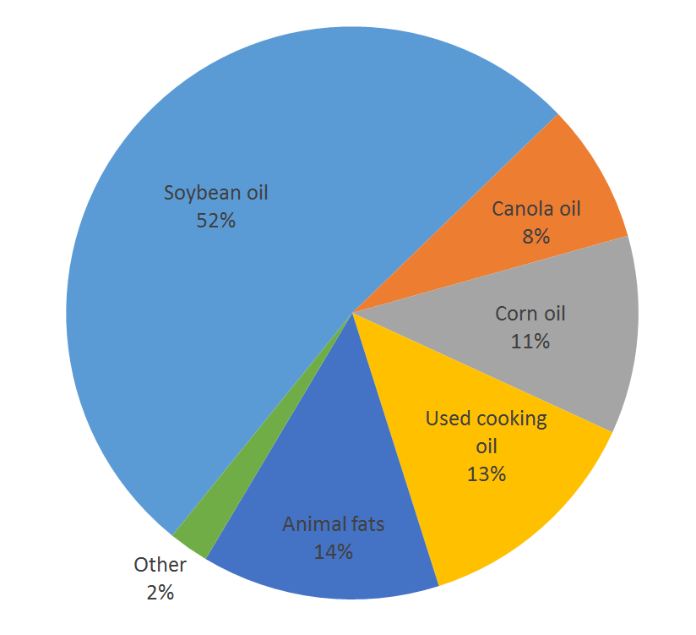
Is biodiesel more sustainable?
(1) yes:
When made from used oils, biodiesel has 80 – 90% lower GHG emissions than petro-diesel.
(2) really questionable:
When made from virgin oils grown on land converted from forest.
When food crops are converted to fuels.
Deforestation
Food vs. fuel
So scale is critical.
Waste and small-scale oil crops; vs.
Industrial palm plantations.
https://www.ucsusa.org/resources/biodiesel-basics (2015)

Slide 4
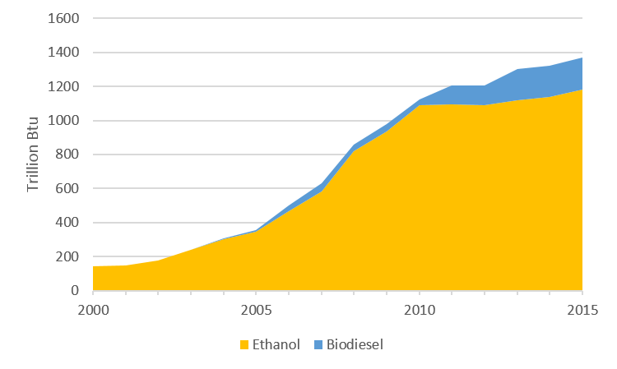
Bioethanol vs. biodiesel?
While most of biodiesel’s carbon footprint comes from the process of growing the crop and pressing the oil, the conversion and purification processes of bioethanol account for most of its GHG emissions.
While we use much more bioethanol, biodiesel production is growing more quickly.
https://blog.ucsusa.org/jeremy-martin/all-about-biodiesel

Slide 5
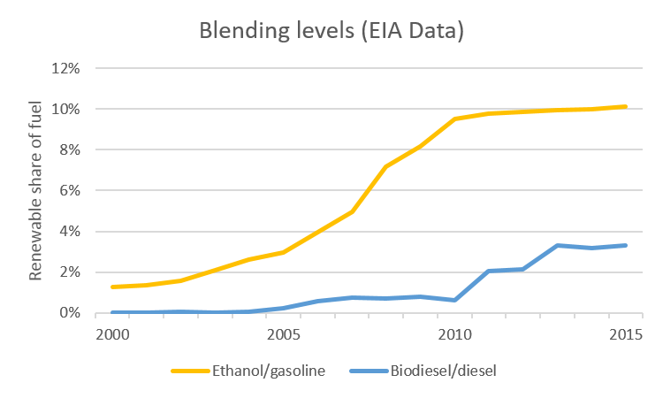
Blending?
Blended fuels contain more bioethanol than biodiesel.
https://blog.ucsusa.org/jeremy-martin/all-about-biodiesel

Slide 6
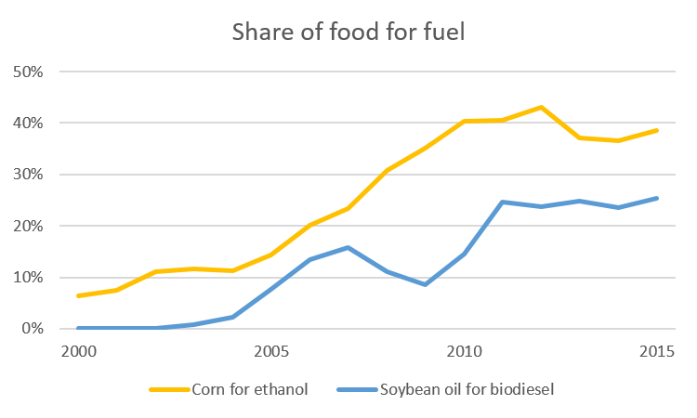
Agricultural impacts?
Making bioethanol from corn increases the cost of corn-fed meat.
Strangely, making biodiesel from soy cuts the cost of soy-fed meat!
https://blog.ucsusa.org/jeremy-martin/all-about-biodiesel

Slide 7
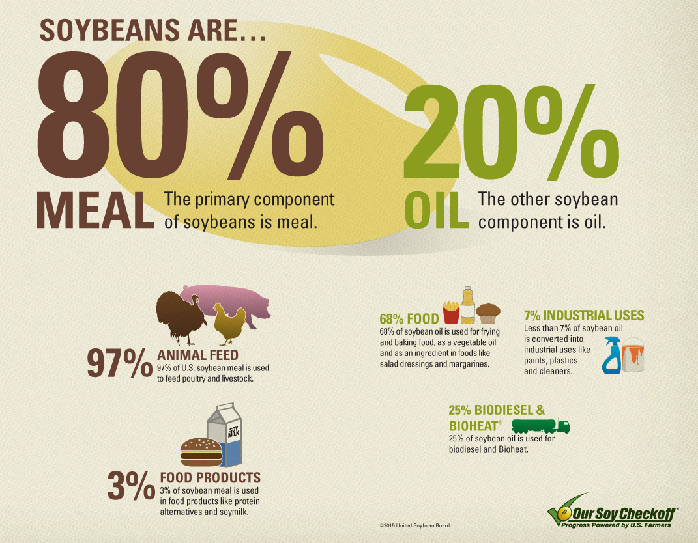
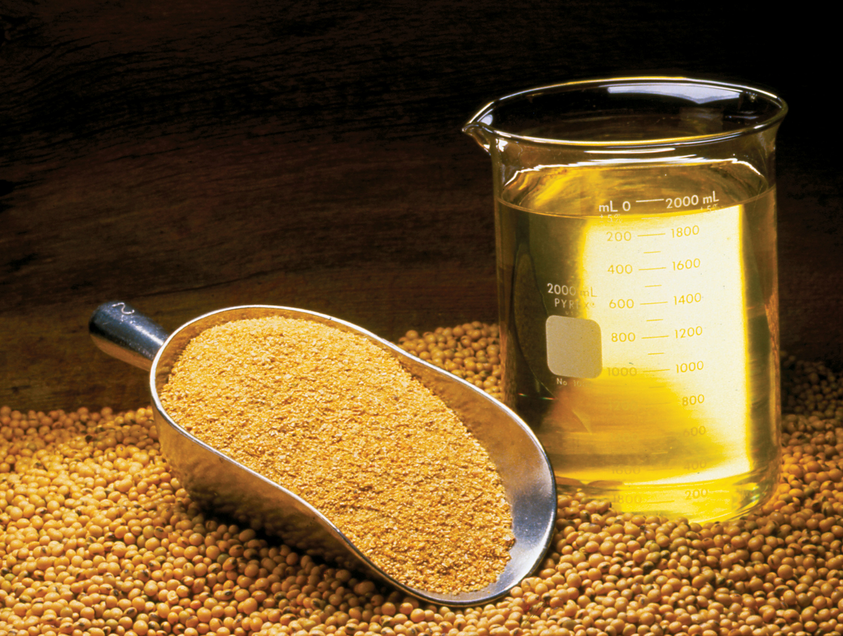
Breaking down the soybean
40% of soy value
Demand for biodiesel drives up the demand for soy. Thus decreases cost of soy meal.
However, biodiesel does drive up the price of vegetable oil.

Slide 8
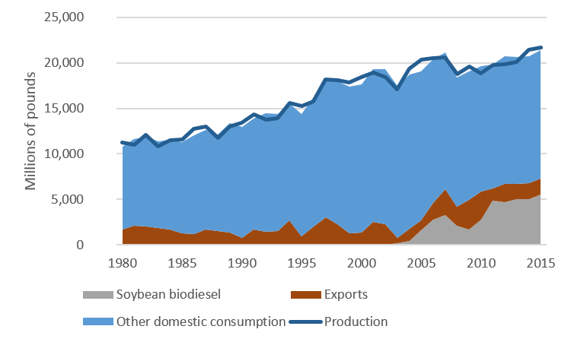
Biodiesel drives soy production..
https://blog.ucsusa.org/jeremy-martin/all-about-biodiesel

Slide 9
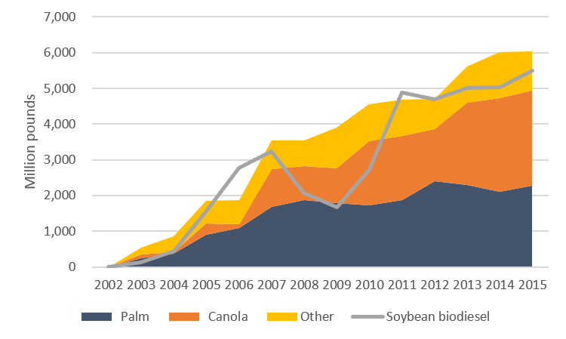
…and import of other food oils
The US now imports more palm, canola and other oils to make up for conversion of soy oil to biodiesel.
Replacement of unhealthy trans fats (often soy) in foods could also accounts for some of the importation of vegetable oil substitutes, particularly palm oil.
Trans-fat is now replaced, ‘extra’ soy oil gone.
New? Canola or palm?
https://blog.ucsusa.org/jeremy-martin/all-about-biodiesel

Slide 10
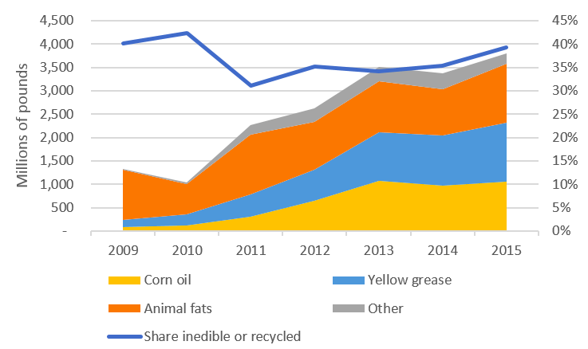
Waste oil feedstock?
Lower LCA and GHG emissions, but:
  Amounts of this feedstock aren’t increasing.
  It’s already used to make soap, feed livestock, pet food, etc.,.
    So they also need to be replaced.
https://blog.ucsusa.org/jeremy-martin/all-about-biodiesel

Slide 11
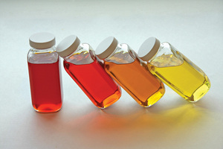
Brewer’s corn oil?
Corn is distilled to bioethanol.
Distiller’s grain is leftover.
→ Used as an animal feed.
(Now lower-calorie feed)
Distiller’s corn oil can be extracted from brewer’s grain.
→ Used to make biodiesel.
Often at the bioethanol plant.
Example:
Adkins Energy (Lena, IL) produced bioethanol from corn.
Their new 8,500 ft2 plant now produces 1.15 m gallons of distiller’s corn oil an converts that to biodiesel.
https://blog.ucsusa.org/jeremy-martin/all-about-biodiesel

Slide 12
How much more can we make?
So, biodiesel from waste feedstock and increased growth of feedstock crops on a small-scale can be sustainable.
How much more sustainable biodiesel can we produce?
US estimate: 29 m gallons/year
  But that’s only 2% of existing
  biodiesel production.
New biodiesel would have to be made from feedstock:
Grown on land now used for forest or food crops;
Imported (probably also from converted land); or
Waste diverted from other uses.
https://blog.ucsusa.org/jeremy-martin/all-about-biodiesel

Slide 13
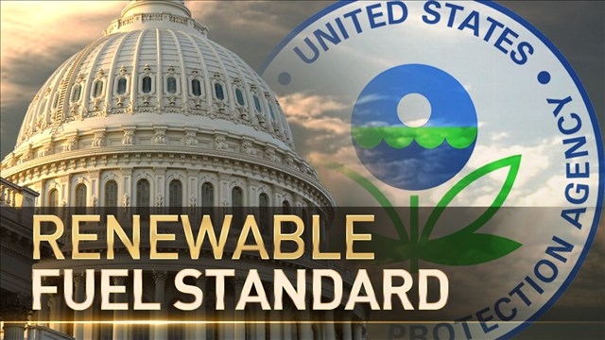
Policy plans the future
EPA’s annual update to the Renewable Fuel Standard (RFS) plans for the amount of increase in each type of fuel.
EPA biodiesel should increase from 2 b gallons to 2.1 b gallons.
Biodiesel producers want an increase to 2.5 b gallons.
Both of these increases are greater than the 29 m gallon estimate of sustainable increase and will probably result in:
Imported oil that isn’t produced sustainably; palm plantation?
Unless algae fueled dreams come true…. more later.
https://blog.ucsusa.org/jeremy-martin/all-about-biodiesel

