Slide 1
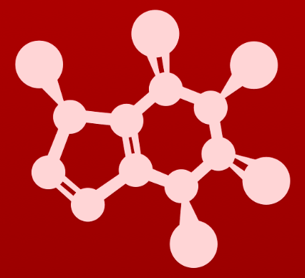
3. Conformation and stereochemistry
3.10: Stereochemistry in biology and medicine

Slide 2
Biomolecules are chiral
Many, if not most, biomolecules contain chiral centers and are chiral.
Proteins are chiral:
Receptors send signals to and through cells.
Enzymes do the chemical work of the cell.
Antibodies defend the body against invaders.
So the ligands that are bound by these proteins must be chiral and a match.
Where chirality exists
:
:
:
:
:
:
:
:
The R enantiomer doesn’t do this.
The S enantiomer reduces inflammation by binding to, and inhibiting, the enzyme prostaglandin H2 synthetase.
An enzyme in our bodies converts the R form to the S form over time, so it must be considered in dosage.
Z

Slide 3
Remember thalidomide?
Thalidomide’s side effect was tetratogenicity: the ability to cause serious birth defects, like missing limbs.
Why did that happen?
In 2010, Japanese researchers found that thalidomide binds to a protein called thereblon.
What does thereblon do? When it’s production is blocked in zebra fish their offspring have birth defects like those seen in human victims of thalidomide.
Z

Slide 4
Harmless but spicy enantiomers
Most enantiomers have far more benign differences in biological effects.
:
:
:
:
These two enantiomers create the very different odors, and tastes, of two different herbs.
Z

Slide 5
Enzymes bind & create one enantiomer
Because enzymes are chiral, they bind one enantiomer and create one chiral product; either R or S.
However, chemical reactions produce a mixture of both enantiomers.
In glycolysis, triose phosphate isomerase creates a chiral product from an achiral substrate.
The R enantiomer is made, but the S enantiomer is not.
:
:
:
:
:
:
:
:
:
:
:
:
:
:
:
:
:
:
:
:
:
:
:
:
:
:
:
:
Z

Slide 6
Enzymes create one type of bond
Here the enzyme polymerizing (linking) isoprene units creates an E bond, but not a Z bond.
:
:
:
:
:
:
:
:
:
:
:
:
:
:
:
:
:
:
:
:
:
:
:
:
:
:
:
:
:
:
:
:
:
:
:
:
:
:
:
:
:
:
:
:
:
:
:
:
:
:
:
:
:
:
:
:
:
:
:
:
:
:
:
:
:
:
:
:
:
Z

Slide 7
Can you?
(1) Describe why biological molecules are chiral and recognize only one enantiomer?
(2) Explain why biological processes produce only one enantiomer while
chemical reactions produce both?

