Slide 1
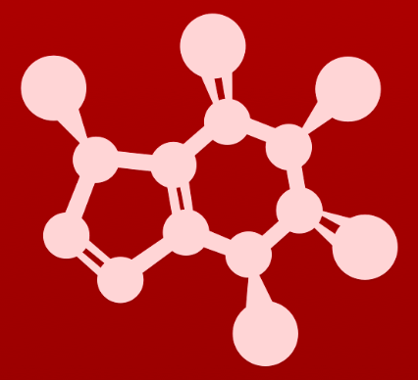
3. Conformation and stereochemistry
3.6: Molecules with multiple chiral centers

Slide 2
Several chiral centers are common
This four-carbon sugar has two chiral carbons, labelled here with blue and red dots.
How many possible stereoisomers? 2^{n}, where n = chiral centers
:
Notice that enantiomeric pairs have opposite chiralities:
R,R vs. S,S
S,R vs. R,S
Diastereomer: stereoisomers that are not enantiomers
Physical properties may vary.
Epimers: diastereomers that differ at only one chiral center

Slide 3
Try this:
Here’s a three-carbon sugar.
(a) How many possible stereoisomers are possible?
(b) Draw the R,R,R stereoisomer.
(c) How would you then draw any of the other stereoisomers?
2³ = 8
:
Once you’ve got one, just switch dashes and wedges where needed.
:
:
:
:
:
:
What was your process? I have to admit that I tend to prioritize the four substituents, randomly add dashes and wedges and then determine whether I’ve made R or S. If I’m wrong, I switch the dash and wedge.
Models can be faster!
:
:
:
:
:
:
1
:
:
3
2
3
:
2
2
3
:
:
:
1
:
:
1

Slide 4
Try this:
Again, refer to the same three-carbon sugar shown in the last problem.
(a) Draw the SRS stereoisomer.
(b) List all epimers of the SRS stereoisomer.
(c) List all non-epimer stereoisomers of SRS.
:
:
:
1
:
:
3
2
3
:
2
2
3
:
:
:
1
:
:
1
SRS stereoisomer
All possibilities (2³ = 8):
RRR RRS epimer RSS SSS epimer
RSR enantiomer SRS identical
SRR epimer SSR

Slide 5
:
Epimerases
Epimerases: enzymes that ‘convert’ stereoisomers at one chiral center
:
:
:
:
:
:
:
:
:
:
:
:
:
:
:
:
:
:
:
:
:
:
:
:
:
:
:
:
:
:
:
:
:
:
:
:
:
:
:
:
:
:
:
:
:
:
:
:
:
:
:
:
:
:
:
:
:
:
:
:

Slide 6
:
Try this:
This is the amino acid D-threonine, drawn without stereochemistry. (a) Draw it as S,S-threonine as it is found in nature.
(b) Draw the enantiomer of the natural version.
(c) Draw all possible diastereomers.
:
:
:
:
:
:
:

Slide 7
Can you?
(1) Define the term ‘diastereomer’?
(2) Calculate the number of diastereomers that an organic molecule has?
(3) Define the term ‘epimer'?
(4) Convert the dash-wedge drawing of one stereoisomer to another?
(5) Describe what an ‘epimerase’ is and what it does?

