Slide 1
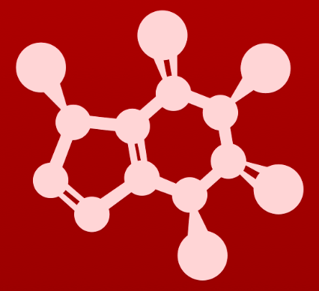
3. Conformation and stereochemistry
3.9: Stereochemistry of alkenes

Slide 2
Cis-trans isomers
The groups on either side of double bonds can assume different stereoisomeric conformations if both carbons share a common substituent.
Here methane and hydrogen are common to both double-bonded carbons.
Cis: both groups are on the same side
Trans: the common groups are on opposite sides
These molecules aren’t chiral and don’t have chiral carbons, but they are stereoisomers.
Diastereomers

Slide 3
Can’t be cis-trans?
If one of the double-bonded carbons has two identical substituents, then the molecule doesn’t have stereoisomerism.
two Hs
two methyl groups
two ethyl groups

Slide 4
Cis-trans fatty acids
Most naturally occurring fatty acids with double bonds are found in the cis conformation.
However, when double bonds are introduced into fatty acids using chemistry, their conformation is often trans.
Trans fatty acids are associated with heat disease and other health issues.
:
:
:
Notice that cis double bonds create a ‘kink’ in fatty acid tails. The kink impairs packing and lowers mp.
:
:
:
:
:
:
:
:
:

Slide 5
Retinal signals with cis-trans change
Retinal is derived from vitamin A and is found in the eye’s rod cells.
Light enters the eye and converts the cis stereoisomer to the trans form.
The shape change alters the way retinal binds to the protein rhodopsin.
This causes a signal to be sent to the vision center of the brain.
:
:
:
:

Slide 6
E and Z when all groups are unique
The terms cis and trans can be used when both double-bonded carbons share a common substituent.
If they don’t share a substituent, then the stereoisomerism is described as E or Z.
Use E and Z when all four substituents are different.
Steps:
For each carbon, identify the substituent with the greater atomic number.
If the ‘high’ groups are on the same side of the double bond: Z.
If the ‘high’ groups are on opposite sides of the double bond: E.
E-2-methyl-2-buten-1-ol
:
:

Slide 7
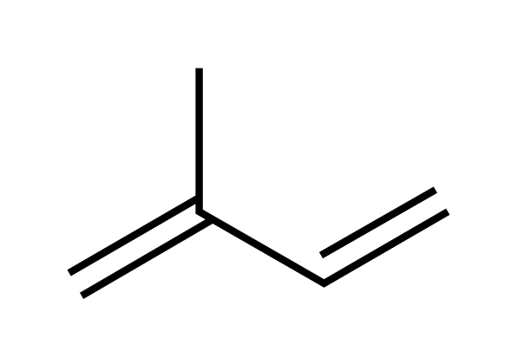
E and Z isoprenoid polymers
Isoprene units can be polymerized to create large biomolecules.
Stereoisomerism determines form and function.
:
:
:
:
:
:
:
:
:
:

Slide 8
Which is more stable?
Generally, large substituents prefer to be across the double bond from one another (trans or E) because that gives them more space and lowers ‘steric hindrance’ or crowding.
more crowding
less crowding

Slide 9
Try this:
Label each molecule as one of the following:
N (not stereoisomer)
E
Z
E
N
Z
E

Slide 10
Try this:
These molecules were isolated from natural sources. For double bonds outside of 5- or 6-membered rings, label the bonds as:
N (not stereoisomer)
E
Z
:
:
:
:
:
:
:
:
:
E
:
E
N
N
:
:

Slide 11
Can you?
Define the terms ‘cis’ and ‘trans’, and what types of molecules can and cannot be cis-trans?
(2) Describe the class of stereoisomer that cis-trans isomers are?
(3) Identify and draw cis-trans isomers?
(4) Define what ‘E’ and ‘Z’ isomers are?
(5) Identify and draw E and Z isomers?
(5) Describe whether cis or trans isomers are more stable and why?

