Slide 1
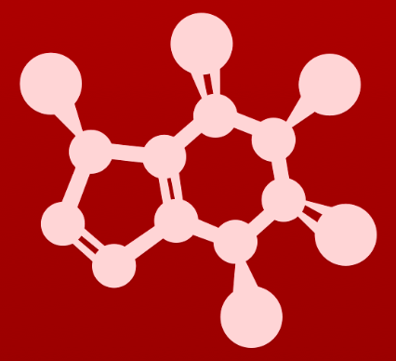
CHE 2060: Principles of Organic Chem
4. Overview of organic reactivity
Introduction: The $300 million reaction
4.1: A first look at some organic reaction mechanisms
4.1A: The acid-base reaction
4.1B: A one-step nucleophilic substitution mechanism
4.1C: A two-step nucleophilic substitution mechanism
4.2: A quick review of thermodynamics and kinetics
4.2A: Thermodynamics
4.2B: Kinetics
4.3: Catalysis
4.4: Comparing biological and laboratory reactions

Slide 2
4. Overview of organic reactivity
4.2: A brief overview of thermodynamics & kinetics

Slide 3
Reaction coordinate diagrams
Reaction coordinate diagrams show the energy levels of reactants, transition states and products of a chemical reaction.
Energy levels show why reactions happen as reactions run downhill toward stability or lower energy states.
transition state
Notice that:
Energy of P < R.
Transition states have the highest energy levels.
Energy of R must be increased to push the reaction forward.
Gºrxn is the difference between the energy of R and P.

Slide 4
Gibb’s free energy change (△Gº)
Gibb’s free energy change (△Gº) is the difference between the energy states of reactants and products at standard conditions (25ºC, 1 atmosphere).
△Gº = △Hº - T△Sº
standard enthalpy change
temperature
(ºK)
standard entropy change
Standard enthalpy change (△Hº): heat change during the reaction
+ heat is absorbed (endothermic)
- heat is released (exothermic)
Standard entropy change (△Sº): change in disorder
+ disorder increases; number of molecules increases
- disorder decreases; number of molecules decreases

Slide 5
Equilibrium constant (Keq)
Equilibrium constant (Keq): describes the ratio of products to reactants at equilibrium for each chemical reaction
How complete does the reaction tend to be? (Complete means all reactants are converted to products.)
Keq > 1
= 1
< 1
Products are favored
Products ~ reactants
Reactants are favored.

Slide 6
Putting thermodynamics together
These factors can be related to each other to describe the thermodynamics of chemical reactions.
△Gº = - (R)(T)(lnKeq)
Gibb’s free energy change
Ideal gas constant
(8.314 J/mol-K)
temperature
(ºK)
natural log Keq
When △Gº is negative, Keq is positive.
Products are favored.
Exergonic reaction
When △Gº is positive, Keq is negative.
Reactants are favored.
Endergonic reaction
strong acid + strong base
weak acid + weak base
Keq > 1
= 1
< 1

Slide 7
Activation energy
For a chemical reaction to proceed (go forward) from reactants to products, energy must be added to get reactants up the hill to the transition state.
Activation energy (E_{A}) is the amount of energy that must be added to reach the transition state.
The ‘energy barrier’ that must be overcome
activation energy (E_{A})
Keq > 1
= 1
< 1

Slide 8
Activation energy & kinetics
Here both reactions A & B are somewhat endergonic.
However, activation energy is lower for reaction A than for reaction B.
Therefore, reaction A occurs more quickly than reaction B.
Reaction A reaches equilibrium more rapidly.
Keq > 1
= 1
< 1

Slide 9
Try this
Consider the hypothetical reaction coordinate diagrams below, and assume
that they are on the same scale.
(a) Which of the diagrams describe(s) a reaction with Keq < 1 ?
(b) Which of the diagrams describes the fastest reaction?
(c) Which of the diagrams describes the reaction with the highest value of Keq?
(d) Which of the diagrams describes the reaction with the largest △G˚‡ (E_{A}) for the reverse
reaction?
(e) Copy the diagram for your answer to part (d), and add a label which graphically
illustrates the value of △G˚‡ (E_{A}) for the reaction in the reverse direction.
Keq >> 1
highest EA reverse
fastest
Keq < 1

Slide 10
Two-step reactions
lower E_{A} means step 1 is faster
higher E_{A} means step 1 is slower
The first, slower step is called the rate-limiting step because it determines the overall rate of reaction.
Keq > 1
= 1
< 1

Slide 11
Try this
Imagine that you must extinguish a burning campfire using buckets of water filled at a faucet some distance from the fire. It takes 20 seconds to fill the bucket, 2 seconds to carry it and dump it on the flames. There are many bucket carriers but only one faucet.
If you double the speed at which buckets are carried, what effect will this have on how fast water gets to the fire?
If you could add a second faucet, what effect would that have?
What is the rate-limiting step?
No effect!
Adding a second faucet would double the speed.
The time it takes to fill a bucket: the slowest step.

Slide 12
Can you?
(1) Place reactants, products and transition states on an energy diagram?
(2) Compare activation energies of reactions and understand how they dictate ease and speed of reaction? - Understand why reactions ‘run downhill’?
(3) Define the terms endergonic and exergonic and relate them to energy diagrams?
(4) Define the term ‘Gibbs free energy’ and how it relates to energy diagrams? - Describe how ΔG relates to Keq?
(5) Define the term ‘entropy’ and identify reactions in which entropy increases vs decreases?
(6) Understand the concept of ‘rate-limiting step’ for reactions with more than one step?

