Slide 1
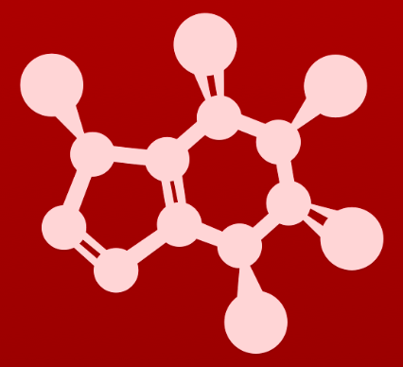
CHE 2060: Principles of Organic Chem
4. Overview of organic reactivity
Introduction: The $300 million reaction
4.1: A first look at some organic reaction mechanisms
4.1A: The acid-base reaction
4.1B: A one-step nucleophilic substitution mechanism
4.1C: A two-step nucleophilic substitution mechanism
4.2: A quick review of thermodynamics and kinetics
4.2A: Thermodynamics
4.2B: Kinetics
4.3: Catalysis
4.4: Comparing biological and laboratory reactions

Slide 2
4. Overview of organic reactivity
4.3: Catalysis

Slide 3
Strategies to increase speed or rxn
Consider this reaction coordinate diagram. It’s exergonic with a high E_{A}.
How can we increase the speed of the reaction?
1. Increase temperature (add energy)
2. Increase [R] (concentration of R)
3. Add a catalyst
What’s a catalyst?
A molecule of substance that increases the speed of a chemical reaction by lowering E_{A}. Catalysts are not changed by the reaction and can be used many times.
Keq > 1
= 1
< 1

Slide 4
The Hammond postulate
Hammond postulate: when a catalyst lowers the energy level of an intermediate it also lowers the energy of adjacent transition states.
Here the speed of a tw0-step reaction is increased by addition of a catalyst that lowers the energy of the transition state and both E_{A}s.
Keq > 1
= 1
< 1

Slide 5
How do enzymes lower E_{A}?
Enzymes lower EA by strategies employed at their active sites, where the ligand (aka substrate) is bound and chemistry is done.
1. Bring two reactants together in the proper orientation.
2. Binding substrates so that their conformation favors the reaction.
3. By increasing chemical reactivity of the substrates; increasing the strength of nucleophiles or electrophiles.
4. By stabilizing transition states of the slower, rate-limiting step.
The most efficient enzyme known, orotidine monophosphate decarboxylase, increases reaction rate by a factor of 10¹⁷.

Slide 6
Try this
Table sugar, or sucrose, is a high-energy dietary compound, as are the fats
in vegetable oil. Conversion of these compounds, along with oxygen gas (O2), to water and carbon dioxide releases a lot of energy. If they are both so high in energy (in other words, thermodynamically unstable), how can they sit for years on your kitchen shelf without reacting?
Without a catalyst, like an enzyme, the reactions may proceed but will be glacially slow.
Keq > 1
= 1
< 1

Slide 7
Enzymes are incredibly specific
Because enzymes are chiral molecules, they work only on the appropriate chiral substrate and produce only one chiral product, rather than both enantiomers.
Stereospecific:only this stereoisomer is formed.
Regiospecific: phosphate is only added here at C6.
:
:
:
:
:
:
:
:
:
:
:
:
:
:
:
:
:
:
:
:
:
:
:
:
:
:
:
:
:
:
:
:
Substrate specific: glucose is the only sugar the enzyme will use as substrate

Slide 8
Can you?
(1) List three methods to increase the speed of a chemical reaction?
(2) Define the term ‘catalyst’?
(3) Draw examples of reaction diagrams with and without catalysts?
(4) Describe means by which catalysts decrease reaction E_{A}?
(5) Understand that enzymes are catalysts that are extremely specific for one substrate molecule and even regions of that molecule and stereochemistry?

