Slide 2
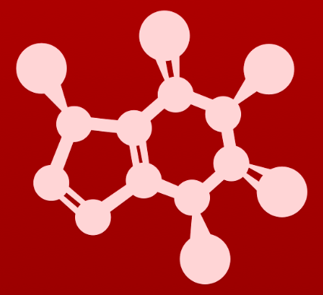
5. Acid-base reactions
5.4: Acid-base properties of phenol

Slide 3
Phenol has resonance
Phenol’s resonance makes it more acidic than similar compounds without resonance.
Do all of these resonance structures make equal contributions? Why or why not?
minor: C charged
minor: C charged
major: O is charged
minor: C is charged

Slide 4
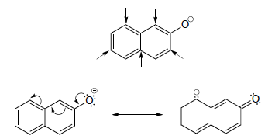
Try this
Draw the conjugate base of 2-napthol (the major resonance contributor),
and on your drawing indicate with arrows all of the atoms to which the negative charge can be delocalized by resonance.

Slide 5
Adding electron withdrawers to phenol
Addition of electron withdrawing groups to the phenol ring increases the stability of the anion and increases acid strength.
Again, this is delocalization.
Here, the ketone group acts as an electron withdrawing group and becomes part of the aromatic ring’s resonance network.
Inductive + resonance

Slide 6
Try this
The position of the electron-withdrawing substituent relative to the
phenol hydroxyl is very important in terms of its effect on acidity. Which of the two substituted phenols below is more acidic? Use resonance drawings to explain.
The para substituted phenol is more acidic because resonance only charges oxygen, not carbon.

Slide 7
Try this
Rank the four compounds below from most acidic to least.
Acidity: B > A > D > C
B: - charge on conjugate base can be delocalized to the aldehyde oxygen
A: meta position prevents – from delocalizing to the aldehyde O, but the aldehyde still acts as a stabilizing e- withdrawing group
D: plain unsubstituted phenol is still acidic (pka ~10)
C: no acidic protons (hydrogen atoms)

Slide 8
Try this
Nitro groups are very powerful electron-withdrawing groups. The
phenol derivative picric acid has a pKa of 0.25, lower than that of trifluoroacetic acid. Use resonance to explain why picric acid has such high acid strength.
When picric acid donates its proton, the negative charge of the conjugate base can be delocalized, via resonance, to any of the three nitro groups.
This creates an extremely stable conjugate base, thus a very strong acid.

Slide 9
Electron-donating groups increase pKa
Just as electron-withdrawng groups increase acidity (and lower pKa) by stabilizing anions, electron-donating groups lower acidity (raise pKa) by destabilizing the conjugate base.
phenolate ion
repulsion
methoxide
Note that the methoxide O can be e- w/drawing.
Think of the methoxide’s oxygen pushing a lone pair through the ring and up towards the negatively charged phenolate ion.
Repulsion between the adjacent negative charges destabilized the anion.
So taking the hydrogen back restores stability. (Motivation to keep H.)

Slide 10
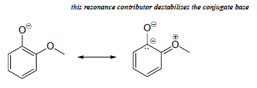
Try this
Rank the three compounds below from lowest pKa to highest, and
explain your reasoning. Hint - think about both resonance and inductive effects!
:
:
:
:
:
:
:
:
:
:
highest pka
lowest pka
Here both oxygen atoms are uncharged but electronegative and stabilize the negative charge of the ring carbon.
Here the ether oxygen is positively charged and pushes electrons towards the carbanion and the phenolate ion.
:
:
:
:
:
:
:
:
:
:
-
:
:
:
:

Slide 11
Can you?
(1) Explain how phenol’s resonance stabilizes its conjugate base and increases its acidity?
(2) Identify which of phenolate’s resonance structures are major and which minor?
(3) Describe how electron-withdrawing groups increase the acidity of phenol?
(4) Describe how the position of electron-withdrawing groups affects their ability to participate in resonance, increasing stabilization effects?
(5) Describe how electron-donating groups lower acidity by destabilizing the conjugate base and preventing the acid from donating its hydrogen atom?

