Slide 1
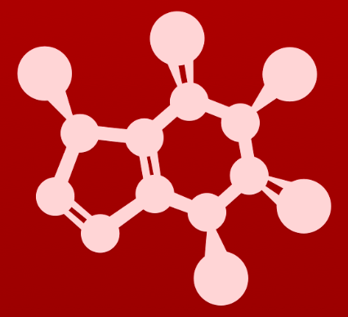
5. Acid-base reactions
5.7: Polyprotic acids

Slide 2
Polyprotic acids
Polyprotic acids: acids with more than one proton, or hydrogen to donate
Phosphoric acid, H3PO4, has three hydrogens to donate, each with its own pKa.
Weaker acid / less stable conjugate base
Each acid is weaker because it has more negative charge and fewer atoms means remaining to delocalize the negative charges.
Stability decreases along with acid strength.
Σ = 1478 kJ/mol

Slide 3
Try this
In a buffer at physiological pH, what form(s) of phosphoric acid
predominate? What is the average net charge?
pKa is the pH at which half of the molecules are protonated and half are deprotonated. Physiological pH is 7.2 to 7.4, so the average net charge is negative ½.
http://www.biology.arizona.edu/biochemistry/problem_sets/ph/10t.html
Σ = 1478 kJ/mol

Slide 4
Free amino acids are polyprotic
Free (unpolymerized) amino acids have at least two functional groups with acid-base potential: amino group and carboxylic acid group [zwitterion]
Alanine
pH 0.5
pH 12
Zwitterion: an ion that has both a positive and a negative charge
Some amino acids have a third pKa because of their side chains: arginine, lysine, aspartate, glutamate, tyrosine, and histidine.
Some organic acids also have multiple pKa values.
Citric acid: 3.1, 4.8, 6.4
Σ = 1478 kJ/mol

Slide 5
Can you?
(1) Define the term ‘polyprotic acid’?
(2) Explain why polyprotic acids become weaker as fewer acidic hydrogen atoms remain? How does the stability of the conjugate anion change?
(3) Describe how pKa relates to the protonation state of molecules?
(4) Explain how one molecule can have multiple pKa values?
(5) Describe how the concept of pKa relates to zwitterions?

