Slide 1

SSC 2030: Energy Systems & Sustainability
4. Forms of energy
4.1 Kinetic energy
4.2 Potential energy
4.3 Thermal energy
4.4 Chemical energy
4.5 Energy density
4.6 Electromagnetic radiation
4.7 Nuclear energy
4.8 Power
4.9 Summary of forms of energy

Slide 2
4. Forms of energy
  4.1 Kinetic energy

Slide 3
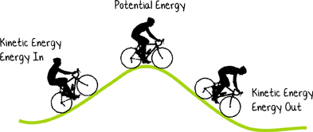
What is kinetic energy?
Kinetic energy: the energy of a moving mass or object
KE = (1/2)(m)(v²)
Problem:
If the 130 lb cyclist slows from 20 mph to 10 mph, how much does her kinetic energy change?
kinetic energy (J)
mass (kg)
velocity (m/s)
130 lb 1 kg = 59 kg
2.2 lb
20 miles 1.6093 km 1 E3 m 1 hr = 9 E-3 m/s
1 hr 1 mile 1 km 3600 s
KE = (1/2)(59 kg)(9 E-3)² = 2.4 E-3 J
KE = (1/2)(59 kg)(4.5 E-3)² = 6 E-4 J
ΔKE = 2.4 E-3 J - 6 E-4 J = 1.8 E-3 J
Energy Systems & Sustainability, 2/e, Chapter 4; http://science.jrank.org/

Slide 4
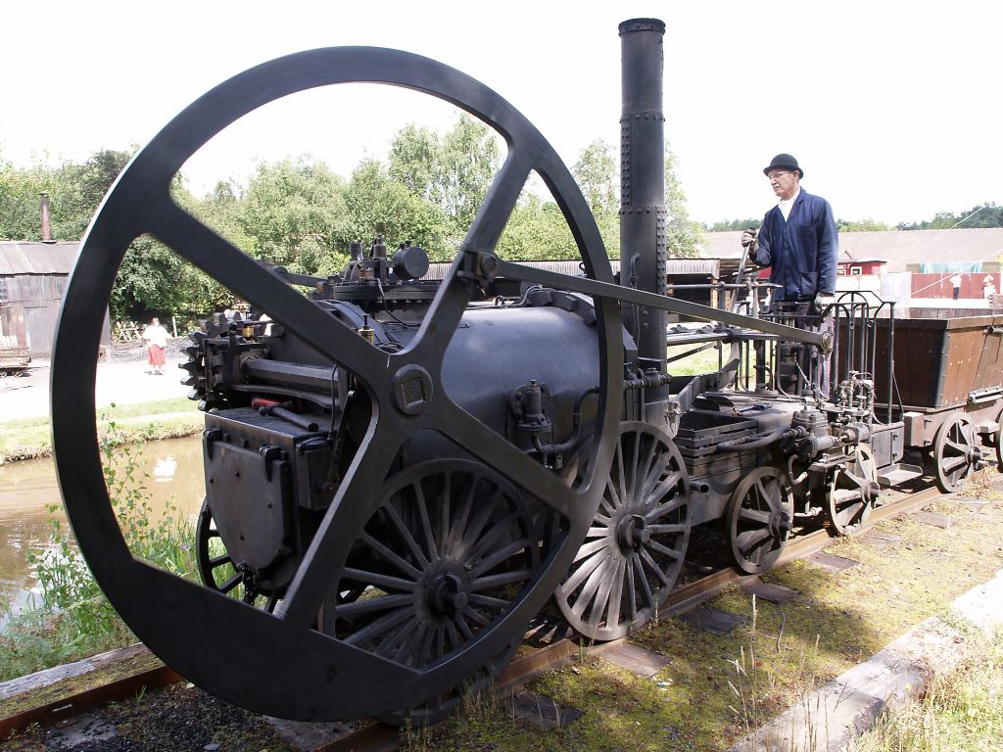
Kinetic rotational motion
Kinetic rotational energy: a form of kinetic energy used to spin generators to make electricity or flywheels to store energy
Erot = (1/2)(Ι)(ω²)
kinetic energy (J)
jntertia
(kg m²)
angular velocity (m/s)
This 1802 steam locomotive used a flywheel to even out the power produced by it’s single cylinder engine.
Today, flywheels are being investigated by NASA.
Energy Systems & Sustainability, 2/e, Chapter 4; wikipedia

Slide 5
4. Forms of energy
  4.2 Potential energy

Slide 6
What is potential energy?
Potential energy: stored energy caused by attractive forces
  gravity (aka position)
  electrostatic attraction
work (creates PE)
Problem:
If an elevate water tank holds 100,000 gallons of water at a height of 200 feet, how much potential energy is created?
PE = (m)(g)(h)
Potential energy (J)
mass (kg)
gravity
(m/s²)
height
(m)
100,000 gallons 3.7854 L 1 m3 1000 kg = 3.7854 E8 kg water
1 gallon 1 L 1 m3
200 feet 12 inches 2.54 cm 1 m = 61 m
1 foot 1 inch 100 cm
PE = (3.7854 E8 kg)(9.8 m/s²)(61 m) = 2.26 E11 J
Energy Systems & Sustainability, 2/e, Chapter 4; http://science.jrank.org/

Slide 7
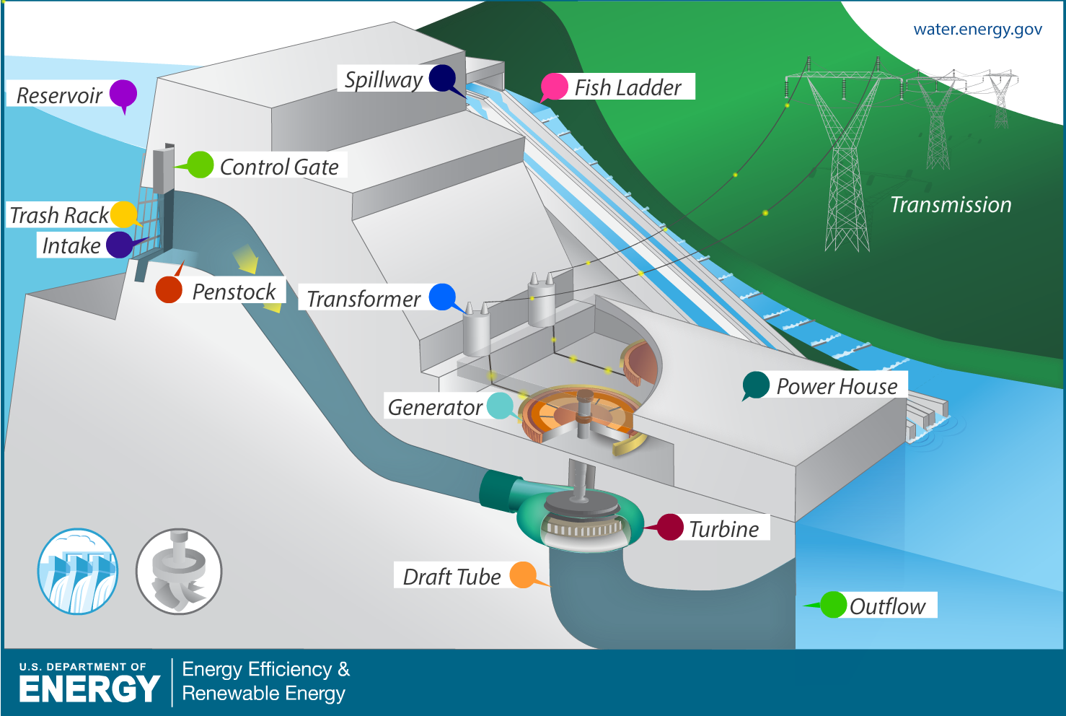
Hydropower uses potential energy
Energy Systems & Sustainability, 2/e, Chapter 4; energy.gov

Slide 8
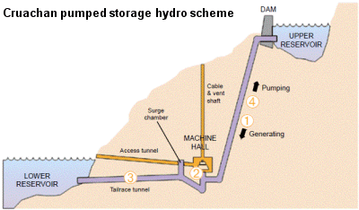

Pumped storage uses potential energy
Scotland’s Cruachan pumped storage hydro facility pumps water to an upper reservoir when surplus electricity is available. When electricity is needed, water is released to generate electricity.
The upper reservoir can store:
7 gigawatt-hours of energy
25 TJ of energy
Energy Systems & Sustainability, 2/e, Chapter 4; scotsrenewables.com

Slide 9
4. Forms of energy
  4.3 Thermal energy
  ‘...not that heat generates motion or that motion generates heat (though both are true in certain cases), but that heat itself, its essence and quiddity, is motion and nothing else.’
  - Frances Bacon, 1620

Slide 10

What is thermal energy?
Thermal energy: an object’s energy measured by temperature (J)
Molecular kinetic theory: the average kinetic motions of atoms depend only on heat. Thus, heat is the kinetic motion of atoms or molecules.
Q = (m)(C)(ΔT)
ΔT = Q .
(m)(C)
heat (J)
mass (kg)
specific heat capacity
(J/kg-°) or (Btu/lb-°)°
change of temperature
(degrees °)
Q = (V)(C)(ΔT)
volume (L) or (gallons)
Find specific heat with volumetric units
specific heat of water = 4810 J/kg-°
= 8.314 Btu/gal-°
Energy Systems & Sustainability, 2/e, Chapter 4

Slide 11
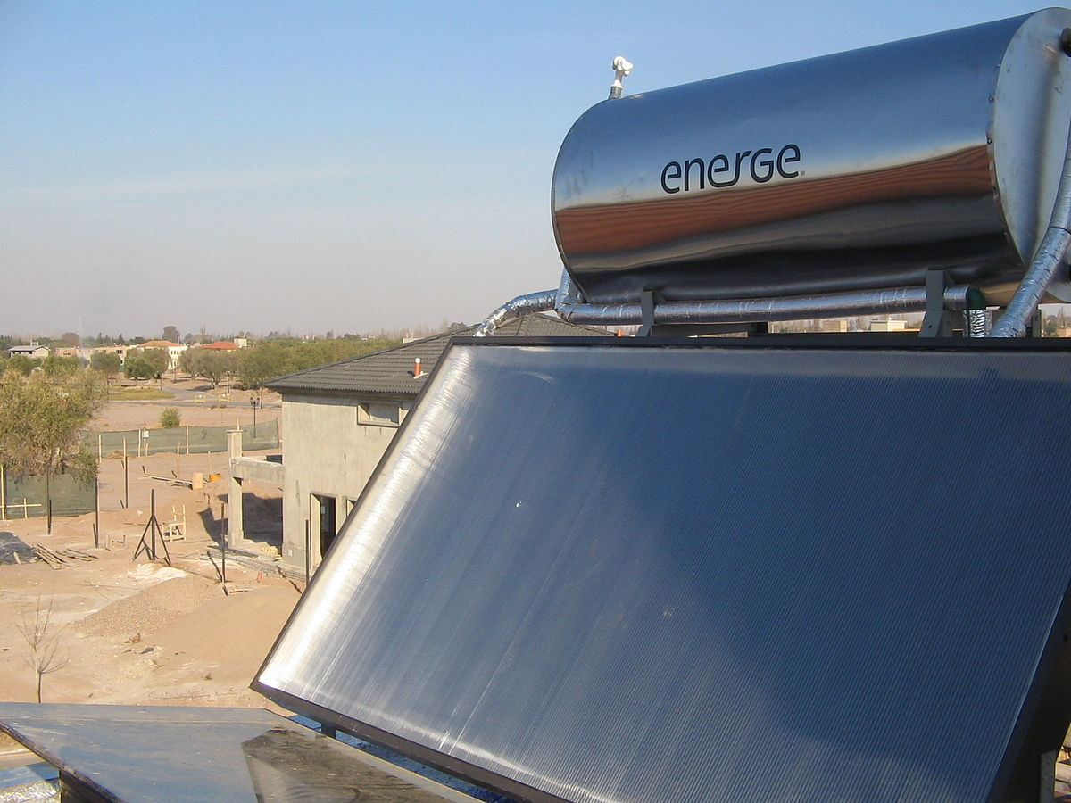
Thermal energy example
Problem: How much energy does it take to increase the temperature of water in a 400 gallon tank from 50 to 140°F?
Note that since ΔT is the difference in temperature rather than an absolute value, the units can be F, C or K.
Q = (V)(C)(ΔT)
Q = (400 gallons)(8.314 Btu/gal-°)(140 – 50°F) = 2.99 E5 Btu
Energy Systems & Sustainability, 2/e, Chapter 4; wikipedia

Slide 12
4. Forms of energy
  4.4 Chemical energy

Slide 13
What is chemical energy?
Chemical energy: the energy stored in inter- & intra-molecular bonds.
  Heat is released by when bonds are made during:
    combustion or…
    reduction-oxidation reactions.
Compounds / molecules: two or more atoms combined (bonded) at a constant ratio
methane (CH₄)
oxygen gas (O₂)
Energy Systems & Sustainability, 2/e, Chapter 4; wikipedia

Slide 14
Chemical reactions & chemical energy
Chemical reactions rearrange atomic connections (bonding) by breaking bonds and create new molecules by forming new atomic bonds.
Reactions obey the law of conservation of mass, but often involved changes in energy depending on the ratio of bonds broken to the bonds made.
Combustion reactions: burn carbon- & hydrogen-based fuel in the presence of oxygen gas to produce carbon dioxide, water & energy.
combustion
+
+
reaction
carbon dioxide
(CO₂)
methane (CH₄)
oxygen gas (O₂)
water
(H₂O)
CH₄ + 2O₂ → CO₂ + 2H₂O
Energy Systems & Sustainability, 2/e, Chapter 4; wikipedia

Slide 15
Exothermic reactions release energy
Exothermic reactions release energy as they occur.
  Heat is a product.
  Combustion reactions are exothermic.
Negative ΔH means that heat is released (exothermic).
ΔH is enthalpy or heat energy
C + O₂ → CO₂ ΔH = - 32.8 MJ/kg
Burning 1 kg of pure carbon (approximating coal) releases 32.8 MJ.
C₂H₆O + 3O₂ → 2CO₂ + 3H₂O ΔH = - 29.8 MJ/kg
Burning 1 kg of pure ethanol (approximating coal) releases 29.8 MJ.
Endothermic reactions require energy to occur.
  Heat is a reactant.
  Can be used to store energy rather than make it.
Energy Systems & Sustainability, 2/e, Chapter 4; wikipedia

Slide 16
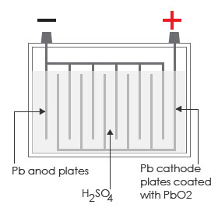
Batteries: redox chemistry
Batteries: linked voltaic cells (redox half-cells) that store chemical energy until the half-cells are linked by a conductor
Some have finite power (non-rechargeable).
Others are rechargeable.
Example: lead-acid batteries used in cars
Discharge (produce) energy to start the car.
  Pb(SO₄) coats the electrodes.
Charged when the car runs.
  Pb(SO₄) is redoxed back to plates.
Discharging:
PbO₂ + Pb + 2H₂(SO₄) → 2Pb(SO₄) + 2H₂O
cathode
anode
Builds up on anode & cathode plates.
Charging:
2Pb(SO₄) + 2H₂O → PbO₂ + Pb + 2H₂(SO₄)
anode & cathode
Energy Systems & Sustainability, 2/e, Chapter 4
http://www.astragrp.com/bateriku/images/battery_safety_handling.jpg

Slide 17
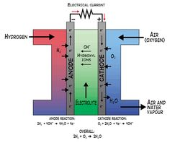
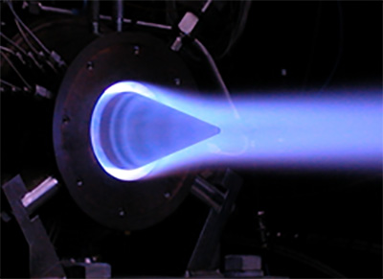
Combustion vs. redox reactions
Both type of reactions can use traditional fuels like methanol & methane.
Redox reactions can also use non-traditional fuels like H₂ gas.
Redox reactions are more efficient at converting fuel to electricity.
  Internal combustion engine: 30% (so 70% ‘waste’ heat)
  Fuel cells: 70%
gas combustion
Redox hydrogen fuel cell
Energy Systems & Sustainability, 2/e, Chapter 4; wikipedia

Slide 18
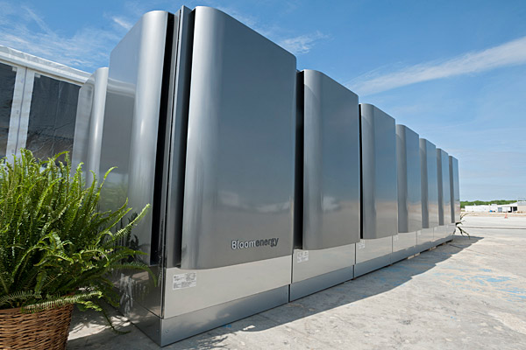
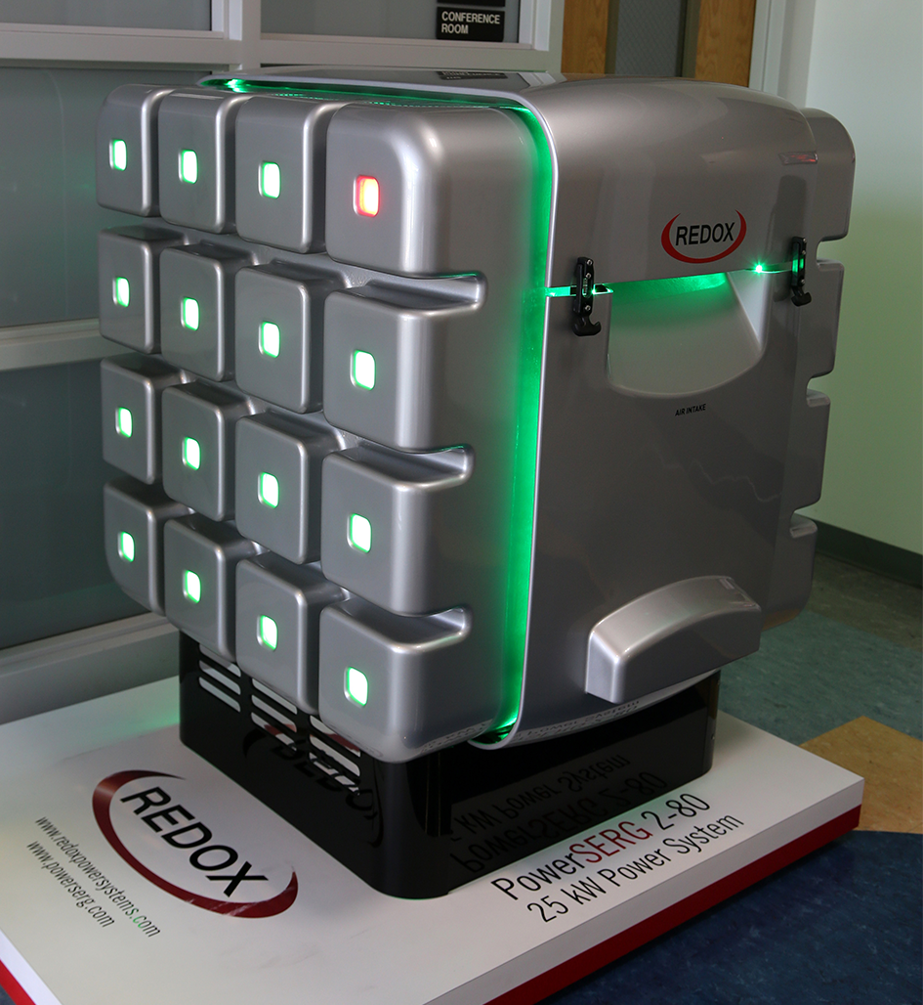
Fuel cells are in commercial use
The Bloom box is a fuel cell that passes natural gas (methane) over thin ceramic plates coated with a proprietary redox ‘powder.
As of 2015, installed boxes were producing 160 MW at….
Apple, ebay, Fedex, etc.,.
New design doubles power output.
Revenue, but still little profit.
Source: University Delaware
Redox (backed by Microsoft) may be big competition.
Closer to being competitive with combustion.
Technology may provide 100x power for the same cost.
Redox 25 kW power system
Energy Systems & Sustainability, 2/e, Chapter 4;
http://www.delawareonline.com/story/news/local/2015/07/22/new-bloom-box/30475483/
http://www.dailytech.com/Microsofts+New+Fuel+Cell+Partner+is+Ready+to+Blow+Away+the+Bloom+Box/article36118.htm

Slide 19
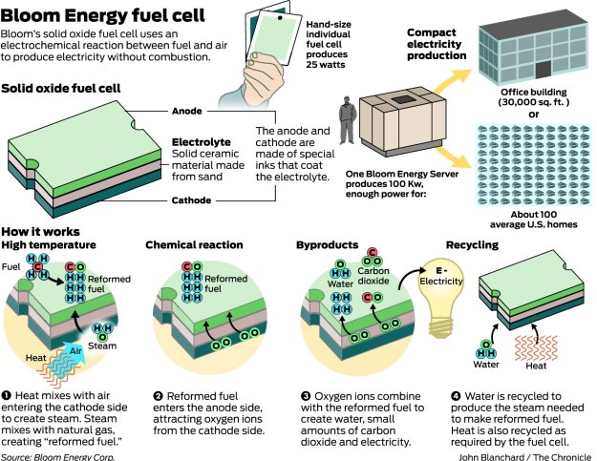
Bloom box schematic
http://www.dailytech.com/Microsofts+New+Fuel+Cell+Partner+is+Ready+to+Blow+Away+the+Bloom+Box/article36118.htm

Slide 20
Bloom box schematic
http://www.dailytech.com/Microsofts+New+Fuel+Cell+Partner+is+Ready+to+Blow+Away+the+Bloom+Box/article36118.htm

Slide 21
4. Forms of energy
  4.5 Energy density / heat content

Slide 22
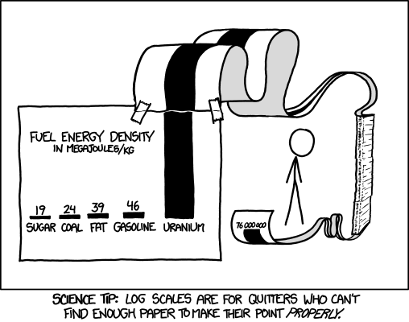
Relative energy densities
Energy Systems & Sustainability, 2/e, Chapter 4; http://xkcd.com/1162

Slide 23
Chemical energy density
Storing energy is ‘expensive’ in terms of quantities of chemical or potential energy needed.
pounds to store 10 gas gallon equivalents
22
52
68
105
191
6,578
11,440
762,667
fuel (=chemical energy) | MJ/kg
hydrogen gas | 130
natural gas | 55
gasoline | 45
oil | 42
coal | 28
ethanol | 27
wood | 15
lead-acid batteries
water at 80c
pumped storage (h = 370 m)
Energy Systems & Sustainability, 2/e, Chapter 4

Slide 24
HHV vs. LHV heat values?
There are two ‘flavors’ of heat values (or energy densities) for combusted fuels.
HHV (high heat values) used when the steam is condensed after use; condensing steam to water releases additional energy.
Aka HCV or GCV
LHV (low heat values) used when the steam is not condensed after use.
Aka LCV or NCV
Fuel | HHV (MJ/kg) | LHV (MJ/kg)
hydrogen | 141.80 | 119.96
methane | 55.50 | 50.00
propane | 50.35 | 46.35
diesel | 44.80 | 43.40
wood | 21.20 | 17.0
Energy Systems & Sustainability, 2/e, Chapter 4; wikipedia

Slide 25
Example: storing energy as H₂ (1)
Problem: How much hydrogen gas would be required to store the energy equivalent of 10 gallons of gasoline, and what pressure would be required to store the gas a standard temperature?
Gasoline has a density of 719.7 kg/m³.
10 gallons gasoline 3.7854 L 1 m³ 719.7 kg = 27.2 kg
1 gallon 1000 L m³
27.2 kg 45 MJ = 1224 MJ in 10 gallon of gasoline
1 kg
1224 MJ 1 kg 1 E3 g 1 L 1 m³ = 104.8 m³ H₂ gas at STP
130 MJ 1 kg 0.08988 g 1000 L
Ideal gas law: PV = nRT → P = mRT/V
P = mRT = (9.42 kg)(4124.18 Nm/kg-°K)(298 °K) = 1.10 E5 Pa = 16 psi
V 104.8 m³
Problem: this is a massive volume!!!
Energy Systems & Sustainability, 2/e, Chapter 4

Slide 26
Example: storing energy as H₂ (2)
Commercial ‘low pressure’ hydrogen storage tanks are rated at 440 psi. How much would this higher pressure storage decrease to volume required to store the hydrogen gas?
Ideal gas law: PV = mRT → V = mRT/P
Pa = N/m²
m³
kg
4124.18 N-m/kg-°K
°K
1 psi = 6894.76 Pa → 440 psi 6894.76 Pa = 3.034 E6 Pa
1 psi
V = mRT = (9.42 kg)(4124.18 Nm/kg-°K)(298 °K) = 3.8 m³
P 3.034 E6 Pa (=N/m²)
What if a commercial compressed gas tank (2000 psi) were used?
2000 psi = 1.38 E8 Pa
V = mRT = (9.42 kg)(4124.18 Nm/kg-°K)(298 °K) = 8.4 E-2 m³
P 1.38 E8 Pa (=N/m²)
Energy Systems & Sustainability, 2/e, Chapter 4

Slide 27
4. Forms of energy
  4.7 Electromagnetic radiation
  & electricity

Slide 28
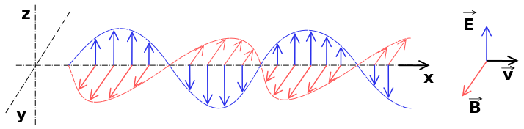
Electromagnetic radiation
Electromagnetic radiation: ‘Classically, electromagnetic radiation consists of electromagnetic waves, which are synchronized oscillations of electric and magnetic fields that propagate at the speed of light through a vacuum ‘
1820 Oersted: electric current can deflect the needle of a compass
1820 Ampere: two parallel wires carrying electric current generate magnetic force
1821 Faraday: a wire carrying current will spontaneously rotate around a magnet
1832 Faraday: moving a bar magnet in a coil of wire causes current to flow in a coil
1864 Maxwell: EM waves are simply oscillating electric & magnetic fields that can travel through empty space at nearly the speed of light
      The source of all EM radiation are oscillating electric charges
      EM radiation is 'pure energy’
1900 Plank / 1905 Einstein: EM radiation is quantized
Energy Systems & Sustainability, 2/e, Chapter 4; wikipedia

Slide 29
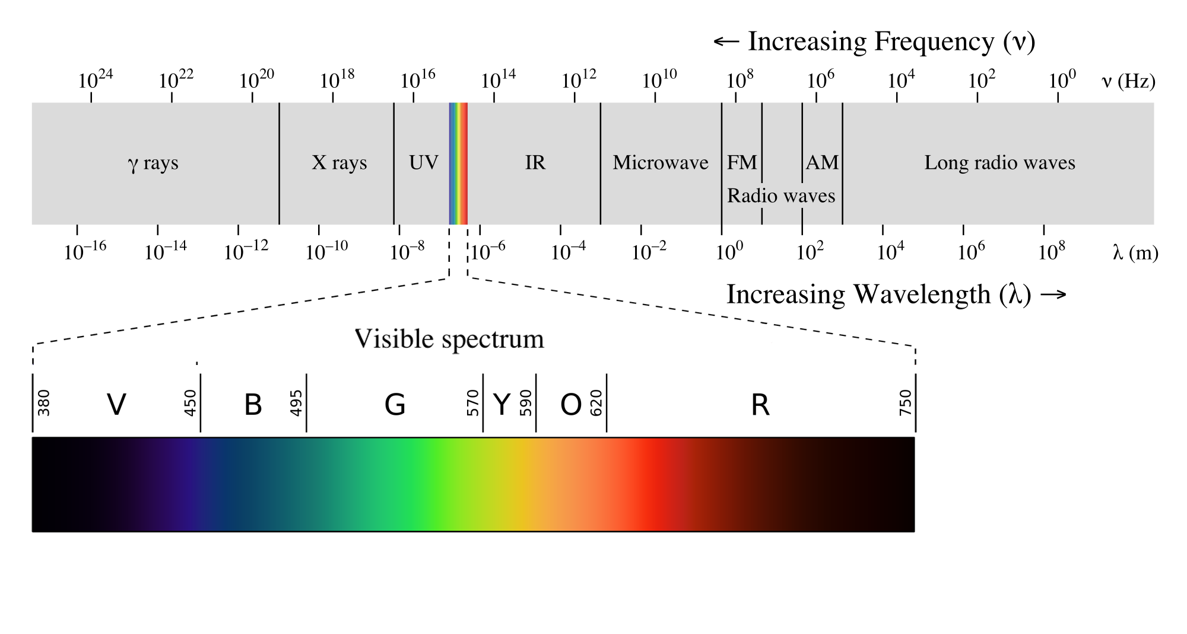
Spectrum of electromagnetic radiation
EM radiation includes a broad spectrum of types of radiation defined by their wavelengths.
Visible light is a small part of the EM spectrum
Energy Systems & Sustainability, 2/e, Chapter 4; wikipedia

Slide 30
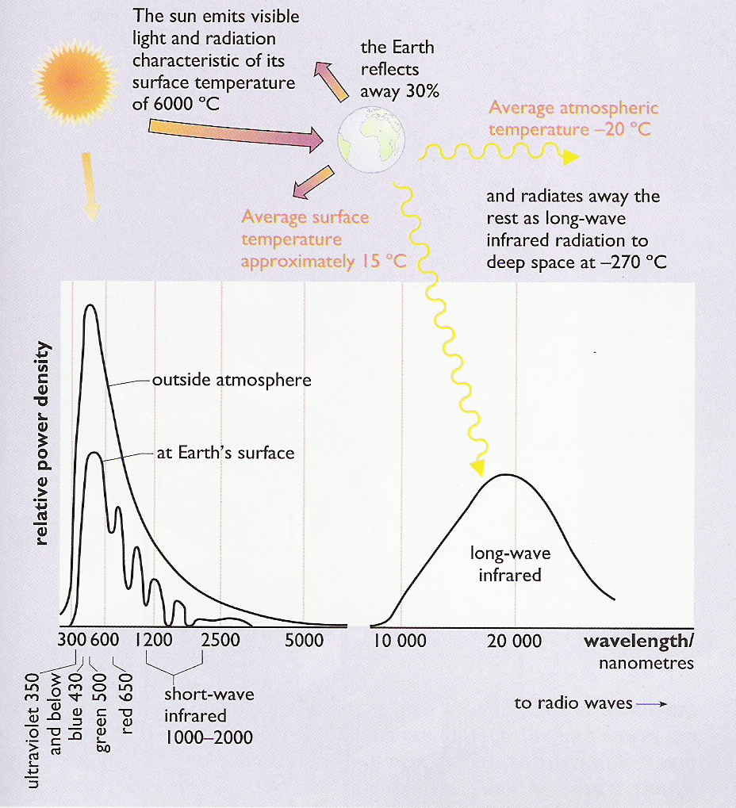
Solar energy (insolation)
The solar energy that reaches the earth represents a small part of the EM spectrum & includes:
UV light (mainly A & B)
visible
Short-wave infrared
Long-wave infrared
Maximum insolation power:
= 1000 W/m²
Power of sunlight hitting the earth’s surface.
Solar energy is responsible for:
Photons (PV power)
Molecular vibration (heat)
Photosynthesis (biomass)
Energy Systems & Sustainability, 2/e, Chapter 4; XXXX

Slide 31
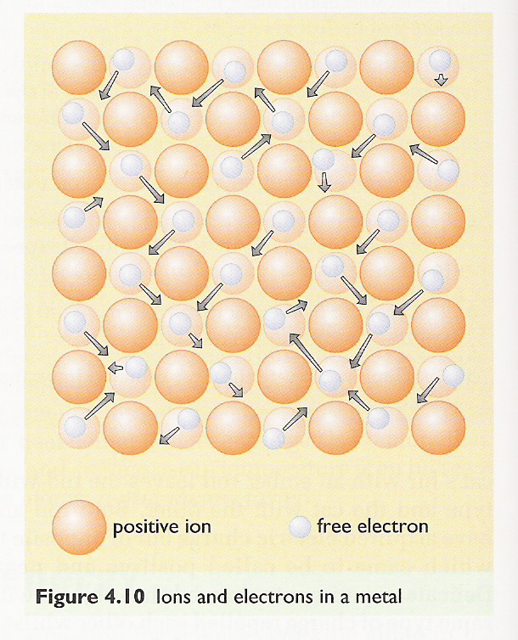
Electricity: movement of electrons
Electricity: a flow of electrons
Electrons flow in response to pressure (an electrical field) or as the result of a chemical reaction; a reduction-oxidation reaction.
Ultimately, it’s all about the law of electrostatic attraction.
Metals conduct electricity. How?
Metal atoms are easily oxidized: lose electrons & become + cations.
Free electrons mill about, attracted to the cations.
Free electrons will move (flow) in response to a stronger attractive force.
Energy Systems & Sustainability, 2/e, Chapter 4

Slide 32
Electric power?
Electricity power: rate of transfer of electric energy into a circuit
Voltage (~pressure): the difference in electrical potential between terminal (source & destination); a measure of energy (V = volt)
Current (~ flow rate): the flow of electrons (I; units = amperes, A)
Resistance (~friction): material’s ability to slow electron flow (Ω; V/A)
P = (V) (I)
V = (I)(R)
power
(W)
voltage
(V)
current
(Amp)
voltage (V)
current
(Amp)
resistance
(Ω)
High Pressure, Low Flow Rate
⬆V, ⬇I
Low Pressure, High Flow Rate
⬇V, ⬆I
Energy Systems & Sustainability, 2/e, Chapter 4; xxx

Slide 33
Electric power example
Problem: A bulb is labelled 1.5 V, 0.3 A. What is the bulb’s resistance and power when it is connected to a 1.5 V battery?
R = V/I = 1.5 V = 5.0 Ω
0.3 A
P = (V) (I) = (1.5 V) (0.3 V) = 0.45 W
Energy Systems & Sustainability, 2/e, Chapter 4

Slide 34
4. Forms of energy
  4.8 Nuclear energy

Slide 35
Nuclear energy: background
Quick review of basic atomic structure & chemistry:
Matter is made of atoms.
Atoms have nuclei made of positively charged protons and neutral neutrons & surrounded by negatively charged electrons.
Atomic number is the number of protons in the atoms of an element.
Atomic mass is the mass of the atoms of an element.
Isotopes are atoms with a variant number of neutrons & thus mass that is slightly higher or lower than the average mass of atoms of that element.
What hold nuclei together? After all, since protons are positively charged, the should repel one another when packed together into the nucleus!
  Strong nuclear force (the 3rd force)
  The nuclei of most atoms are stable & do not change.
Energy Systems & Sustainability, 2/e, Chapter 4

Slide 36
Periodic table
Most actinide isotopes with odd numbers of neutrons are fissile.
Nuclear fuels: U-233, U-235, Pu-239, Pu-241
Energy Systems & Sustainability, 2/e, Chapter 4; webelements.com

Slide 37
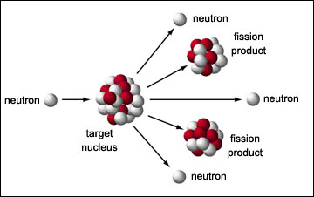
Nuclear fission
Nuclear fission: nuclei of certain elements split into two nearly equal parts
Since the energy of the two fission products is lower than the energy of the atom which is split, energy is released.
And because the intranuclear forces are very strong, lots of energy is released.
1 E8 times as much energy is released from fission of one atom of uranium-235 as from the burning of one carbon atom.
Energy Systems & Sustainability, 2/e, Chapter 4

Slide 38
Special theory of relativity
Einstein’s special theory of relativity sought to resolve conflicts between Newton’s laws of motion and Maxwell’s laws of electromagnetism.
The special theory has two big tenets:
1. Mass is not a fixed quantity: the mass of objects in motion is larger
than the mass of objects at rest.
  The increased mass is equal to the object’s kinetic energy.
2. Therefore, mass and energy are the equivalent and mutable.
E = (m)(c²)
energy (J)
mass
(kg)
speed of light
(3 E8 m/s²)
Energy Systems & Sustainability, 2/e, Chapter 4

Slide 39
Mass is energy is power?
So, if mass and energy are equivalent then just convert to harvest energy!
Hypothetically, a small, 20 g, marble contains as much energy as a 500-kiloton hydrogen bomb.
Problem: releasing (converting) nuclear energy is very hard to do because the nuclear force is so darned strong.
So how can we accomplish conversion?
Matter/anti-matter annihilation? Not enough anti-matter …
Chemical reactions like combustion? Very little mass lost
Nuclear fission?
  Result in a 100,000 greater loss of mass than chemical reactions, thus produce more energy!
Energy Systems & Sustainability, 2/e, Chapter 4
https://www.brightstorm.com/science/physics/nuclear-physics/mass-energy-equivalence/

Slide 40
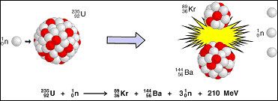
Nuclear energy
Nuclear energy: is the energy that holds protons and neutrons together in the nucleus
Much greater than the usual chemical energy.
Released during fission or fusion.
The amount of energy released is related to changes in the total mass of the system, per Einstein’s equation:
Mass lost = energy released
Eexo = (Δm)(c²)
Problem: When 1 metric tonne of uranium-235 undergoes fission, its mass is decreased by 6.6 g. How much energy is this loss of mass produce?
Eexo = (0.0066 kg)(3 E8 m/s²)² = 5.94 E14 J = 600 TJ
Energy Systems & Sustainability, 2/e, Chapter 4; www.euronuclear.org

Slide 41
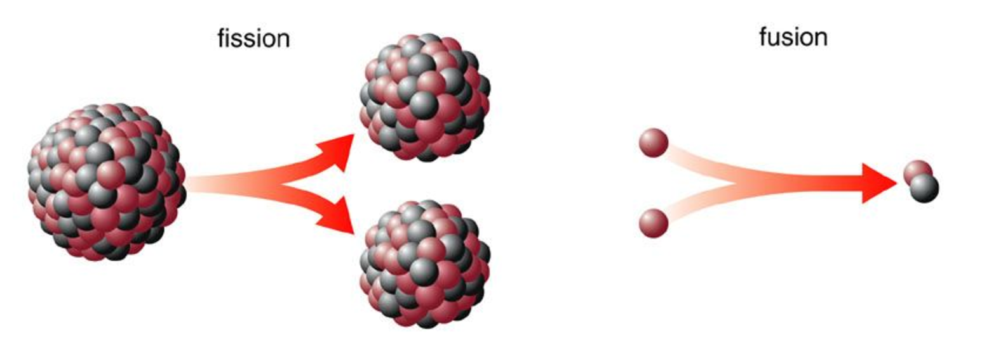
Fusion vs. fission
Nuclear fusion: the process of fusing two atoms to create a new atom
Enormous amounts of energy is needed to make fusion happen, but more energy is released: net energy yield.
Fusion is safer because no radioactive products are produced.
Not yet practical or applied.
Radioactive K
H
He
H
Radioactive U
Radioactive Ba
https://nuclear.duke-energy.com/2013/01/30/fission-vs-fusion-whats-the-difference

Slide 42
4. Forms of energy
  4.8 Power

Slide 43
Power
Power: is the rate of energy flow (energy / time)
Unit = watt (W) = 1 Joule/second = kg-m²/s³
In many cases, power is created when mass flows:
  wind is flow of air;
  hydro is flow of water; &
  combustion depends on the flow rate of fuel to an engine.
When the flow of mass is involved in producing power, the flow rate of mass (Qmass) can be substituted for mass in energy equations, converting energy equations into power equations.
Qmass = mass flow rate (kg/s)
Example:
Kinetic energy (KE) = ½(m)(v²) = kg-m² = J
s²
Power of KE (PKE) = ½(Qmass)(v²) = kg-m² = J/s = W
s³
Energy Systems & Sustainability, 2/e, Chapter 4

Slide 44
Power equations
Kinetic power
PKE = (1/2)(Qmass)(v²) = W
Potential power
PPE = (Qmass)(g)(h) = W
Chemical power
Pfuel = (Qmass)(H) = W
Electrical power
Pelectrical = (V)(I) = W
Qmass flow rate kg/s, gallons/s, etc.
v velocity m/s
g gravitational acceleration m/s²
H heat content J/kg
V voltage V
I current A
Energy Systems & Sustainability, 2/e, Chapter 4

Slide 45
4. Forms of energy
  4.8 Summary of forms of power

Slide 46
Summary: forms of energy
Kinetic energy: motion
KE = (1/2)(m)(v²)
Potential energy: gravity (positional energy)
PE = (m)(g)(h)
Thermal energy: heat (Δ temperature)
Q = (m)(c)(ΔT)
Chemical energy: fuels & batteries
Q = (H)(fuel quantity)
Electrical energy: flow of electrons
P = (V)(I)
Nuclear energy: change in mass
E = (m)(c²)
Energy Systems & Sustainability, 2/e, Chapter 4

