Slide 1
SSC 2030: Energy Systems & Sustainability
8. Engines
8.1 Oil & gas engines: an introduction
8.2 Spark ignition engines
8.3 Diesel compression engine
8.4 Reducing pollution
8.5 Gas turbines
8.6 Stirling engines (external combustion)

Slide 2
8. Engines
8.1 Introduction

Slide 3
Evolution of engines
Reciprocating steam engines:
1700s to late 1800s
Evolved to become a reliable power supply for:
Factories;
Transportation (trains & ships); &
Power stations.
An external combustion engine, since combustion of the fuel is used to make steam and only steam enters the engine’s cylinders or pistons
Internal combustion engines: fuel is combusted within the engine’s cylinders (or turbine)
Expansion of combustion gases does work, moving pistons
Energy Systems & Sustainability, 2/e, Chapter 8

Slide 4
8. Engines
8.2 Spark ignition engines

Slide 5
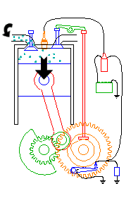
Internal combustion engine (1)
Breakthrough design won the gold medal at the 1867 World Exhibition.
Invented by Nikolaus Otto;
Spark ignition;
4-stroke engine was a quieter advance:
Intake → compression → power → exhaust
Intake:
Piston moves down;
Creates a partial vacuum; &
Draws fuel vapor/air into cylinder.
Energy Systems & Sustainability, 2/e, Chapter 8; http://www.animatedengines.com/otto.html

Slide 6
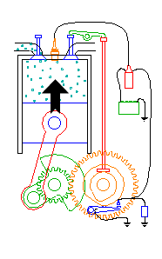
Internal combustion engine (2)
Breakthrough design won the gold medal at the 1867 World Exhibition.
Invented by Nikolaus Otto;
Spark ignition;
4-stroke engine was a quieter advance:
Intake → compression → power → exhaust
Compression:
Piston rises, driven by flywheel momentum;
Forces the poppet valve shut;
Compressing the mixture of fuel & air.
Energy Systems & Sustainability, 2/e, Chapter 8; http://www.animatedengines.com/otto.html

Slide 7
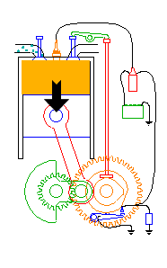
Internal combustion engine (3)
Breakthrough design won the gold medal at the 1867 World Exhibition.
Invented by Nikolaus Otto;
Spark ignition;
4-stroke engine was a quieter advance:
Intake → compression → power → exhaust
Power:
At the top of the compression stroke;
The spark plug fires;
Igniting the compressed fuel/air;
The burning fuel expands;
Driving the piston down.
Energy Systems & Sustainability, 2/e, Chapter 8; http://www.animatedengines.com/otto.html

Slide 8
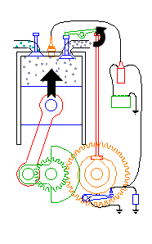
Internal combustion engine (4)
Breakthrough design won the gold medal at the 1867 World Exhibition.
Invented by Nikolaus Otto;
Spark ignition;
4-stroke engine was a quieter advance:
Intake → compression → power → exhaust
Exhaust:
At the bottom of the power stroke;
The exhaust valve is opened by the cam/lift mechanism;
The rising piston pushes the exhausted fuel out of the cylinder;
And repeat from step (1).
Energy Systems & Sustainability, 2/e, Chapter 8; http://www.animatedengines.com/otto.html

Slide 9
Internal combustion engine advances
1882-3 Gottlieb Daimler & Wilhelm Maybach: small, high-speed engines
1885 Maybach: float carburetor to deliver a precise mix of fuel &air
2-cyliner engine design; higher rpm & power
Karl Benz produces a 3-hp four wheel vehicle
1900 de Dion Bouton produces a 3.5 hp vehicle
Mercedes sells car for the equivalent of $240,000
1904 The Daimler car company offers a 24-hp, 34-seat bus
Energy Systems & Sustainability, 2/e, Chapter 8

Slide 10
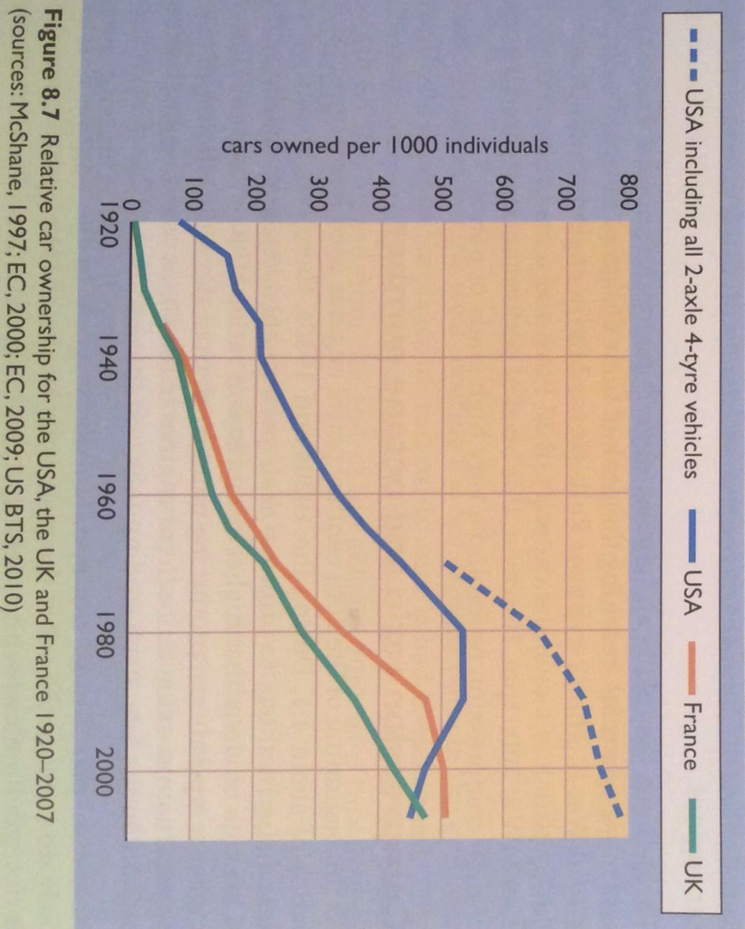
Ford: cars for everyman
Henry Ford: increased the sale and use of the car in the US
1903 Founded the Ford Motor Company
1908 Introduced the Model T for $850
1913 Assembly line manufacturing cut time from 12 hr to 93 min.
Prices fell, sales soared.
1923 Sales of the Model T soar to 1 million per year
Energy Systems & Sustainability, 2/e, Chapter 8

Slide 11
Aircraft engines
Aircraft engines had some special requirements:
Lightweight;
Powerful;
Capable of coping with thinner air at higher altitudes.
Superchargers are engine-driven pumps that compress air before it enters the engine.
Turbochargers compress air using hot exhaust gases.
Both increase the power of engines & can be used on the ground too.
Aircraft engines used other strategies to increase power without increasing size and weight:
High compression ratios; &
High octane fuels.
Energy Systems & Sustainability, 2/e, Chapter 8

Slide 12
Compression ratio & octane numbers
Compression ratio: the ratio of smallest & largest volumes of a cylinder
Higher compression ratios allow higher combustion temperatures;
And higher power outputs
4:1
6:1
7.5:1
9:1
1930s
1940s
today
Octane rating: the ability of the fuel to avoid knocking or pinging
‘Knocking’ is caused when sparking & ignition aren’t synchronized.
Fuel octane rating must be matched with compression ratio.
Pure octane is the best anti-knocking fuel.
Mixtures are therefore rated in relation to octane.
Energy Systems & Sustainability, 2/e, Chapter 8

Slide 13
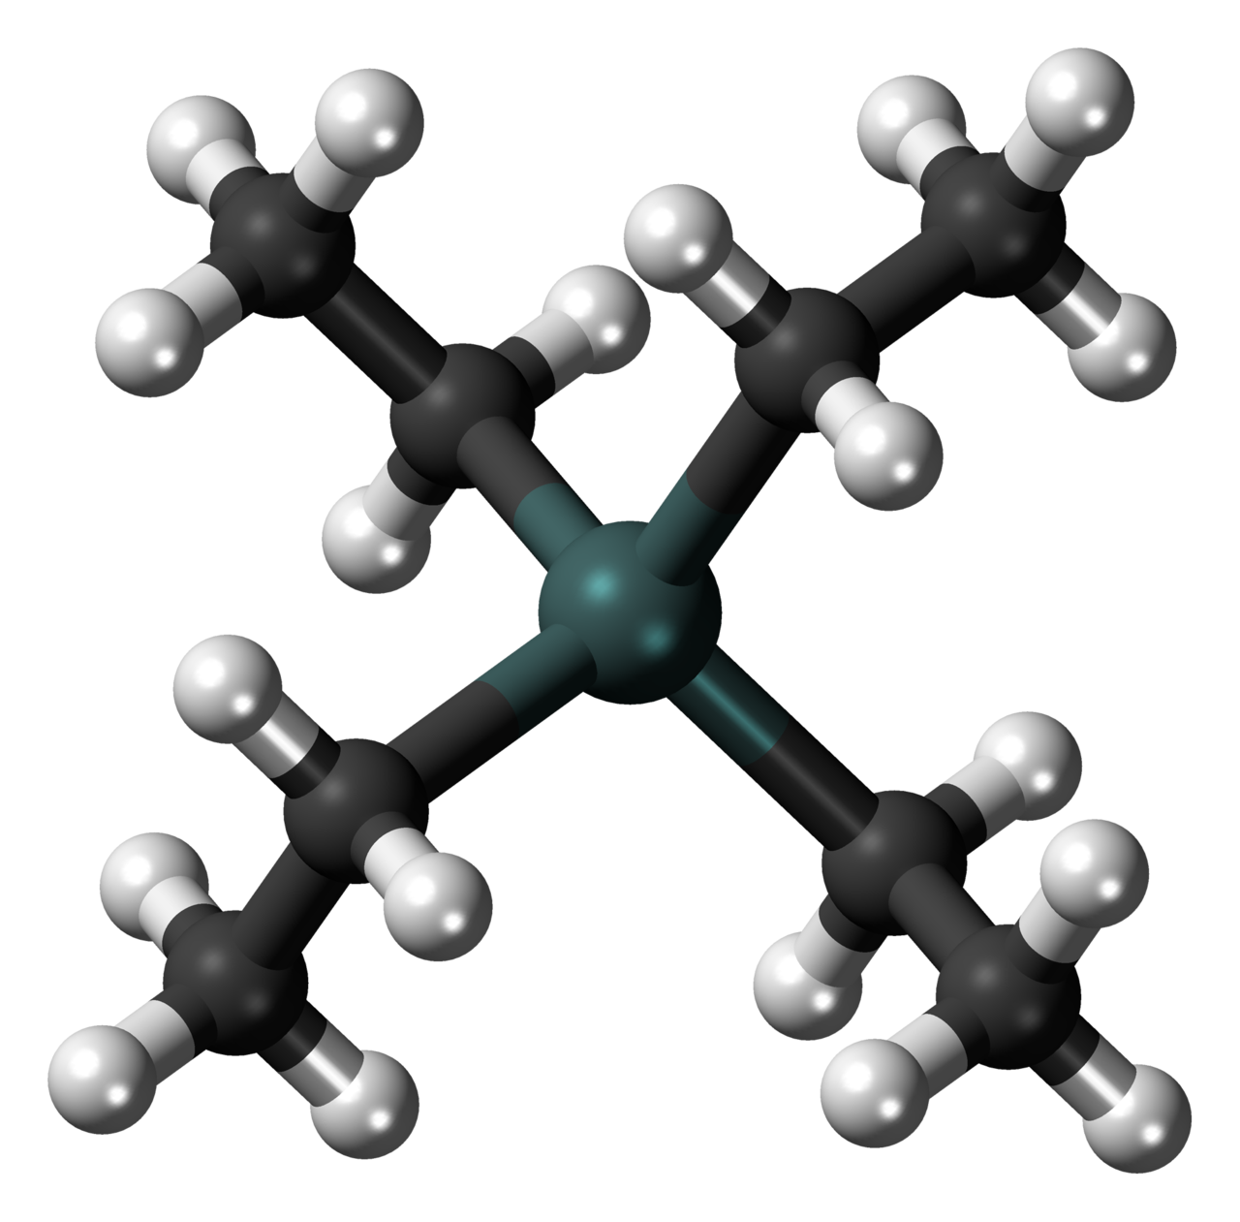
Why was lead added to gas?
Refining better grades of gas is expensive. Is there a cheaper way to make reduce knocking & improve fuel ‘quality’?
Tetraethyl lead:
1 gram / L increases octane rating by 10-15 points.
Reduced wear & tear on the engine by creating a coating.
Added fine powder of lead oxide to engine exhaust.
By the 1960s it became clear that leaded gas increased blood levels of lead in children; compromised brain development.
Banned in the EU in 2000.
Still used in aviation fuels.
Energy Systems & Sustainability, 2/e, Chapter 8

Slide 14
Alternative fossil fuels
Liquified petroleum gas (LPG)
Propane (C₃H₈)
Butane (C₄H₁₀)
high octane ratings
Compressed natural gas (CNG)
Methane (CH₄)
Methanol (CH₃OH) liquid fuel made from methane
Rocket fuel!
High octane
Toxic
Energy Systems & Sustainability, 2/e, Chapter 8; wikipedia

Slide 15
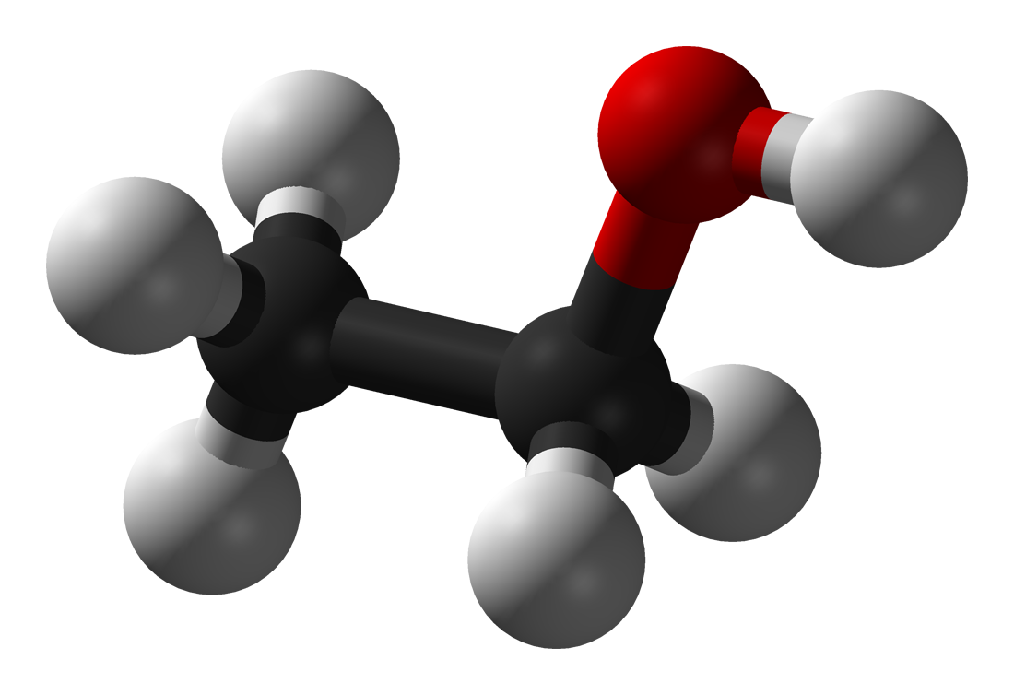
Alternative biofuels: ethanol
Ethanol (aka EtOH; CH₃CH₂OH; C₂H₅OH)
Single largest use is as a fuel alternative or additive
Brazil is the largest user of ethanol fuel where gasoline contains at least 20%
US ethanol fuel industry is also ‘healthy’ due to significant agricultural subsidies for corn growers and fuel producers.
EROEI?
Corn ethanol 1.3
Sugarcane ethanol 8
Cellulosic ethanol 2 - 36
Henry Ford designed the Model T to run on pure (anhydrous) alcohol, which he called ‘the fuel of the future’.
Energy Systems & Sustainability, 2/e, Chapter 8; https://en.wikipedia.org/wiki/Ethanol_fuel_energy_balance

Slide 16
8. Engines
8.3 Diesel compression engine

Slide 17
Diesel’s compression engine
Rudolph Diesel wanted to create an engine that would be rugged & could run on a wide variety of inexpensive fuels.
He wanted an engine for the everyman.
"In 1900 a small Diesel engine was exhibited by the Otto company which, on the suggestion of the French Government, was run on arachide [peanut] oil, and operated so well that very few people were aware of the fact. The motor was built for ordinary oils, and without any modification was run on vegetable oil.”
"I have recently repeated these experiments on a large scale with full success and entire confirmation of the results formerly obtained.”
While he didn’t meet his goal of producing an engine that could run on coal-dust, the diesel engine can run on a wide range of fuels, including thick, viscous oils.
More efficient than the gasoline engines of its day.
Energy Systems & Sustainability, 2/e, Chapter 8; https://en.wikipedia.org/wiki/Rudolf_Diesel

Slide 18
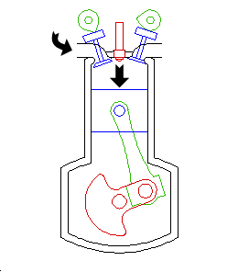
Diesel’s compression engine (1)
Rudolph Diesel created an engine that ignited fuel by compression alone.
Requires high pressure to compress the fuel, so robust construction;
Noisier;
Incomplete combustion is more likely and causes sooty emissions.
intake → compression → injection → power → exhaust
Intake:
Intake valve opens; &
Fresh air is drawn into the cylinder.
Energy Systems & Sustainability, 2/e, Chapter 8; http://www.animatedengines.com/diesel.html

Slide 19
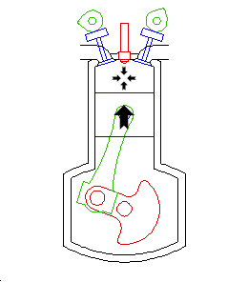
Diesel’s compression engine (2)
Rudolph Diesel created an engine that ignited fuel by compression alone.
Requires high pressure to compress the fuel, so robust construction;
Noisier;
Incomplete combustion is more likely and causes sooty emissions.
intake → compression → injection → power → exhaust
Compression:
The piston rises;
Compressing the air, and thus;
Increasing temperature.
At the end of the compression stroke the air is hot enough to ignite fuel.
Energy Systems & Sustainability, 2/e, Chapter 8; http://www.animatedengines.com/diesel.html

Slide 20
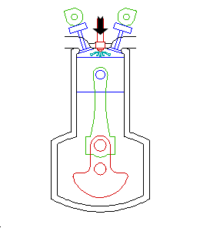
Diesel’s compression engine (3)
Rudolph Diesel created an engine that ignited fuel by compression alone.
Requires high pressure to compress the fuel, so robust construction;
Noisier;
Incomplete combustion is more likely and causes sooty emissions.
intake → compression → injection → power → exhaust
Injection:
Near the top of the compression stroke,
The fuel injector drives fuel into the cylinder;
Fuel ignites on contact with hot air.
Energy Systems & Sustainability, 2/e, Chapter 8; http://www.animatedengines.com/diesel.html

Slide 21
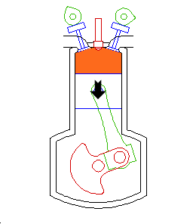
Diesel’s compression engine (4)
Rudolph Diesel created an engine that ignited fuel by compression alone.
Requires high pressure to compress the fuel, so robust construction;
Noisier;
Incomplete combustion is more likely and causes sooty emissions.
intake → compression → injection → power → exhaust
Power:
Combustion in the cylinder causes gases to expand;
Driving the piston down.
Energy Systems & Sustainability, 2/e, Chapter 8; http://www.animatedengines.com/diesel.html

Slide 22
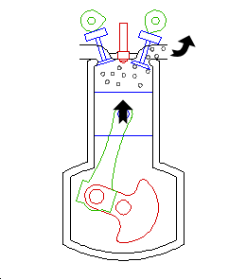
Diesel’s compression engine (5)
Rudolph Diesel created an engine that ignited fuel by compression alone.
Requires high pressure to compress the fuel, so robust construction;
Noisier;
Incomplete combustion is more likely and causes sooty emissions.
intake → compression → injection → power → exhaust
Exhaust:
The exhaust valve opens;
And exhaust is driven out the cylinder as the piston rises.
Energy Systems & Sustainability, 2/e, Chapter 8; http://www.animatedengines.com/diesel.html

Slide 23
Diesel engines dominate shipping
The nearly 40% efficiency of diesel engines and their pumpable liquid fuel made them the dominant engine for shipping.
Though diesel fuel is 3-4 times as expensive than coal.
Diesel engines still power nearly all commercial shipping.
Heat produced by the massive engines produces steam for electric production.
With electricity, total efficiency is ~ 50%.
Marine diesels tend to run on the least expensive oil with high sulfur content & thus produce high levels of air pollution.
Energy Systems & Sustainability, 2/e, Chapter 8

Slide 24
Diesel trains, planes & automobiles
Diesel engines have also been adapted for use in most forms of transportation.
Air travel is now dominated by jet engines.
Diesel trains increased fuel economy tremendously.
Diesel cars & trucks have higher fuel efficiency, but produce higher levels of particulate emissions than gasoline engines.
VW scandal
Energy Systems & Sustainability, 2/e, Chapter 8

Slide 25
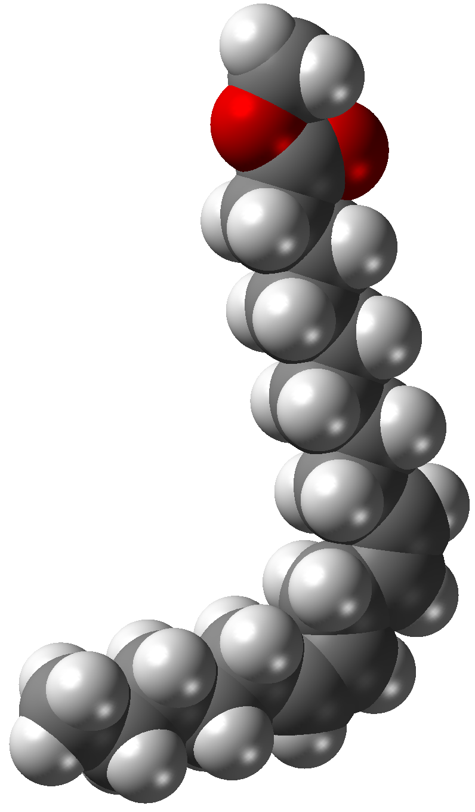
Biodiesel
Biodiesel (aka fatty acid methyl ester (FAME))
Chemically modified vegetable oil
Can be produced from virgin oil or used (waste) vegetable oil (WVO)
Viscosity less than straight vegetable oil (SVO)
Replaces petroleum diesel fuel
Burns cleaner than petro-diesel
Non-toxic & biodegradeable
Often blended with petro-diesel: B5 – B100
EROEI ~2.5 – 3
Higher EROEI if made from waste (used) oil
Energy Systems & Sustainability, 2/e, Chapter 8; Pahl (2005); wikipedia

Slide 26
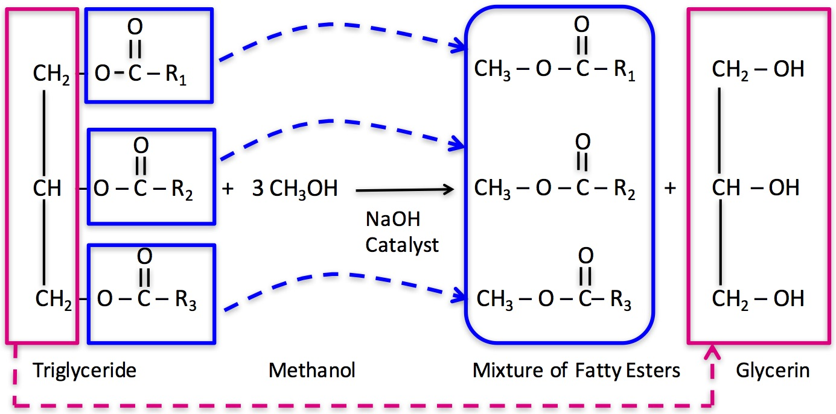
Biodiesel transesterification
Transesterification: the chemical reaction that produces biodiesel from triacylglycerol
70%
30%
https://www.e-education.psu.edu/egee439/sites/www.e-education.psu.edu.egee439/files/8.b.jpg

Slide 27
8. Engines
8.4 Reducing pollution

Slide 28
Pollutants from combustion of petroleum
Air pollutants produced by combustion of petroleum fuels include:
Carbon dioxide (CO₂)
Carbon monoxide (CO)
Hydrogen gas (H₂)
Sulfur oxides (SOx)
Nitrogen oxides (NOx)
GHG
Toxic (modifies hemoglobin)
Forms acid rain
Forms smog
Energy Systems & Sustainability, 2/e, Chapter 8

Slide 29
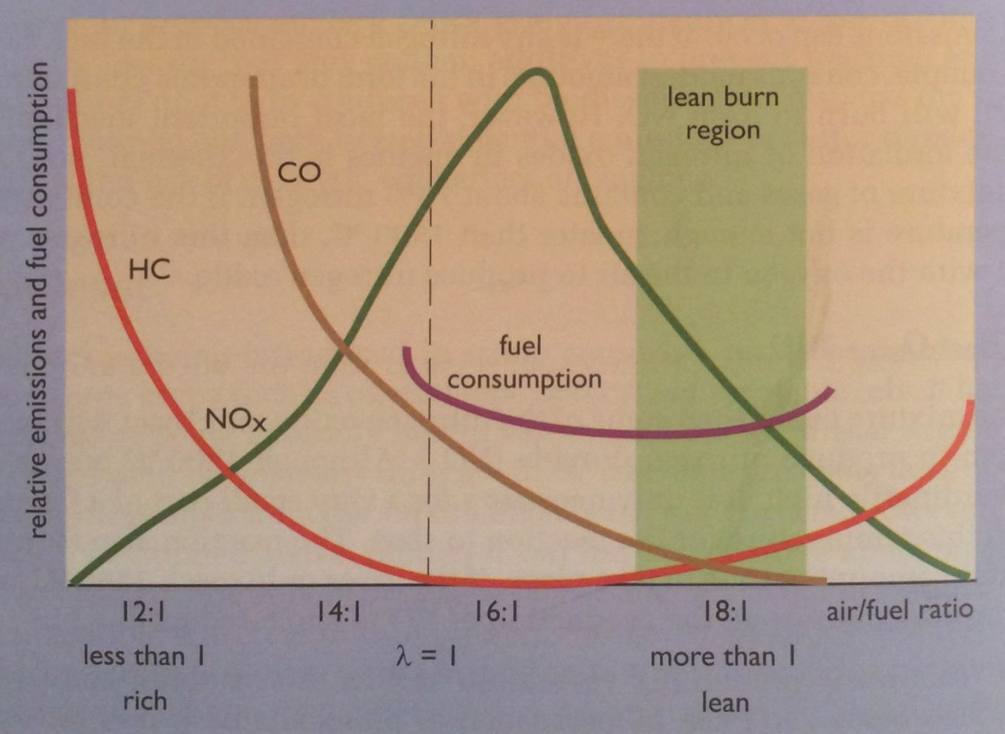
Lean engines minimize NOx
Controlling the ratio of fuel to oxygen used in the engine’s combustion reaction minimizes formation of pollutants by optimizing the stoichiometry of the combustion reaction.
‘Lean’ (aka high) air: fuel ratios cause complete combustion & minimize formation of CO and particulates (soot).
But lean mixtures burn hot and produce high levels of NOx.
At the right ratio (~20:1) combustion happens so quickly that there isn’t enough time for much NOx to form.
Energy Systems & Sustainability, 2/e, Chapter 8

Slide 30
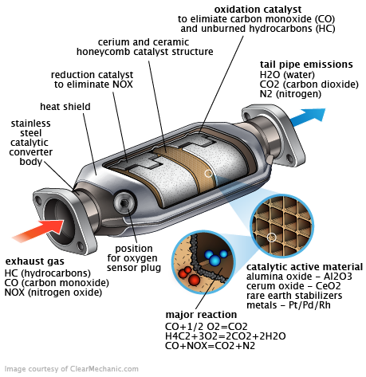
3-way catalytic converter
Catalyst: a substance that increases the rate of a chemical reaction but isn’t changed by the reaction
Catalytic converters use three catalysts to chemically destroy air pollutants.
Platinum (Pt) & Paladium (Pd)
Oxidize unburned hydrocarbons & CO to CO₂
Rhodium (Rh)
Converts NOx to N₂ & O₂
Energy Systems & Sustainability, 2/e, Chapter 8

Slide 31
Diesel engines: more pollution
Diesel engines produce more pollution than gasoline engines.
Particulates (soot) can be reduced with:
Better management of air:fuel ratios
Filters
Oxidizing catalytic converters
Require low-sulfur diesel fuel
NOx?
Diesel engines produce higher levels of NOx than gasoline engines.
Recently, a number of European cities have banned diesel engines because of air pollution concerns, particularly particulates.
Bans will be phased in slowly.
Energy Systems & Sustainability, 2/e, Chapter 8

Slide 32
Optimizing efficiency & pollution
When petro engines are run at full capacity and their most efficient rotational speed they are most efficient and produce the fewest pollutants.
One solution: hybrid petro-electric
Uses petroleum fuel only under the optimal conditions & charges a battery under those conditions.
Uses the battery when petroleum fuel use would be inefficient or more polluting.
Energy Systems & Sustainability, 2/e, Chapter 8

Slide 33
8. Engines
8.5 Gas turbines

Slide 34
Developmental mirror?
In 1884 Norwegian Egidius Elling proposed a gas turbine, but could not build it because metals would have failed at the high temperatures of continuous combustion.
Instead, he created the steam injected gas turbine:
Used fuel to heat a water jacket, producing steam;
Jet of steam + exhaust gases powered turbine.
Not truly competitive with steam & diesel turbines.
Energy Systems & Sustainability, 2/e, Chapter 8

Slide 35
Rival jet engines for aircraft
In the 1930s with war looming, engineers were looking for a faster alternative to the propeller engine. Germany & England both developed jet engines.
Continuous air intake compressed with a turbine.
Fuel injected into the compressed air & ignited.
Hot exhaust gases expanded through an output turbine, producing thrust.
Some force used to drive the air compressing turbine.
Energy Systems & Sustainability, 2/e, Chapter 8

Slide 36
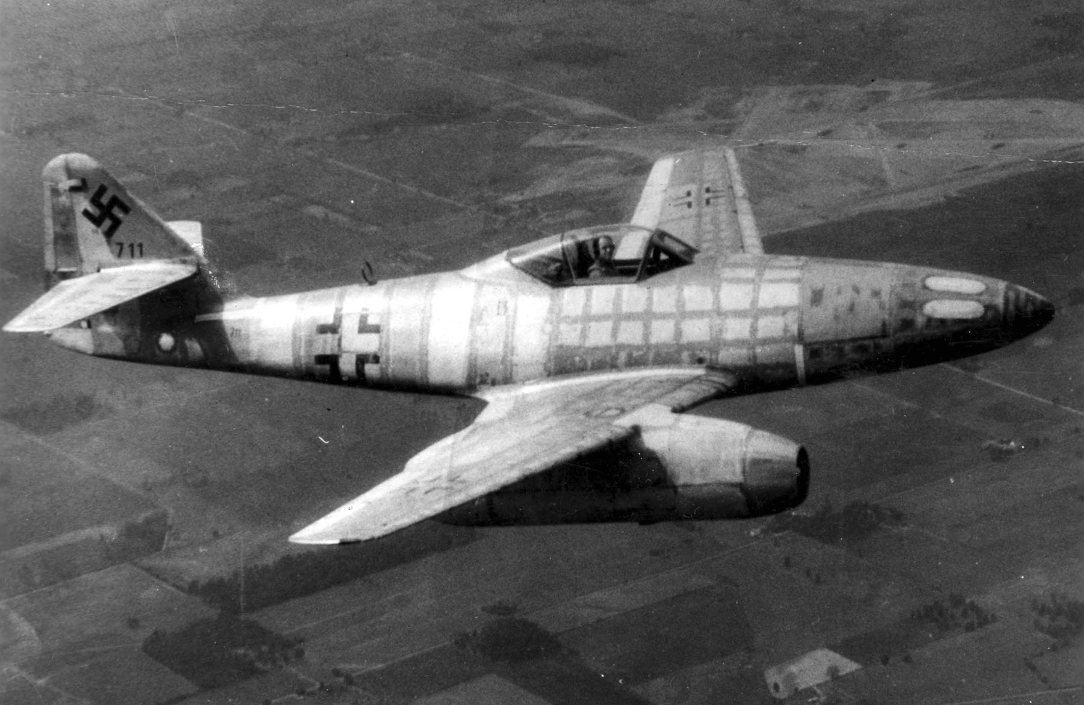
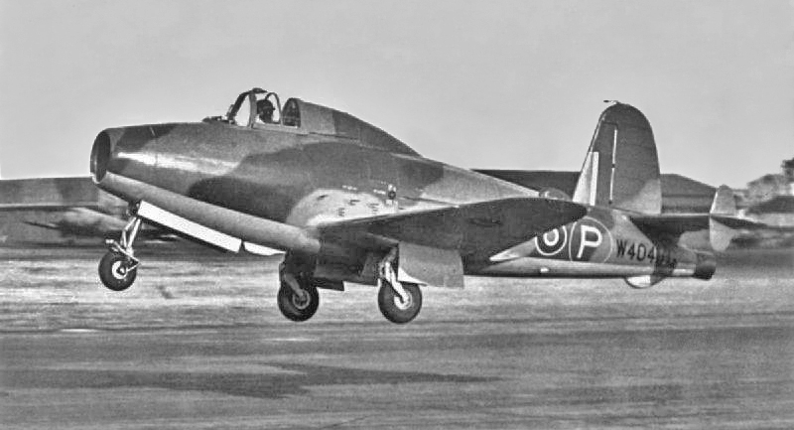
Rival jet engines for aircraft
Rival aircraft were in use at the close of the war.
20% faster
Kerosene vs. high-octane fuel
Messerschmidt 262 (1942)
Gloster Meteor (1943)
https://en.wikipedia.org/wiki/Messerschmitt_Me_262; https://richardedwardsinfo.files.wordpress.com/2013/11/gloster-pioneer-e28-39.jpg

Slide 37
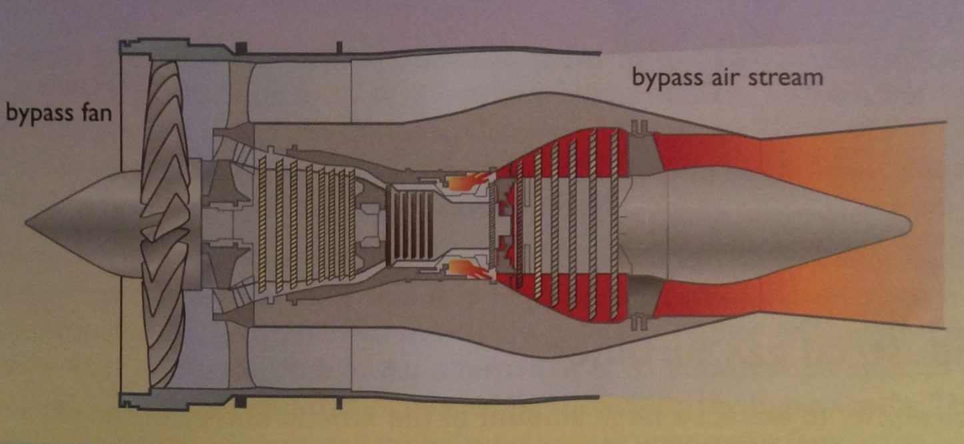
Modern turbofan engines (1)
Modern turbofan engines have wider profiles and bypass fans.
80% of air taken in is funneled through a narrowing bypass stream that flows around the exterior of the engine.
This bypass air stream produces 80% of the thrust.
20% of air is funneled into the engine for combustion of fuel.
Produces only about 20% of the thrust.
2.5X more efficient than early jet engines.
Fig 8.18=
Energy Systems & Sustainability, 2/e, Chapter 8

Slide 38
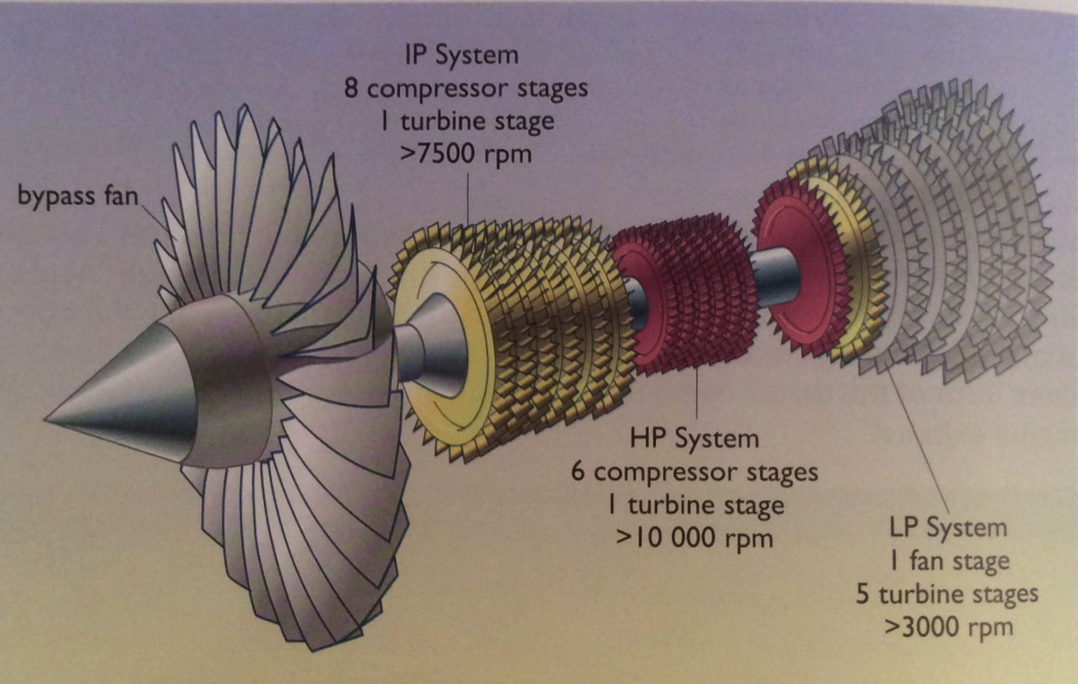
Modern turbofan engines (2)
Turbofan design uses different speeds to achieve maximum efficiency.
Rolls-Royce Trent engine
Energy Systems & Sustainability, 2/e, Chapter 8

Slide 39
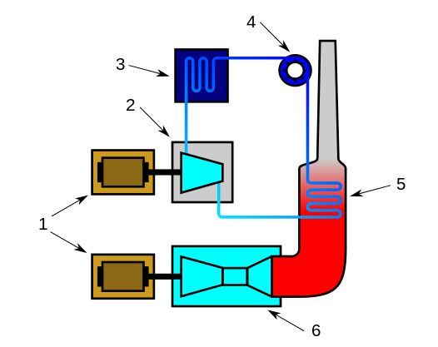
Combined cycle gas turbine (CCGT)
CCGT systems improve the efficiency of electric generation by using waste heat to increase power generation.
Gas turbine → waste heat → steam → steam turbine
Overall efficiency of > 50%
Electric generators
Steam turbine
Condenser
Pump
Boiler / heat exchanger
Gas turbine
Energy Systems & Sustainability, 2/e, Chapter 8; https://en.wikipedia.org/wiki/Combined_cycle

Slide 40
8. Engines
8.6 Stirling engines

Slide 41
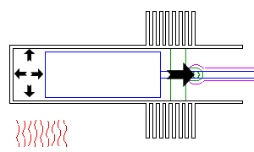
External combustion: Stirling engine (1)
The Stirling engine is an external combustion engine.
4 phases: expansion → transfer → contraction → transfer
Expansion:
Heat applied to the outside of the cylinder causes the gas to expand.
The piston is pushed outward.
Linkage between the piston & displacer is 90° out of phase.
piston
displacer
Energy Systems & Sustainability, 2/e, Chapter 8; http://www.animatedengines.com/stirling.html

Slide 42
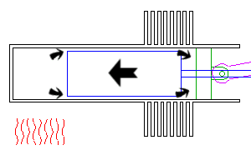
External combustion: Stirling engine (2)
The Stirling engine is an external combustion engine.
4 phases: expansion → transfer → contraction → transfer
Transfer:
The flywheel continues to move the piston outward.
Hot gas escapes around the displacer to the cool end of the cylinder.
Energy Systems & Sustainability, 2/e, Chapter 8; http://www.animatedengines.com/stirling.html

Slide 43
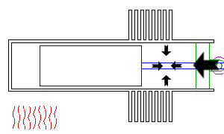
External combustion: Stirling engine (3)
The Stirling engine is an external combustion engine.
4 phases: expansion → transfer → contraction → transfer
Contraction:
The cooling gas contracts,
Drawing the piston down into the cylinder.
Energy Systems & Sustainability, 2/e, Chapter 8; http://www.animatedengines.com/stirling.html

Slide 44
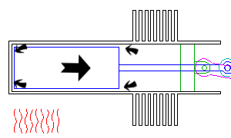
External combustion: Stirling engine (4)
The Stirling engine is an external combustion engine.
4 phases: expansion → transfer → contraction → transfer
Transfer:
The flywheel moves the piston inward.
The displacer falls into the vacumn,
Carrying the cooled gas to the warm end.
Energy Systems & Sustainability, 2/e, Chapter 8; http://www.animatedengines.com/stirling.html

Slide 45
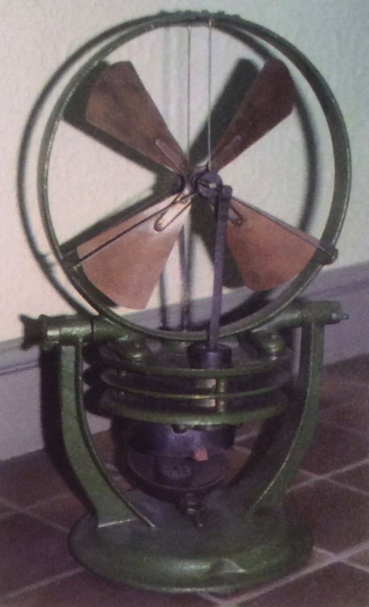
Commercial use of Stirling engines
Through the 1800s and early 1900s, Stirling engines competed with steam engines.
Less dangerous because no steam pressure.
Popular in small, home applications
Philips engine: a Dutch adaptation of the Stirling that used modern steel & replaced air with H₂ or He.
Outpaced by small electric engines.
Very effective heat pump.
Energy Systems & Sustainability, 2/e, Chapter 8; http://www.animatedengines.com/stirling.html

Slide 46
Stirling solar electricity (Ripasso dish)
Stirling solar power: (Ripasso dish) a dish of mirrors focuses solar rays on a Stirling engine and drive production of electricity.
Temperatures as high as 500°C
Efficiencies of 34%
Given near constant sunlight, one 100 m² dish can produce 75 – 85 MW per year.
Energy Systems & Sustainability, 2/e, Chapter 8

Slide 47
Stirling CHP
Because Stirling engines are quiet and robust, they are being looked at as candidates for residential micro-CHP in the UK, Canada…
Gas boiler that also creates electricity
Size of a washing machine
4-cylinder engine heated by NG
1 kW generation
Energy Systems & Sustainability, 2/e, Chapter 8

