Slide 1
SSC 2030: Energy Systems & Sustainability
9. Electricity
9.2 Making electricity in 19th century
9.3 Continuing development of electric light
9.4 Electric traction
9.5 Expanding uses
9.6 Large-scale generation
9.7 Transmission & distribution
9.8 Running the system
9.9 Electricity around the world
9.10 Electricity storage!

Slide 2
9. Electricity
9.2 Making electricity in the 19th century

Slide 3
Batteries & ‘chemical’ electricity (1)
Sir Humphry Davy (1778-1829)
Described the basic properties of a battery.
Voltage would occur between two ‘dissimilar’ metals connected by wire and dipped in an electrolytic solution.
Used a 2000-cell battery to power a carbon arc lamp: long spark arcs between two carbon electrodes in proximity.
A stream of white hot carbon particles carries the stream of electrons between electrodes.
Later evolved into the fluorescent tube
Worked with electrolysis to smelt metals directly, making pure metals from dilute solutions of salt
Energy Systems & Sustainability, 2/e, Chapter 9

Slide 4
Batteries & ‘chemical’ electricity (2)
More advanced primary cell battery designs (non-rechargeable):
1839 William Grove: Zn / Pt battery using acid solutions as electrolytes.
Developed commercially & powered the telegraph
Grove also developed a H / O ‘gas battery’ (aka fuel cell) though he didn’t try to commercialize it.
1868 Georges Leclanché developed a Zn / C dry cells battery that became widely used as alkaline batteries were in the 20th century
Energy Systems & Sustainability, 2/e, Chapter 9

Slide 5
Electromagnetism & production of current
1820: Andre-Marie Ampere founded the science of electromagnetism
When a wire carrying a current is placed parallel to a second conducting wire, a force is exerted between the wires.
He called the force the ampère (aka amp).
Electromagnets could be made by using iron as the core of a coil of copper wire.
Used to attract or repel other magnets and cause motive force.
1831: Michael Faraday showed that movement of a magnet through a coil of wire produced amps, a current or flow of electricity.
Developed the dynamo that produced continuous electric current by moving a coil of wire in a magnetic field.
Energy Systems & Sustainability, 2/e, Chapter 9

Slide 6
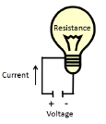
Electrical energy; quick review
Current: flow of electrons (Amp, A; I)
Voltage: electrical pressure (Volts, V)
Resistance: acts like friction, slows flow (Ohms, Ω; R)
Property of electric material or device.
Governs how much current will flow when a voltage is applied.
Transmission wire has resistance.
V = (I)(R)
I = V/R
power (P) = (V)(I) = I²R
Energy Systems & Sustainability, 2/e, Chapter 9

Slide 7
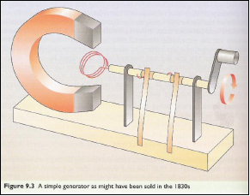
Electric motors & generators
Electric current is induced by the change of the magnetic field in a coil.
The crank moves the coil in the field produced by the magnet.
The metal springs that contact the rotating shaft pick up the current & allow it to be harvested.
This device makes alternating current (AC).
Addition of a commutator allows production of direct current (DC).
Energy Systems & Sustainability, 2/e, Chapter 9

Slide 8
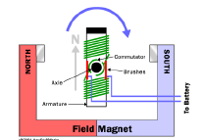
Generator vs. motor?
What’s the difference between a generator and a motor?
Generator: Rotating coils of wire through a magnetic field induces a current in the wire, producing electricity
Motor: Running a current through a wire produces forces that can cause rotation, or mechanical motion, thus work
Energy Systems & Sustainability, 2/e, Chapter 9

Slide 9
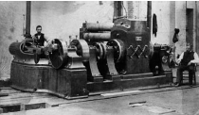
Mains electricity
Thomas Edison developed:
The electric light bulb; and
Steam powered dynamos capable of converting mechanical energy into electrical energy.
Mains electricity: the general purpose electric supply
Edison set up the first power distribution system using DC current.
Used batteries to meet peak power demand.
Energy Systems & Sustainability, 2/e, Chapter 9

Slide 10
Electrical lighting was the driver for mains
The brilliant light of the arc lamp was sought after for special uses like lighthouses. At first, steam-powered generators were used for power.
Lighter electromagnets allowed generators to replace steam.
1878: generators & arc lamps were competing with street gas light.
Smaller-scale & domestic lighting?
1878: Swan introduces the incandescent light bulb, carbon fiber in an evacuated glass bulb that glowed when current was run through it.
1883: After an acrimonious patent fight, Edison (filament) & Swan (vacuum) joined forces in the Edison & Swan United Electric Light Co. Ltd.
1880s: Edison sets up lighting supply companies in London & NY using dynamo plants, cables and bulbs → lighting rush.
1882: London requires companies to get permission before digging up the streets to lay cable.
Energy Systems & Sustainability, 2/e, Chapter 9

Slide 11
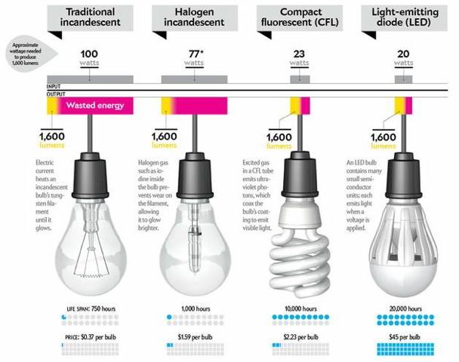
Electric lighting: quick comparison
https://static1.squarespace.com/static/
5537e356e4b07cdf87217594/t/55380489e4b002ebf3fac72c/1429734542343/

Slide 12
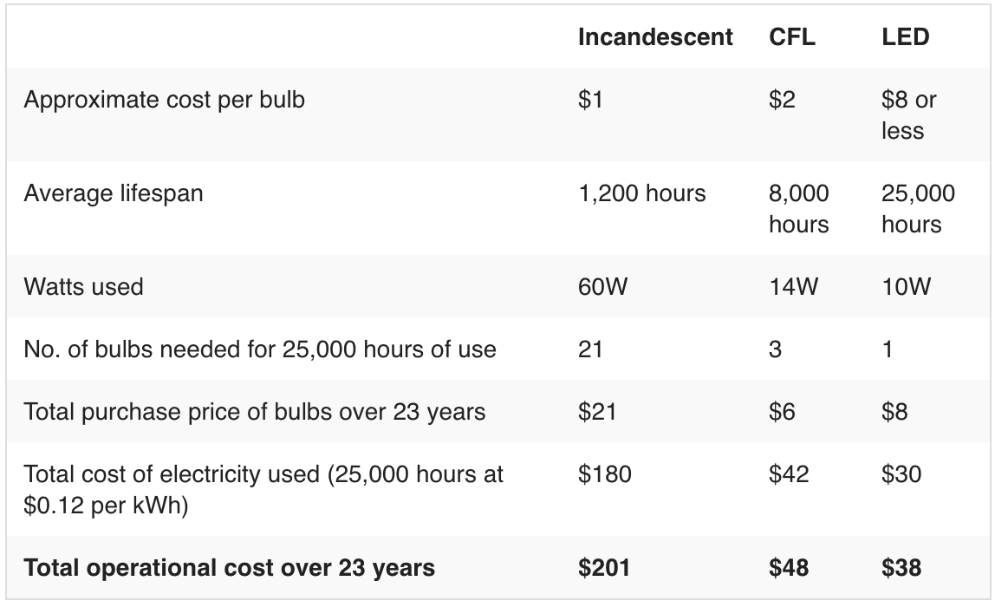
Electric lighting: quick comparison
https://www.thesimpledollar.com/the-light-bulb-showdown-leds-vs-cfls-vs-incandescent-bulbs-whats-the-best-deal- now-and-in-the-future/

Slide 13
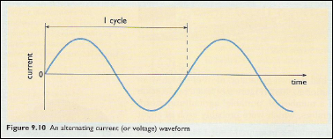
Alternating vs. direct current
Direct current: current that runs continually in a single direction
Example: from a battery or fuel cell
Championed by Edison & the early US standard
**Not easily converted to higher and lower voltages
Alternating current: reverses direction a number of times per second, 60 times/second in the US
Can be converted to different voltages using a transformer.
Championed by Nikola Tesla & George Westinghouse
Led to the ‘War of the currents’ in the 1890s.
AC won.
Energy Systems & Sustainability, 2/e, Chapter 9; https://energy.gov/articles/war-currents-ac-vs-dc-power

Slide 14
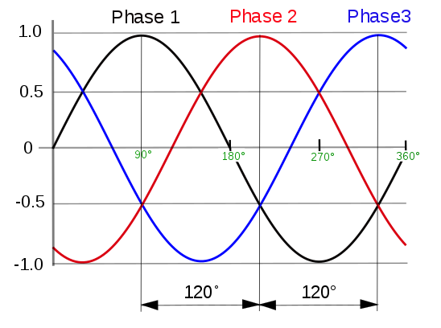
AC & three-phase power
Nikola Tesla
Developed motors that run on AC electricity.
Developed the foundation for three-phase power and AC power distribution.
Three-phase power: a poly-phase power distribution used for AC power generation, transmission & distribution
Late 1880s
Uses less conductor material
Consistent supply of power (average peak)
Generated & transmitted at high voltage & then stepped down for local use.
Energy Systems & Sustainability, 2/e, Chapter 9; wikipedia

Slide 15
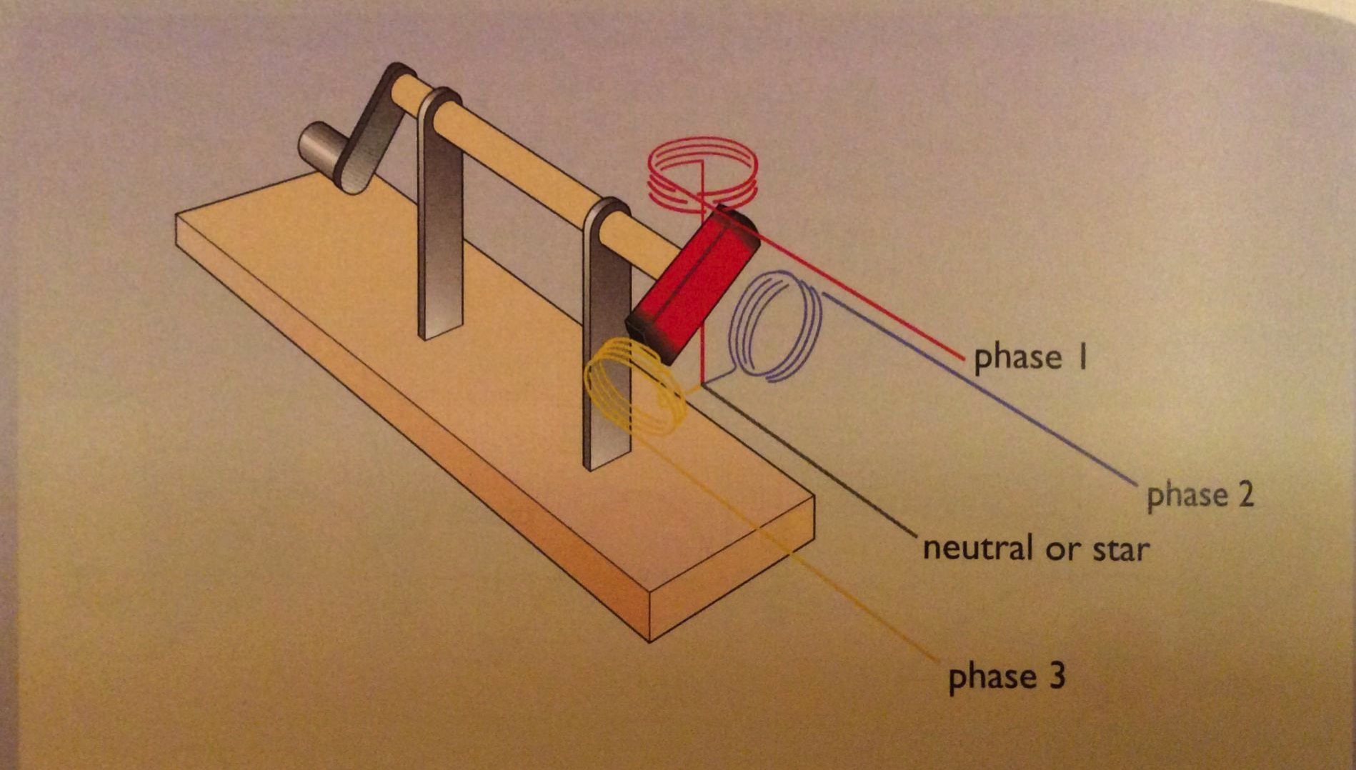
Three-phase power: generation
Alternator: three coils of wire are placed around a rotating magnet; each coil will produce a cycling voltage as the magnet passes it.
The three voltages will be ‘out of phase’ with one another.
Energy Systems & Sustainability, 2/e, Chapter 9

Slide 16
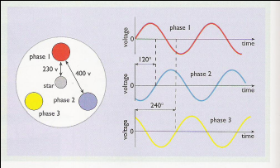
Three-phase power: uses
Three-phase power is used for ‘heavy’ uses of electricity:
Long-distance transmission of electricity;
Industrial motors;
Some household uses
Energy Systems & Sustainability, 2/e, Chapter 9

Slide 17
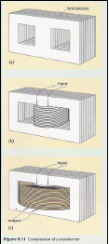
Transformers change voltage
Transformer: an electrical device that transfers energy between two or more circuits through electromagnetic induction
Transformers have two sets of ‘windings’.
A magnetic field in one set of windings produces voltage in the second set of windings.
Voltage is ‘stepped’ up or down.
Vs = Ns
Vp Np
Vs = voltage in secondary windings
Ns = number turns in secondary windings
Vp = voltage in primary windings
Np = number of turns in primary windings
Energy Systems & Sustainability, 2/e, Chapter 9

Slide 18
Why transformers were critical
Transmission of electricity is more efficient & less expensive at higher voltages: smaller wire is needed & loss still leaves useful power.
DC power can’t be stepped up & down, so must be transmitted at the voltage needed by the end user.
This would take a very thick cable.
Distance of transmission limited to about 2 km.
AC power can be stepped up & down with transformers so it can be distributed at > 400 kV more efficiently & only stepped down at the point of use.
US: overhead transmission at 220 kV; underground at 132 kV
Very long distance transmission uses 800 kV or more
Energy Systems & Sustainability, 2/e, Chapter 9

Slide 19
Primary energy sources for US electricity
In 2016, US electricity was generated from these sources:
Energy source | % total US electric generation
NG | 33.8
coal | 30.4
nuclear | 19.7
renewable energy | 14.9
hydro 6.5%
wind 5.6%
biomass 1.5%
solar 0.9%
geothermal 0.4%
petroleum | 0.6
other gas (biogas) | 0.3
other non-renewable | 0.3
pumped storage hydro | -0.2*
* Use more electricity than they produce annually.
https://www.eia.gov/tools/faqs/faq.php?id=427&t=3

Slide 20
9. Electricity
9.4 Electric traction (transportation)

Slide 21
Electric trams
We’ve seen that the first electric supply systems (grids) were built to supply lighting. But while lighting was used mainly at night, electricity had to be generated all day in order to serve the system.
What to do with electricity produced during daylight hours?
Transportation in cities!
Electric transportation cut down on horse pollution.
Horse-draw trams were electrified in the 1880s through early 1914.
Petro-fueled buses have replaced some electric systems.
Energy Systems & Sustainability, 2/e, Chapter 9

Slide 22
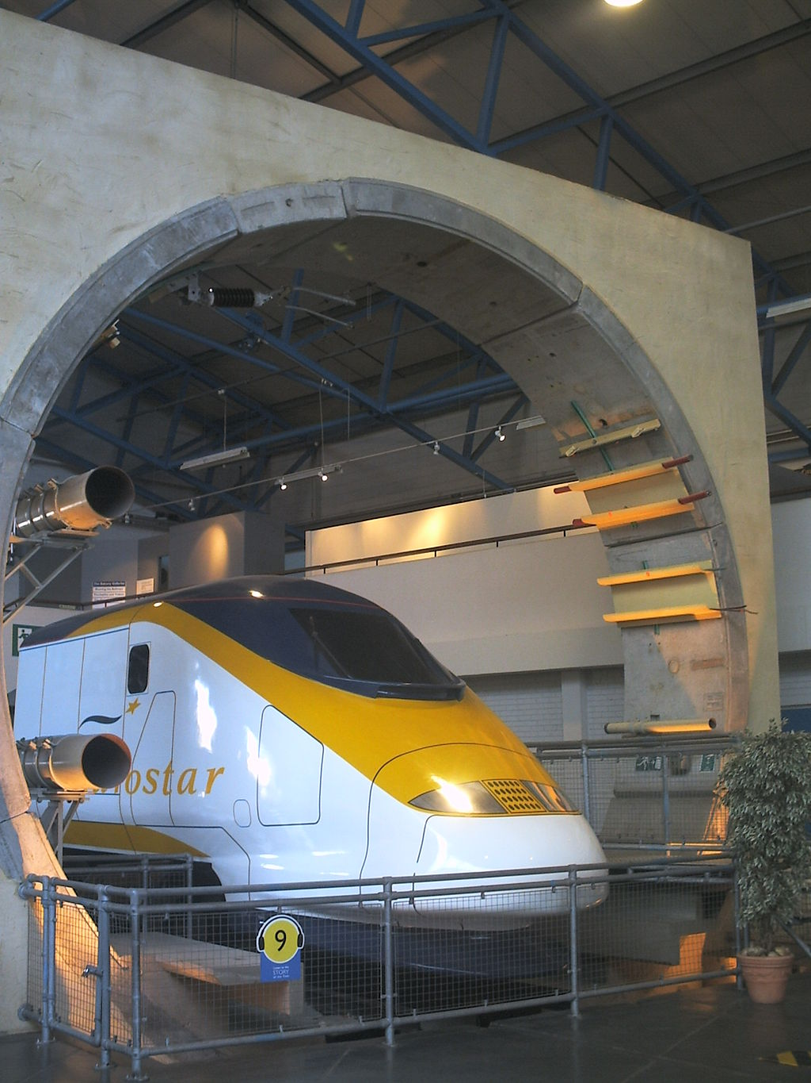
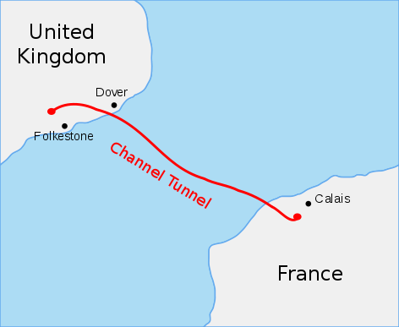
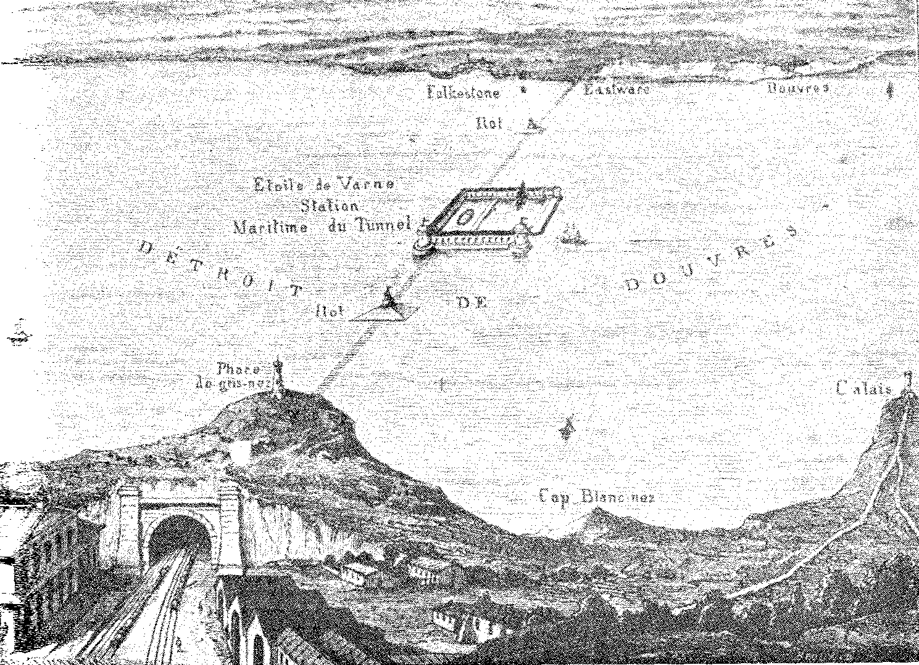
Electric trains
Mains electricity & powerful electric motors allowed trains to be run underground where coal & steam emissions would be impossible.
Chunnel is a good example.
1856
https://en.wikipedia.org/wiki/Channel_Tunnel

Slide 23
Battery-powered vehicles
1899: Jenztzy created a 1.5 tonne car powered by a 50 kW motor &
lead-acid batteries
1900-20: Battery-electric buses & taxis
Recently: improvements in magnets, motor / generators, batteries & regenerative braking have created the modern electric or hybrid vehicle.
Energy Systems & Sustainability, 2/e, Chapter 9

Slide 24
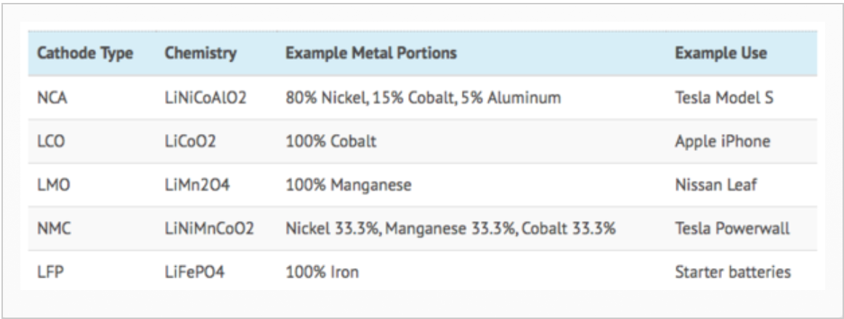
Lithium-ion batteries
https://evannex.com/blogs/news/making-batteries-better- how-tesla-could-improve-electric-vehicle-lithium-ion-battery-technology

Slide 25
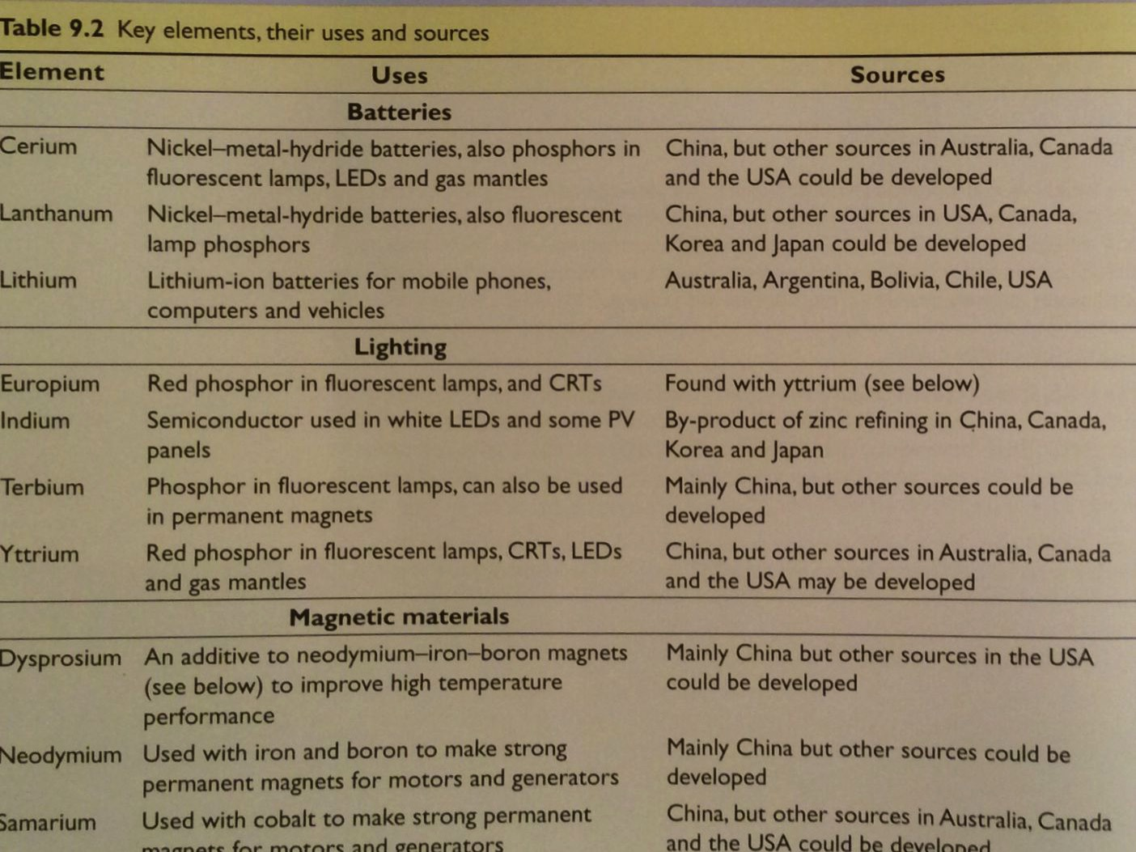
Critical elements for battery technology
Energy Systems & Sustainability, 2/e, Chapter 9

Slide 26
Hybrid electric vehicles
The idea of petro engines with electric transmission isn’t new:
1890s: French railways used steam-electric system in the 1890s.
1905: diesel-electric buses
Toyota Prius uses parallel-hybrid drive (either or both motors), 58 mpg:
1.8-L engine
60-kW motor
regenerative breaking
@ higher speeds; recharges battery
@ slow speeds
Plug-in hybrids get most of their power from the grid.
Petro increases range.
Energy Systems & Sustainability, 2/e, Chapter 9

Slide 27
9. Electricity
9.5 Expanding use of electricity

Slide 28
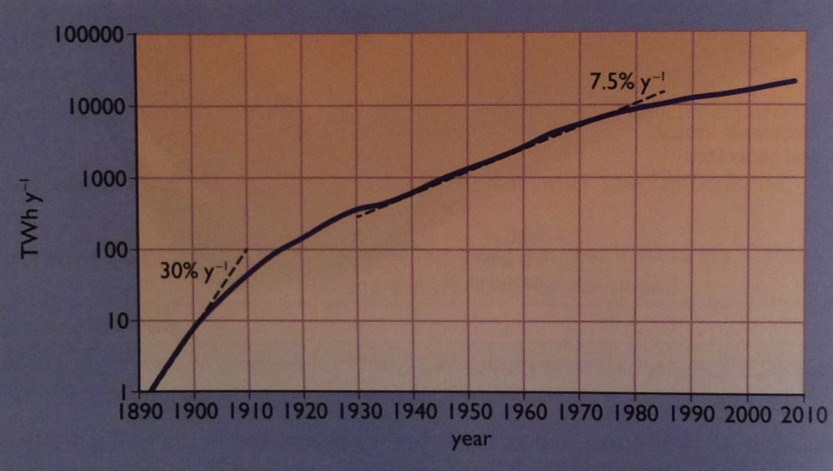
Growth of electric use & consumption
Globally, electric use has expanded at tremendous rates, though it’s now slowing.
50% of growth since 2000 has been in China.
Energy Systems & Sustainability, 2/e, Chapter 9

Slide 29
Telecommunications & computers
1887: Hertz developed a microwave transmitter; short distance.
1899: Marconi transmits across the English Channel
1907: Marconi transmits across the Atlantic
1922: British Broadcasting Company established
1950s: Transistors allowed use of batteries to power radio
Use of TV expanded
1970s: First linkage of computers over distance: email
1980s: Geostationary satellites were used to broadcast signal IBM PC
1990s: Telecommunication networks combined point-to-point microwave beams, geostationary satellites, undersea fiber-optic
cable
Cell phone networks
Energy Systems & Sustainability, 2/e, Chapter 9

Slide 30
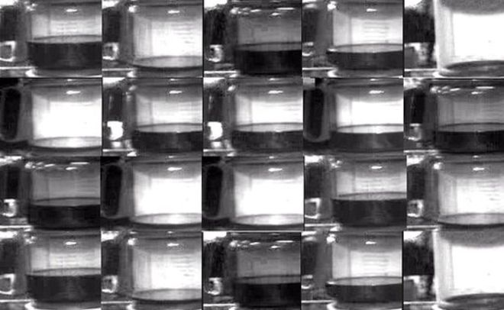
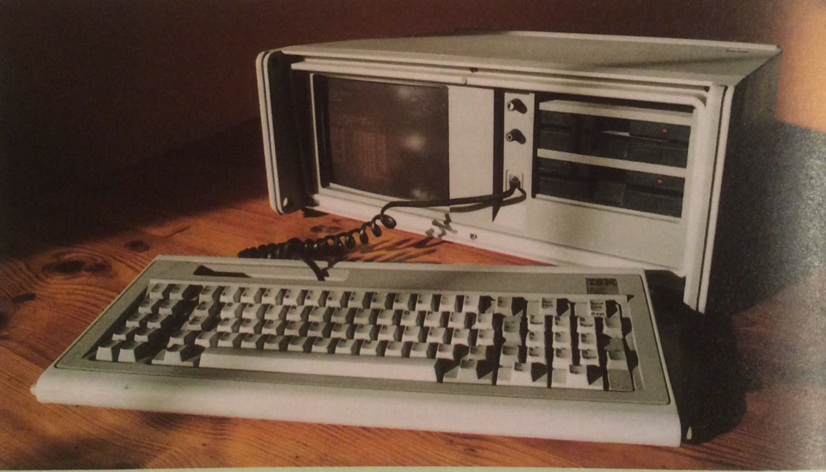
Telecommunications & computers
First webcam on the internet: Cambridge U’s Trojan coffee pot
Energy Systems & Sustainability, 2/e, Chapter 9; http://www.bbc.com/news/technology-20439301

Slide 31
Cooking & heating
1890: GE sells electric irons & immersion heaters
1894: Electric cookers for wealthy Londoners
1939: 67% of UK homes have electric & appliances more common
1947 - 74: Microwave ovens in use (US before UK)
1950s-70s: Electric heating widely used
2000s: Electric heat returns in the more efficient air-to-air heat pump
Energy Systems & Sustainability, 2/e, Chapter 9

Slide 32
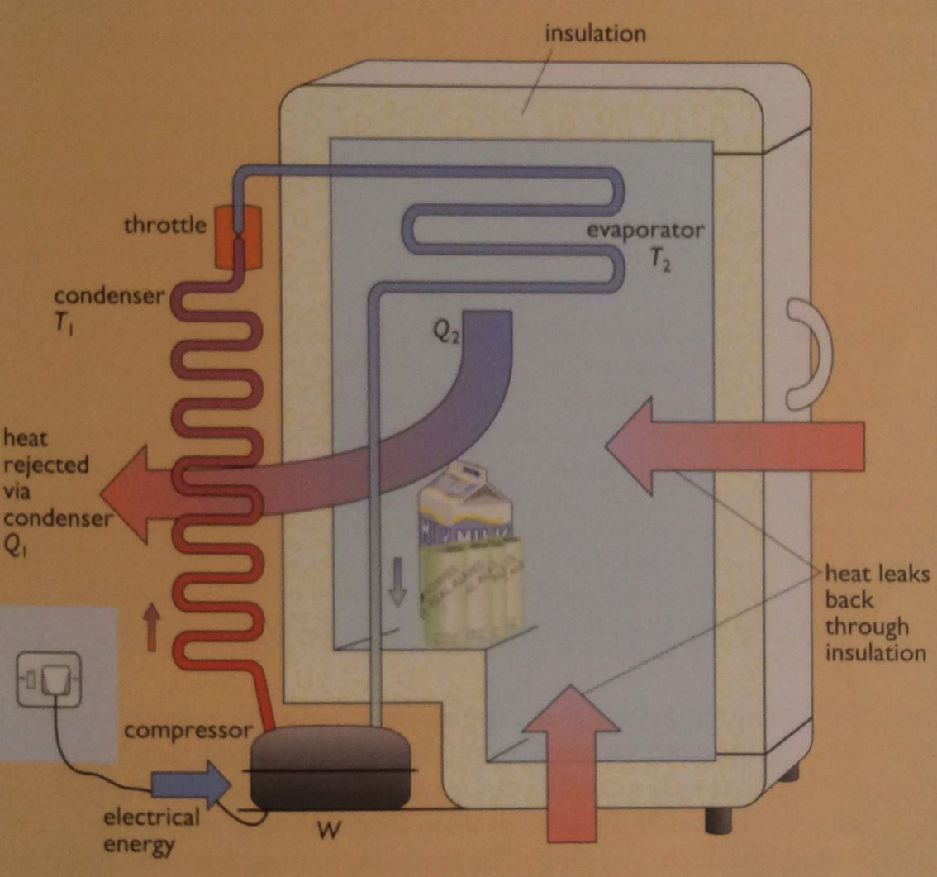
Heat pumps (refrigerant cycle)
The refrigeration cycle takes heat from cooler region and moves it to warmer regions using work / energy.
Refrigerants like isobutane have low boiling points (-12°C).
Energy Systems & Sustainability, 2/e, Chapter 9
Low-pressure refrigerant is compressed by a compressor (doing work).

Slide 33
Heat pumps (refrigerant cycle)
The refrigeration cycle takes heat from cooler region and moves it to warmer regions using work / energy.
Refrigerants like isobutane have low boiling points (-12°C).
Rising pressure increases the refrigerant’s boiling point to above room temperature causing the gas to condense to liquid in the condenser.
Energy Systems & Sustainability, 2/e, Chapter 9

Slide 34
Heat pumps (refrigerant cycle)
The refrigeration cycle takes heat from cooler region and moves it to warmer regions using work / energy.
Refrigerants like isobutane have low boiling points (-12°C).
As condensation occurs, the latent heat of vaporization is released, heating the space around the condenser.
Energy Systems & Sustainability, 2/e, Chapter 9

Slide 35
Heat pumps (refrigerant cycle)
The refrigeration cycle takes heat from cooler region and moves it to warmer regions using work / energy.
Refrigerants like isobutane have low boiling points (-12°C).
Condensed liquid refrigerant is forced into a spray by the throttle & moved into the evaporator where heat causes the liquid to evaporate into a gas, absorbing heat.
Energy Systems & Sustainability, 2/e, Chapter 9

Slide 36
COP: efficiency of heat pumps
The COP (coefficient of performance) of refrigerant cycles measures the efficiency of heat transfer devices
COP = Q₂
W
maximum flow of heat
work (electric power input)
COP_{max} = ____T_{hot}_ where temperature is in °K
T_{hot} – T_{cold}
European testing uses these values:
T_{hot} = 35°C (95°F or 308°K)
T_{cold} = 0°C (32°F or 273°K)
COP_{max} = ___308_ = 8.8
(308 - 273)
In practice, maximal COP is about 4.5.
In extreme cold, COP is reduced to about 1.
Annual averages are about 3.5.
https://en.wikipedia.org/wiki/Coefficient_of_performance

Slide 37
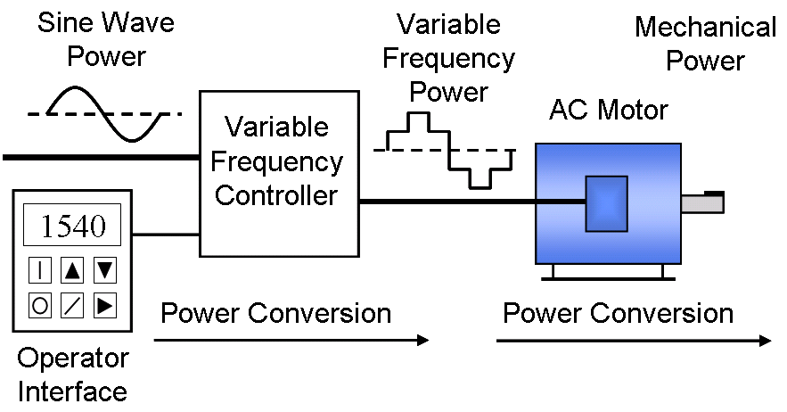
Electric motors are everywhere
That pretty much says it.
Electric motors are very efficient when run at full load
2009 census | small | medium | large
power | 10 W – 750 W | 0.75 – 375 kW | 375 – 10,000 kW-
phase, voltage | 1 ph, <240 V | 3 ph, 200 V – 1 kV | 3 ph, 1 - 20 kV
% motor energy | 9% | 68% | 23%
total stock | 2 billion | 230 million | 0.6 million
Variable-frequency drives (VFD): an adjustable speed drive used to control AC motor speed & torque by controlling input frequency & voltage
Increases efficiency
https://en.wikipedia.org/wiki/Variable-frequency_drive

Slide 38
9. Electricity
9.6 Large-scale electric generation

Slide 39
Evolution: competition vs scale
Early electric generating stations were small & DC power limited their distance from consumers.
Municipally owned & operated.
Laissez-faire capitalism caused lack of standardization or combination.
In the UK, WWI caused the nation to realize that it’s system was a crazy quilt that was difficult to expand quickly in response to the needs of war.
1926: UK created a National Grid:
Connected existing grids.
Specified power output (50 Hz) & centralized control.
Stations were still privately owned, though the small & inefficient were closed.
In 1947, after WWII, utilities were nationalized.
230 V standard was adopted
1950: 60 MW station standard → 1970: 600 MW stations
Energy Systems & Sustainability, 2/e, Chapter 9

Slide 40
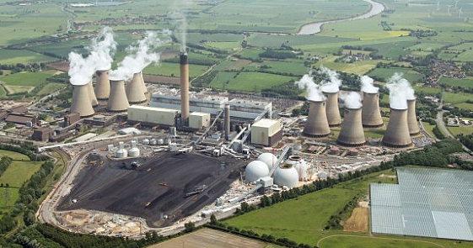
Drax Power Station, N. Yorkshire
Completed in 1986. Largest coal-fired plant in the UK.
7% of UK electricity
~ 36% efficient
Six 660 MW units = ~4GW generation capacity
10 million tonnes of coal per year.
Built close to the Selby coalfield (now closed).
Now burning a mix of domestic & imported coal.
Now burning biomass by ‘co-firing’ (12%)
3 units are biomass only.
Wood pellets from US & Canada
Energy Systems & Sustainability, 2/e, Chapter 9; https://en.wikipedia.org/wiki/Drax_power_station
http://i.dailymail.co.uk/i/pix/2015/06/07/00/29687FF600000578-3113908-image-a-1_1433632556091.jpg

Slide 41
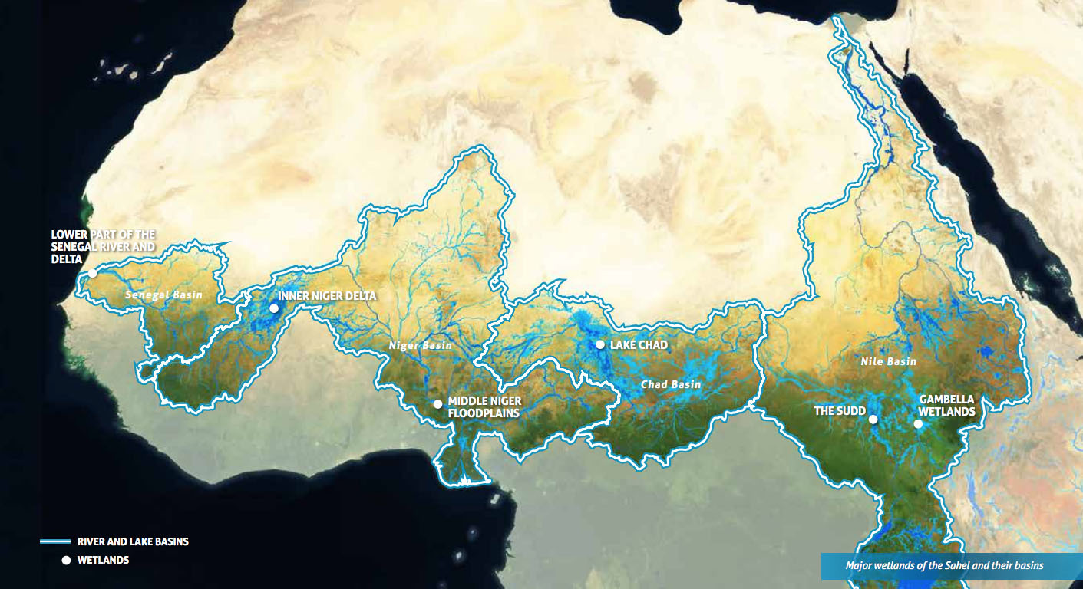
Hydropower
Capital-intensive to build but fuel is ‘free’. Many large hydropower plants were built around the world in the 20th century.
Increase energy security.
Operate 24/7 but can quickly increase output to meet peak demand.
UK (mainly Scotland) has 1.4 GW of hydroelectric + 2.7 GW of pumped hydroelectric storage.
The social & environmental impacts of large hydropower development has become controversial.
Three Gorges Dam
Ethiopia
Amazon
Energy Systems & Sustainability, 2/e, Chapter 9; https://en.wikipedia.org/wiki/Drax_power_station
http://i.dailymail.co.uk/i/pix/2015/06/07/00/29687FF600000578-3113908-image-a-1_1433632556091.jpg

Slide 42
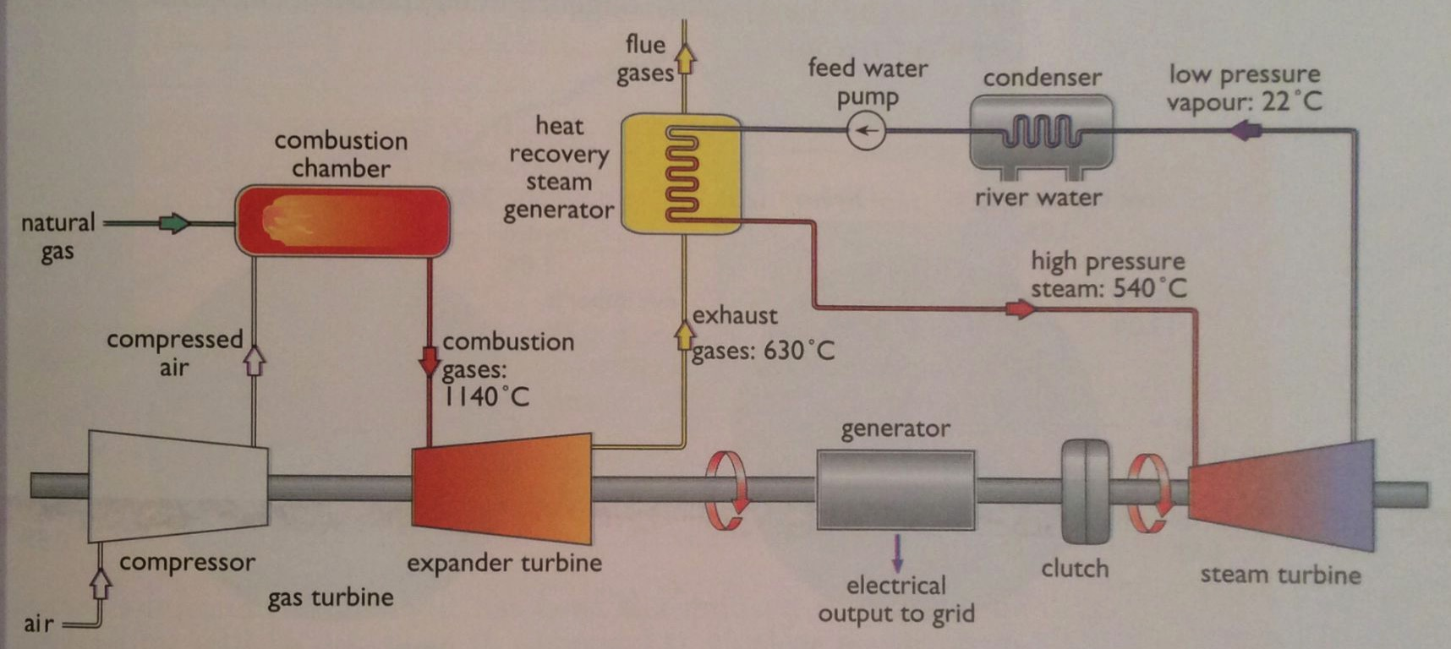
Combined cycle gas turbines
CCGT technology combust gas, runs a turbine & uses waste heat to generate steam to run a steam turbine as well.
Efficiency reaches 50%.
Can run on NG or light oil.
Energy Systems & Sustainability, 2/e, Chapter 9

Slide 43
Shoreham UK CCGT station
Built in 1999. Produces a total of 380 MW.
Tandem combined system.
15-year fixed gas contracts were available at time of building.
Gas turbine produces 240 MW.
Heat recovery steam generator uses 540°C steam.
Steam turbine produces 140 MW.
Computer controlled & run by two staff.
Energy Systems & Sustainability, 2/e, Chapter 9

Slide 44
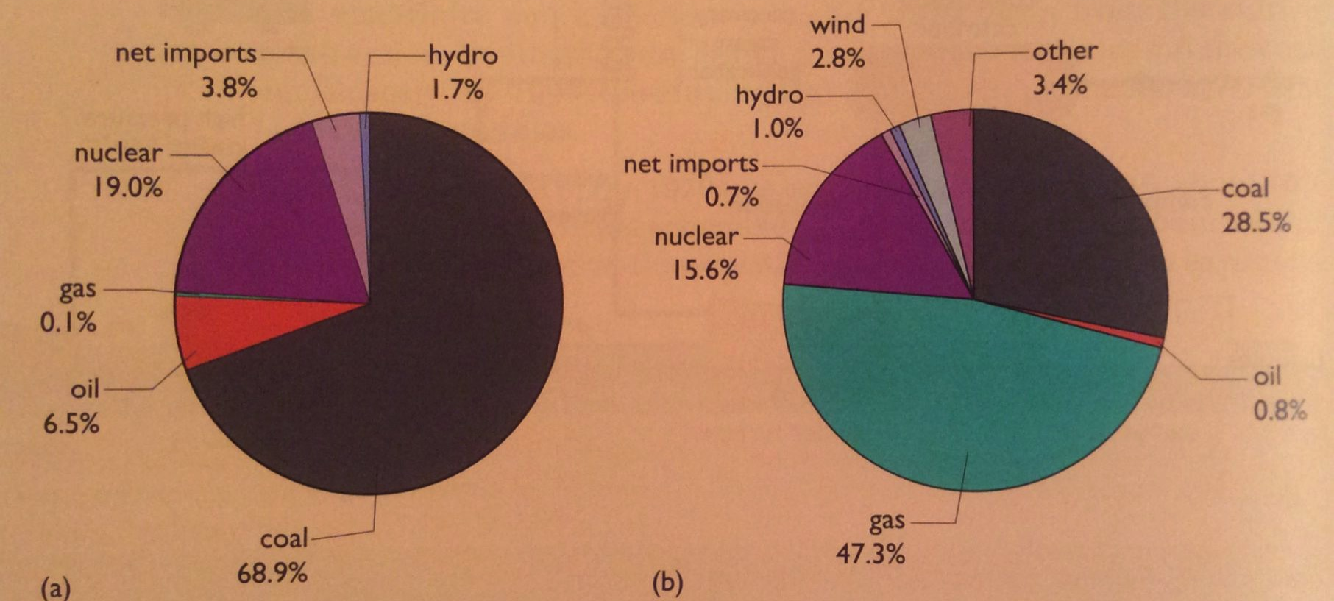
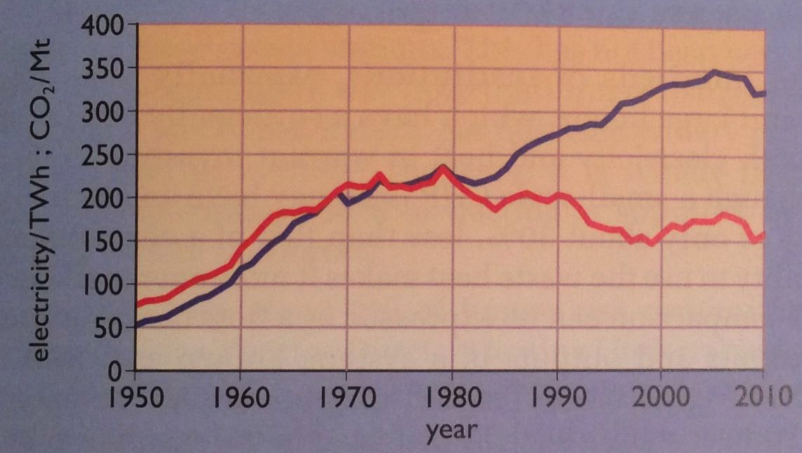
UK dash for gas
In the 20 years between 1990 and 2010, North Sea gas came to dominate UK electricity production.
1990
2010
electricity
CO₂ emissions fell significantly.
CO₂
Energy Systems & Sustainability, 2/e, Chapter 9

Slide 45
Combined heat & power (CHP)
CHP (combined heat & power) plants make electricity like other generating stations, but also use their waste heat, dramatically increasing their efficiency to ~80%.
Autoproducers are plants that make their electricity.
2009: UK had 5500 MW, mostly industrial.
Small-scale CHP are usually between 100 kW – 1 MW & powered by NG.
Large institutions: hotels, hospitals, schools..
Energy Systems & Sustainability, 2/e, Chapter 9

Slide 46
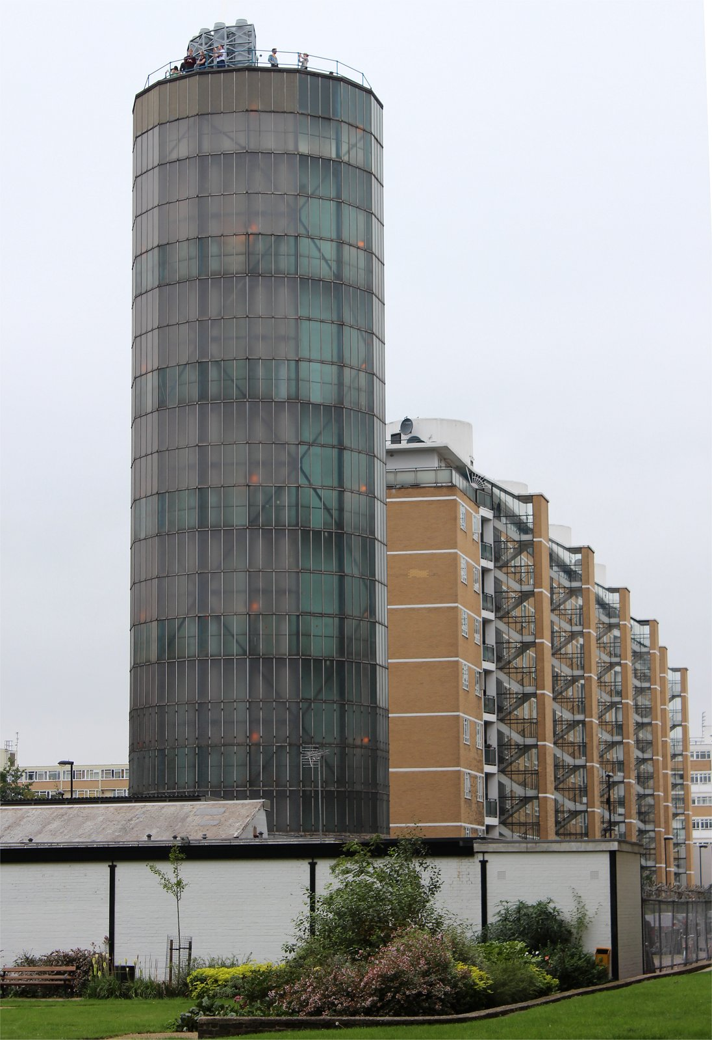
Large-scale CHP & community heating
Larger-scale CHP can produce enough heat for a community of buildings. Heat is distributed as:
Low-pressure steam at < 50°C; or
Hot water at 85-95°C.
This type of district- or community heating is widely used in Scandinavia, currently less so in the UK.
2002 study of the UK suggests that CHP district heat could produce 18 GW & heat 5 million homes 2.5 GW in London alone.
Energy Systems & Sustainability, 2/e, Chapter 9
https://folkestonejack.files.wordpress.com/2013/09/pdhu_12.jpg
The Pimlico District Heating system was built in 1951 in London.
Today powered by a 3.1 MW NG CHP plant.
3000 residences & 50 commercial customers.
‘Accumulator’ tank holds 1 days worth of heat.

Slide 47
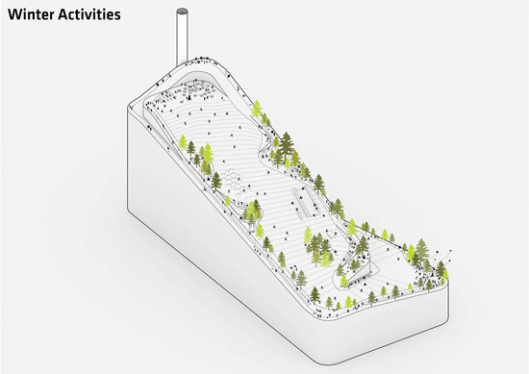
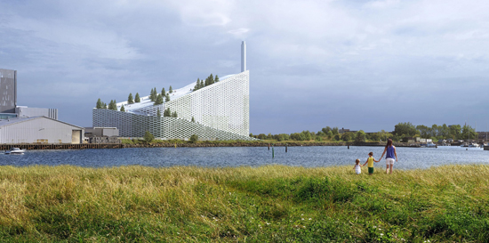
Denmark’s large-scale CHP
Copenhagen’s Avedore plants provide electricity & district heating.
Newest is biomass waste only & will heat 60,000 homes….
And provide a ski slope in winter.
http://www.volund.dk/Waste_to_Energy/References/ARC_Amager_Bakke_Copenhagen

Slide 48
9. Electricity
9.7 Transmission & distribution

Slide 49
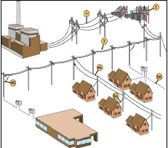
Transmission vs. distribution
Transmission lines use high voltage to minimize electrical loss.
Distribution lines use lower voltage since power loss is less of an issue.
Sub-stations use transformers to step down voltage where transmission lines meet distribution lines
Additional transformers on distribution lines step power down to the 120 V or 240 V needed for household use.
Energy Systems & Sustainability, 2/e, Chapter 9

Slide 50
Transmission loss example
Consider a power plant producing (P) of 50 MW (50 E6 W).
What is the current transmitted at a voltage of 25,000 V?
What is the current transmitted at 400,000 V?
I = P/V = 50 E6 W / 25,000 V = 2,000 A
I = P/V = 50 E6 W / 400,000 V = 125 A
Energy Systems & Sustainability, 2/e, Chapter 9

Slide 51
UK National Grid in the 1930s
In 1926 the concept of the UK’s National Grid was formalized with specifications:
AC only
50 Hz
The last DC supply in London wasn’t disconected until 1962.
There was resistance to:
Centralized (aka governmental) control;
Placement of high voltage lines & towers
While a large, interconnected grid supplies resilient power supply, problems can be as widespread as supply.
Blackouts have occurred in the UK, NY City, Auckland NZ for several weeks.
And suppliers are not always producers.
Southern England (London) imports electricity from the north.
Energy Systems & Sustainability, 2/e, Chapter 9

Slide 52
Coal by wire
Coal by wire describes the transmission of coal-fired electricity to distant users over transmission wires. The alternative would be moving the coal to the consumer.
In WWII, coal by wire freed trains to move war materials rather than coal.
New power stations were located near coal mines.
1 GW electric station requires:
10,000 tonnes of coal / day.
10 large trains per day.
Disadvantage?
When power stations are far from population centers there are fewer ways to use their waste heat.
Energy Systems & Sustainability, 2/e, Chapter 9

Slide 53
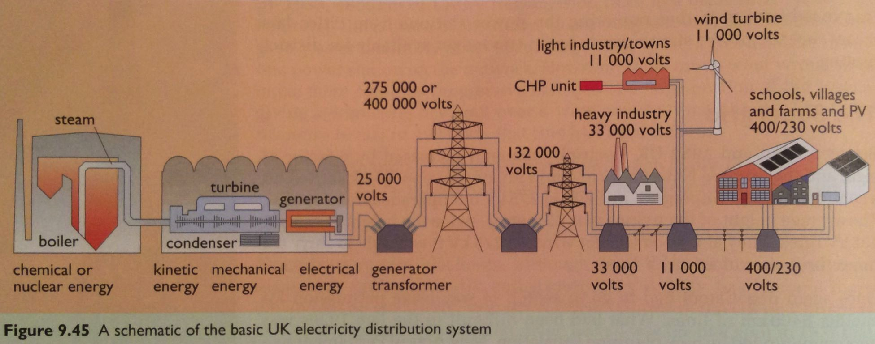
UK Supergrid
UK electric demand increased X8 between 1926 and 1950.
Construction on a new supergrid carrying a voltage of 275 kW (upgradable to 400 kV) was begun in 1964.
42-m towers
Much thicker transmission lines
Putting lines underground solves many objections, but is up to 20 times as expensive as overhead lines.
Energy Systems & Sustainability, 2/e, Chapter 9

Slide 54
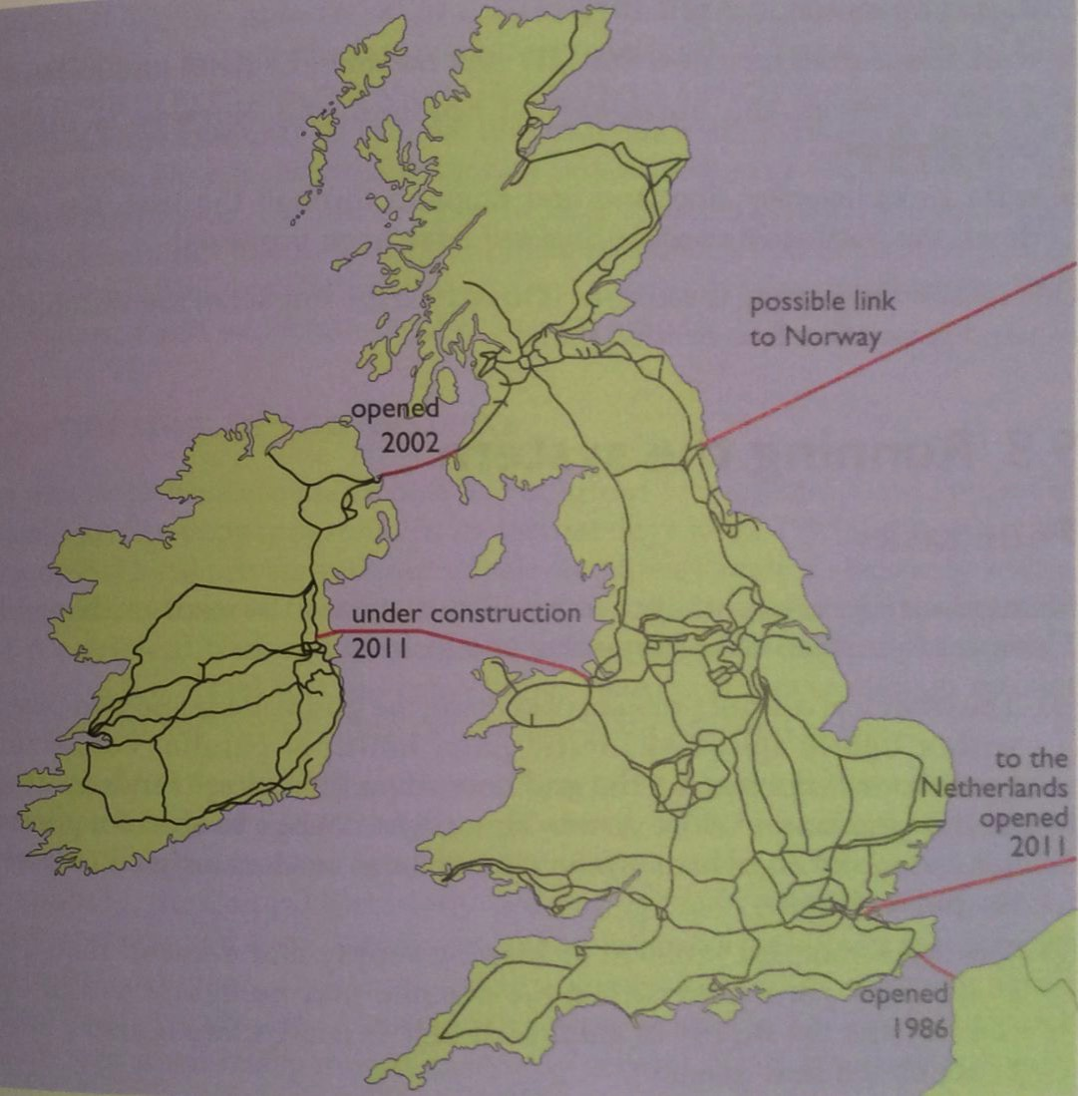
UK grid & international links
Energy Systems & Sustainability, 2/e, Chapter 9
Replaced in 1986 with 2000 MW cable that imports 3% of UK power.

Slide 55
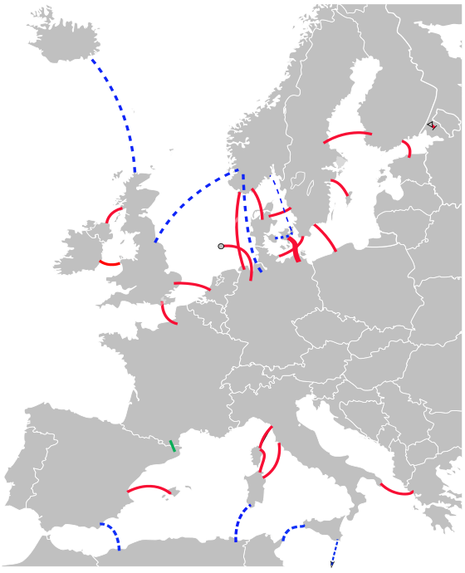
HVDC: long-distance without ‘taps’
HVDC (high-voltage direct current) is now (& increasingly) used for moving power between asynchronous grids.
Cost can be lower then for AC transmission.
Losses can be lower.
Used in Europe & South America.
Most often when the generator & user are separated by long distance & there are no ‘taps’ between the generator & user.
European HVDC
existing
under construction
proposed
Energy Systems & Sustainability, 2/e, Chapter 9
https://en.wikipedia.org/wiki/High-voltage_direct_current

Slide 56
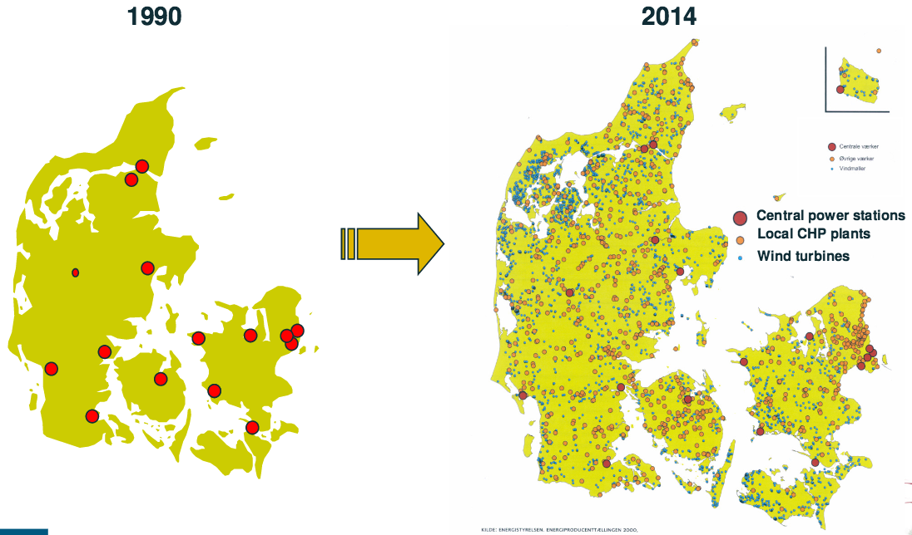
Demark goes DG
Denmark’s energy supply is highly distributed, yet the most reliable in Europe. Ten times as reliable as the US grid.
https://www.vox.com/2016/3/12/11210818/denmark-energy-policies

Slide 57
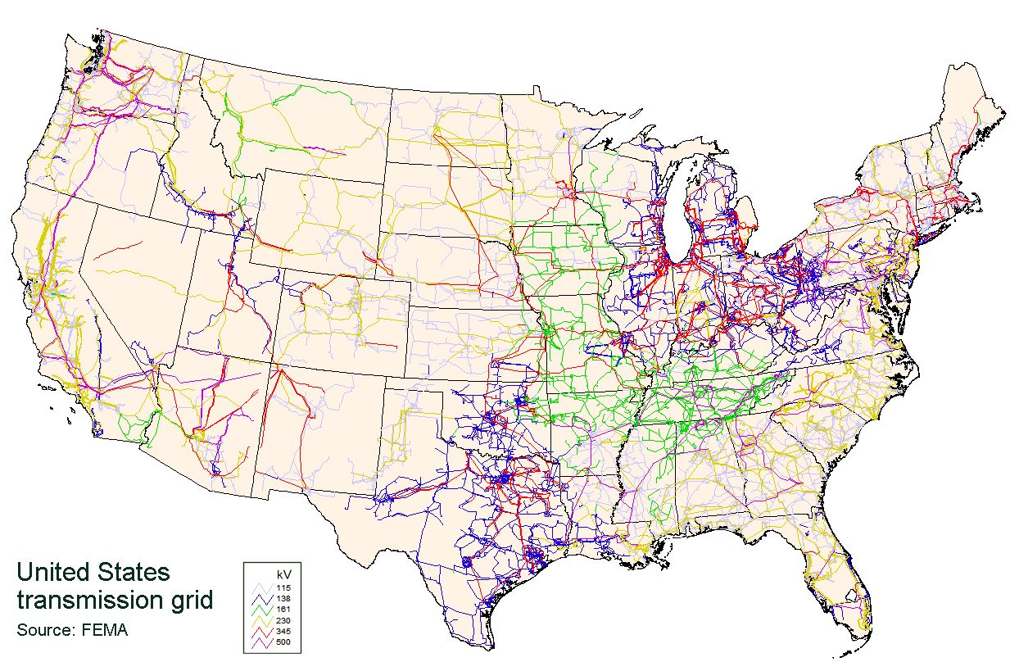
US transmission lines
The US grid consists of a web of transmission lines with a range of voltages.
Energy Systems & Sustainability, 2/e, Chapter 9

Slide 58
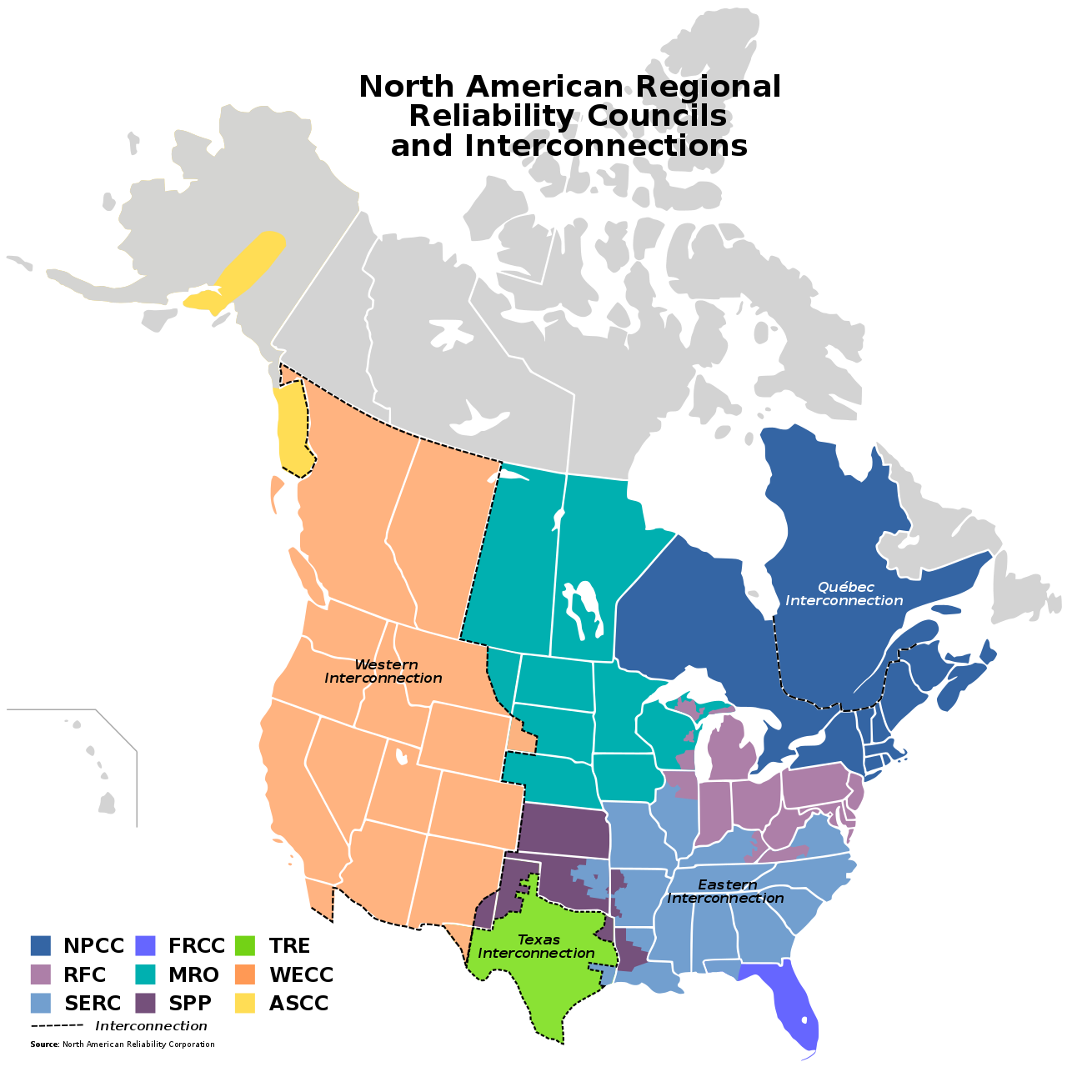
US power grids
NERC oversees a system of interconnected grids to ensure reliability.
Eastern Interconnected System
Western Interconnected System
Texas Interconnected System
Quebec Interconnection
Alaska interconnection

Slide 59
Power grid structure
The US system is based on large, centrally located power plants.
Ideally, these central plants are located on hubs surrounded by major electrical load centers (big users).
Factors influencing the siting of power plants:
Availability of fuel;
Need for a source of cooling water; and
Environmental considerations.
Patterns?
In the West, coal-fired power plants are located near the coal mines rather than the load centers.
Thus, ‘coal by wire’.
In the Pacific Northwest, hydroelectric plants are located at dams that are also far from the load centers, or cities, that use their power.
Energy Systems & Sustainability, 2/e, Chapter 9

Slide 60
Power grid control
Electric generators (power plants) fall into three functional categories:
1. Base-load power plants: run all the time to meet minimum power loads
Nuclear plants work well for base-load power since they are most stable at full power output.
2. Peaking power plants: run only when needed to meet maximum (‘peak’) power loads.
Generally the most expensive.
Often small, older plants using coal or oil.
Gas turbines can also be used.
3. Intermediate power plants: run to meet intermediate power loads.
Gas turbines can be tuned to changing power loads.
Energy Systems & Sustainability, 2/e, Chapter 9

Slide 61
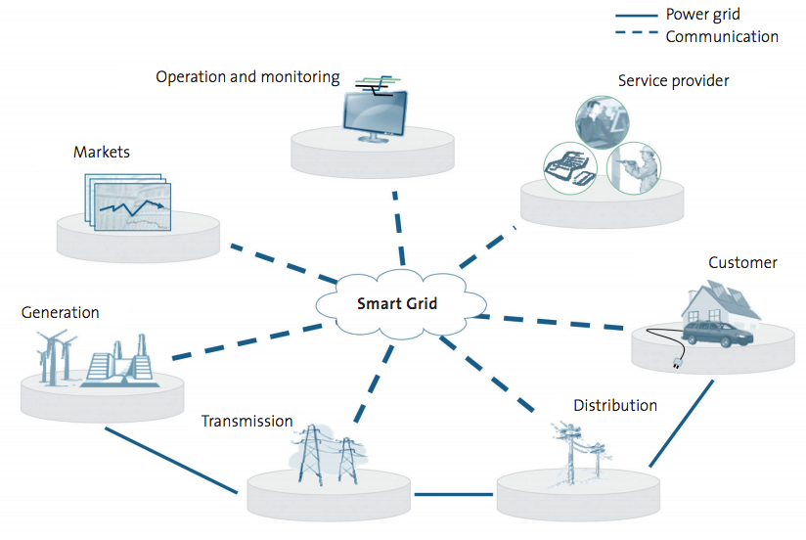
Smart grids
Smart grid: uses two-way energy data collection & communication & acts as a virtual power plant by controlling supply & matching & adjusting demand.
Energy Systems & Sustainability, 2/e, Chapter 9

Slide 62
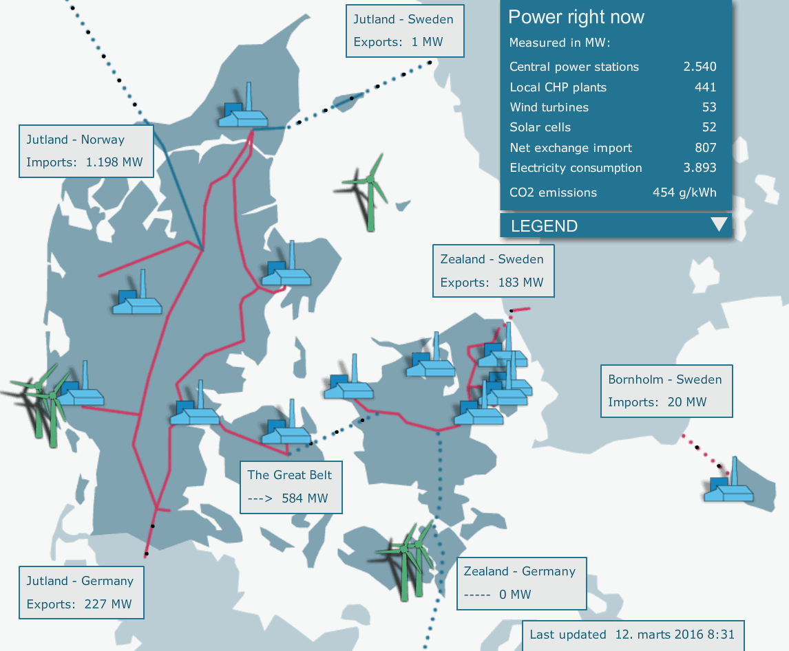
Denmark’s smart & interconnected grid
Demark exports when the wind blows.
Imports hydro when the wind is still.
Timing & communication are critical.
https://www.vox.com/2016/3/12/11210818/denmark-energy-policies

Slide 63
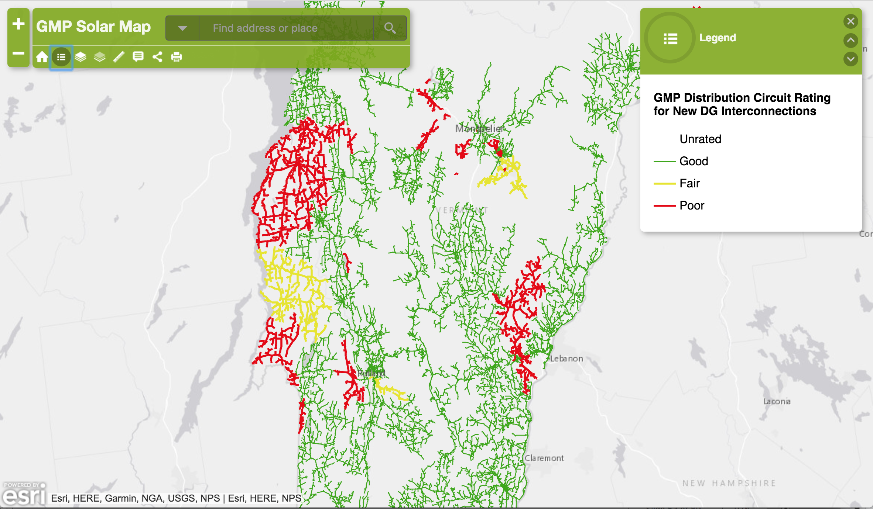
Vermont’s power distribution grid
http://gmp.maps.arcgis.com/apps/Viewer/index.html?appid=546100cc60c34e8eb659023ea8ae03f3

Slide 64
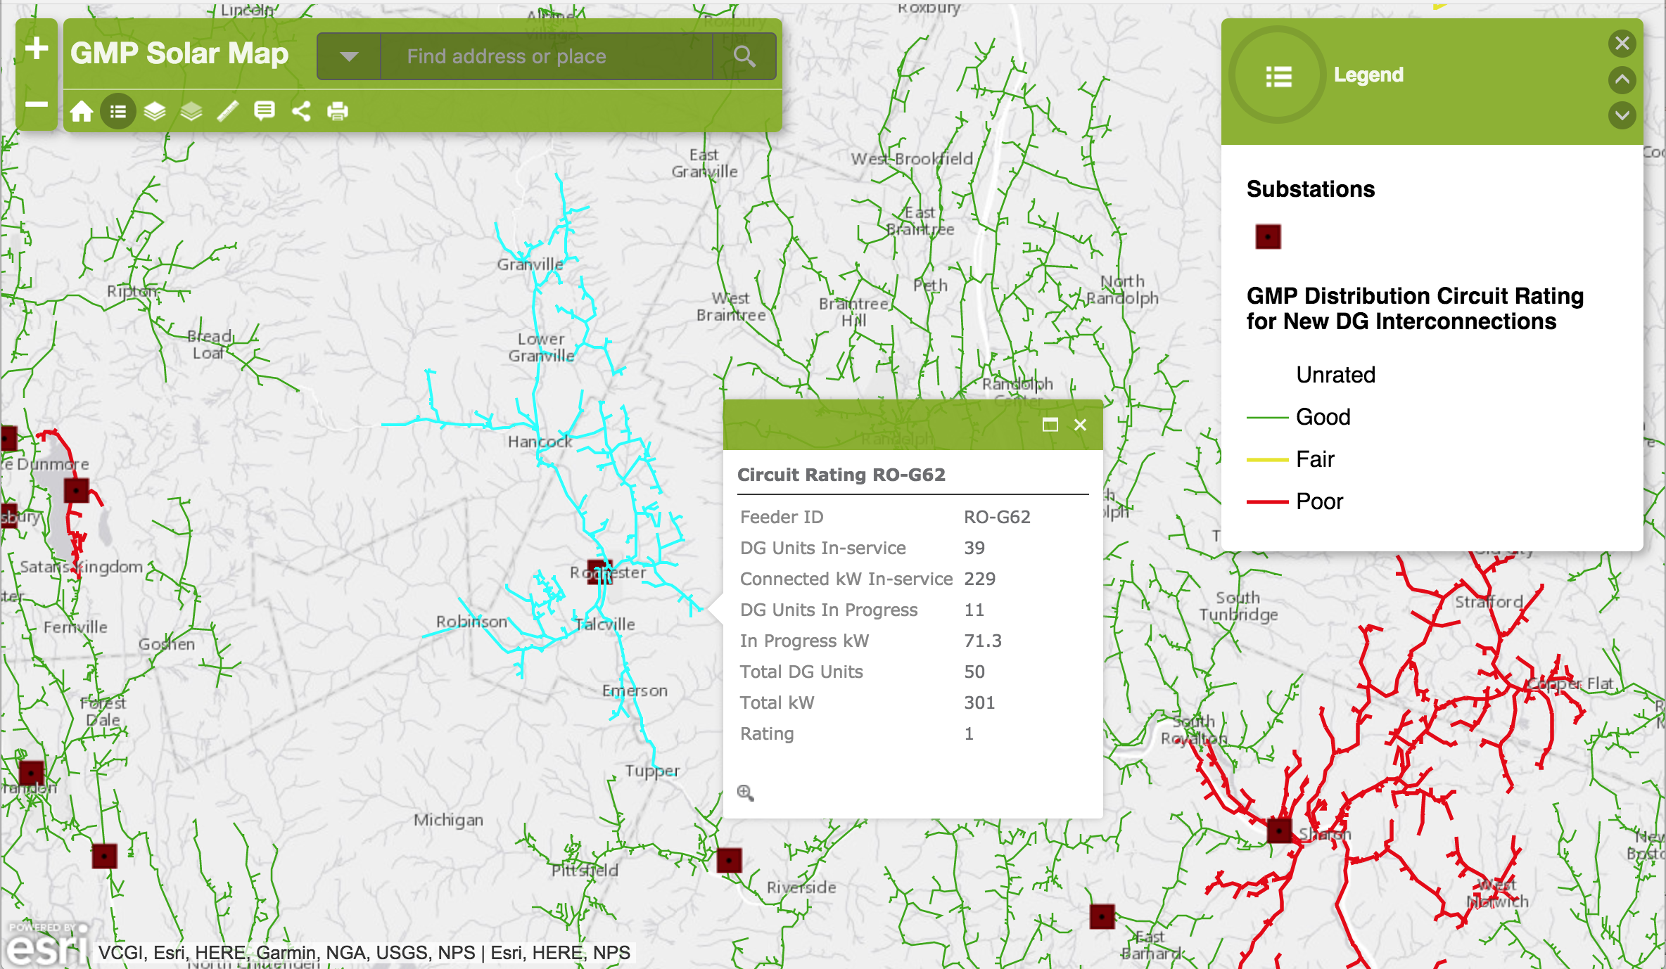
Micro-grid ready sections
http://gmp.maps.arcgis.com/apps/Viewer/index.html?appid=546100cc60c34e8eb659023ea8ae03f3

Slide 65
Designed to flow downhill to the user
Think of each small grid as centered on one substation.
The substation supplies power to users with loads.
Transformers step power down to 120 V for users.
Power only flows outward (or downhill) from the generator to the user.
120 V
Power plant
46 kV
12.47 kV
sub
substation
(transformer)
transformer
load

Slide 66
Each area of the grid has a load
One spur of the distribution line has a load of 0.5 MW.
If the grid serves only to distribute, then it’s easy to understand total need.
0.5 MW load
120 V
Power plant
46 kV
12.47 kV
sub
substation
(transformer)
transformer
load

Slide 67
Renewable energy complicates control
These folks all decide solar is a great idea & install more than they use: 1.0 MW.
Is this a problem for the grid?
What happens in winter when solar production drops & these consumers need to pull power from the grid?
1.0 MW DG
0.5 MW load
120 V
120 V
Power plant
46 kV
12.47 kV
sub
substation
(transformer)
transformer
load

Slide 68
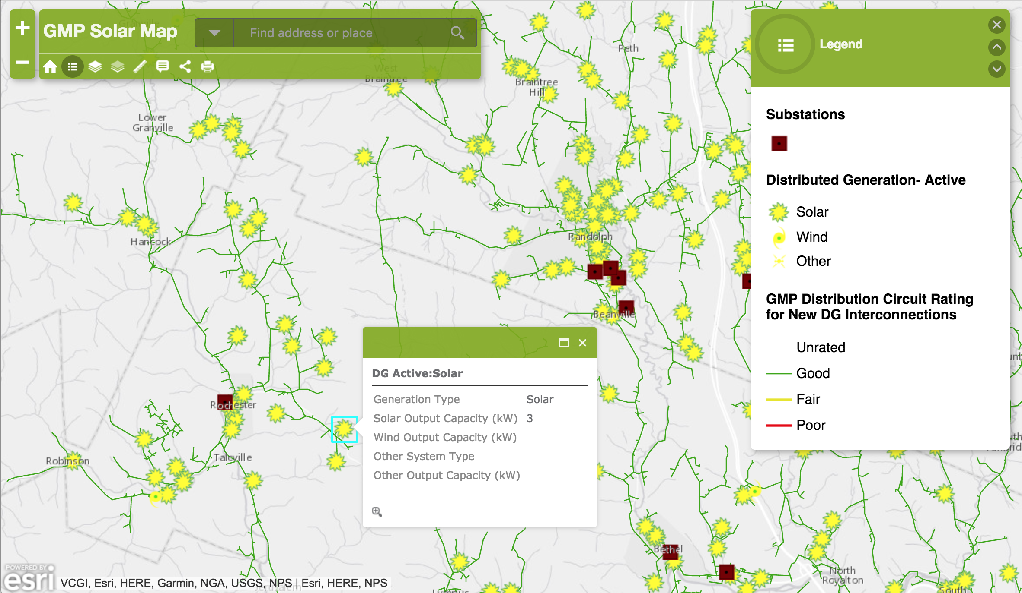
Mapping renewable installations
http://gmp.maps.arcgis.com/apps/Viewer/index.html?appid=546100cc60c34e8eb659023ea8ae03f3

Slide 69
Smart technology improves the grid
Smart technology – collection of data about outflow & inflow of power as well as the controls that allow the flow of power to be controlled – could essentially upgrade our existing grid and allow it to work as a micro-grid.
DG power could be managed & used by all.
1.0 MW DG
0.5 MW load
*
120 V
*
*
120 V
*
*
Power plant
46 kV
12.47 kV
*
*
sub
substation
(transformer)
*
*
*
*
transformer
*
*
0.5 MW load
load
*
smart data

Slide 70
Distributed storage does too
Batteries – like the Tesla Powerwall – installed by users throughout the grid would allow the grid to store power when consumption is low and then send that power back into the grid as power demand peaks.
This could replace the need for additional large, base-load production.
1.0 MW DG
0.5 MW load
*
120 V
*
*
120 V
*
*
Power plant
46 kV
12.47 kV
*
*
sub
substation
(transformer)
*
*
*
*
transformer
*
*
0.5 MW load
load
*
smart data
batteries

Slide 71
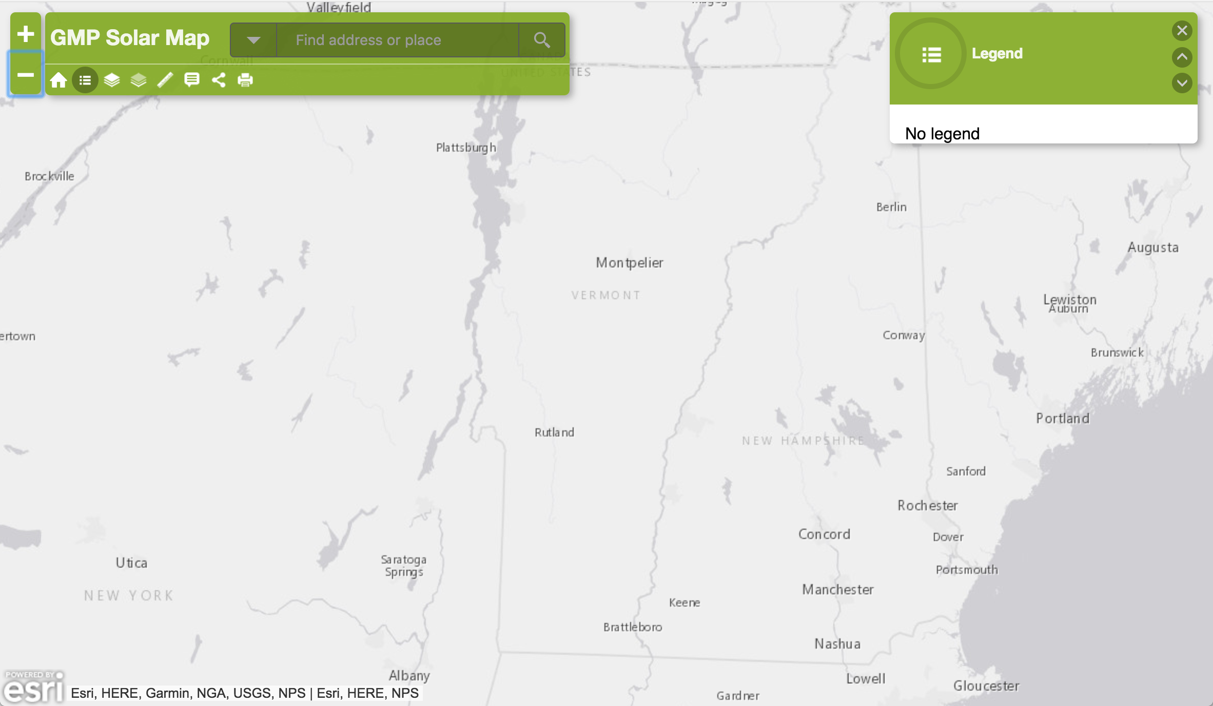
Resiliency?!
Smaller grids can be linked together using transmission lines vs. distribution lines.
http://gmp.maps.arcgis.com/apps/Viewer/index.html?appid=546100cc60c34e8eb659023ea8ae03f3

Slide 72
9. Electricity
9.8 Running the system

Slide 73
Four tasks of running the system
Technical control
Matching supply & demand in real time
Keep the lights on
Optimize
Keep voltage & frequency within specified limits.
By constant adjustment of many connected generators operating in parallel.
Both locally & across different parts of the country.
If CHP is involved then heat demands must also be considered.
Basic operations
Black start if grid failure occurs
Resources
Operations & maintenance
Economics
Externalities like environmental impacts
Energy Systems & Sustainability, 2/e, Chapter 9

Slide 74
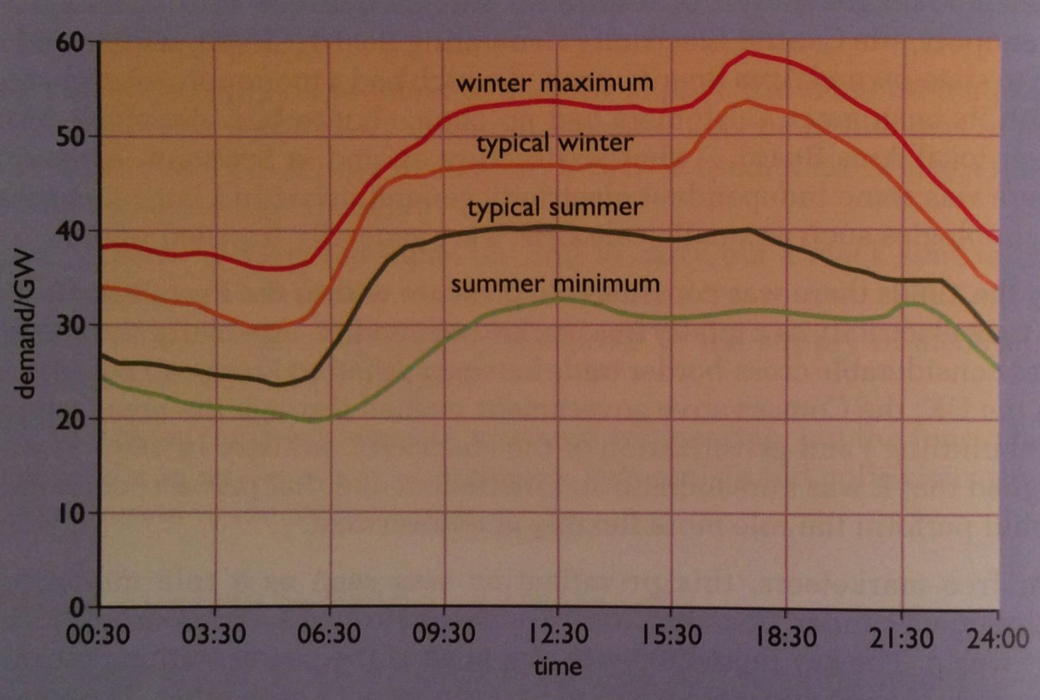
Balancing supply & demand
Different types of power generators:
600 MW coal-fired station is 40% efficient, but takes 8 hours to reach maximum output; and less efficient at less than full load.
30 MW gas turbine station is only 30% efficient but reaches full power in minutes.
Demand varies with time:
Demand varies over 24 hours & weekday vs. weekend.
Demand also varies seasonally.
Energy Systems & Sustainability, 2/e, Chapter 9

Slide 75
Bidding for who runs when
National Grid computer system continuously projects power need for the next hours or days.
Computers at each power station then bid to produce that power by offering a price.
Stations of < 1 MW aren’t constrained & receive a constant price.
Generally
Systems with the lowest fuel & operating costs supply baseload power.
Renewables
As demand rises, systems with higher costs come on line & the cost of electricity increases.
Nuclear
Gas & coal
Peak demand uses the systems with most rapid uptime.
Hydro
Gas
Energy Systems & Sustainability, 2/e, Chapter 9

Slide 76
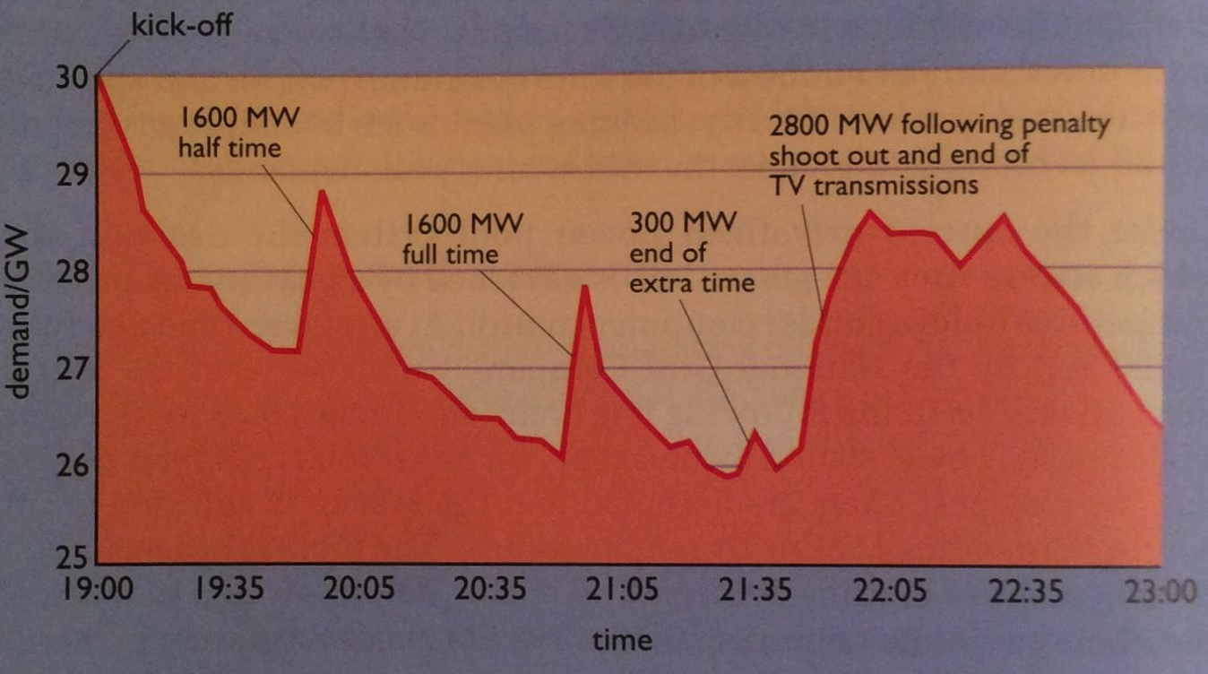
Peak demands
Peak demands are sudden surges in electric demand. Predictable?
TV commercials cause predictable rush for bathrooms & tea kettles.
Pumped storage can generate huge amounts of electricity at a moment’s notice, though only for a relatively short period of time.
Perfect for peak.
UK has three pumped storage plants with combined capacity of 2 GW.
Energy Systems & Sustainability, 2/e, Chapter 9

Slide 77
Renewable energy is variable
Renewable energy technologies tend to produce power predictably but not continuously, so matching demand and supply can be challenging.
wind
PV
tidal
Strategies?
Demark produced 19% of electricity by wind in 2009. They fill in with hydro power from Norway & Sweden by cable.
As the UK develops more wind they could increase pumped storage & connect to Scandinavia.
Wind tracks from west to east, so connecting across Europe from Ireland through Scandinavia would produce a more resilient system. As wind power slows in the west it will be picking up in the east.
Energy Systems & Sustainability, 2/e, Chapter 9

Slide 78
Smart meters & grids
Two-way communication between electricity generators & producers makes it easier to match demand & supply.
Clear general energy use information would allow consumers to understand when they were using, how use relates to rates & to make real-time decisions to change behavior & use. Energy monitoring
Peak demand tariffs could then discourage heavy use at peak hours decreasing demand & the need for more generation.
California has reduced peak demand by 13% using monitoring & communication.
Remote scheduling of loads involves spreading electric use out over time where possible, & avoiding peak use times.
Energy Systems & Sustainability, 2/e, Chapter 9

Slide 79
9. Electricity
9.9 Electricity around the world

Slide 80
Comparing sources & consumption
Energy Systems & Sustainability, 2/e, Chapter 9

Slide 81
Comparing sources & consumption
UK:
Consumption flat from 1995 – 2009 because of efficiency campaigns.
Gas rising & replacing coal, but North Sea reserves are running low.
Nuclear power declining as plants are retired.
Nuclear by wire as UK imports 3% of power from French nuclear plants.
Plan to cut 80% of CO2 emissions by 2050. 30% achieved by 2010.
Energy Systems & Sustainability, 2/e, Chapter 9

Slide 82
Comparing sources & consumption
USA:
Consumption twice that of UK.
Now 31% from coal (2017).
Nuclear was 20% but falling as plants retire.
US & Canada have 25% of world hydro.
Great potential for RE.
State control of utilities. Grid seen as weak & vulnerable.
Energy Systems & Sustainability, 2/e, Chapter 9

Slide 83
France:
High consumption for Europe.
Exports electricity.
Domestic demand is high since electricity is used for heat.
Electricite de France is a recently privatized company with vertical integration of production, grid management & distribution.
Comparing sources & consumption
Energy Systems & Sustainability, 2/e, Chapter 9

Slide 84
Comparing sources & consumption
Demark:
Consumption doubled from 1975 to 2009 but without increased primary energy consumption: efficiency.
Early 1970s electric production was nearly all oil.
Transitioned to coal & CHP; 53% CHP by 2010.
North Sea gas used for some CCGT.
19% wind power
8% biomass CHP
Grid links to Norway & Sweden to trade hydro for wind & increase reliability.
Small municipal & coop structure facilitate CHP.
Energy Systems & Sustainability, 2/e, Chapter 9

Slide 85
Comparing sources & consumption
India:
Small but growing consumption.
20% used in agriculture; mainly irrigation.
Vast grid with 80% of villages having mains power, though 400 m lack power.
29% distribution losses with some theft.
16% short of energy supply at peak.
Nationalized utilities that are in debt.
Coal for electric production is high ash, producing air pollution.
Interest in thorium nuclear.
Renewable, wind, solar, biomass are coming on strong.
Energy Systems & Sustainability, 2/e, Chapter 9

Slide 86
Comparing sources & consumption
China:
Demand rose by 6X from 1990 – 2009.
Most use still industrial.
Agriculture uses 3.5%, mainly irrigation.
Millions still lack access.
Significant hydropower.
Strong investment in renewables.
Energy Systems & Sustainability, 2/e, Chapter 9

Slide 87
9. Electricity
9.10 Electricity storage:
a holy grail for sustainable energy

Slide 88
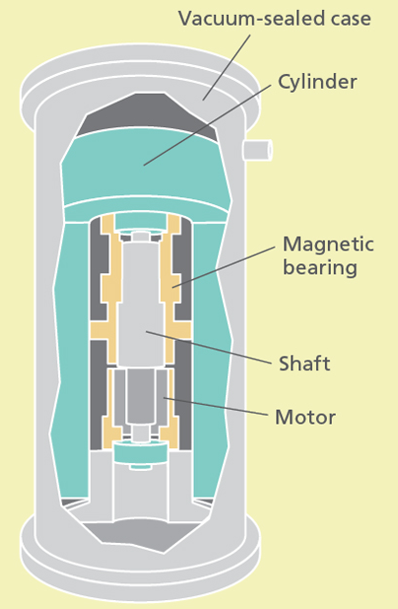
High-speed flywheels
At low electricity demand, motors accelerate a cylinder (flywheel) spinning in a vacuum-sealed case which reduces friction. When demand rises, kinetic energy is quickly converted to electricity.
Pros: Nearly instant response to need.
Cons: Good for short bursts of power, ~15’.
http://discovermagazine.com/2015/july-aug/26-power-stash

Slide 89
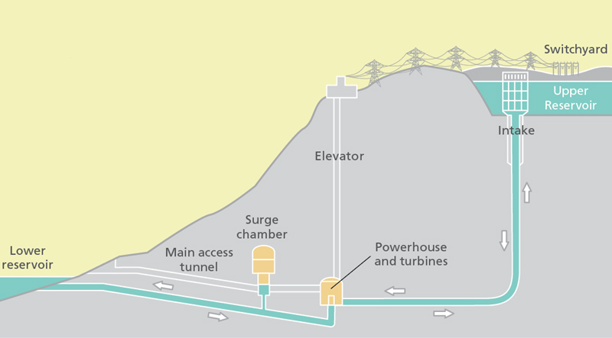
Pumped storage hydropower
At low electricity demand, huge volumes of water are pumped from a low reservoir to an upper one. When demand rises, water is released to flow down through turbines, producing electricity.
95% of current grid storage
Pros: High capacity (10,000 MWh) & long-lived.
Cons: Requires the right site. High initial (capital) costs.
http://discovermagazine.com/2015/july-aug/26-power-stash

Slide 90
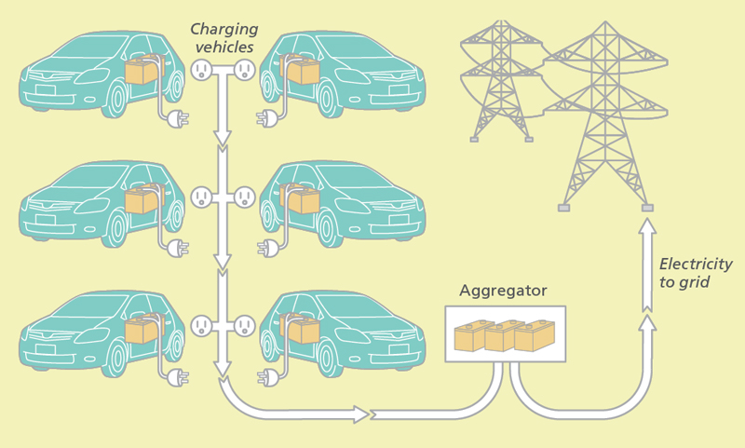
Vehicle-to-grid
Electric vehicles serve as distributed batteries for the grid when they are plugged in to recharge. They can store power when demand is low & serve as power sources when demand is high.
Pros: Double duty use of an existing resource. Owners credited.
Cons: Could shorten battery life. Coordination required to assure batteries maintain enough charge.
GMP is offering to install Tesla batteries in customer’s homes at a steep discount for this purpose.
http://discovermagazine.com/2015/july-aug/26-power-stash

Slide 91
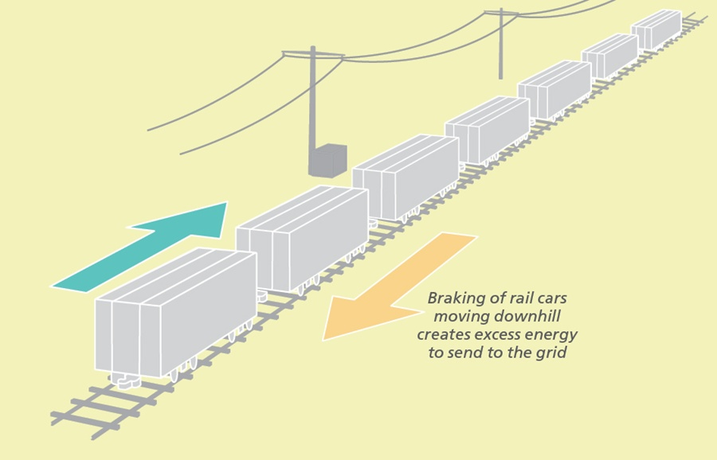
Rail energy storage
Electric trains loaded with ballast travel up a hill when demand is low. When demand rises the cars roll down the hill and regenerative braking generates electricity.
Pros: Proven, rapid response.
Cons: Need the right site & infrastructure.
http://discovermagazine.com/2015/july-aug/26-power-stash

Slide 92
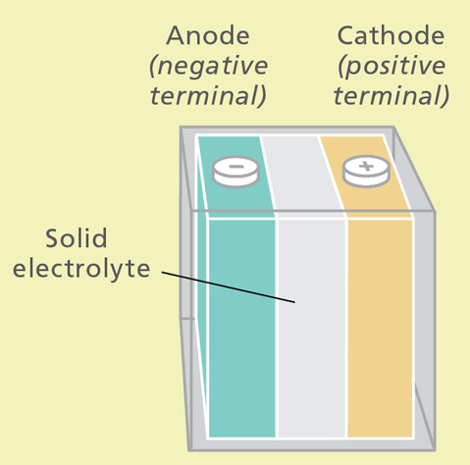
Solid electrochemical battery
Batteries store & release energy using reduction-oxidation reactions.
Pros: Proven, rapid response, reliable, portable.
Cons: Expensive, limited capacity (though they scale). Safety issues with fire & hazardous chemicals.
http://discovermagazine.com/2015/july-aug/26-power-stash

Slide 93
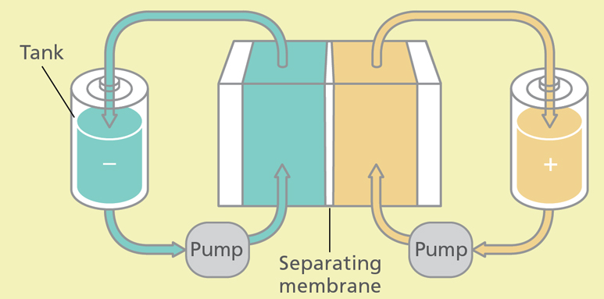
Flow batteries
Flow batteries operate on the same principle as solid state batteries but can store much larger amounts of energy since redox reactants are stored in massive tanks.
Pros: Proven, rapid response.
Cons: Less reliable than solid state. Risk of pollution from leaks.
Biological molecules called quinones, used for photosynthetic redox, have been used to create flow batteries.
‘Rhubarb battery’
http://discovermagazine.com/2015/july-aug/26-power-stash

Slide 94
Molten salt storage
At low demand, mirrors focus sunlight on tanks of molten salt, heating them to nearly 1,000 F. When demand rises, the salt’s heat is used to produce steam, driving turbines to make electricity.
Pros: Proven & in use.
Cons: Space needed for tanks.
http://discovermagazine.com/2015/july-aug/26-power-stash

Slide 95
Thermal energy storage
At low demand, electricity is used to freeze or cool tanks of liquid. When demand rises, the cold water is used for cooling
Pros: Simple, cheap, reliable
Cons: Cools but does not heat or produce electricity.
http://discovermagazine.com/2015/july-aug/26-power-stash

Slide 96
Hydrolysis to create hydrogen gas
At low demand, electricity is used for hydrolysis, breaking water into hydrogen & oxygen gases. Hydrogen gas is then used to power a fuel & produce electricity, or transported in NG lines & combusted.
Pros: Simple, cheap, reliable
Cons: The gas is small & can be hard to store. Fuel cells not yet economic.
https://en.wikipedia.org/wiki/Power-to-gas
https://www.technologyreview.com/s/530331/germany-and-canada-are
-building-water-splitters-to-store-renewable-energy/
Containerized power to gas unit.

