Slide 1
SSC 2030: Energy Systems & Sustainability
2. Global climate change
2.1: The elephant in the room: What is GCC?
2.2: What is the evidence of GCC?
2.3: What are the cause(s) of GCC?
2.4: Paradigms, change, revolutions and transitions
2.5: Decarbonization and the energy trilemma

Slide 2
2. Global climate change
2.2: What is the evidence of GCC?

Slide 3
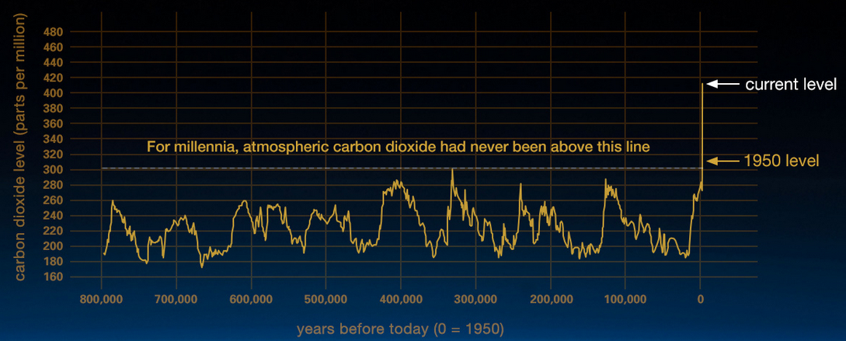
Atmospheric carbon is way up
Our current spike in atmospheric CO₂ follows both:
The rise of human civilization; and
A number of revolutions, driven by extraction and combustion of fossil fuels.
Human civilization?
https://climate.nasa.gov/evidence/

Slide 4
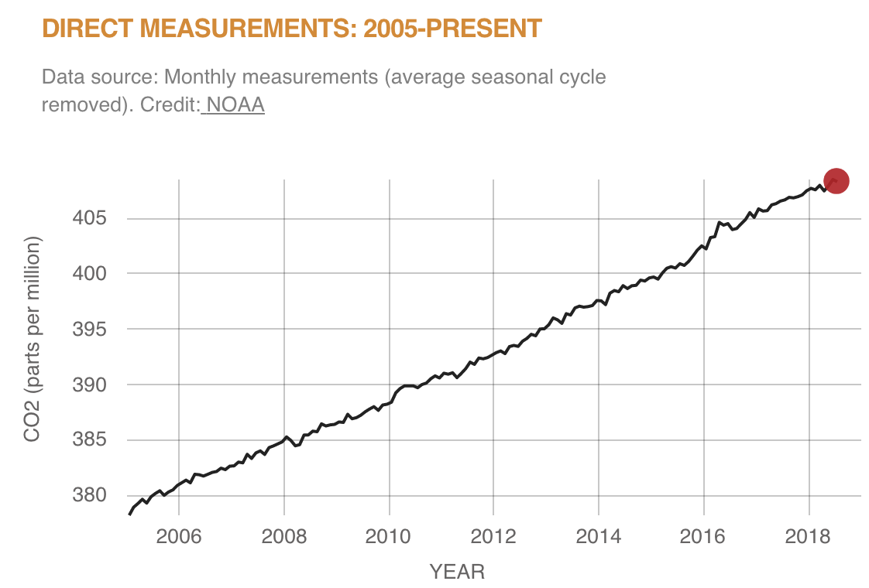
Vital signs: CO₂ levels
https://climate.nasa.gov/evidence/

Slide 5
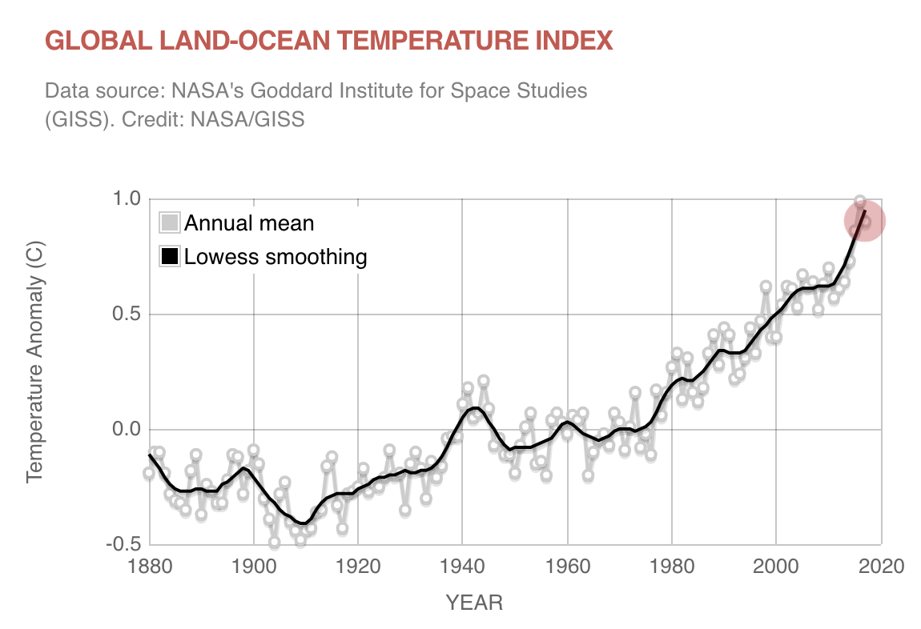
Vital signs: global temperature
https://climate.nasa.gov/evidence/

Slide 6
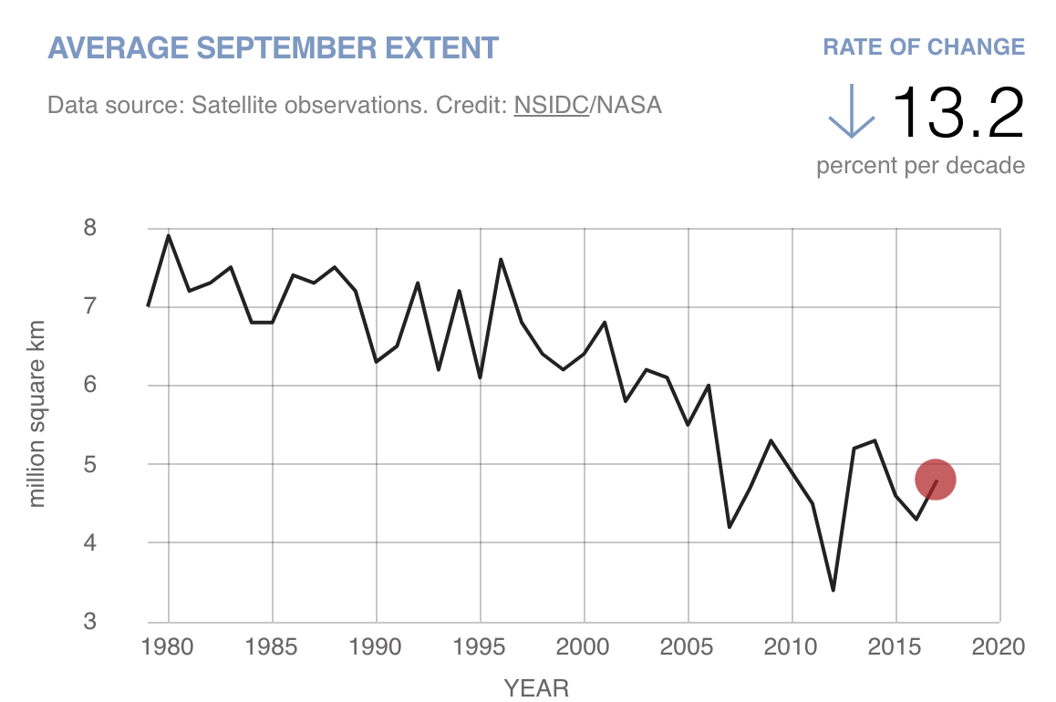
Vital signs: Artic sea ice
https://climate.nasa.gov/evidence/

Slide 7
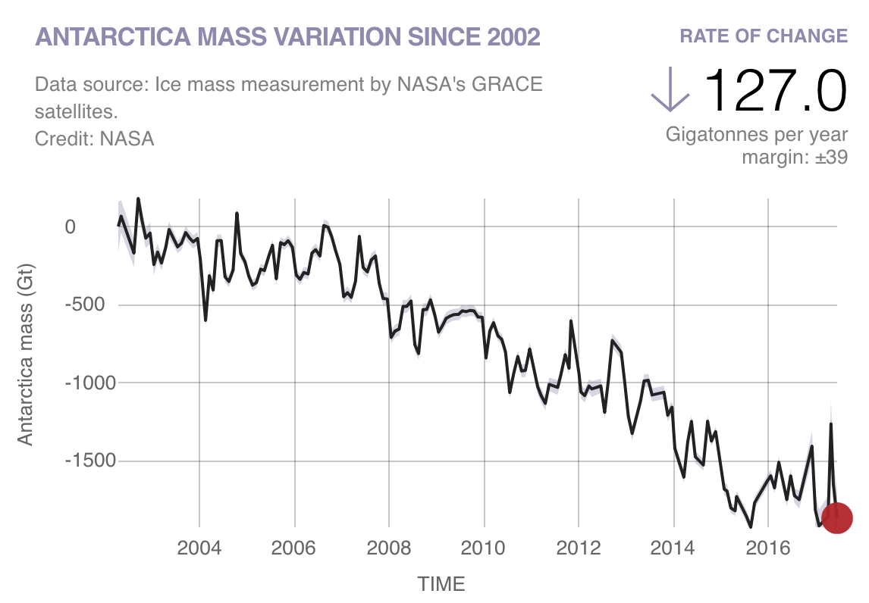
Vital signs: ice sheets
https://climate.nasa.gov/evidence/

Slide 8
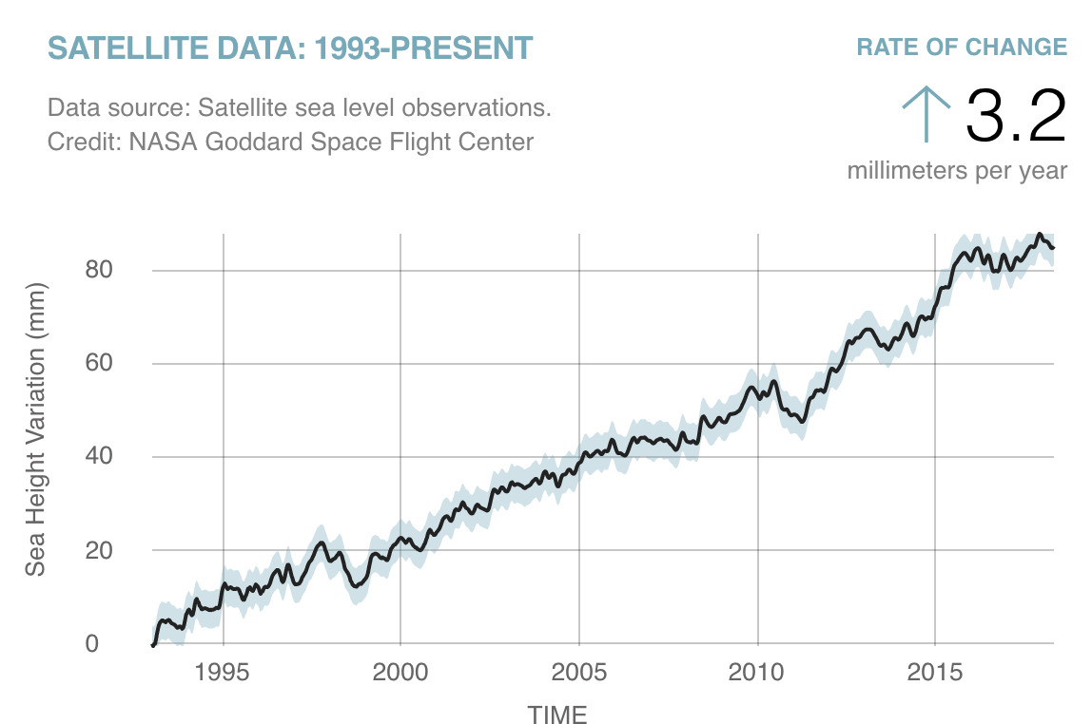
Vital signs: sea level
https://climate.nasa.gov/evidence/

Slide 9
Example: Glacier National Park, MT
Montana’s Glacier National Park
1910: 150 glaciers
Globally, glaciers store ¾ of the world’s freshwater.
2019: 30 glaciers
National Geographic: Effects of global warming

Slide 10
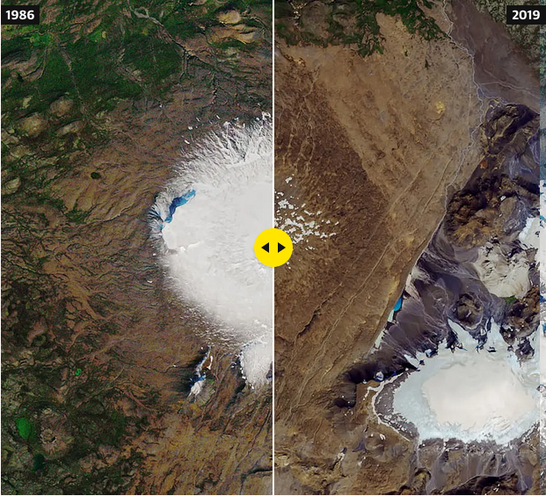
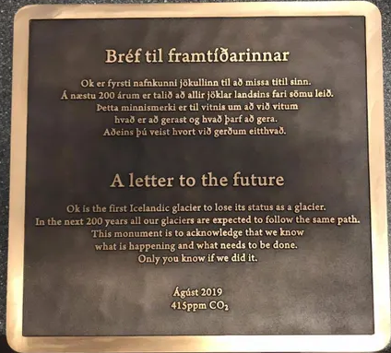
Iceland’s first glacier has disappeared
And a memorial plaque has been placed at the site.
https://www.theguardian.com/environment/2019/jul/22/memorial-to-mark-icelandic-glacier-lost-to-climate-crisis

Slide 11
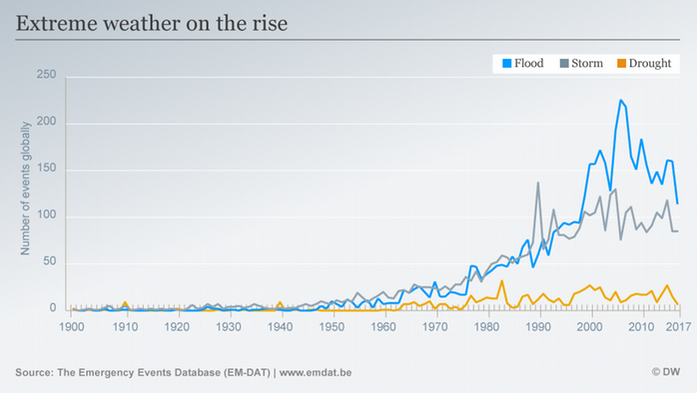
Extreme weather events
Increasing:
Record high temperature events (decreasing lows);
Intense rainfall and storm events.
2012 Arctic Sea ice minimum – lowest on record
https://climate.nasa.gov/evidence/
https://www.dw.com/en/climate-change-and-extreme-weather-science-is-proving-the-link/a-43323706

Slide 12
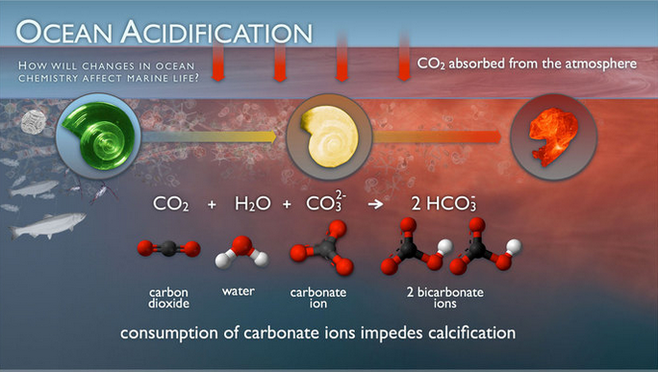
Ocean acidification
Since the industrial revolution (starting in the 1860’s) acidity of surface waters has increased by 30% due to increased carbon emissions.
CO2 absorbed by the ocean has increased by 2 b tons/year
https://climate.nasa.gov/evidence/
https://www.pmel.noaa.gov/co2/story/Ocean+Acidification

Slide 13
Ecosystems are changing
And species are moving.
Adelie penguin populations are collapsing
N
mosquitos
ticks
jellyfish
crop pests
diseases
butterflies
foxes
alpine plants
National Geographic: Effects of global warming

Slide 14
Today’s planetary vital signs
CO₂ = 412 ppm
Temperature up 0.8ºC
Arctic Sea ice down 12.8%
Ice sheets down 127.0%
Sea levels up 3.3%
https://climate.nasa.gov/evidence/

Slide 15
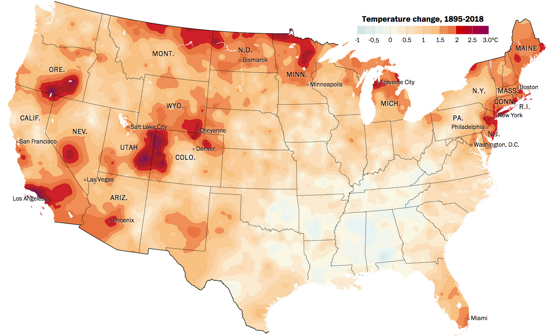
US: warming more quickly than expected
NB: The Paris Accord suggested a maximal 2ºC increase.
5.4ºF
Alaska is warming most quickly.
Washington Post analysis of more than a century of NOAA temperature data across the Lower 48 states and 3,107 counties
https://www.washingtonpost.com/graphics/2019/national/climate-environment/climate -change-america/?wpisrc=nl_most&wpmm=1

Slide 16
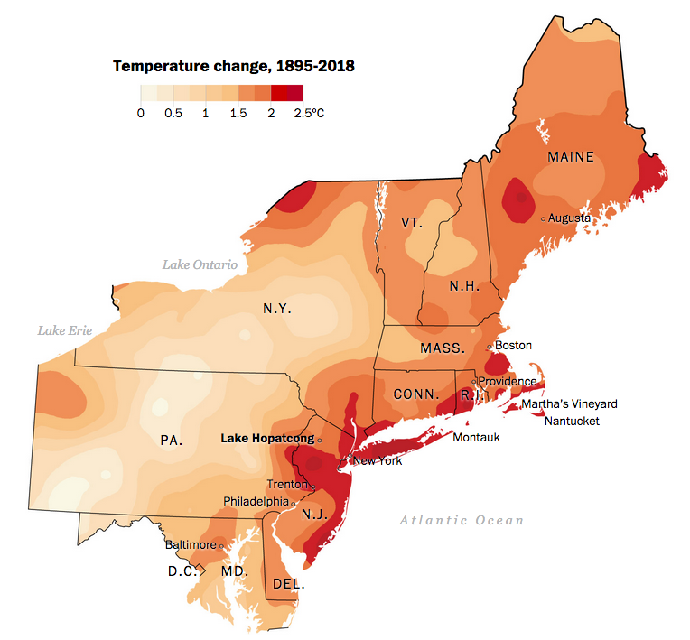
NE is a hotspot
Why?
Losing winters that lower our average annual temperatures. Loss of the albedo effect.
Warming waters along the coast.
https://www.washingtonpost.com/graphics/2019/national/climate-environment/climate -change-america/?wpisrc=nl_most&wpmm=1

Slide 17
Predictions of future change in the US?
Change will continue through 2100…. And on.
Temperatures will continue to rise.
Growing seasons will lengthen.
Northern US: more winter and spring precipitation Southwest US: less precipitation
Droughts in the Southwest
Heatwaves will increase across the country.
Hurricanes will become stronger and more intense.
Sea level will rise 1 - 4 feet by 2100.
Arctic Sea will become ice-free in summer by ~2050.
https://climate.nasa.gov/evidence/

Slide 18
Regional predictions
Northeast: heat waves
heavy downpours
sea-level rise
Northwest: reduced supplies of freshwater
sea-level rise
erosion and inundation
effects from increasing ocean acidity
increasing wildfire, insect damage to forests
Southeast: sea-level rise
extreme heat
decreased availability of freshwater
ecosystems
agriculture
fisheries
water supplies
health
Infrastructure
economy
Midwest: extreme heat
heavy downpours and flooding
many changes and risks to Great Lakes
Southwest: increased and extreme heat
drought
wildfires and insect outbreaks
https://climate.nasa.gov/evidence/

Slide 19
Predictions for Vermont
Roger Hill, longtime Vermont weather forecaster, recently gave a talk about the what Vermont can expect to see from climate change.
100 years storms may come every 10 years
Within 20 years, summers will be like those in Kentucky though we will still have some winter snows
Weather chaos is the first phase of change, so heavy snowfalls – perhaps 6 – 10 feet on ocaission, will still occur
Significant increases in flooding, particularly in river valleys
Roger Hill, Climate change comes to Vermont
https://www.youtube.com/watch?v=5A03kOcTLdA

