Slide 1
SSC 2030: Energy Systems & Sustainability
5. Oil and natural gas
5.1: Origins & geology of petroleum
5.2: Origins of oil & gas industries
5.3: Finding & producing petroleum
5.4: Petroleum refining & products
5.5: Oil today
5.6: Natural gas
5.7: Rise & fall of North Sea oil & gas
5.8: Why are oil & gas so special?
5.9: Conversion technologies
5.10: Unconventional oil & gas
5.11: Methane leaks and GCC

Slide 2
5. Oil & gas
5.3: Finding & producing petroleum

Slide 3
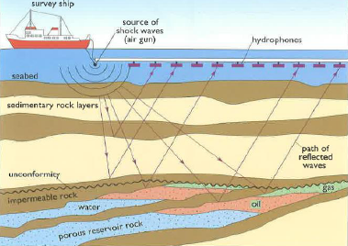
Oil prospecting
Modern survey methods make drilling the last step.
Gravimetric survey:
oil-bearing rock is less dense than most rock
Geomagnetic survey
looks for variation in magnetic field. Sedimentary rock is iron-poor & not magnetic.
Seismic survey:
reflection & refraction of waves may reveal pockets of oil.
Energy Systems & Sustainability, 2/e, Chapter 7

Slide 4
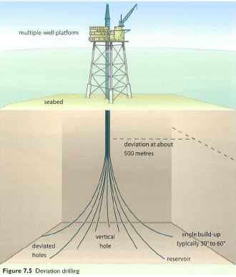
Oil wells
Wells as deep as 4500 m are possible depending on geology.
If the initial well finds oil, more
appraisal wells are drilled to assess the size & shape of the deposit or oil field.
Deviation wells can be drilled from a single platform to extract oil from a larger area.
Use in the North Sea.
Finally, production wells are drilled used to extract maximum amounts of oil.
Energy Systems & Sustainability, 2/e, Chapter 7

Slide 5
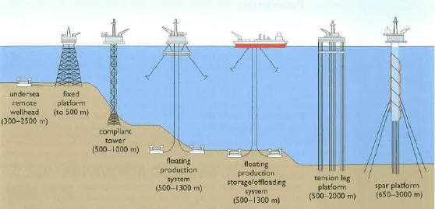
Offshore oil well technology
After depleting easily harvested oil, we’ve developed technology that allows us to drill for oil in more challenging conditions.
“Necessity is the mother of invention.”
Energy Systems & Sustainability, 2/e, Chapter 7

Slide 6
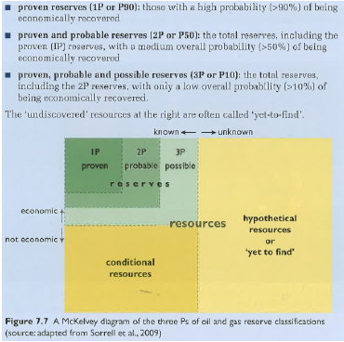
The three Ps of the oil & gas industry
Oil & gas exploration is a form of informed gambling.
How lucky to you feel?
1P = 90%
2P = 50%
3P = 10%
Energy Systems & Sustainability, 2/e, Chapter 7

Slide 7
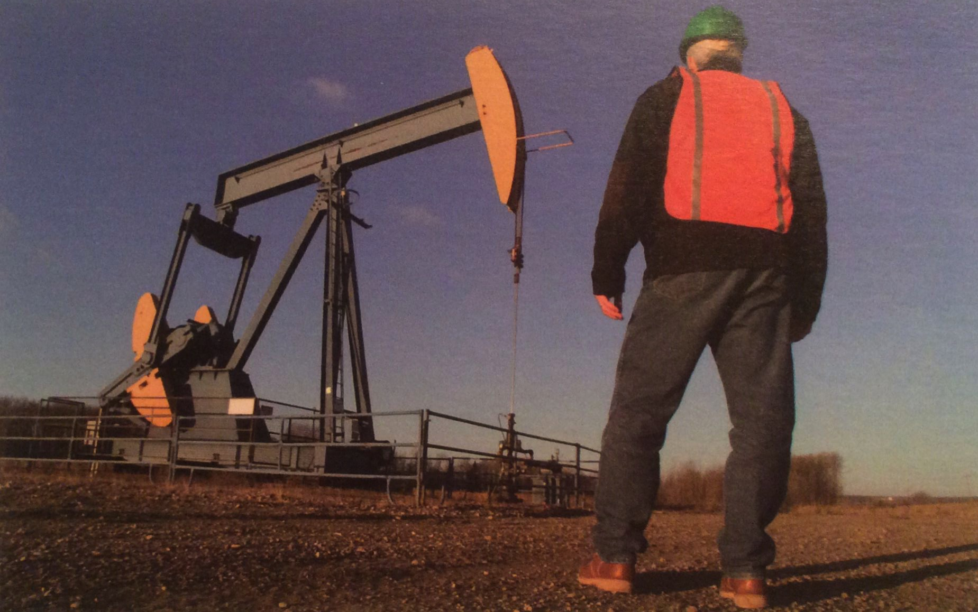
Oil production
Primary recovery: pumping oil from freshly drilled & capped wells
High pressure makes this simple.
30 – 50%
recovery
Secondary recovery: becomes necessary after well pressure falls
Pressure is increased by pumping in NG or water.
Secondary recovery may be very slow.
Saudi Arabia pumps seawater across the desert.
Tertiary recovery (aka enhanced oil recovery): more extreme
Injecting steam
Injecting CO₂ or N₂
Energy intensive & slow
5 – 15%
recovery
Energy Systems & Sustainability, 2/e, Chapter 7

