Slide 1
SSC 2030: Energy Systems & Sustainability
6. Nuclear power
6.1: Nuclear power: an introduction
6.2: Nuclei: a brief summary
6.3: Radioactivity
6.4: Nuclear fission
6.5: Thermal fission reactors
6.6: Types of thermal fission reactors
6.7: Nuclear fuel cycles
6.8: Fast neutron reactors
6.9: Newer nuclear reactor designs
6.10: Nuclear power in Vermont
6.11: Power from fusion

Slide 2
6. Nuclear power
6.11: Power from fusion

Slide 3
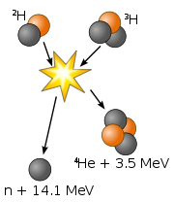
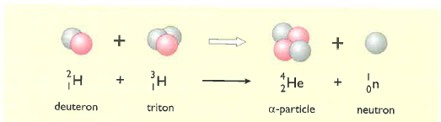
What is fusion?
Fusion of two isotopes of hydrogen, deuterium (²H) and tritium (³H), creates helium-4.
A neutron is freed.
17.59 MeV of energy is released when matter is converted to energy according to E = mc².
Fusion powers the sun, & thus is the ultimate source of power for life on our planet.
Products are not radioactive or hazardous.
Energy Systems & Sustainability, 2/e, Chapter 10
www.eia.doe.gov

Slide 4
Energy released by fusion
How much energy is released when one atom of deuterium fuses with one atom of tritium to create an atom of helium and a neutron?
particle | mass (atomic mass units)
deuterium atom | 2.0136
tritium atom | 3.0155
helium atom | 4.0015
neutron | 1.0087
²H + ³H → ⁴He + 1 n
2.0136 + 3.0155 → 4.0015 + 1.0087
5.0291 → 5.0102
Loss of 0.0189 amu
Energy = (0.0189 amu)(931 MeV/amu) = 17.6 MeV → 2.82 E-12 J / event
Fusion of 2 kg of deuterium & 3 kg of tritium → 350 TJ
Energy Systems & Sustainability, 2/e, Chapter 10
www.eia.doe.gov

Slide 5
Fuel for fusion
Deuterium occurs naturally at a very low abundance and can be extracted from large volumes of water.
Tritium is a radioactive isotope with a relatively short half-life of 12 years.
Produced by bombarding Li-6.
Energy Systems & Sustainability, 2/e, Chapter 10
www.eia.doe.gov

Slide 6
Barriers to fusion?
So if fusion is a better idea than fission, why aren’t we using it now?
It takes an enormous amount of energy to fuse two positively charged nuclei and initiate the fusion process.
Speed?
Heating atoms will increase their speed, but change their physical state to plasma.
How can plasma – the physical state of the sun – be contained?
And stabilized?
Energy Systems & Sustainability, 2/e, Chapter 10
www.eia.doe.gov

Slide 7
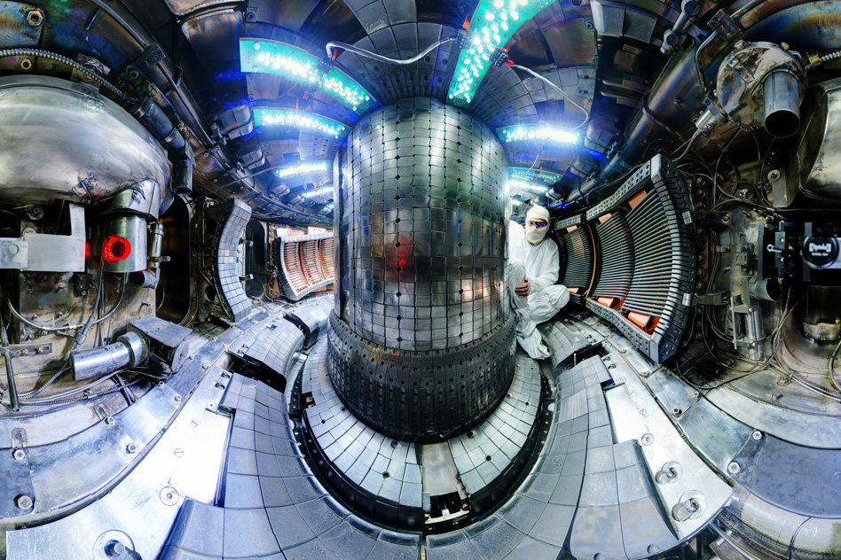
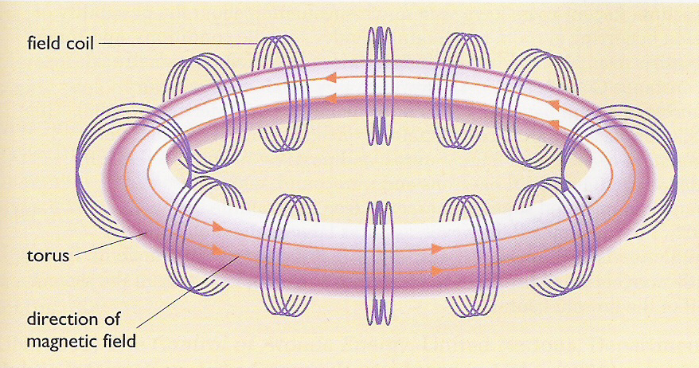
Tokamak
Tokamak: a machine that uses magnetic fields to contain plasma in a torus, or doughnut shaped space.
Breakthrough at MIT?
Adding small amounts of ³-He seems to stabilize plasma & increase efficiency.
Alcator C-Mod @ MIT
Energy Systems & Sustainability, 2/e, Chapter 10
http://www.popularmechanics.com/science/energy/a27961/mit-nuclear-fusion-experiment-increases-efficiency/
www.eia.doe.gov

Slide 8
Inertial petawatt laser confinement
Inertial confinement fusion (ICF): fusion fuel is placed in a sphere which is held in a hohlraum (hollow area) & then bombarded with many, many laser beams.
The laser beams compact & heat the fusion fuel…
... creating a shock wave which causes fusion to begin.
https://lasers.llnl.gov/science/icf/how-icf-works
https://www.youtube.com/watch?v=yixhyPN0r3g

Slide 9
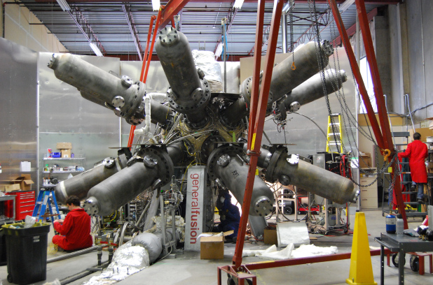
Magnetized target fusion
Magnetized target fusion: fusion fuel is confined by a magnetic field while heated to plasma-producing temperatures. Then pistons are used to quickly squeeze the plasma, increasing density and initiating fusion.
Pistons synchronize to create repeated ‘hammering’.
Energy Systems & Sustainability, 2/e, Chapter 10;
https://youtube/b-LCfx9v4YQ

