Slide 1
SSC 2030: Energy Systems & Sustainability
6. Nuclear power
6.1: Nuclear power: an introduction
6.2: Nuclei: a brief summary
6.3: Radioactivity
6.4: Nuclear fission
6.5: Thermal fission reactors
6.6: Types of thermal fission reactors
6.7: Nuclear fuel cycles
6.8: Fast neutron reactors
6.9: Newer nuclear reactor designs
6.10: Nuclear power in Vermont
6.11: Power from fusion

Slide 2
6. Nuclear power
6.9: Newer reactor designs

Slide 3
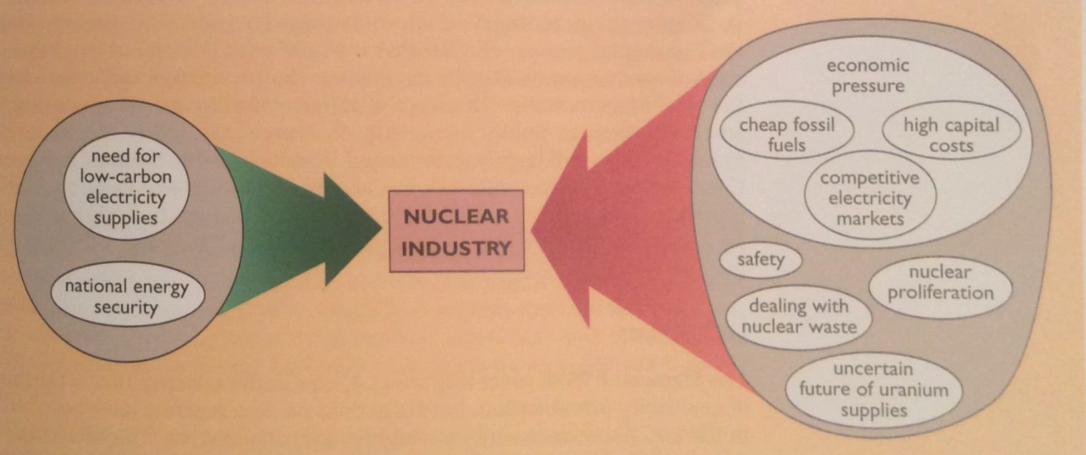
Factors in the decline of nuclear power
As we’ve seen, the construction of new nuclear plants slowed in the 1990s. Why?
Both the Thatcher & Regan governments supported the free market vs. government backing needed to prop up nuclear in an era of cheap fossil fuels.
Energy Systems & Sustainability, 2/e, Chapter 11

Slide 4
Costs & CO₂ emissions of nuclear power
Levelized costs of generation from EIA.
Median carbon dioxide values
Fuel | LCOE ($ / MWh) | Grams CO₂ / kWh
Coal (pulverized) | *140.0 | 820
NG (CCGT) | 57.3 | 490
biomass | 102.4 | 230
Solar PV (utility) | 66.8 | 48
geothermal | 46.5 | 38
Concentrated solar | 184.4 ??? | 27
hydropower | 66.2 | 24
Offshore wind | 145.9 | 12
Nuclear, advanced | 99.1 | 12
Onshore wind | 52.2 | 11
*EIA: 2016 levelized costs including capital, O&M, transmission, tax credits.
https://en.wikipedia.org/wiki/Life-cycle_greenhouse-gas_emissions_of_energy_sources; 2014 IPCC; EIA

Slide 5
Reducing the costs of nuclear power
To make nuclear power more competitive capital, operating & maintenance costs must be reduced &safety must be improved.
Design changes may lower costs and improve safety:
Modular design for factory construction and testing;
Simplified design with fewer components;
Simplified fuel handling to reduce O&M costs; &
Increasing operating temperatures for improved efficiency.
Energy Systems & Sustainability, 2/e, Chapter 11

Slide 6
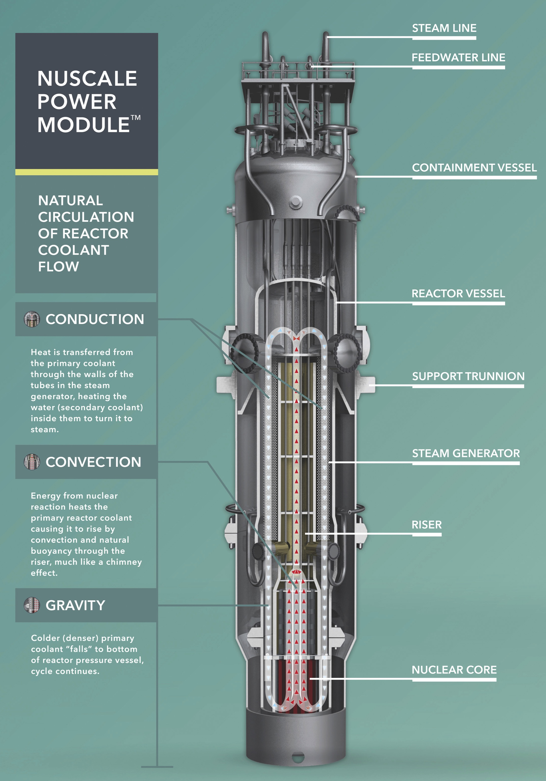
Shrink it: small modular reactor
Example: NuScale Power
Self-contained
65’ tall, 9’ diameter
Built in factory & shipped to site ready for installation in cooling pool
Passive coolant circulation operates without power
50 MWe electrical capacity
Cost ~ $5,100 / kW
http://www.nuscalepower.com/our-technology/design-advances

Slide 7
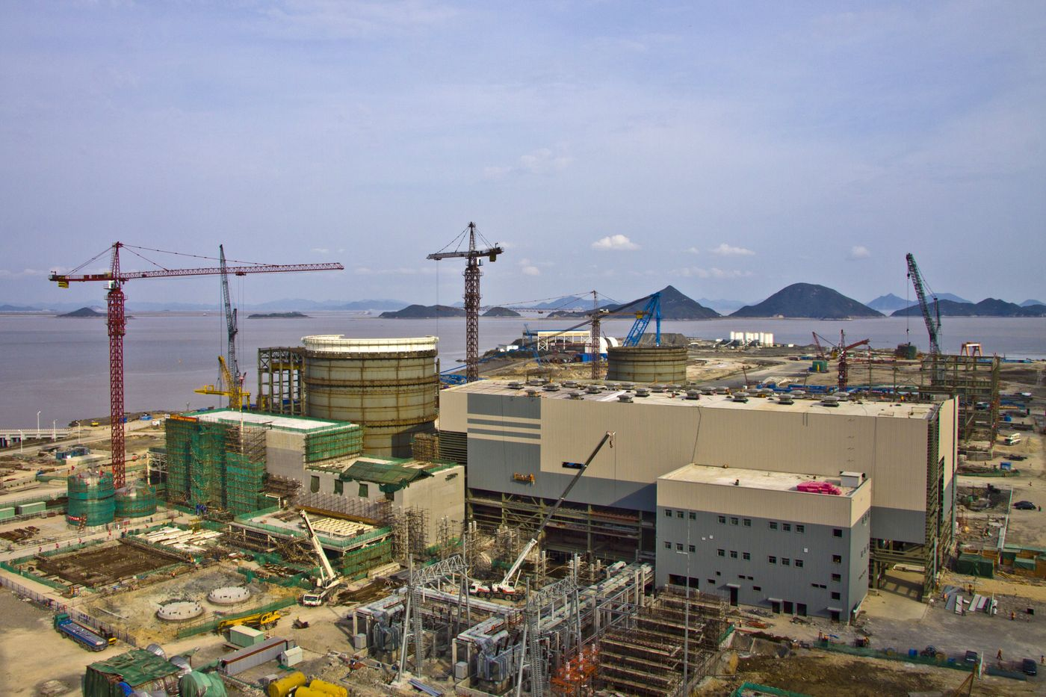
Westinghouse Advanced Passive AP1000
In the US, four plants of this design were under construction in Georgia & SC. Construction of the SC plants has been halted. The GA plants are under construction with issues.
China has built plants with the AP1000 design at Sanmen. Start-up is expected in late 2017.
AP1000 features:
Steel secondary containment;
Passive, gravity fed water cooling system;
Simplified design:
35% fewer pumps;
85% fewer control cables;
Also fewer safety system pumps;
Smaller size;
Modular construction.
Energy Systems & Sustainability, 2/e, Chapter 11;
https://www.bloomberg.com/news/articles/2017-04-26/nuclear-reactor-treasure-seen-buried-in-wreck-of-westinghouse

Slide 8
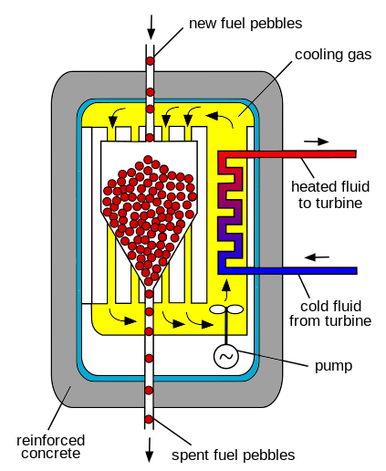
Pebble-bed high temperature reactor
Pebble-bed reactors have radically different fuel handling systems.
Pebbles: 1000s of small kernels of UO₂ coated with layers of graphite.
Combining many pebbles in a hopper achieves critical mass.
Cooled by pumping high-pressure He through the pebbles.
Operates at 900°C.
Drives a CCGT generation system.
Germany abandoned the design when a pebble jammed, was damaged & leaked.
China is building pebble-bed reactors.
Energy Systems & Sustainability, 2/e, Chapter 11;
https://en.wikipedia.org/wiki/Pebble-bed_reactor

Slide 9
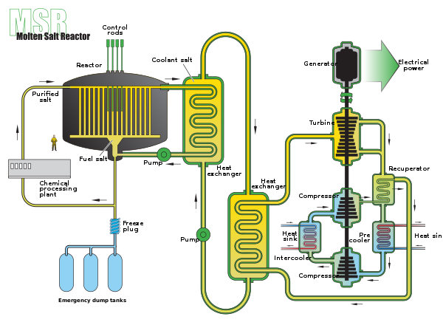
Molten-salt reactors
Molten-salt reactors use a radically different design in which the coolant – which may be the fuel itself – is a molten salt.
Advantages:
High temp & thermal efficiency.
Liquid UF4 is dissolved in coolant.
Circulation through graphite core causes criticality.
Safety:
Loss of coolant is loss of fuel, so stops criticality.
Overheating melts a safety plug, draining fuel into water cooling pond, solidifying fuel.
Energy Systems & Sustainability, 2/e, Chapter 11;
https://en.wikipedia.org/wiki/Molten_salt_reactor

