Slide 1

SSC2030: Energy Systems and Sustainability
Module 9. Solar energy
9.1: Introduction - types of solar energy
9.2: Global, US and VT use of solar energy
9.3: Nature and availability of solar radiation
(9.4: History of our use of solar energy)
9.5: Modern passive solar heating
9.6: Active solar heating
9.7: Daylighting
9.8: Concentrating solar power
9.9: Photovoltaics: how PV works
9.10: Types of PV systems and arrays
9.11: Trends PV applications
9.12: New developments in solar energy
Main source: Boyle, Godfrey (ed) (2004) Renewable Energy: Power for a Sustainable Future, 2/e, Oxford University Press, UK

Slide 2
Module 9. Solar energy
  9.1: Introduction: types of solar energy
Renewable Energy, 2/e, Chapter 2

Slide 3
Types of solar energy
Passive solar heating:
(1) Space heating via a hot air collector or solar porch
(2) Integrated while building design that optimizes solar energy use and minimizes the use of fossil fuels
Active solar heating: uses a solar collector and produces low-temperature hot water for domestic hot water
Daylighting: making best use of natural lighting (sunlight) at all seasons
Concentrating solar power (CSP): more complex solar collectors that produce high-temperature heat that can produce steam and thus electricity
Photovoltaic (PV) electric generation: the conversion of solar energy directly into electricity using a solid-state device
Renewable Energy, 2/e, Chapter 2

Slide 4
Module 9. Solar energy
  9.2: Global, US and VT use of solar energy
Renewable Energy, 2/e, Chapter 2

Slide 5
Global use of solar PV energy
Asia 258 GW
Europe 94 GW
US 62 GW
4.9%
3.1%
2.4%
global
~2%
4.0%
3.9%
7.5%
7.5%
2.8%
https://www.forbes.com/sites/joshuarhodes/2020/02/03/the-us-solar-industry-in-2020/#5989e5035ed3
8.6%
7.6%

Slide 6
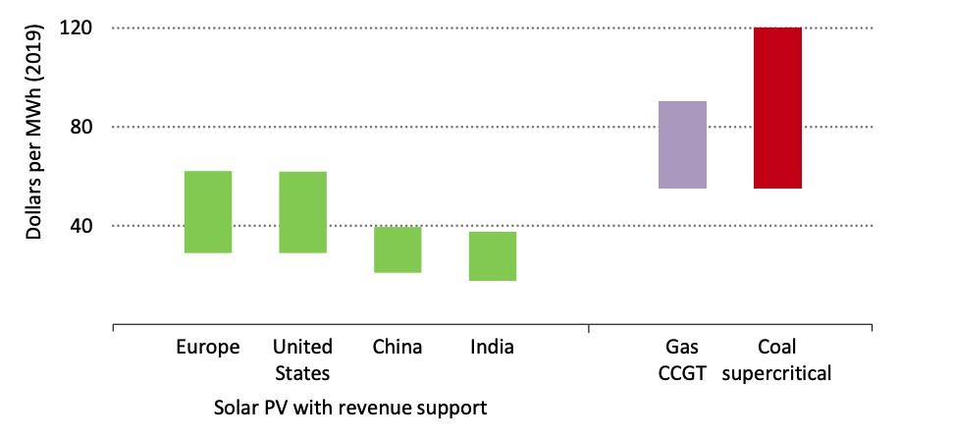
Solar energy is new less expensive then fossil fuels
2019 LCOE data confirms a trend.
Solar is now the least expensive form of electricity in history.
Guaranteed price supports push costs down.
Guaranteed price supports push costs down.
The cost of solar is 20-50% lower than forecast in 2019.
Also true for wind
https://www.carbonbrief.org/solar-is-now-cheapest-electricity-in-history-confirms-iea

Slide 7
Solar is a major source of global RE
Note that hydropower isn’t included in this analysis of renewable energy.
Biofuels and all other forms of RE are included.
2019 | global production (TWh) | global production (%)
wind | 1429.6 | 51.0
solar | 724.1 | 25.8
other | 651.8 | 23.2
total RE | 2805.5 | 100
https://www.bp.com/content/dam/bp/business-sites/en/global/corporate/pdfs/energy-economics/statistical-review/bp-stats-review-2020-full-report.pdf

Slide 8
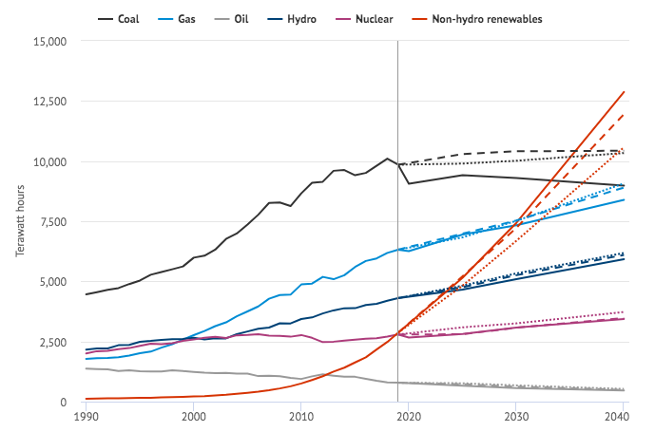
Solar’s low cost has boosted its forecasted use
WEO 2020
Lower costs have pushed the cost for solar capital (investments) down.
This should boost investment and deployment.
WEO 2019
WEO 2018
https://www.carbonbrief.org/solar-is-now-cheapest-electricity-in-history-confirms-iea

Slide 9
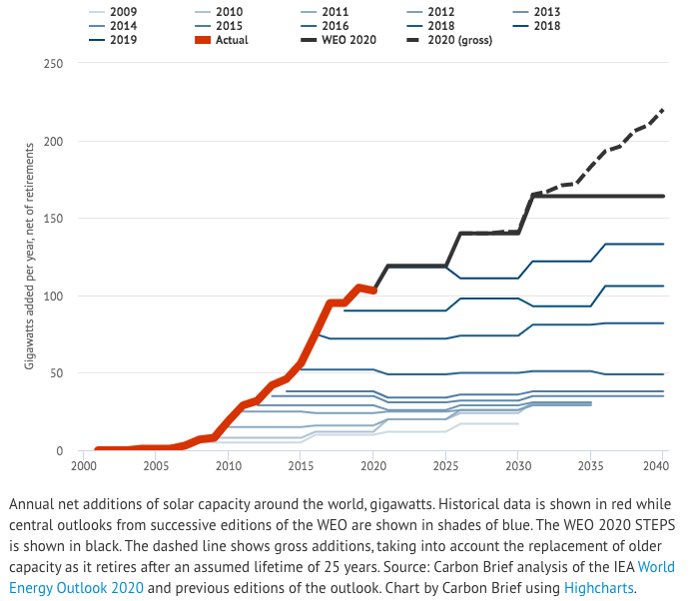
Solar capacity is rising and seems to be accelerating
Includes replacement of out-dated solar
https://www.carbonbrief.org/solar-is-now-cheapest-electricity-in-history-confirms-iea

Slide 10
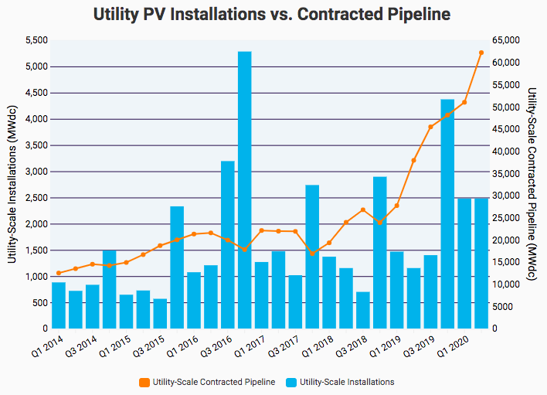
Utility scale PV? Plans outpace installs
plans = pipeline
utility PV installs
https://www.seia.org/solar-industry-research-data

Slide 11
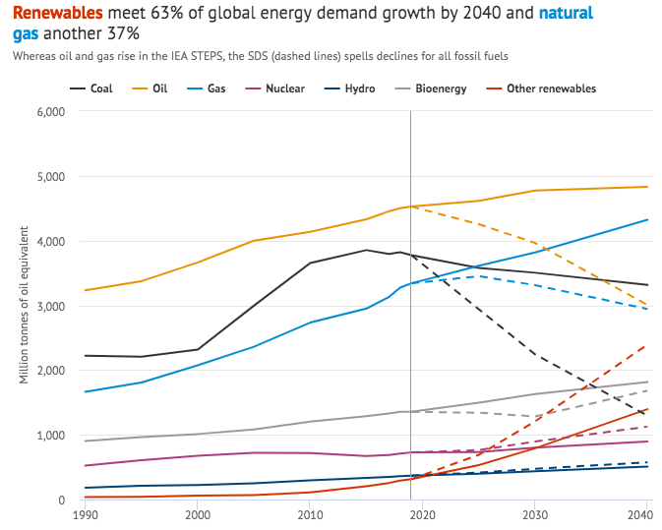
Effects on forecasted primary energy use?
STEPS
older model
SDS
newer model
https://www.carbonbrief.org/solar-is-now-cheapest-electricity-in-history-confirms-iea

Slide 12
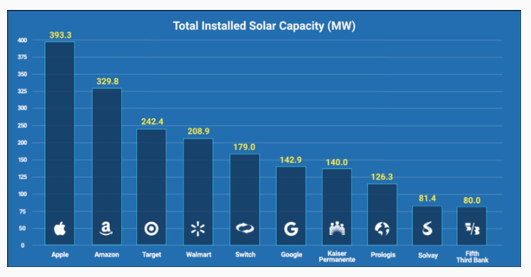
Corporations are investing in PV
plans = pipeline
https://www.seia.org/solar-industry-research-data

Slide 13
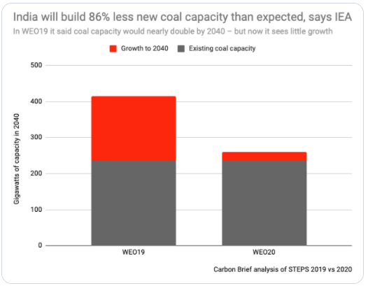
Cheaper solar is killing coal more quickly
86% drop in expected increases in coal capacity
https://www.carbonbrief.org/solar-is-now-cheapest-electricity-in-history-confirms-iea

Slide 14
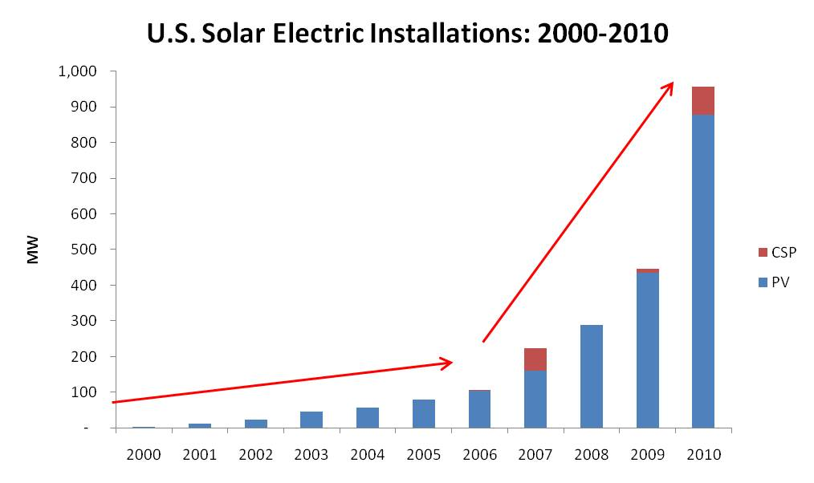
PV is now common in the US…
Seia.org

Slide 15
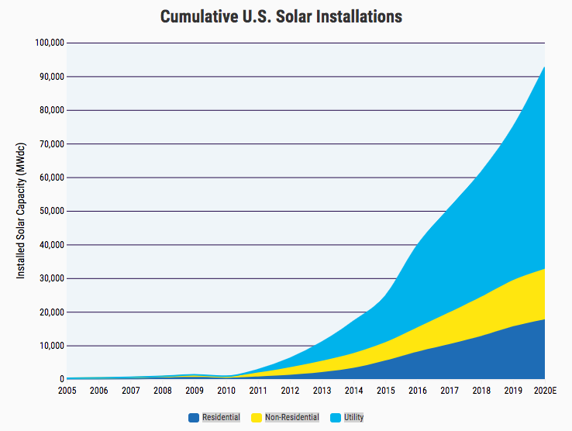
… and US solar energy is still growing
Rapid growth due to:
ITC
(investment tax credit)
Falling prices
Increasing demand
https://www.seia.org/solar-industry-research-data

Slide 16
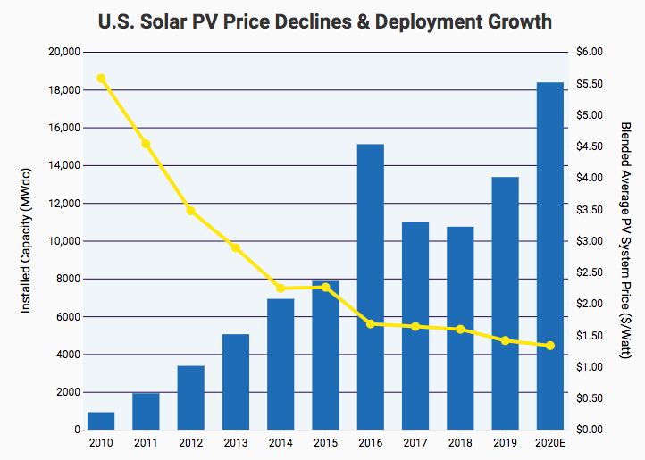
Solar deployment has grown as price has fallen
https://www.seia.org/solar-industry-research-data

Slide 17
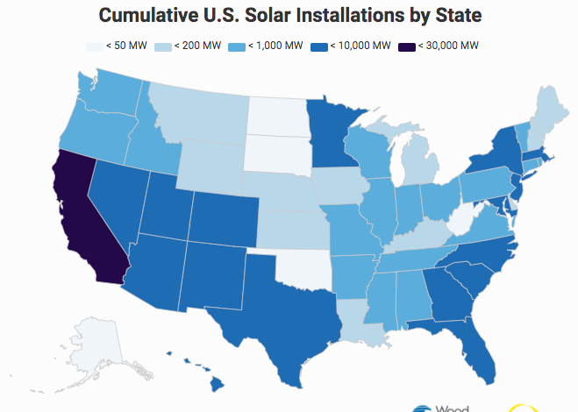
Solar use varies by state
https://www.seia.org/solar-industry-research-data

Slide 18
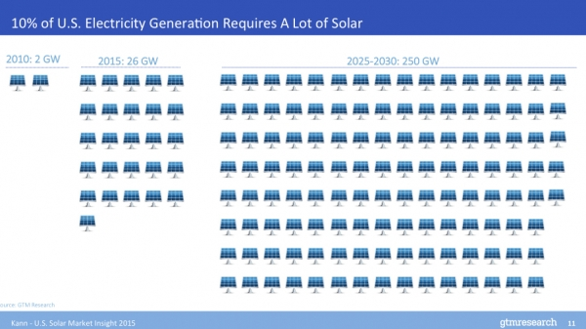
How far are we from 10%
X3
2020 = 71.6 GW solar
Seia.org

Slide 19
Vermont’s solar electric capacity
Vermont’s first-in-the-nation feed-in tariff for renewable electricity jump-started installation of solar power.
2015: Vermont’s total solar electric capacity:107 MW.
2016: Vermont ranked 8th in per capita solar power (270 W/person)
X3
2020 = 358.2 MW installed
https://www.seia.org/research-resources/top-10-solar-states

Slide 20
Caveat: the grid will need to change quickly
The rise of variable renewable sources means that there is an increasing need for electricity grid flexibility, the IEA notes. “Robust electricity networks, dispatchable power plants, storage technologies and demand response measures all play vital roles in meeting this,” it says.
https://www.carbonbrief.org/solar-is-now-cheapest-electricity-in-history-confirms-iea

Slide 21
What if the SDS forecast is accurate?
If the SDS forecast is accurate what will 2040 look like?
Low-carbon primary energy sources would be up to 44% from 19% in 2019.
Coal would be down to 10%, lowest since the industrial revolution.
Net-zero carbon wouldn’t occur until 2070.
Increase in global temperatures would not be held to a 1.5ºC increase.
https://www.carbonbrief.org/solar-is-now-cheapest-electricity-in-history-confirms-iea

Slide 22
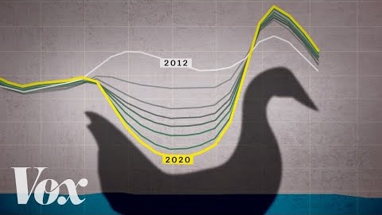
Biggest challenges to increased reliance on solar?
The intermittent nature of solar requires either (1) baseload alternatives or (2) storage or both.
This results in the ‘duck curve’.
https://www.youtube.com/watch?v=YYLzss58CLs&feature=emb_logo

Slide 23
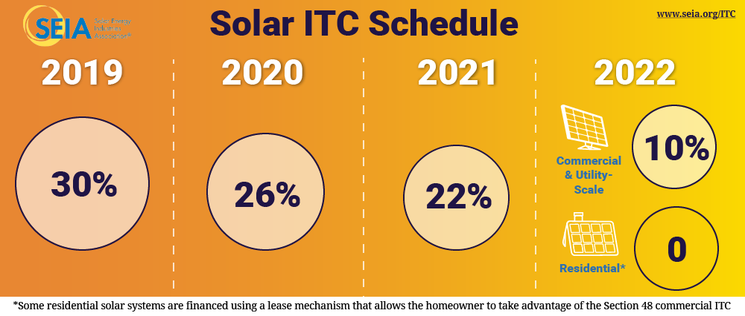
Policy: tariffs on imported solar panels; falling ITC
The US produces a small number of solar panels, 6 GW capacity with a planned increase to 9 GW.
In 2018, the US government imposed a 20% tariff on imported solar panels.
This has increased the cost of solar installations and slowed the rate of installation.
In 2005, the Federal Energy Policy Act created a 30% investment tax credit (ITC) for those who installed solar power. This ITC provided a critical incentive for expansion of the US solar industry.
Extended 2006 and 2008
2015: with drops
Since the ITC, the solar industry has had average annual growth of 52%.
https://www.seia.org/sites/default/files/resources/History%20of%20ITC%20Slides.pdf

Slide 24
Module 9. Solar energy
  9.3: Nature and availability of solar radiation
Renewable Energy, 2/e, Chapter 2

Slide 25
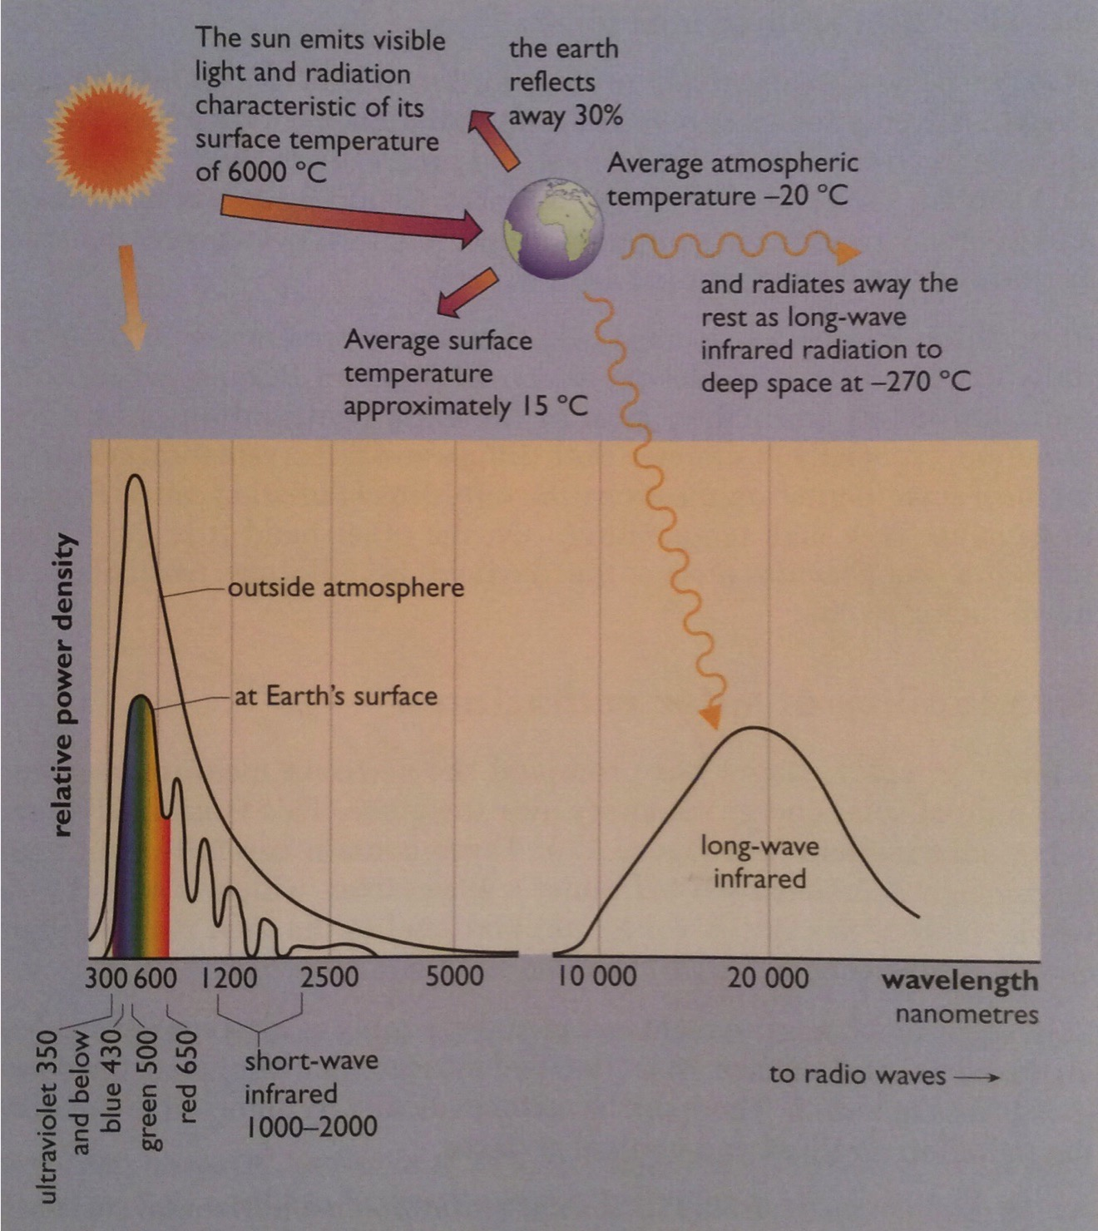
Wavelengths of solar radiation
The sun is a fission reactor that converts H to He at 4 million tonnes /second.
The earth receives solar radiation and re-radiates half back out to space.
Sunlight has a wide range of wavelengths.
PV: 380- 750 nm
heat: long-wave infrared
Renewable Energy, 2/e, Chapter 2

Slide 26
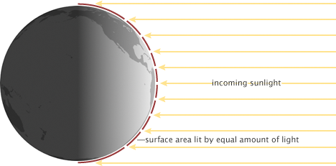
Insolation: more intense at equator
Insolation, and thus the potential for solar energy, is highest at the equator because the density of light is highest there.
The density of sunlight falls at higher latitudes.
Earthobservatory.nasa.gov

Slide 27
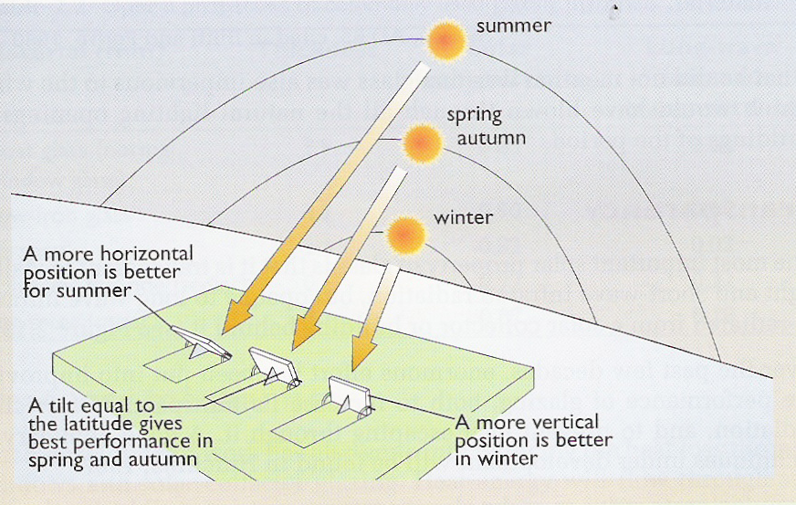
Seasonal angles of insolation
The angle of the earth’s axis is constant, but the tilt of the earth relative to the sun changes with the seasons.
Renewable Energy, 2/e, Chapter 2

Slide 28
Effect of angle of tilt
While tilt makes a difference, imperfect angles still produce significant and useful levels of power.
tilt (°) | annual total radiation (kWh/m²) | June total radiation (kWh/m²) | December total radiation (kWh/m²)
0° | 944 | 153 | 16
30° | 1,068 | 153 | 25
45° | 1,053 | 143 | 29
60° | 990 | 126 | 30
90° | 745 | 82 | 29
equator
*Data from London England (Achard and Gicquel, 1986)
Likewise, south-east to south-west orientation to the sun, while imperfect can be used for effective solar power.
Renewable Energy, 2/e, Chapter 2

Slide 29
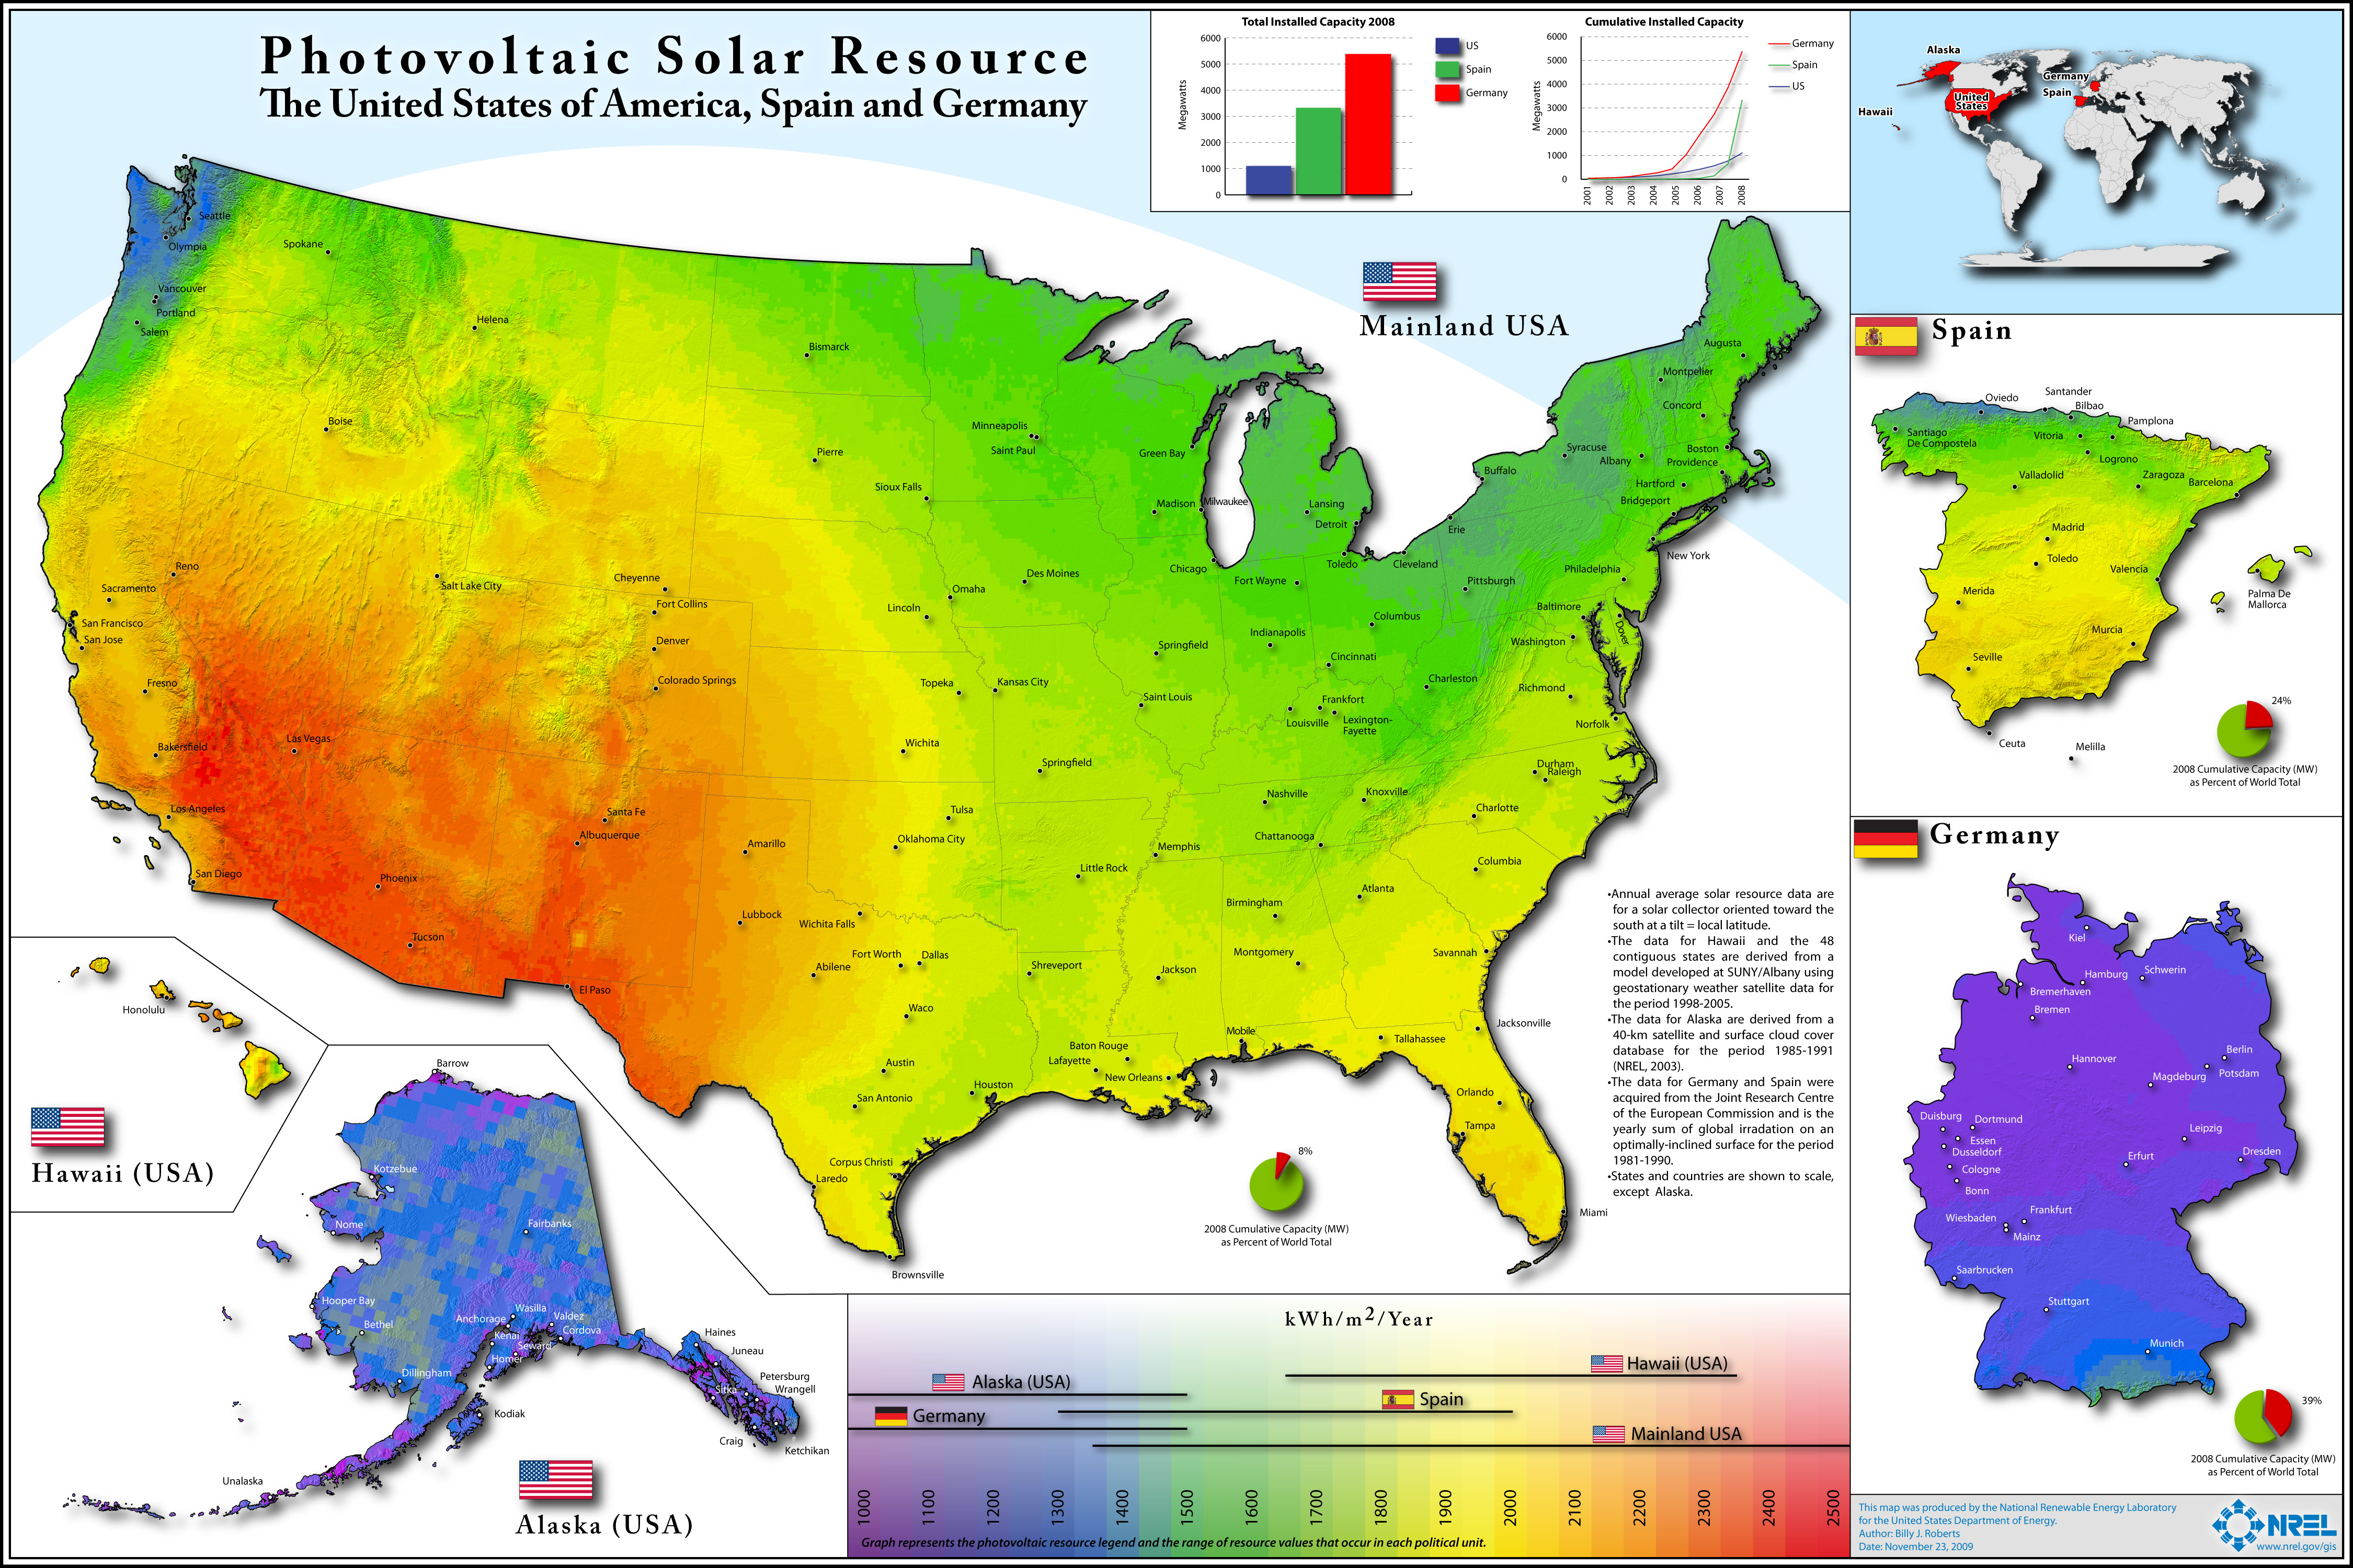
Insolation varies with location

Slide 30
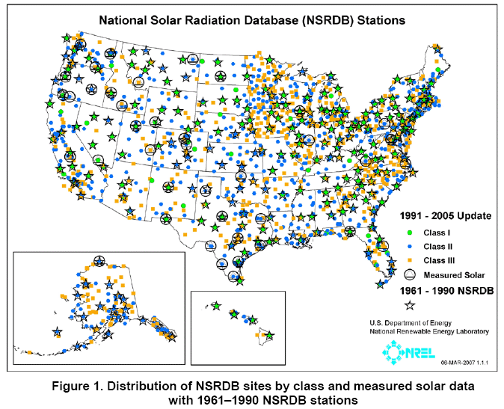
NREL’s insolation stations
NREL

Slide 31
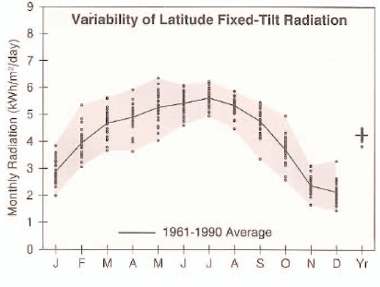
Solar data for Burlington, VT
NREL

Slide 32
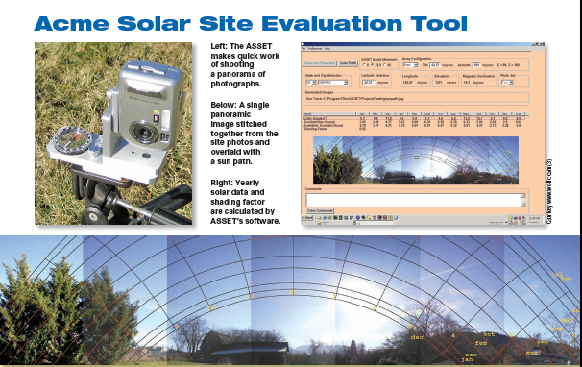
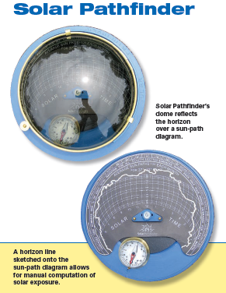
Solar citing analysis
Software tools, like PVmapper and GIS, can be used for 5,000-foot level mapping of solar resources. But location of arrays within a site are better assessed using solar pathfinder tools that look at shading from trees and buildings.
NREL

Slide 33
Module 9. Solar energy
  (9.4: History of our use of solar energy)
Renewable Energy, 2/e, Chapter 2

Slide 34
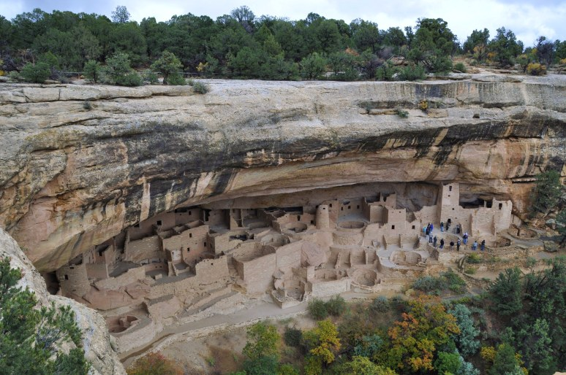
Ancient peoples
Anasazi people of the American southwest
“Some very sophisticated solar communities were built by the Pueblo Indian tribes of the American Southwest….south facing cliff dwellings and others on the open plateaus – that display a remarkable sensitivity to the suns daily and seasonal movements.”
Butti & Perlin, A Golden Thread – 2500 Years of Solar Architecture and Technology

Slide 35
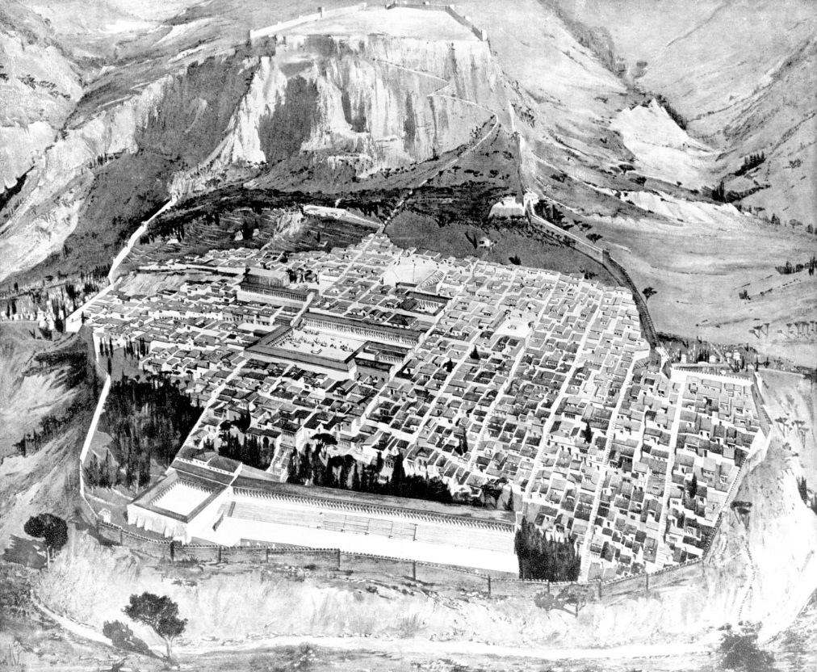
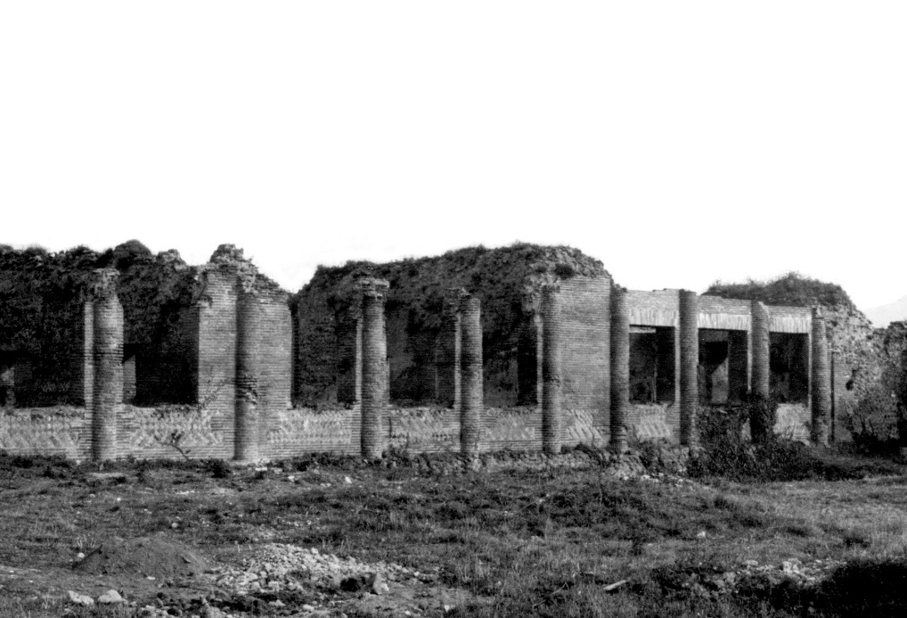
Ancient peoples
Romans oriented their cities towards the sun and used glass to let the sun in.
Butti and Perlin, A Golden Thread – 2500 Years of Solar Architecture and Technology

Slide 36
Enlightenment Europe
Scientists, like chemist Antoine Lavoisier experimented with sunlight and used it as a tool.
https://csirosolarthermal.wordpress.com/tag/solar-furnace/

Slide 37
Enlightenment Europe
In the mid-1860s, France ran short of cheap coal. Innovation with concentrated solar power flowered, producing solar powered printing presses, wine stills, cookers and refrigerators.
Concentrated solar energy was focuses on a steam boiler.
https://www.uh.edu/engines/epi2871.htm

Slide 38
Solar thermal: domestic hot water
Clarence Kemp’s ‘batch solar water heater’ from 1891
https://www.renewableenergyhub.co.uk/solar-thermal-information/the-history-of-solar-thermal-technology.html

Slide 39
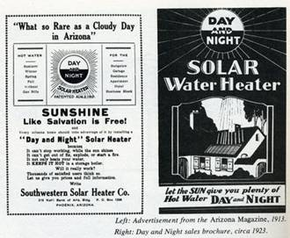
Solar thermal: domestic hot water
https://www.renewableenergyhub.co.uk/solar-thermal-information/the-history-of-solar-thermal-technology.html

Slide 40
California – always a solar leader
By 1900 there were 1600 solar water heaters in southern California.
The first modern flat-plate solar collector was invented by William Bailey in 1909. Sold by his ‘Day and Night’ company.
  Used a separate hot water storage tank

Slide 41
US solar milestones, 20th century
1920: cheap NG ends the solar boom in California
1950: low electrical costs in Florida end its solar boom
1970s: Arab oil embargoes lower oil supplies and increase oil prices
1970s: …so wood & solar heating make a comeback
    government incentives
1979: Jimmy Carter – White House solar thermal panels
1986: Ronald Regan removes those solar thermal panels
2000s: fossil fuel price volatility increases;solar makes a comeback
    PV booms
    PV driven air-to-air heat pumps become popular
https://www1.eere.energy.gov/solar/pdfs/solar_timeline.pdf

Slide 42
Module 9. Solar energy
  9.5: Modern passive solar heating
Renewable Energy, 2/e, Chapter 2

Slide 43
The magic of glass
‘Certain inventions have come about within our own memory – the use of window panes which admit light through a transparent material.’
- Seneca, AD 65
Glass keeps wind and weather out but admits light from the visible to the short-wave infrared portion of the spectrum.
Glass does not let through long-wave infrared, lower energy heat that is re-radiated from solar collectors or buildings.
material | thickness (mm) | solar transmittance | long-wave infrared transmittance
float glass | 3.9 | 0.83 | 0.02
low-iron glass | 3.2 | 0.90 | 0.02
acrylic | 3.1 | 0.82 | 0.02
polyvinyl fluoride | 0.1 | 0.92 | 0.22
polyester (mylar) | 0.1 | 0.87 | 0.18
Renewable Energy, 2/e, Chapter 2

Slide 44
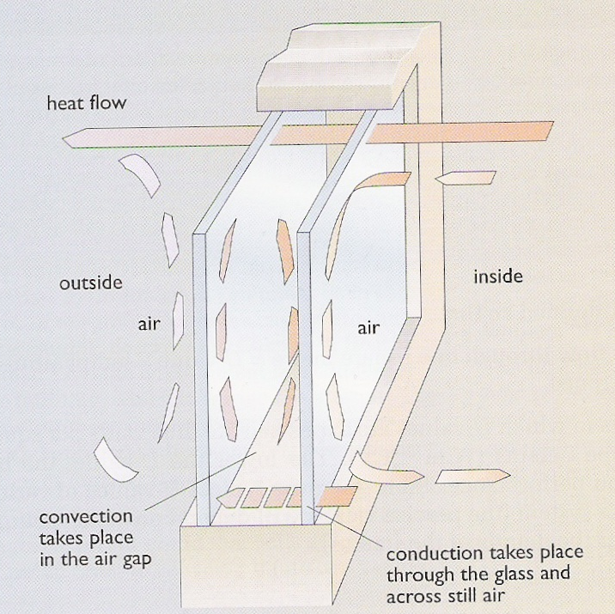
Heat loss and terms
The rate of heat flow through glass depends on three factors:
Difference in temperature on either side;
Total area; and
Insulating properties of the glazing.
Thermal conduction: flow of heat from hot to cold areas
Radiation: low-E (emission) coatings cut radiated heat loss across panes
Insulators: resist the flow of heat
Air is a good insulator
Convection: warming air (or fluid) becomes less dense and rises; as it cools it sinks back down
Filling air spaces with denser, thus less mobile gases, reduces convection.
Reducing the size of the space reduces convection: triple glazing
Vacuum stops convection but is technically difficult
Renewable Energy, 2/e, Chapter 2

Slide 45
Heat loss characteristics, U-value
U-value is a practical measurement of the loss of energy through a material.
Lower U-value is better.
Heat loss can be calculated using U-value, square footage and the temperature differential.
window type | U-value (W/m²/°C)
single glazed | 6
double glazed | 3
+ low-E coating | 1.8
+ heavy gas filling | 1.5
+ 3 plastic films and heavy gas | 0.35
+ evacuated with low-E coating | 1.0
10 cm opaque fiberglass | 0.4
A 2-square meter single-glazed window is used with indoor and outdoor temperatures of 20°C and 5°C.
Heat loss rate
= (6 W/m²/°C)(2 m²)(15°C)
= 180 W
Effect of more efficient windows
= (1 W/m²/°C)(2 m²)(15°C)
= 30 W
Renewable Energy, 2/e, Chapter 2

Slide 46
Providing low-temperature heat
In the UK (2003) most domestic end-of-use fuel was used for low-temperature heating.
  58% space heating
  24% water heating
Efficient means of providing this heat include:
  Solar;
  District heating systems using waste heat;
  Small-scale CHP; and
  Heat pumps.
Renewable Energy, 2/e, Chapter 2

Slide 47
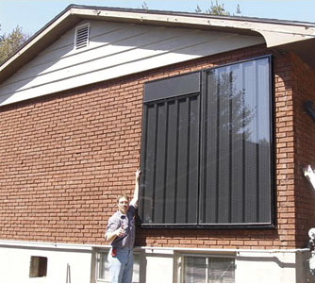
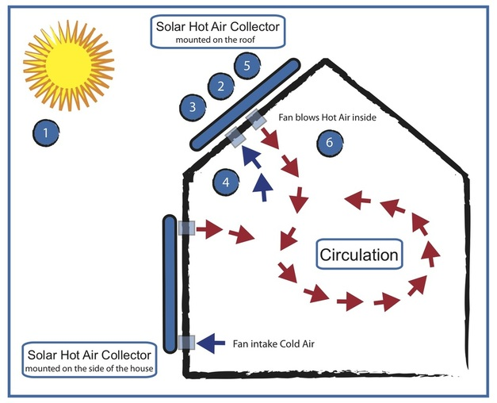
Solar hot air collector
Solar hot air collectors: are a modular, after-market Trombe wall.
Cold air flows into the bottom of the panel.
Solar energy is captured by an absorber and heats the air.
Rising hot air is blown into the house when the heated air is warmer than inside air.
Up to 50°C increase
Renewable Energy, 2/e, Chapter 2;
http://www.beach1electric.ca/solar-hot-air.html;
http://www.beebehavior.com/images/SolarCollector/air_solar_collector_2.jpg

Slide 48
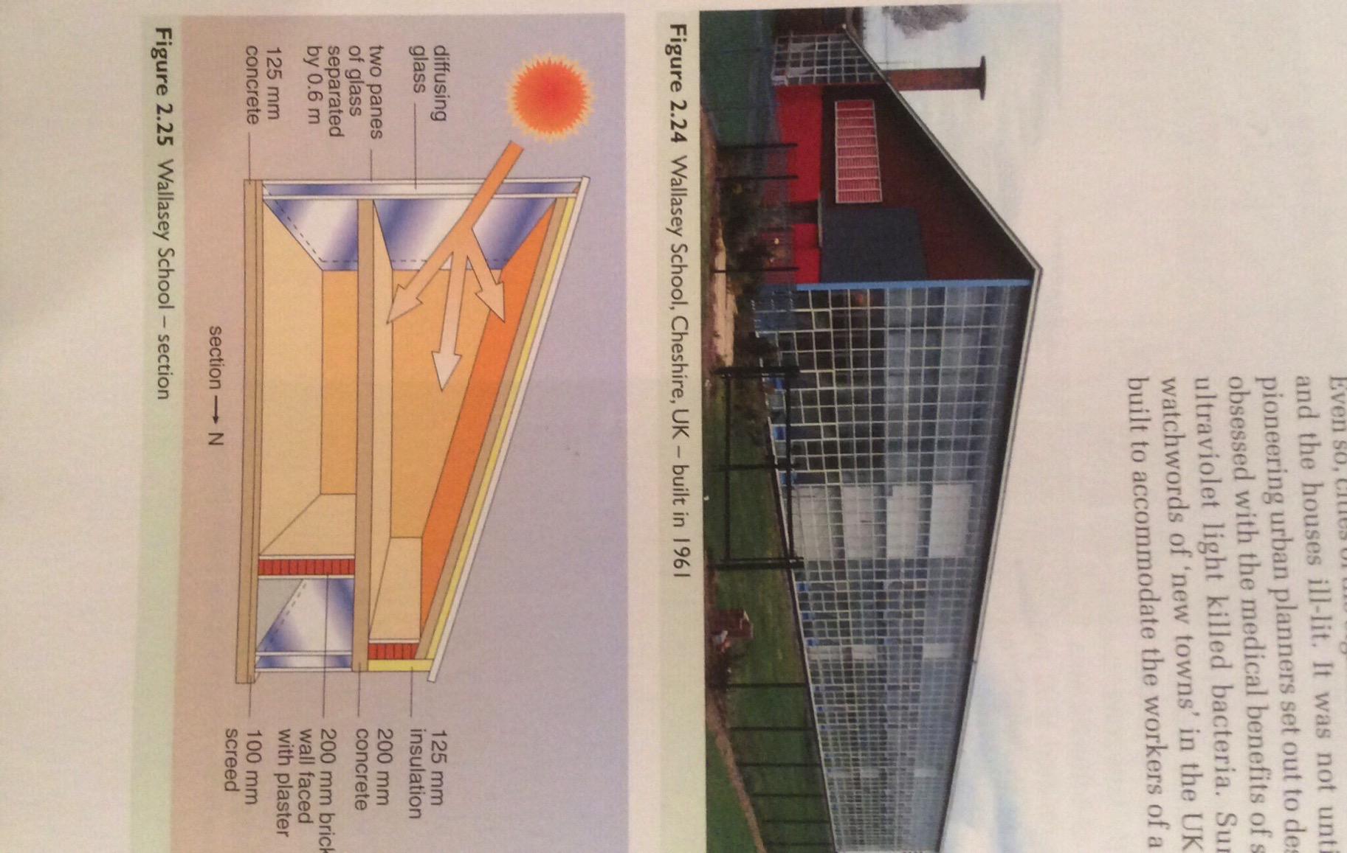
Passive solar heating: tied to glass
The Romans could make large glazed windows. After the fall of Rome this art disappeared and didn’t resurface until the late 1700s in France.
The push for sanitation & health made use of sunlight a priority in building in late 1880s.
Direct gain design:
Large area of south-facing glazing;
Thermally heavy construction to store / retain heat until night;
Thick insulation to retain heat.
Renewable Energy, 2/e, Chapter 2

Slide 49
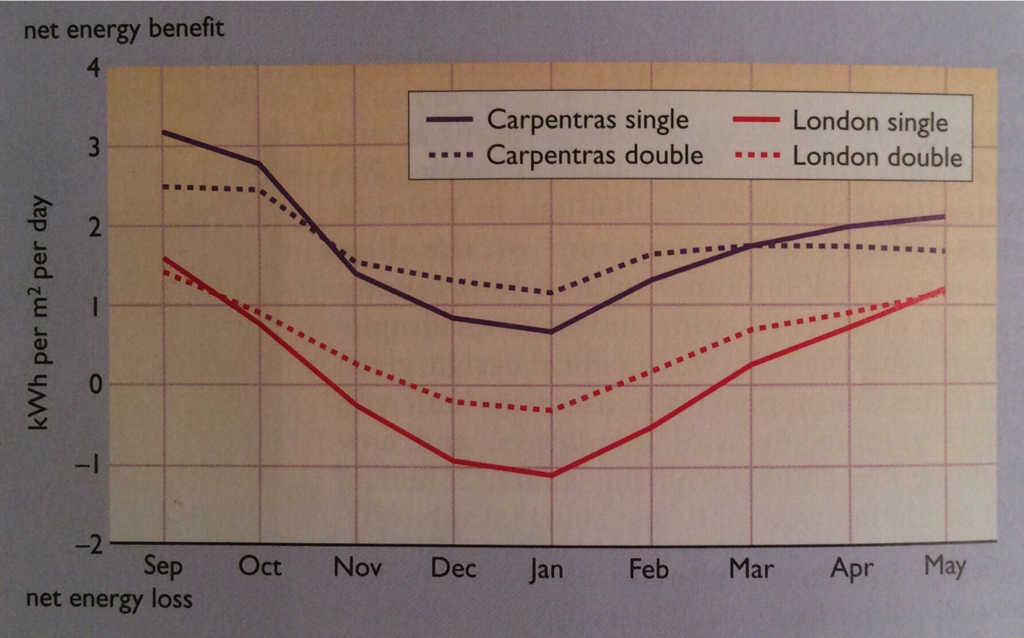
Window energy balance
Window energy balance looks at the possible thermal gain (net energy benefit) from placing a window in a south-facing wall.
Dependent on location
Shoulder seasons vs. total heating season
Renewable Energy, 2/e, Chapter 2

Slide 50
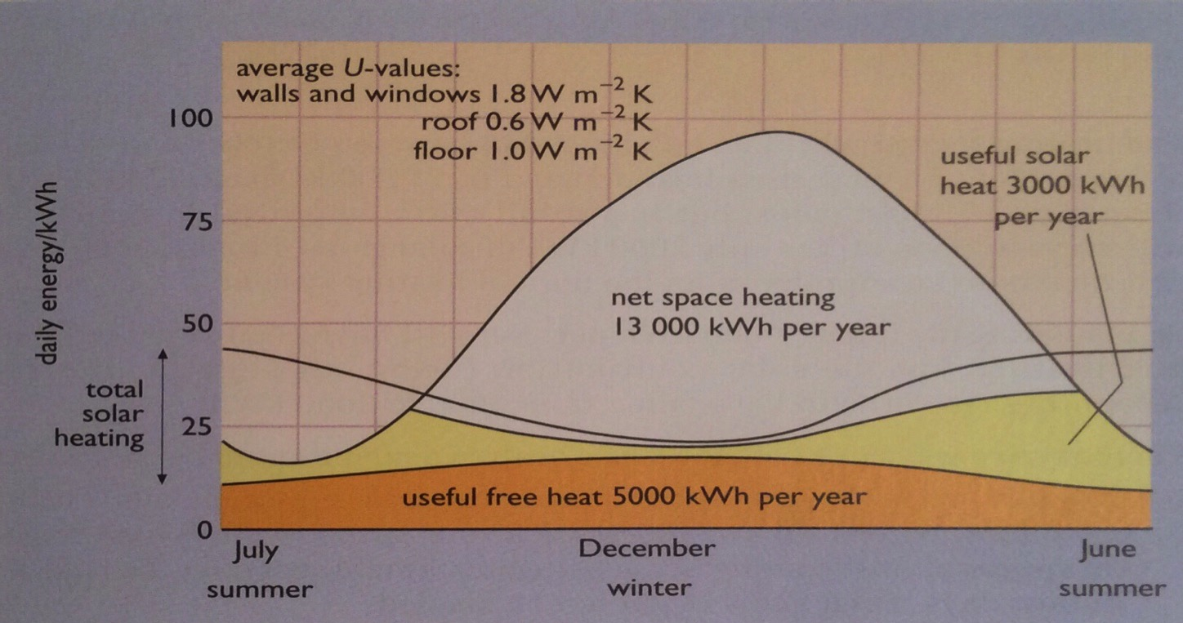
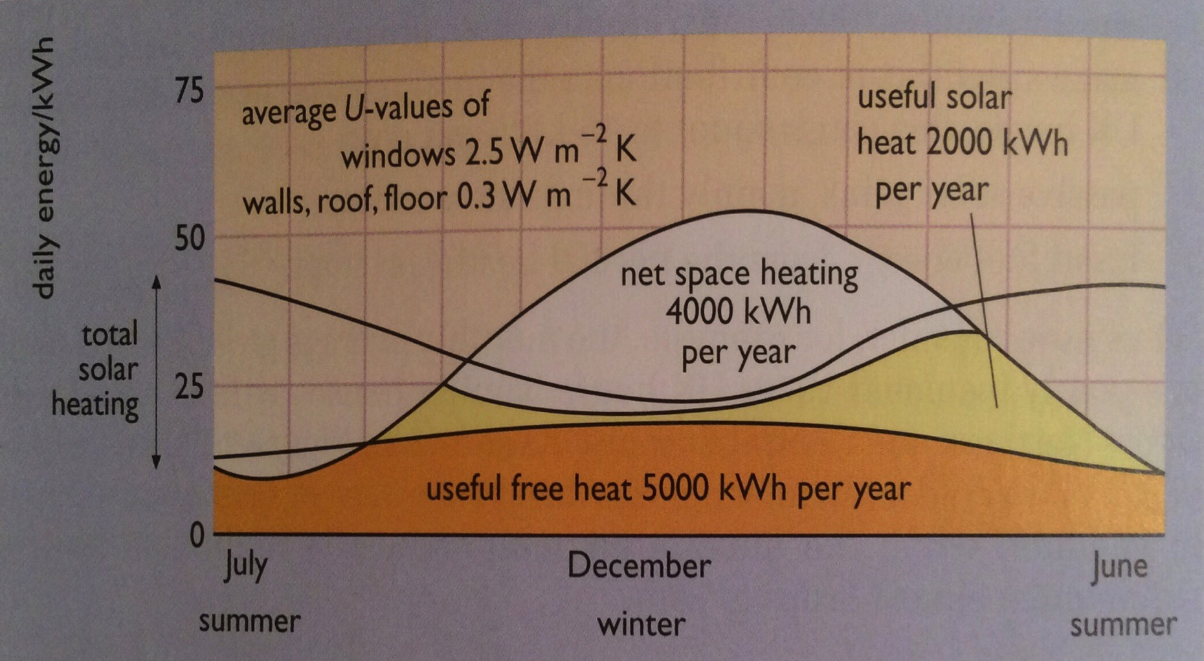
Contribution of solar gain?
The ability of solar gain to play a significant role in total building heating need depends on a number of factors:
Location
Design and insulation
14% passive solar
Renewable Energy, 2/e, Chapter 2
18% passive solar and better insulation

Slide 51
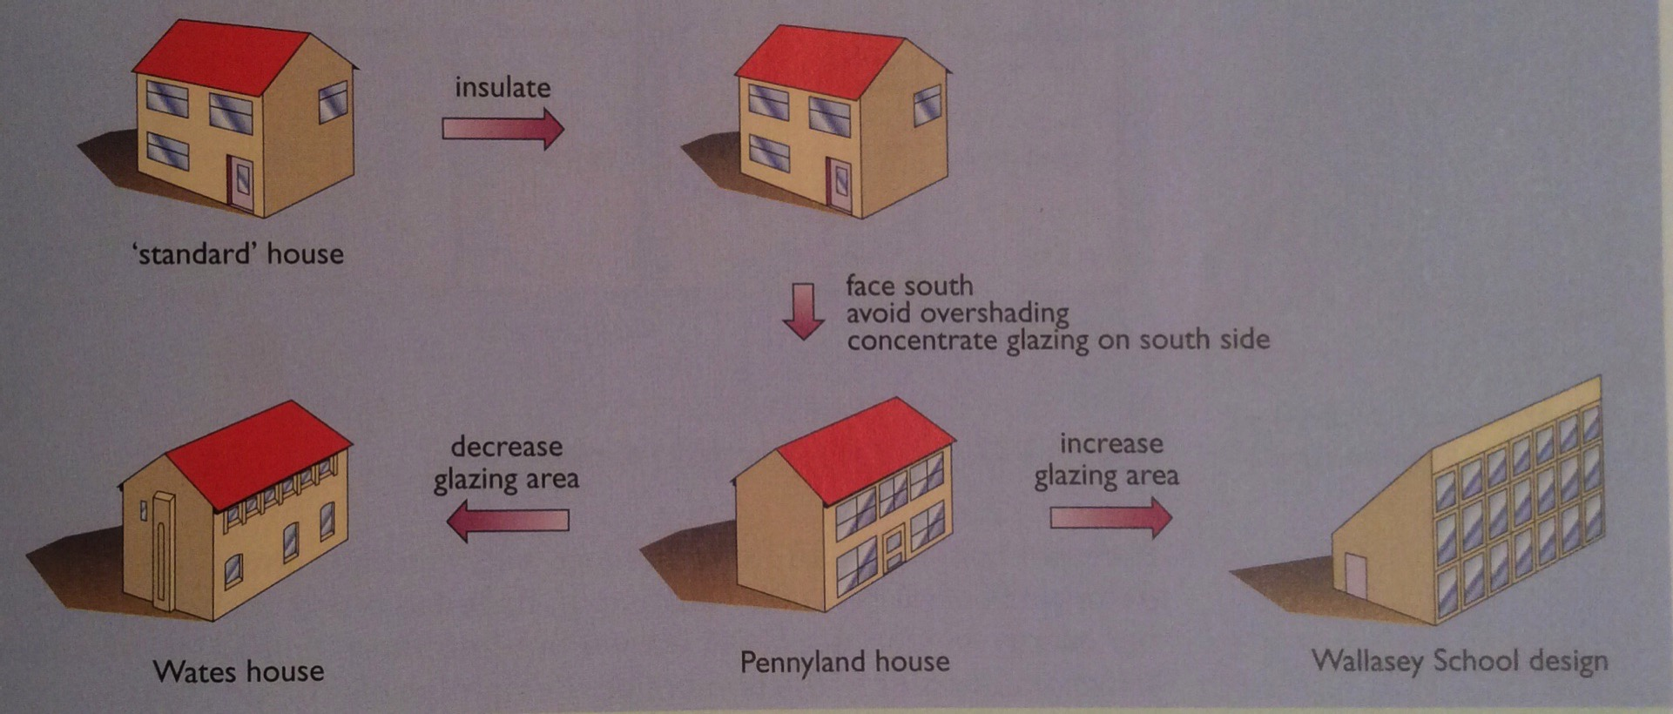
Passive solar heating techniques?
Buildings meant to use passive solar gain should:
Be well insulated;
Have responsive and efficient heating systems;
Face south with most-used rooms open to the south;
Avoid over-shading; and
Be thermally massive to hold heat and summer cool.
Extra cost = 2.5%; payback = 4 years
Renewable Energy, 2/e, Chapter 2

Slide 52
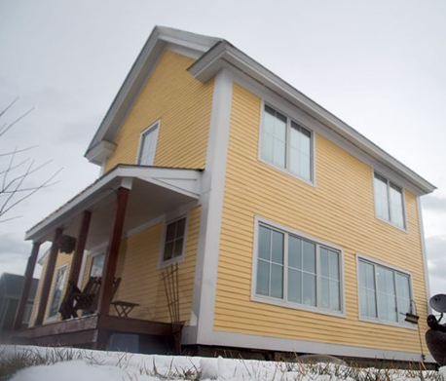
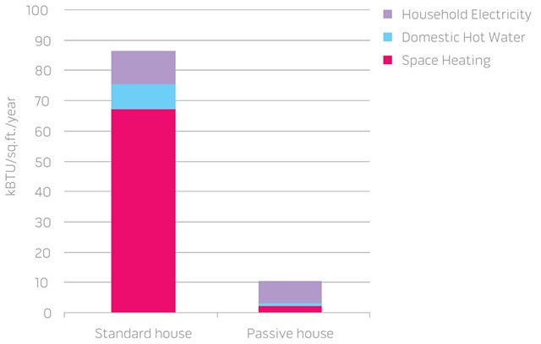
Vermont passive home
This passive home was built by Habitat for Humanity in Charlotte in 2011.
Super-insulated
Heated by the sun, appliances and occupants
All electricity is solar
Uses 90% less energy than an average home
Renewable Energy, 2/e, Chapter 2
https://www.sevendaysvt.com/vermont/does-the-ultra-efficient-passive-house-point-the-way-to-carbon-neutrality/Content?oid=2500123

Slide 53
Module 9. Solar energy
  9.6: Active solar heating
Renewable Energy, 2/e, Chapter 2

Slide 54
What is active solar heating?
Active solar heating uses water to collect, move and store the heat of the sun. Water is used as the storage medium and is then circulated to heat a space or as hot water.
Unglazed panels
Flat plate water collectors
Flat plate air collectors
Evacuated tube collectors
Line focus collectors
Point focus collectors
Renewable Energy, 2/e, Chapter 2

Slide 55
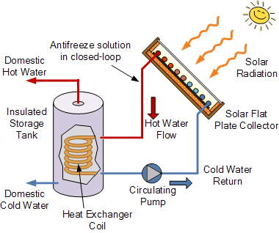
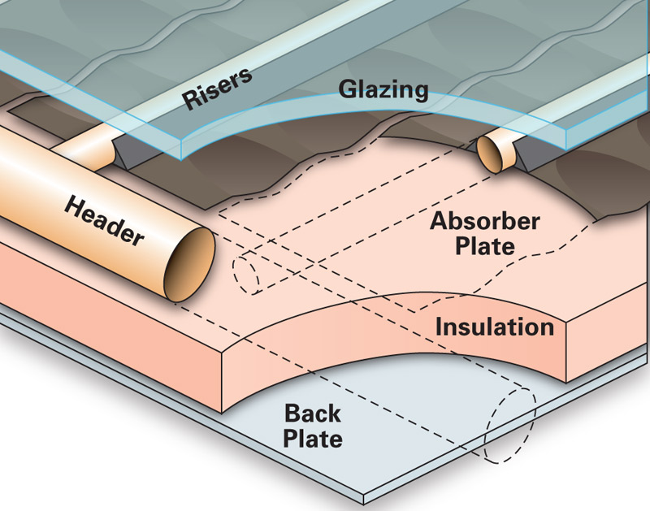
Unglazed, flat plate collectors
Unglazed panels: black boxes to run water through for low-level heating
  10°C increase
  Swimming pool heaters
Flat plate water collectors: box with single or double glazing
  Black absorber plate that collects > 90% of solar energy.
  High thermal conductivity to transfer heat to water pipes.
  Up to 50°C increase
homepower.com/articles/solar-water-heating/equipment
-products/flat-plate-evacuated-tube-solar-thermal-collectors
alternative-energy-tutorials.com/solar-hot-water/flat-plate-collector.html

Slide 56
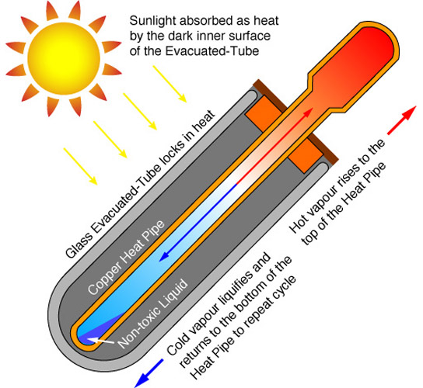
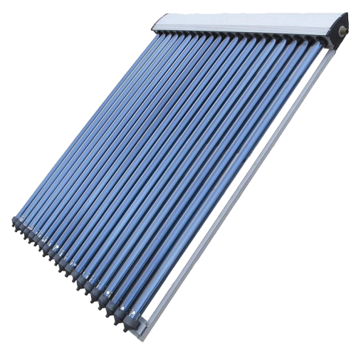
Evacuated tube collectors
Evacuated tube collectors: evacuated glass tubes are used as the collector box to prevent convective heat loss
Strip of absorber runs down each tube along with…
A closed copper tube containing alcohol.
Solar energy boils the alcohol, steam (vapor) rise to the top...
And transfers heat to a manifold heat exchanger.
10 – 150°C increase
http://www.siliconsolar.com/30-vacuum-tube-collector-p-18102.html

Slide 57
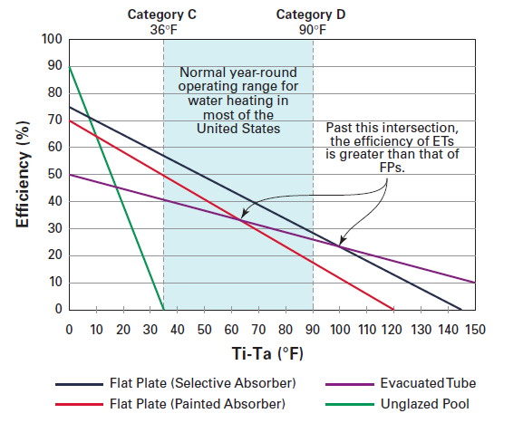
Collector efficiency
T_{i} : Temperature at collector inlet
T_{a}: Air temperature
NREL

Slide 58
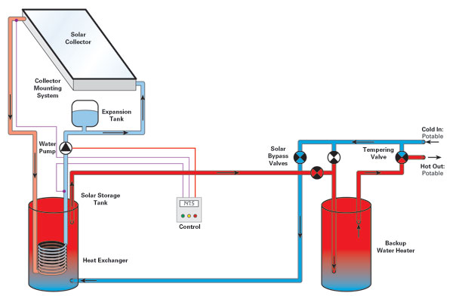
Pressurized heat transfer system
Pressurized glycol systems: best choice for very cold climates.
Active, closed-loop system
Incoming potable water is routed to the solar storage tank.
A water and antifreeze mixture circulates from the collectors through a coil of pipe in the solar tank, and then is pumped back through the collectors.
http://www.intermtnwindandsolar.com/pressurized-glycol-system/

Slide 59
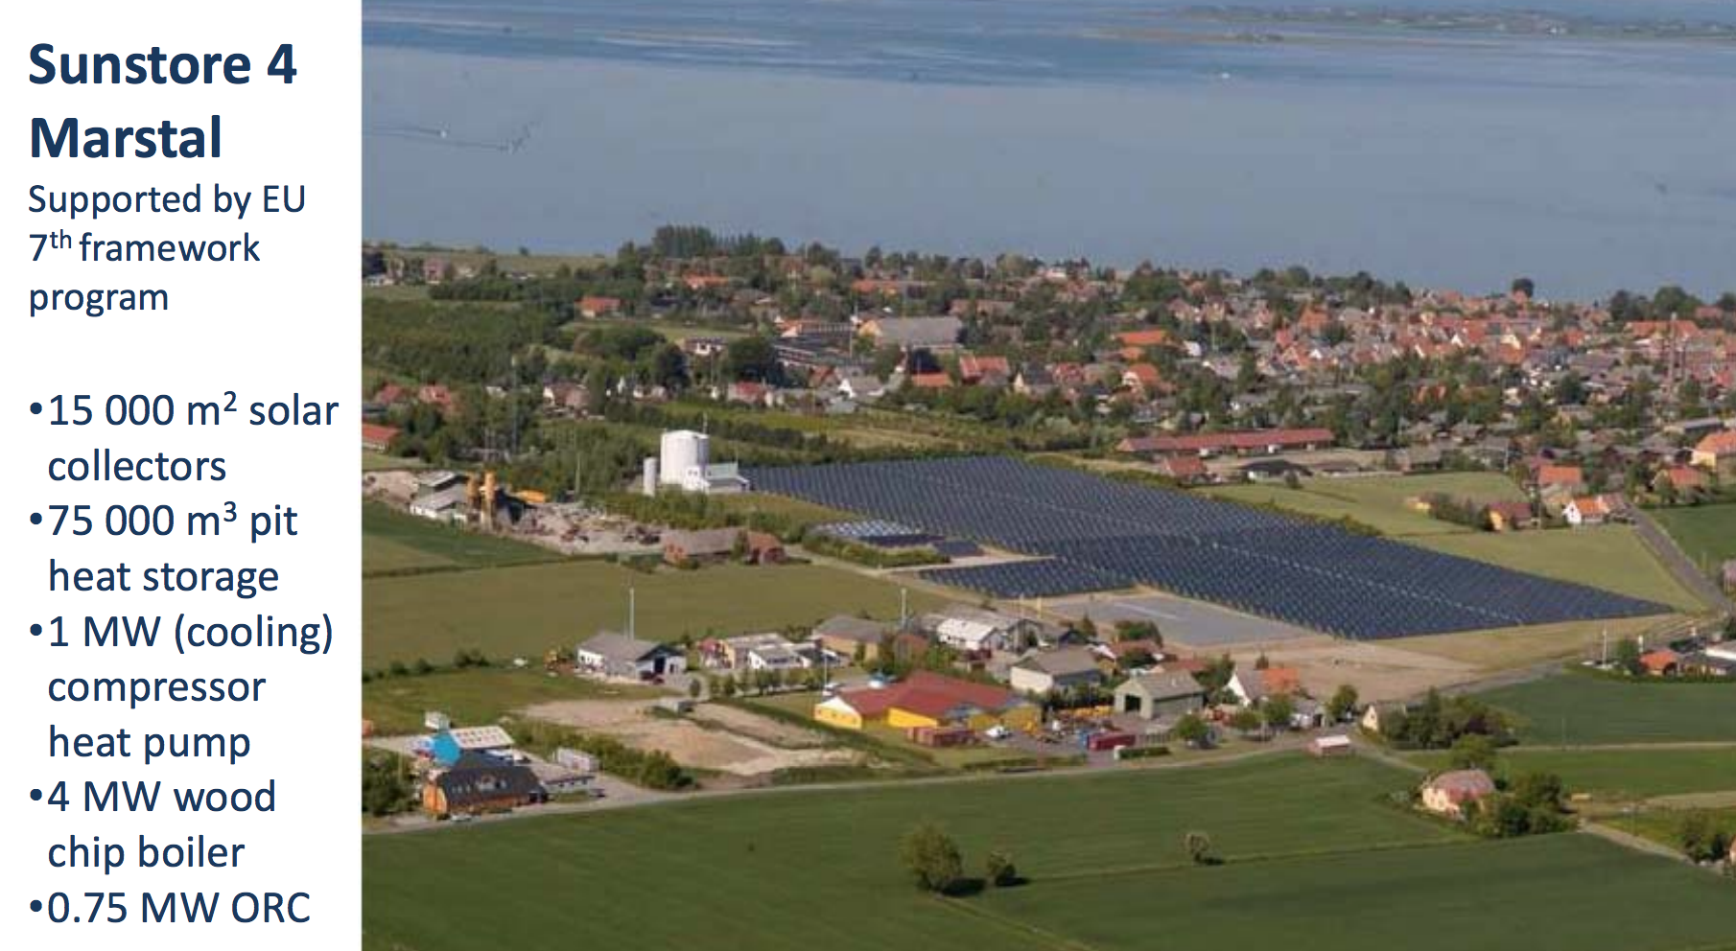
District solar heating
By 2002, 65 district solar heating systems in Denmark, Sweden and Germany had more than 500 m² of collector area each.
Total of 110,000 m²
Peak output of 50 MW of heat
Residential service
https://en.wikipedia.org/wiki/Central_solar_heating
https://cleanenergysolutions.org/sites/default/files/documents/June%205%20Per%20Alex%20Sorenson_MARSTAL_CHP%20DHC_05062014.pdf

Slide 60
Module 9. Solar energy
  9.7: Daylighting
Renewable Energy, 2/e, Chapter 2

Slide 61
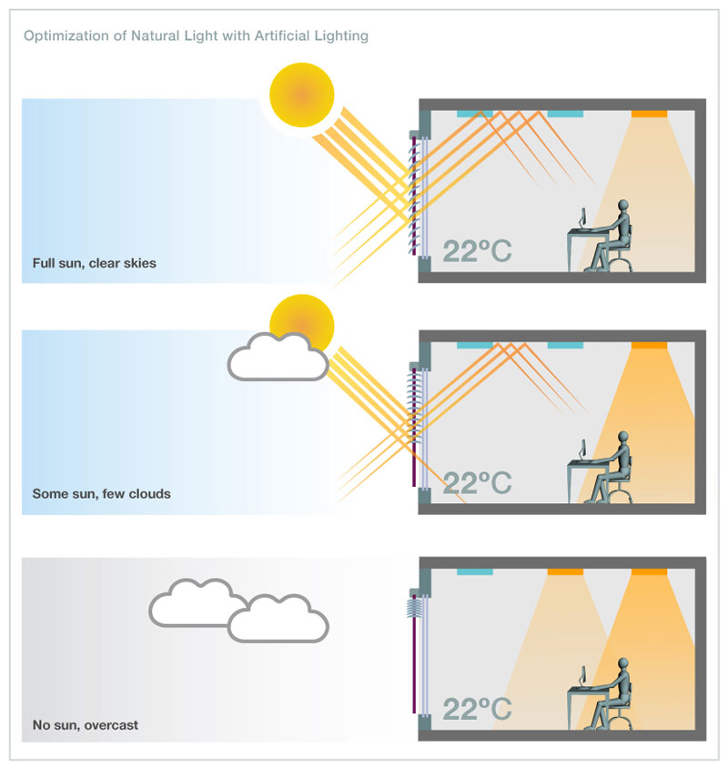
Daylighting
Daylighting is the design of a building to make maximal use of natural (sun)light and minimize use of electrical lighting.
Techniques:
Shallow-plan design for good light penetrance;
Light wells at the center of the building;
Roof lights;
Tall windows; and
Task lighting vs. room lighting.
Renewable Energy, 2/e, Chapter 2
sunproject.com/sustainable-design/energy-daylight-management

Slide 62
Module 9. Solar energy
  9.8: Concentrating solar power
Renewable Energy, 2/e, Chapter 2

Slide 63
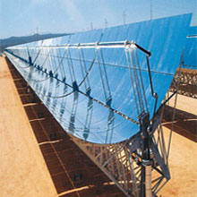
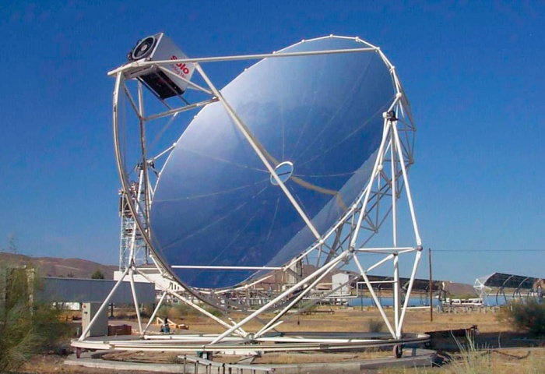
Line and point focus collectors
Line or point focus collectors: concentrate solar energy using parabolic mirrors and heat water to steam.
Typically used for generating electricity.
Mirrors may follow or track the sun.
100 – 150°C increase
http://www.ecosolenergy.com/images/services/Solar_Trough_01.jpg
https://www.homepower.com/articles/image/7353/3319?template=colorbox

Slide 64
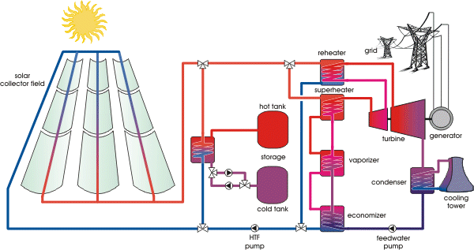
Solar thermal engine schematic
https://www.volker-quaschning.de/articles/fundamentals2/index_e.php

Slide 65
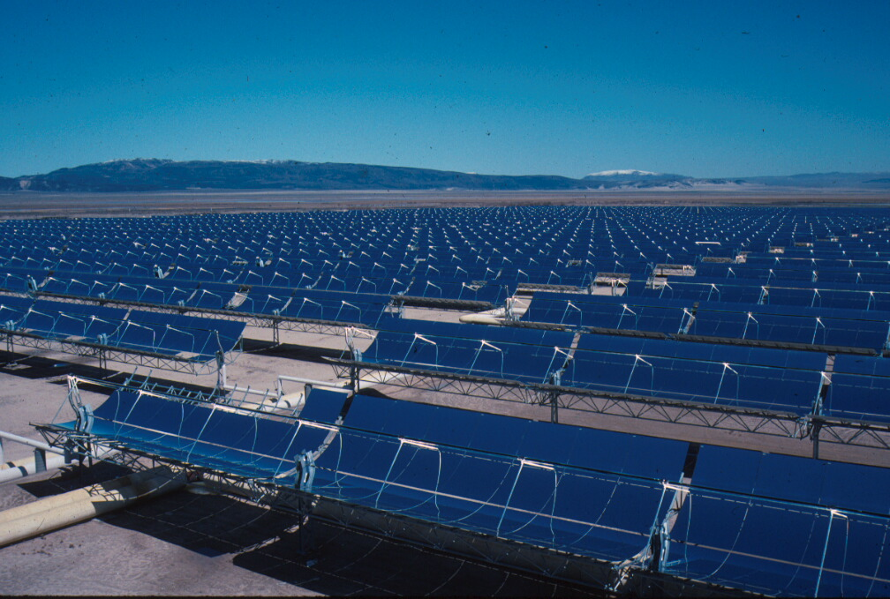
Solar Electric Generating systems, CA
Solar Electricity Generating Systems, CA (Mojave Desert)
Nine generating plants of 13 – 80MW each
  >936,000 mirrors on 1,600 acres
  Power 232,500 homes, displacing 3,800 tons of pollution
Fields of parabolic trough solar collectors
focused on pipes carrying synthetic oil to 390°C.
Produces high-temperature steam
to drive Rankin cycle steam turbines.
18 – 20% efficient
LCOE higher than PV NG.
  NG runs the turbines at night.
Renewable Energy, 2/e, Chapter 2
https://en.wikipedia.org/wiki/Solar_Energy_Generating_Systems

Slide 66
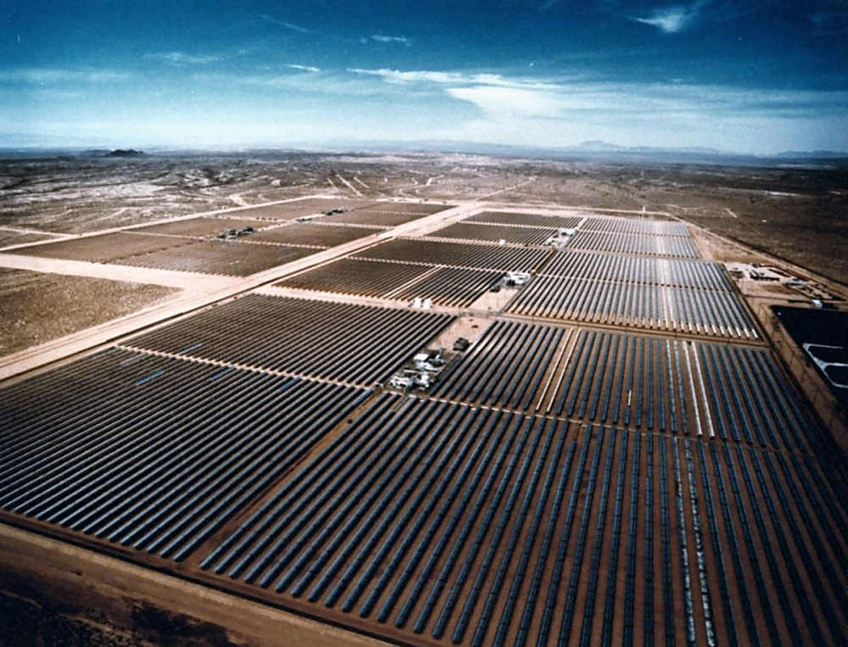
SEGS, Mojave Desert

Slide 67
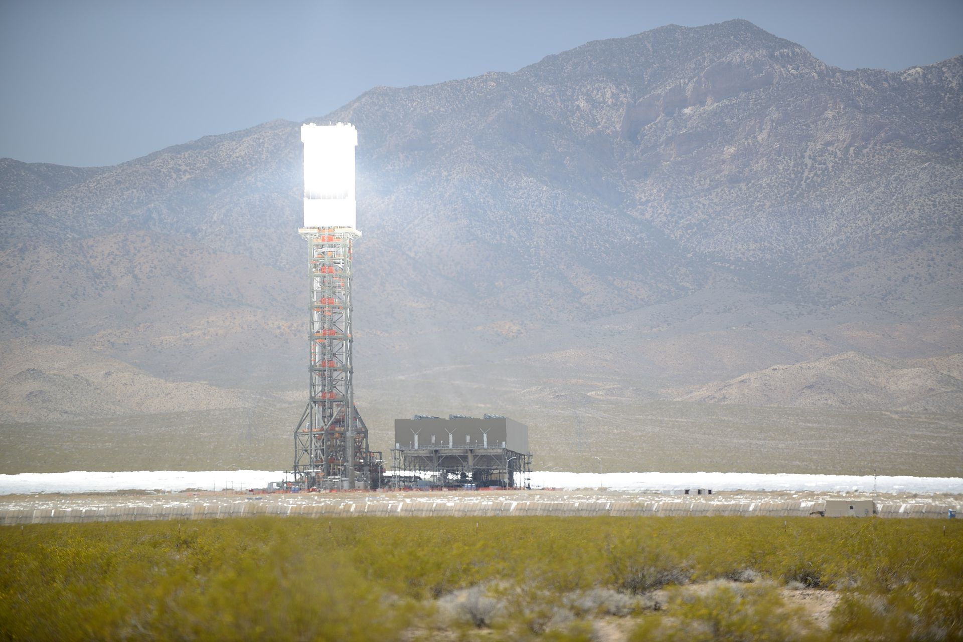

Concentrating solar-thermal power (CSP)
Power towers (aka solar furnace) focus the solar energy from fields of heliostat mirrors upon a boiler located atop a central tower. Heat exchange produces high-temperature steam and thus electricity.
Heat transfer medium?
Synthetic oil was used in the 1980s.
Molten sodium metal allows heat storage as well as transfer.
Molten salts “ “ “
https://en.wikipedia.org/wiki/Solar_power_tower#cite_note-Kraemer-4
https://www.energy.gov/eere/solar/concentrating-solar-thermal-power

Slide 68

Concentrating solar-thermal power (CSP)

Slide 69

PS10 in Seville, Spain (CSP)
Europe's first commercial concentrating PS10 CSP tower is operating near the sunny southern Spanish city of Seville.
The 11 MW solar power tower produces electricity with 624 large movable mirrors called heliostats.
https://en.wikipedia.org/wiki/PS10_solar_power_plant

Slide 70

Ivanpah, California (CSP)
2014 - The world's largest solar thermal plant, the Ivanpah Solar Electric Generating System in California. The array produces a total 392 MW of power through 173,500 multi-mirror units.
https://en.wikipedia.org/wiki/Ivanpah_Solar_Power_Facility

Slide 71

Crescent Dunes, NV (CSP)
Power sold to NV Energy for $0.135 / kWh, 25-year agreement
500,000 MW output at capacity factor of 52% (110 MW plant)
640-foot tower with molten salt energy storage (1.1 GW)
$737 m loan guarantee from the Federal Government
Renewable Energy, 2/e, Chapter 2
breakingenergy.com/2015/02/10/solarreserve-crescent-dunes-solar-tower-will-power-up-in-march-without-ivanpahs-woes/

Slide 72


Reducing bird mortalities
In the first months of operation, a solar tower killed hundreds of birds that flew through its solar halo.
Reworking operations has lowered bird deaths.
Each spot in the pancake is equivalent to ‘only’ four suns.
Renewable Energy, 2/e, Chapter 2
https://cleantechnica.com/2015/04/16/one-weird-trick-prevents-bird-deaths-solar-towers/
Solar halo formed by heliostats
in standby position
Algorithms were used to reshape the ‘halo’ into a less dangerous ‘pancake’.

Slide 73
Module 9. Solar energy
  9.9: Photovoltaics: how PV works
Renewable Energy, 2/e, Chapter 3

Slide 74
Photoelectric effect
In 1839, the French physicist Alexandre-Edmund Becquerel found that the voltage of a wet cell battery he was developing increased when its silver plates were exposed to sunlight.
In 1876, William Grylls Adams and his student, Richard Evans Day, discovered that an electrical current could be started in selenium solely by exposing it to light.
This pioneering work portended quantum mechanics long before most chemists and physicist had accepted the reality of atoms.
In 1883, Charles Edgar Fritts made a selenium solar cell with 1% efficiency.
In 1905, Albert Einstein discovered that the photoelectric effect was resulted from the quantum nature of matter at the subatomic scale.
In 1953, the team of Chapin-Fuller-Pearson at Bell Labs produced ‘doped’ silicon that had much better PV efficiency.
Renewable Energy, 2/e, Chapter 3

Slide 75


Silicon makes PV cells practical
1953: While researching silicon for its possible applications in electronics, Gerald Pearson, an empirical physicist at Bell Laboratories, inadvertently made a solar cell that was far more efficient than solar cells made from selenium. Two other Bell Labs scientists - Daryl Chapin and Calvin Fuller - refined this discovery and developed the first solar cell capable of converting enough of the sun's energy into power electrical equipment.
Renewable Energy, 2/e, Chapter 3

Slide 76

Evolution of PV technologies
While the efficiencies of newer technologies are low, they will likely increase as development continues. Printed panels offer some obvious advantages.
NREL

Slide 77

Semiconductors
Semiconductors: materials or elements whose ability to conduct electrons is intermediate between conductors (metals) and insulators (like glass).
Don’t have an abundance of electrons in the ‘conduction band’.
Group IV semiconductors
Group III-V semiconductors
Group II-V semiconductors

Slide 78

Semiconductors and doping
PV cells are a junction between two thin layers of silicon.
p layer (positive)
n layer (negative)
Doped with B (electron-deficient, so positive) = holes
Doped with P (surplus electrons so negative)
Renewable Energy, 2/e, Chapter 3
http://solarjourneyusa.com/bandgaps.php

Slide 79

How a PV cell works
www.homepower.com/articles/solar-electricity/equipment-products/peek-inside-pv

Slide 80

How do solar panels work?

Slide 81


Monocrystalline ingots via C
Single crystals, or ingots, of silicon can be formed using the Czochralski process, developed by accident when he dipped his pen nib in tin instead of ink and pulled a single crystal of tin out.
https://en.wikipedia.org/wiki/Czochralski_process
single silicon crystals or ingots

Slide 82


Less expensive forms of Si for PV
Pulling single crystals requires very pure silicon and is slow and painstaking. Less pure, and less expensive, forms of silicon can be used to make PV cells.
Polycrystalline silicon is made from many small grains of monocystalline silicon.
Formed into cubic ingots; sawn into wafers.
Ribbons and sheets of silicon can be drawn from multicrystalline silicon melt.
Pulled via dies, cut with lasers and formed into sheets.
Renewable Energy, 2/e, Chapter 3

Slide 83

Assembling cells into panels

Slide 84

Environmental costs of PV?
The processing of making silicon for PV panels uses hazardous and toxic chemicals like sulfuric acid, hydrofluoric acid, and heavy metals; creates hazardous waste like silicon tetrafluoride.
Serious effects on human health, and
Environmental health: compromised water quality and
infertile soils
In 2008, there were reports of chemical dumping in China.
By 2014, a study of 37 PV manufacturers by Solar
Scorecard ranked one Chinese company as most
responsible, followed by a US firm.
http://www.washingtonpost.com/wp-dyn/content/article/2008/03/08/AR2008030802595.html
https://news.nationalgeographic.com/news/energy/2014/11/141111-solar-panel-manufacturing-sustainability-ranking/
http://2011.solarteam.org/news/recycling-methods-for-used-photovoltaic-panels
As PV panels age out, they will need to be recycled to avoid releasing hazardous chemicals, like the toxic heavy metals in many panels.
PV panels are recycled in Europe.
Recycling hasn’t begun in the US;
not sufficient need.

Slide 85
Repurposing old PV panels
A number of businesses have now sprung up to repurpose solar panels at the end of their efficient lifespan, or that are replaced to increase the efficiency of existing arrays.
Replacement parts for old PV systems.
Installation of systems that need not be super efficient.
Missionary work like ’Working for the Son Solar’
  Sell and install degrading panels for volunteer projects and use the proceeds to create solar + storage microgrids at missionary projects in Mexico.
  They recycle some of the panels, recovering 90% of the solar module.
https://www.solarpowerworldonline.com/2019/01/old-solar-panels-get-second-life-in-repurposing-and-recycling-markets/

Slide 86
Recycling old PV panels
In 2018, RecyclePV opened a plant designed to recycle PV panels opened in Arizona.
Uses European techniques
The recover up to 98% of the materials which can then be used to make new panels.
As the panels used in the current PV boom age out, reuse and recycling will be critical.
All states will need to enact PV recycling mandates.
Not so today.
https://www.solarpowerworldonline.com/2019/01/old-solar-panels-get-second-life-in-repurposing-and-recycling-markets/

Slide 87
Module 9. Solar energy
  9.10: Types of PV systems and arrays
Renewable Energy, 2/e, Chapter 3

Slide 88



Fixed-mount rooftop PV arrays
Generally less expensive and a bit less efficient than pole-mount or trackers.
Siting is never controversial.
Permitting is minimal.
Electrical service is present.

Slide 89
Size and cost for a household PV system?
The average Vermont household uses 569 kWh per month (2015),
or 6,828 kW per year.
A 2012 study looked at 5 kW rooftop-mounted residential PV systems in Vermont.
$25,000 total cost installed
10-year payback
$34,956 profit over a 25-year life
By 2020, prices had fallen dramatically to $2.64 to $3.56/W.
5 kW system would now be ~ $15,000
In Vermont, the average solar payback period is 10.05 years.
https://en.wikipedia.org/wiki/Solar_power_in_Vermont

Slide 90



Pole-mount PV arrays
Trackers follow the sun while pole-mount arrays do not.
Trackers generate more electricity, but…
  Are a bit more expensive and ...
  A bit more complex.
https://www.solarpowerworldonline.com/2016/05/advantages-disadvantages-solar-tracker-system/

Slide 91

Building-integrated PV
Integration could contribute to making new buildings self-sufficient.
Perovskite thin films should make building-integrated PV easier, more efficient and less expensive.
… more later

Slide 92

Utility-scale PV
Utility scale-PV is large field of fixed-angle or tracking PV panels or solar tower powers.
In Vermont, the cap for net-metering is a 1-MW solar array.
http://fortune.com/2015/05/18/solar-power-ripasso

Slide 93

Most Americans: wildly in favor of expanding solar
While Americans can have pretty NIMBY attitudes towards many things the vast majority favor increased use of solar power.
In a 2016 poll, 76% of Vermonters were in favor of expanding solar power.
https://pv-magazine-usa.com/2019/11/26/92-percent-of-americans-want-moar-solar-power/
https://suncommon.com/vermonters-want-more-solar-in-their-towns/

Slide 94

However, some fear that solar will displace farms
And opposition is often more passionate than support.
Lewiston NY (upstate) a landowner, who had leased 18 acres to a farmer, switched his lease to a power company who created a PV farm. The landowner’s income increased 20%.
The community is angry and concerned:
Loss of farmland available to small farmers
Loss of biodiversity and species
Glare that could endanger drivers
Aesthetics and loss of property value for neighbors
“At least a dozen towns in New York State have placed moratoriums on new solar projects, and several others are weighing temporary bans.”
Similar backlashes are occurring in other states like Virginia.
https://www.nytimes.com/2020/03/18/nyregion/solar-energy-farms-ny.html

Slide 95
Big solar vs. neighborhood solar?
Also in upstate NY, a power company is planning the Bear Ridge Solar project.
100 MW
900 acres – much prime agricultural soil
Power for 15 – 20,000 homes
Offset 160,000 tons of CO2 ~ 15,000 cars
In 2018, a solar developer proposed a 20-MW array in Randolph Center, just down the road from the college.
100 acres – much on prime agricultural land
49 acres of woods would be cleared
Energy credits would be sold to
CT so that project wouldn’t
could towards Vermont’s RE goals.
https://www.nytimes.com/2020/03/18/nyregion/solar-energy-farms-ny.html
https://ccrenew.com/projects/bearridge/
https://www.ourherald.com/articles/opposition-forms-around-big-solar/

Slide 96
Can solar PV and agriculture co-exist?
There is evidence – and evolving business models – that suggest that solar farming and agricultural farming can co-exist and use the same land.
A NJ sheep farmer was looking for more land for her folk, drove past a solar farm and had an epiphany. She now pastures sheep at a number of solar farms where they graze the land and take the place mowing equipment.
Others are grazing beef, chickens or goats and some are farming vegetables, some of which grow better in partial shade.
Agrivoltaics
High racks leave sufficient space beneath them.
Universities are investigating systems that optimize both ‘crop’ yields.
https://www.npr.org/2020/10/09/919225272/how-to-have-your-solar-farm-and-keep-your-regular-farm-too

Slide 97
Module 9. Solar energy
  9.11: Trends in PV application
Renewable Energy, 2/e, Chapter 3

Slide 98
Remote PV: of use where grids don’t go
Remote (or off-grid) PV is used to power devices in areas that don’t have access to the electrical grid.
Battery storage is sometimes included to allow power to extend beyond daylight hours.
Uses are limited only by human imagination, but are often prioritized by a community’s needs:
Pumping water;
Refrigerators;
  Keeping medicines and vaccines cold;
Power for homes and community centers; and
Telecommunications.
Renewable Energy, 2/e, Chapter 3

Slide 99
Who’s got power?
2017 data showing the percent of global and national populations without access to an electrical grid.
10.5% of global
population

Slide 100

Pairing PV and energy storage
Pairing PV systems and energy storage is useful for:
Remote, off-grid systems
To create a flexible and distributed grid with high levels of intermittent generation.
https://www.seia.org/solar-industry-research-data

Slide 101

Adding PV to infrastructure
The Swiss have used PV in place of visual and noise barriers along roadways.
tnc.ch/en/power-instead-noise-photovoltaic-noise-barriers-1

Slide 102
Floatovoltaics
Water reservoirs offer huge flat surfaces for installation of solar panels.
Water cools the back of the panels and increases efficiency by 10%.
No arable land is used.
Evaporation is reduced.
Growth of algae is reduced.
https://e360.yale.edu/features/floating_solar_a_win-win_for_drought-stricken_lakes_in_us
https://science.howstuffworks.com/environmental/green-tech/energy-production/china-flips-switch-on-world-s-largest-floating-solar-farm.htm

Slide 103
Module 9. Solar power
  9.12: New developments in solar energy

Slide 104

Multi-junction PV
Multi-junction PV cells essentially stack number of different n- and p-layers to create a cell that is responsive to photons of varying wavelengths, increasing the overall efficiency of the cell.
  Overall efficiencies approach 50%.
Renewable Energy, 2/e, Chapter 3
https://en.wikipedia.org/wiki/Multi-junction_solar_cell

Slide 105

Concentrating PV systems
The efficiency of any PV cell can be increased by focusing (or concentrating) more sunlight on each cell.
Lenses can be used to capture and focus sunlight.
The must efficient cells should be used & must be cooled.
The array should track and be located where sunlight is abundant.
A head-to-head study at Penn State showed that tracking concentrating PV can produce 53% more energy than standard solar cells.
73% increase possible with cooling
Renewable Energy, 2/e, Chapter 3
.solaflect.com/faq-what-about-future-advances-in-solar-technology/

Slide 106

Silicon sphere PV
Spheres of doped silicon are placed in hexagonal reflective cups and mounted on a flexible foil surface: mini concentrators.
Uses less silicon (only 20%).
Cuts manufacturing costs by up to 50%.
P-doped spheres are coated with n-doped surface and anti-reflective coating.
Bonded to an electrode at cup’s bottom.
Efficiency needs to be improved.
Renewable Energy, 2/e, Chapter 3
technologyreview.com/s/409037/focusing-light-on-silicon-beads/

Slide 107
Insolight: lenses focus light and increase efficiency
An array of hexagonal lenses focuses sunlight on small PV cells.
Increases efficiency from ~19% to 30%.
Less effects from shading.
https://insolight.ch/technology/
https://www.bbc.com/news/business-51799503

Slide 108

Perovskites: an alternative to silicon
Perovskites are a mineral, calcium titanium oxide (CaTiO3).
Perovskites can be used in place of silicon to create PV cells with these advantages:
Can be used to make a thin (300 nm) flexible film to coat many objects
  Can by applied with an ink jet printer from solution
Perform better with low light intensity – cloudy days; indoors
Inexpensive
Less stable?
Coating conventional PV cells increases effective wavelengths and increases efficiency to 30%.
Up to 35%?
And less expensive
https://en.wikipedia.org/wiki/Perovskite#:~:text=Perovskite%20(pronunciation%3A%20%2Fp%C9%99,known%20as%20the%20perovskite%20structure. https://www.bbc.com/news/business-51799503
https://www.theguardian.com/business/2020/aug/15/uk-firms-solar-power-breakthrough-could-make-worlds-most-efficient-panels-by-2021

Slide 109

Solar thermophotovoltaic cells
Conventional PV panels loose much of incoming photon’s energy as heat. Researchers at MIT to capture most of the energy of incoming solar radiation, focus all of it to a narrower wavelength tuned to a particular PV cell, and emit it at that cell at will.
Current efficiencies are about 20%.
Promise? Storage of sunlight as heat with re-emission on demand.
‘Revers’ solar panels could harvest heat from radiated into the night sky.
http://bgr.com/2016/05/25/solar-panels-efficiency-doubled-mit/
https://s3tec.mit.edu/solar-thermophotovoltaics
https://www.euronews.com/living/2020/02/05/reverse-solar-panel-technology-still-works-when-the-sun-goes-down

Slide 110

PV in space?
Satellite solar power system (SSPS): would place PV arrays in geosynchronous orbit around the earth they would have access to 24/7 solar energy without absorbance by the atmosphere or any terrestrial shading. So, 1365 vs. 1000 W/m² power.
30-year old concept
Huge 50 km² arrays, each producing GW
Electricity would be converted to
microwaves and beamed from 1 km-
diameter antennas to 10 km² receiving
dishes on earth.
  Laser transmission might be possible.
Hugely complex and expensive
Renewable Energy, 2/e, Chapter 3
https://energy.gov/articles/space-based-solar-power

Slide 111

Artificial photosynthesis?
Plants capture 1% of the sun’s energy in photosynthesis to create sugars and carbon-based molecules. Let’s do that!
Researchers at Harvard have developed a ‘bionic leaf’ using a cobalt-phosphorous allow that can capture 10% of sunlight’s energy.
Energy is used to split water into H₂ and O₂.
Bacteria are then used to combine H₂ with
CO₂ to create hydrocarbons that could be
used as liquid fuels.
Researchers at Lawrence Berkeley National labs have developed a solar device that uses sunlight to convert CO₂ to formate, a carbon-based molecule that can be converted to liquid fuels.
Efficiency of 10%.
https://www.technologyreview.com/s/601692/the-road-to-solar-fuels-hits-a-speed-bump/;
https://hms.harvard.edu/news/bionic-leaf

Slide 112
Solar energy summary
Solar energy can be captured by passive or active systems as heat.
Solar radiation can be converted into electricity through heat engines or photovoltaics.
Photovoltaic devices are semiconducting diodes that produce currents when irradiated with photons
Photovoltaic systems cover a wide range of sizes.
Solar PV systems connected to the grid are the largest part of the current market.
Huge growth in this sector is expected.

