Slide 1
SSC 2030: Energy Systems & Sustainability
7A. Conventional baseload RE: hydropower
7.1: Hydropower history and global use
7.2: Hydropower technology
7.3: Large and medium dams and barrages
7.4: Small-scale hydropower
7.5: Hydropower without dams
7.6: Tidal power
7.7: Ocean and wave power without barrages
7.8: What about evaporation engines?

Slide 2
7. Conventional baseload RE
7.1: Hydropower history and global use

Slide 3
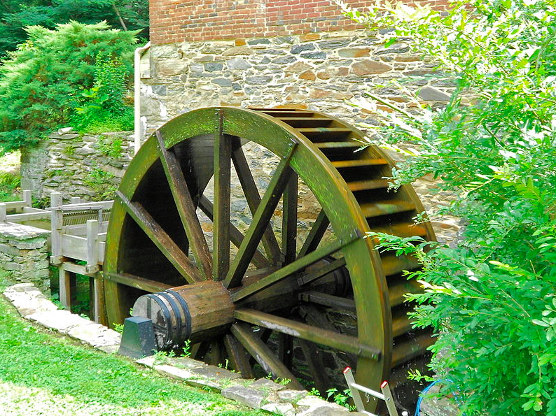
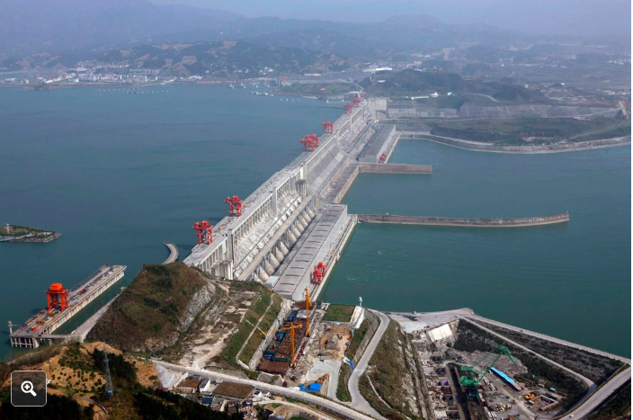
What is hydropower?
Hydropower is a form of renewable energy that converts the kinetic energy of moving water to mechanical energy and then electricity.
Dams and pumped storage hydropower create elevated reservoirs that store energy as positional potential energy.
When water is released, potential energy becomes kinetic.
In-flow hydropower (and tidal power) uses the kinetic energy of flowing water to produce electricity without use of dams or reservoirs.
Wave power uses the kinetic energy of constant (not tidal) wave action to produce electricity without use of dams or reservoirs.

Slide 4
Hydropower: ancient and modern
2,000 B.C.
Greeks use water wheels to grind grains
1975
US begins environmental regulation and protection
2005
US Energy Policy Act provides loan guarantees
2013
US federal boost to small hydro
1933
US establishes the Tennessee Valley Authority
1929
First major pumped storage on the Hoostatonic River in CT
1940
New Deal ramps up hydropower
1960s-1970s
Large dams built across the globe with IMF incentives
1936
Hoover Dam built
2012
Three Gorges Dam becomes operational
(longest)
https://www.energy.gov/eere/water/history-hydropower

Slide 5
Ancient hydropower
Traditional horizontal axis water wheels developed later.
The Norse and Greeks used vertical axis mills to grind grains.
Fig 5.9
Renewable Energy, 2/e, Chapter 5
http://www.top-alternative-energy-sources.com/water-wheel-design.html

Slide 6
Hydropower today? Electricity!
Today, the major function of hydropower is the production of renewable electricity.
Hydroelectric power is baseload power as water flows (nearly) constantly.
If dams and pumped storage are used, the amount of power produced can be adjusted very quickly.
https://ensia.com/features/hydropower/
https://www.eia.gov/energyexplained/index.php?page=hydropower_home

Slide 7
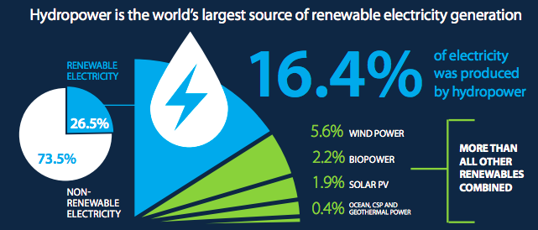
Significant global electricity producer
Globally hydropower is:
16.4% of all electricity
62% of all renewable electricity
US: 7.5% of all electricity production 44% of utility-scale electric generation
https://ensia.com/features/hydropower/
https://www.eia.gov/energyexplained/index.php?page=hydropower_home
https://www.hydropower.org/sites/default/files/publications-docs/
2018_hydropower_status_report_infographics_spread_0.pdf

Slide 8
Largest global hydropower producers
China leads by a length.
Country | Consumption (mTOE) | 2017*
China | 261.5 | 28.5%
Canada | 89.8 | 9.8
Brazil | 83.6 | 9.1%
U.S. | 67.1 | 7.3%
Russia | 41.5 | 4.5%
Norway | 32.0 | 3.5%
India | 30.7 | 3.3%
Japan | 17.9 | 2.0%
https://www.bp.com/content/dam/bp/en/corporate/pdf/energy-economics/statistical-review/
bp-stats-review-2018-full-report.pdf
*Share of global consumption
1 million TOE = 11.63 GWh

Slide 9
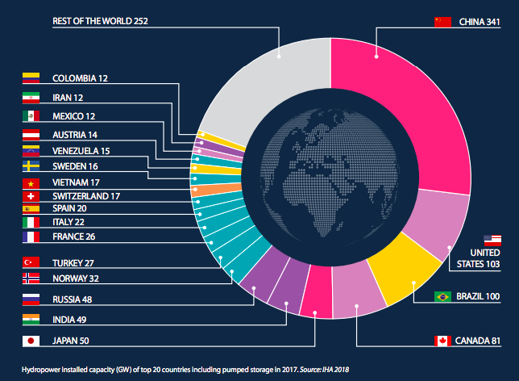
Largest global hydropower producers
https://www.bp.com/content/dam/bp/en/corporate/pdf/energy-economics/statistical-review/
https://www.hydropower.org/sites/default/files/publications-docs/
2018_hydropower_status_report_infographics_spread_0.pdf

Slide 10
Global hydropower potential?
In 2000, global output was roughly 18% of technical potential.
Region | technical potential*
N. America | 1668
S. America | 2792
Europe | 2706
Oceania | 232
Asia | 5093
Africa | 1888
Global | 14379
This doesn’t consider:
Practical potential;
Economic potential; or
Sustainable potential.
*TWh/year
Renewable Energy, 2/e, Chapter 5

Slide 11
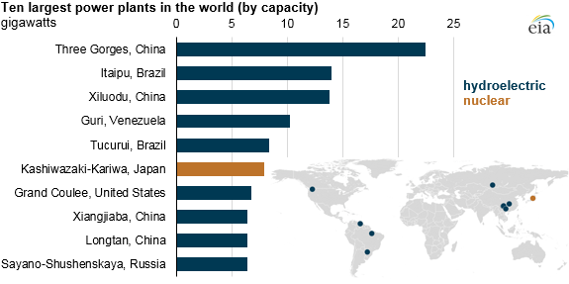
Hydro plants can be massive
In 2016, nine of ten of the world’s largest electric generating plants were hydropower.
https://www.power-eng.com/articles/2016/10/hydroelectric-plants-include-nine-out-of-the-10-biggest-in-the-world.html

Slide 12
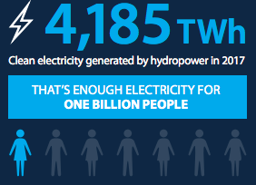
Growing in most countries
Region | Consumption (mTOE) | 2006 – 2016* | 2017*
North America | 164.1 | 0.2% | 6.7%
S/Central America | 162.3 | 0.6% | 4.1%
Europe | 130.4 | 1.6% | - 10.5%
CIS (Central Asia) | 56.7 | 0.4% | 0.9%
Middle East | 4.5 | - 0.6% | - 3.3%
Africa | 29.1 | 2.7% | 7.4%
Asia Pacific | 371.6 | 7.4% | 1.1%
Global total | 918.6 | 0.9% | 2.9%
https://www.bp.com/content/dam/bp/en/corporate/pdf/energy-economics/statistical-review/
bp-stats-review-2018-full-report.pdf
*Growth rate per annum

Slide 13
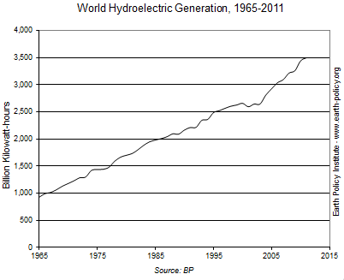
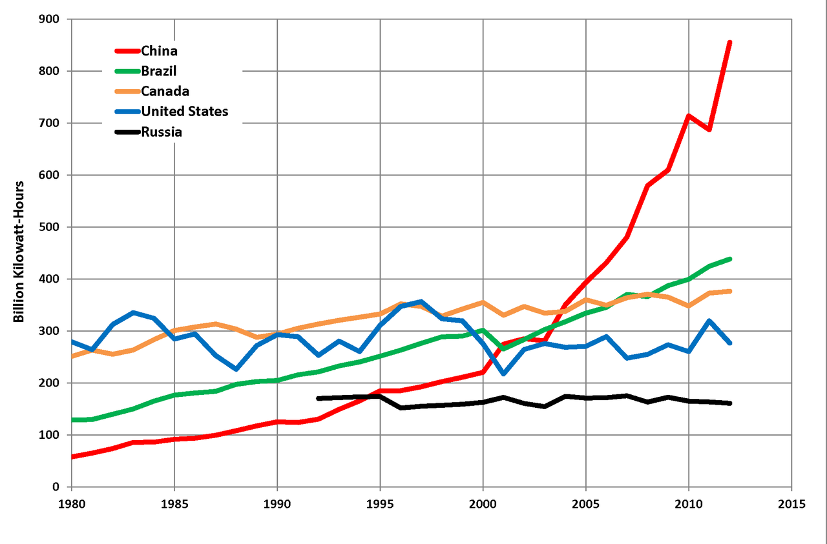
Rate of growth
The global rate of hydropower growth has been remarkably consistent.
Renewable Energy, 2/e, Chapter 5
https://en.wikipedia.org/wiki/Hydroelectricity#/media/File:Top_5_Hydropower-Producing_Countries.png
http://www.earth-policy.org/data_highlights/2012/highlights29

Slide 14
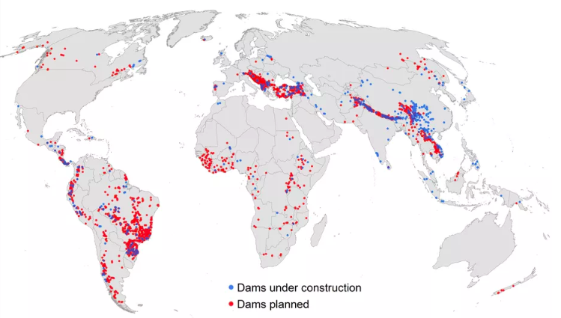
Damming continues
2014
https://www.vox.com/2014/10/28/7083487/the-world-is-building-thousands-of-new-dams-is-that-really-a-good-idea
Aquatic Sciences (DOI: 10.1007/s00027-014-0377-0)

Slide 15
7. Conventional baseload RE
7.2: Hydropower technology

Slide 16
Quick hydropower math
When dams and reservoirs are involved, potential energy is:
potential energy = MgH
J
mass (kg)
gravity, 9.81 m/s²
height (m)
Power:
P = (1000)(n)(Q)(g)(H)
J
kg/m³
turbine efficiency (%)
flow (m³/s)
P = (10)(n)(Q)(H)
kW
Renewable Energy, 2/e, Chapter 5

Slide 17
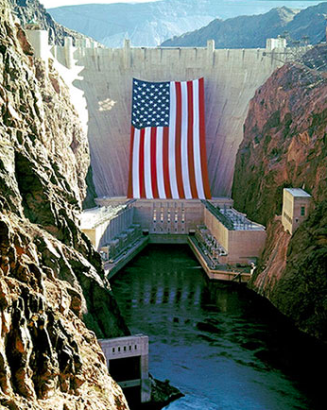
220 m
Classifying hydropower
Modern hydropower can be classified using a number of criteria.
220 m
1. Effective head
2.1 GW
2. Capacity: rated power output
turbo
3. Type of turbine
35 b m³
4. Type of dam, reservoir, etc.,.
Renewable Energy, 2/e, Chapter 5
https://www.usbr.gov/lc/hooverdam/
Hoover dam

Slide 18
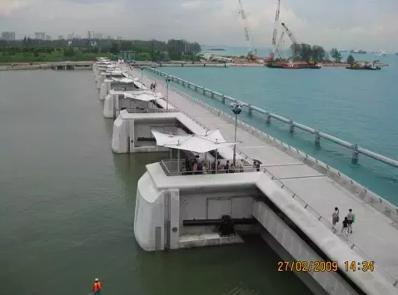
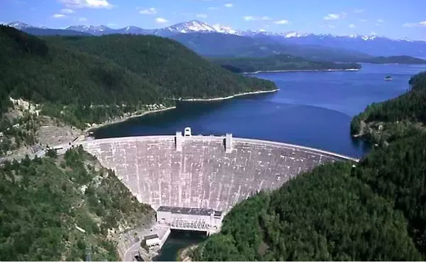
220 m
Effective head
Head varies with location and type of hydropower
1. Low
Barrage (low dam) or run of river
2. Medium
Dam and reservoir
3. High
High dam or pumped storage
Renewable Energy, 2/e, Chapter 5
https://www.quora.com/What-is-the-difference-between-a-barrage-and-a-dam
Low head
Bank-to-bank barrier
Water level depends on height of full—eight gates
High head
Bank-to-bank barrier
Water level depends on:
Volume diverted to turbines
Overflow gates at top
Low head
Bank-to-bank barrier
Water level depends on height of gates

Slide 19
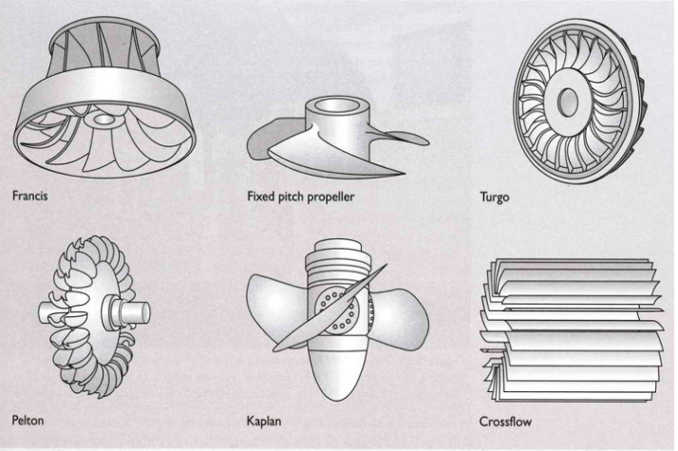
220 m
Turbines: Francis
Turbines come in a variety of designs, though the large hydropower plants depend on the Francis turbine.
Has blades and vanes like steam turbines and jet engines.
Works with head from 2 – 300 m.
Renewable Energy, 2/e, Chapter 5

Slide 20
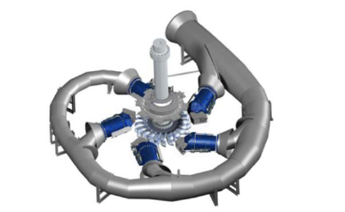
220 m
Turbines: Pelton wheel
Pelton wheel was developed during the California gold rush.
Jets of water (>1) hit cups and spin the wheel.
Jets can be adjusted to change the speed of spin
Works with higher head (>250 m) or with smaller hydro.
Renewable Energy, 2/e, Chapter 5
https://energyeducation.ca/encyclopedia/Pelton_turbine

Slide 21
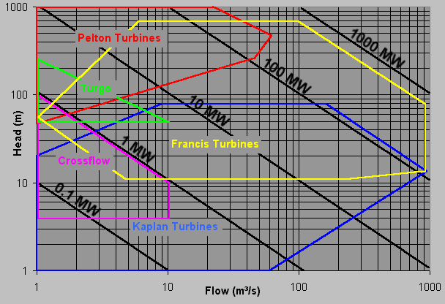
220 m
Choosing a turbine
Turbine choice depends on the site’s combination of head & flow rate.
Renewable Energy, 2/e, Chapter 5
http://rivers.bee.oregonstate.edu/book/export/html/35
Fig 5.23

Slide 22
7. Conventional baseload RE
7.3: Large and medium dams
and barrages

Slide 23
Dams and barrages
Building dams and barrages increases the potential energy available for hydropower and make the water supply more consistent.
A barrage is a low dam used to host hydropower turbines or divert water to a hydro plant.
Barrages are sometimes said to be ‘run of river’.
Other advantages?
Flood control
Consistent supply of water for irrigation
Recreation
No particulates; relatively low carbon
Three Gorges Dam:
1.2 million people
13 cities
140 towns
1,350 villages
Disadvantages?
Displaces human populations
Floods valuable habitat
Disrupts aquatic ecosystems
Reservoirs can create and release significant amounts of methane
Silting up
Dam failure
Geopolitical tension…. or worse
1900s: 200 dam failures o/s China killed 10,000
1975 in China: 250,000 dead
Renewable Energy, 2/e, Chapter 5

Slide 24
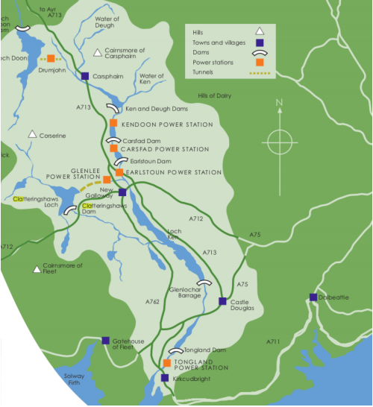
Case study: the Galloway hydros
The Galloway hydros is a system of dams, aqueducts and power plants on the River Dee in southwest Scotland.
Established by an Act of Parliament in 1929; completed 1936.
1
Main long-term seasonal storage of 80 m m³ = 40 m kWh.
Tunnel allows reverse filling during low demand.
3
Series of power plants along the river that allow rapid response to demand:
Kendon
Carsfad
Earlston
Tongland
2
Artificial reservoir storing 24 MW for Glenlee.
Renewable Energy, 2/e, Chapter 5

Slide 25
Galloway power stations
Vital statistics:
Station | head (m) | flow (m³/s) | capacity (kW) | turbine (MW) | turbine type | rotation (rpm)
Drumjohn | 11 | 16 | 2,000 | 2 | prop | 300
Kendoon | 46 | 55 | 24,000 | 12 | Francis | 250
Carsfad | 20 | 73 | 12,000 | 6 | prop | 214
Earlstoun | 20 | 71 | 14,000 | 7 | prop | 214
Glenlee | 116 | 26 | 24,000 | 12 | Francis | 429
Tongland | 32 | 127 | 33,000 | 11 | Francis | 214
Total |  |  | 109,000 | 50
Renewable Energy, 2/e, Chapter 5

Slide 26
Galloway economics
The Galloway hydro system has been operating for over 70 years.
Designed to supply power during peak loads, rather than 24/7.
Built at an initial cost of £29/kW, very inexpensive even then.
£60,000 subsidy (~ $1 million) for the first three years.
Property taxed at lower rates than coal-fired power plants paid because the environmental side effects were lower.
Demand and performance have exceeded expectations, except during a few years of drought.
Today, only the Glenlee power plant is manned.
Generally, capital costs are very high: $2,000-4,000/kW
No fuel costs
85– 95% is engineering, permitting, site work
10% for turbines, generator and control system
Economy of scale is significant.
Renewable Energy, 2/e, Chapter 5

Slide 27
Popular today, but…
…when they were constructed, the locals weren’t pleased.
A raider comes today who kills The glories of our glens and hills With unheroic acts and bills and "Private Legislation" The Company promoters pen Will Dam the Deugh and dam the Ken and Dam the Dee - oh Dam the men Who Plan such desecration!
- W.G.M. Dobie

Slide 28
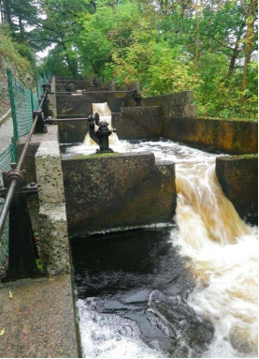
Galloway environmental concerns
Mainly the salmon. Scotland is famous for its salmon fishery and the dams on the River Dee were between the river’s mouth and its salmon spawning pools. There was concern that dams would block:
Adult salmon swimming upriver to spawn; and
Young smelts making their way to the Atlantic.
Fish ladders, a series of stepped and rising pools, were installed at 4 dams. Space forced one ladder into a spiral within a tower.
Biologists study the ladders and fish numbers.
Not satisfied.
Renewable Energy, 2/e, Chapter 5

Slide 29
Environmental downsides of dams
Hydropower is a low-carbon technology, however when dams are involved, environmental effects can be very significant.
Extinction, and near-extinction, of species
Loss, or lowering, of biodiversity
Flooding of existing ecosystems
Creation of drought-like conditions below the dam
Changes to fisheries
Economic change and relocation of communities
Altered water quality
Generation and release of methane from reservoirs
https://www.hydroreform.org/abouthydro/impacts-on-rivers

Slide 30
Environmental effects: change in POV
‘The environmental impacts of a hydroelectric project must be thoroughly analyzed since, after it is completed, they are essentially irreversible.’
- Dorf, 1978
‘The ecological damage per unit of energy produced is probably greater for hydroelectricity than for any other energy source.’
- Committee on Nuclear and Alternative Energy Systems,1979
‘…carefully planned hydropower development can, and does, make a great contribution to improving electrical system reliability and stability throughout the world. [It] will play an important role in the development of living standards in the developing world, [and] make a substantial contribution to the avoidance of greenhouse gas emissions and the related climate change issues.’
- WEC,2003
Renewable Energy, 2/e, Chapter 5

Slide 31
Flooding and silting = methane
When dams create reservoirs, the submerged plant materials decompose. Anaerobic decomposition produces methane that is released from the reservoir.
Regular flooding or silting adds biological ‘fuel’.
2011 study at Washington State University:
Dams emit ~ 1 billion tons of GHG.
Or about 1.3% of global emissions.
25% more than previously thought.
Over a 100-year period, dams emit more methane than:
rice farming and biomass burning; or
lakes and wetlands.
Algae growth increases methane formation.
Worse in warmer climates than in cooler climates.
Some dams release more GHG than fossil fuel-fired power plants.
Renewable Energy, 2/e, Chapter 5
https://www.scidev.net/global/energy/news/dams-raise-global-warming-gas.html

Slide 32
Mitigating damage from dams
The environmental impacts of existing dams can be minimized by changes in operation that may reduce power output, but increase sustainability.
Time water releases to mimic natural flows, temperatures and oxygen levels
This also stabilizes water levels
Provide safe passage for fish
Upgrade turbines to avoid loss of power production that might occur with operational changes
Restore or optimize local habitat for fish and wildlife
These operational changes can be thought of as a burden similar to that of installing sophisticated scrubbers at power plants.
FERC study of 240 dam upgrades since 1986 showed that the loss of energy production was only 1.6%.
https://www.hydroreform.org/abouthydro/impacts-on-rivers
These operational changes can be thought of as a burden similar to that of installing sophisticated scrubbers at power plants.

Slide 33
Mitigation case studies
In northern Michigan, Consumers Power worked with government agencies and citizen groups to restore more natural flows to a local river. Fish populations bounced back quickly, bringing more than $590,000 a year from fisheries into neighboring communities.
In rural western Massachusetts and southern Vermont, recreational flows at a hydropower dam on the Deerfield River allowed new, multi-million dollar rafting and fishing industries to flourish, creating new jobs while maintaining profitable energy production.
A 2004 agreement on Oregon’s Pelton-Round Butte Project – now jointly owned by Portland General Electric and the Confederated Tribes of the Warm Springs – will result in salmon and steelhead returning to the upper reaches of the Deschutes River for the first time in decades while continuing to supply more than 366 MW of power to customers.
https://www.hydroreform.org/abouthydro/impacts-on-rivers
These operational changes can be thought of as a burden similar to that of installing sophisticated scrubbers at power plants.

Slide 34
Fish ladders aren’t effective
A 2012 study of fish ladders at dams on Atlantic rivers in the Northeast showed that fish ladders weren’t effective.
Only 3% of shad, a migratory fish, made it past all of the dams on the Susquehana, Connecticut and Merrimack rivers and reached their spawning grounds.
Other anadromous fish species had slightly better rates of success.
“While investigating fish passage on the Merrimack River in New Hampshire, our project’s lead researcher, Jed Brown of the U.S. Fish & Wildlife Service, was struck by the long-term lack of recovery of the targeted fish populations — at some fish restoration meetings there were more people in the room than salmon in the river.”
“In the end, the challenges are daunting, and for a simple reason: It’s asking a lot for a finned creature to take an elevator or to climb a ladder.
Biologists, particularly in Europe, are trying the build better passages around dams.
https://e360.yale.edu/features/blocked_migration_fish_ladders_on_us_dams_are_not_effective
https://onlinelibrary.wiley.com/doi/full/10.1111/conl.12000

Slide 35
Geopolitical issues
Gabcikovo-Nagymaros hydroelectric system was a planned series of dams on the Danube river jointly agreed to in 1977 by Czechoslovakia and Hungary, whose border the river forms.
The land in this region is rich agricultural land with fragile wetland ecosystems.
After a decade, the Hungarians cancelled the project.
Czechoslovakia split into the Czech Republic and Slovakia.
Slovakia rejected Hungary’s decision, diverted the Danube and kept building.
Environmental impacts were huge despite workarounds.
1993 case went to International Court of Justice.
1995: Slovakia reduced water diversion.
1997: Court ruled both nations were at fault and must negotiate, but the case has never been resolved.
Renewable Energy, 2/e, Chapter 5

Slide 36
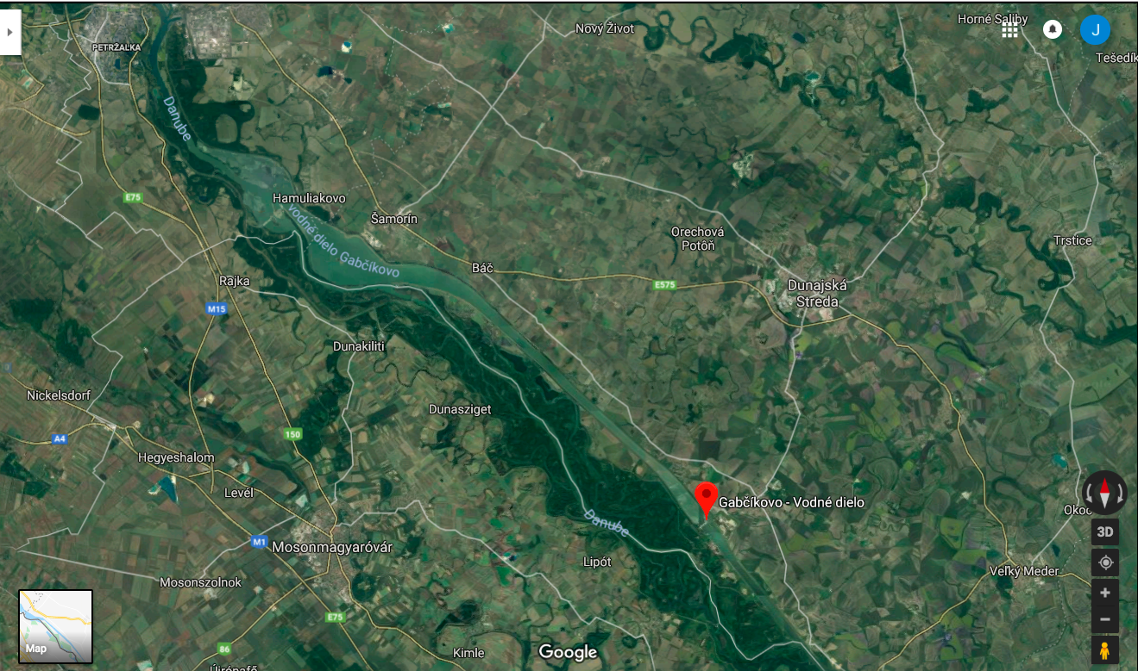
Geopolitical issues
Austria
Slovakia
Hungary
Fig 5.25
Renewable Energy, 2/e, Chapter 5

Slide 37
7. Conventional baseload RE
7.4: Small-scale hydropower

Slide 38
Small-scale hydro
The scale of small-scale hydro varies:
5 MW in the UK
10 MW in Switzerland
30 MW in the US
Smaller? mini-, micro-, pico-
Why a smaller scale?
Large-scale options built or too environmentally costly.
Local power is needed in rural or undeveloped regions.
Technology?
Often run-of-river or low-head technology.
Global use?
In 1999, estimates of 18 GW of <10 MW hydro plants in 38 countries.
China?
2002: 26 GW from plants <25 MW
38,700 plants from 100 – 500 kW
4,300 plants 0.5 – 25 MW
Power for 300 million people
Renewable Energy, 2/e, Chapter 5

Slide 39
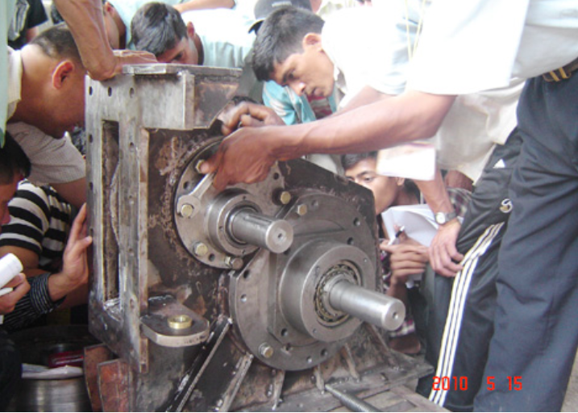
Small-scale hydro: potential
The greatest potential for small-scale hydro is providing ‘water-to-wire’ electricity for remote mountainous regions without electric options.
Nepal: one person can carry a Peltric turbo-generator set that will produce 1 kW with a head of 50-70 m.
This type of hydropower does not use dams or barrages, and minimizes environmental impact.
A small volume of water is diverted from a stream and then returned after it spins the turbine.
Renewable Energy, 2/e, Chapter 5
https://blog.nationalgeographic.org/2012/07/20/nepals-mountain-villages-tap-the-power-of-eternal-snows-with-micro-hydro/

Slide 40
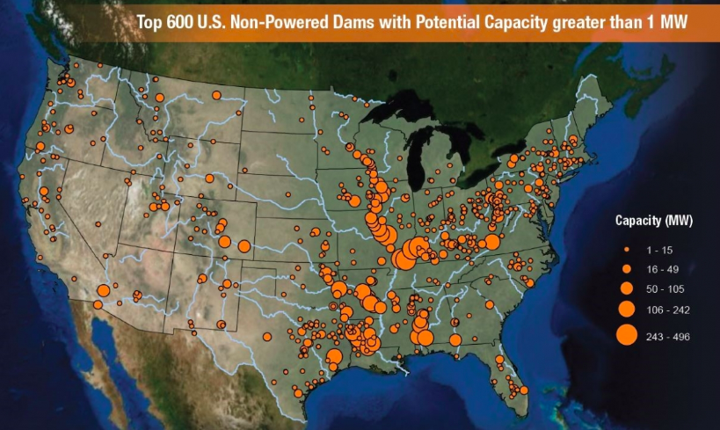
Power up?
Could we add power to existing, non-hydro dams in the US?
Total potential hydropower capacity: 160,000 MW
49% federal
12 GW total
https://www.energy.gov/eere/articles/5-promising-water-power-technologies

Slide 41
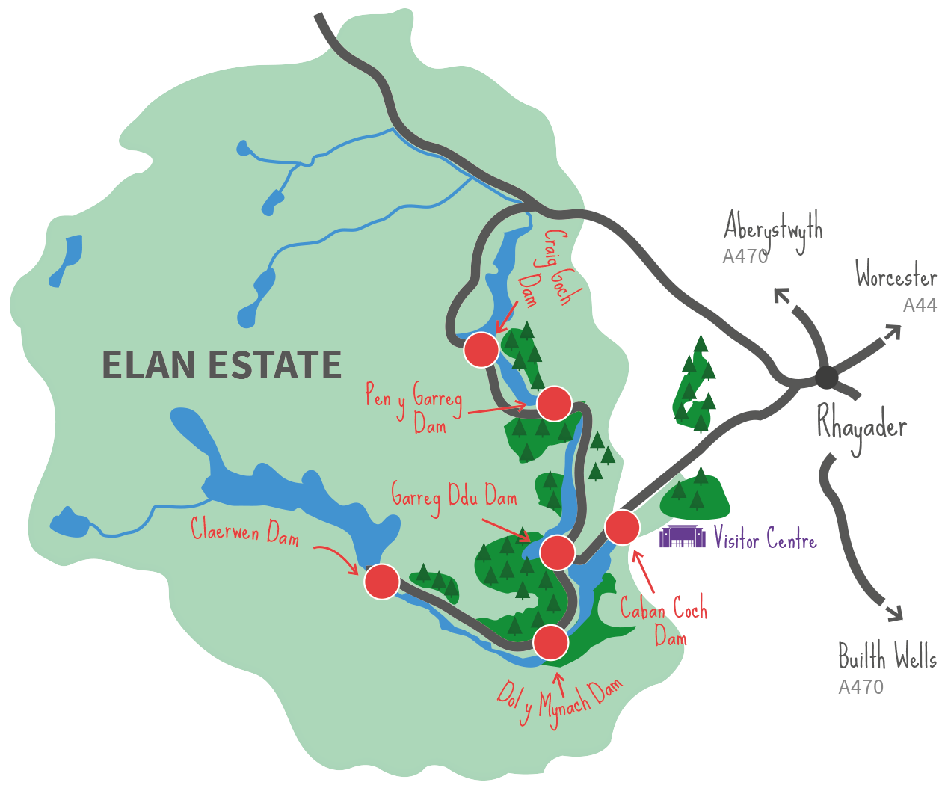
Elan Valley: small-hydro case study
The Elan Valley reservoirs (Wales) are five lakes created by dams built starting around 1900 in order to supply the city of Birmingham with clean water.
1 E8 m3 of water capacity
Renewable Energy, 2/e, Chapter 5
https://www.elanvalley.org.uk/discover/reservoirs-dams/hydropower

Slide 42
Adding hydropower
While one of the dams, at Caban Coch, always produced hydropower, it was upgraded, and turbines were added at the other four dams in 1997.
plants | head (m) | Capacity (kW) | turbine
Craig Goch | 36.5 | 480 | Francis
Pen-y-Garreg | 37.5 | 810 | Francis
Caban Coch | 37.0 | 950 | 2 x Francis
Foel Tower | 13.5 | 300 | Kaplan
Claerwen | 56.0 | 1680 | Francis
total |  | 4.2 MW
At Foel Tower, the turbine is inside one of the three 14-m diameter pipes that carries water from the reservoirs to Birmingham.
Because the area is now renowned for its beauty and is a Site of Special Scientific Interest, most of the new buildings were placed underground.
Renewable Energy, 2/e, Chapter 5
https://www.elanvalley.org.uk/discover/reservoirs-dams/hydropower
At Foel Tower, the turbine is inside one of the three 14-m diameter pipes that carries water from the reservoirs to Birmingham.

Slide 43
Boulder, CO: water / electricity supply
Boulder, CO has hydroelectric facilities that also provide water.
Historically: hydro plants → water supply → expanded hydropower
The huge drop from reservoirs to the city required a reduction an pressure, and adding turbines achieved this with power.
8 facilities (5 built in the 1980s)
~ 40 m kWh of electricity (4,741 households; 11% of electricity)
> $ 2 m revenue
20,399 tons of coal avoided
https://bouldercolorado.gov/water/hydroelectricity
At Foel Tower, the turbine is inside one of the three 14-m diameter pipes that carries water from the reservoirs to Birmingham.

Slide 44
7. Conventional baseload RE
7.5: Hydropower without dams?

Slide 45
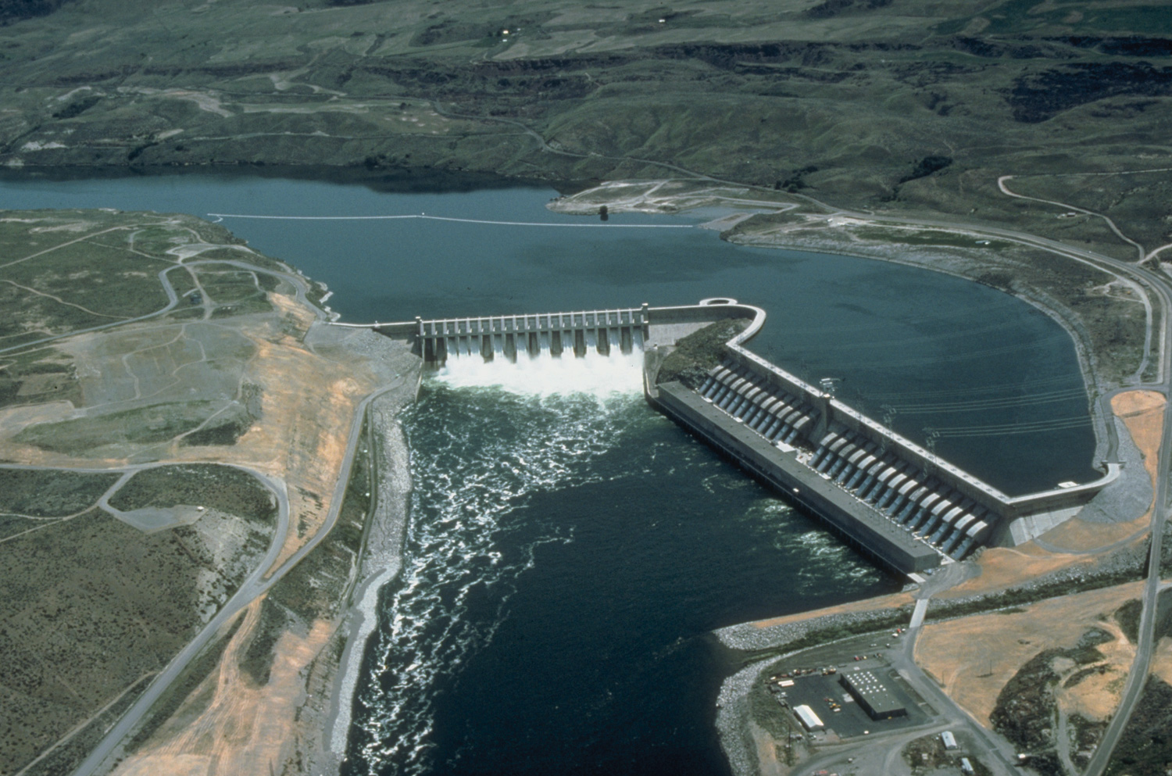
‘Run of river’?
'Run of river’ is used to describe hydropower that neither uses high dams nor creates significant reservoirs.
But, projects using barrages and creating some impoundments are described using this term.
Less detrimental environmental effects?
‘Softer’ power supply.
https://en.wikipedia.org/wiki/Run-of-the-river_hydroelectricity

Slide 46
Creating hydropower without dams?
This is a more radical approach that is likely to:
Greatly reduce the environmental and social impacts of hydropower;
But also reduce the scale of hydropower projects and production.
Perhaps this is the approach we should take to new hydropower projects once existing dam sites (damage) are fully powered and exploited?
Most ‘damless’ hydropower projects involve placing some form of turbine in the flow of the river.
Some involve diverting some of the river’s flow for some distance.
Others place turbines in human-created infrastructure.
https://en.wikipedia.org/wiki/Run-of-the-river_hydroelectricity

Slide 47
In-flow (aka ‘zero head’) turbines
Floating or anchoring turbines in the the flow of a river, without creating a dam or diversion, minimizes change to flow of river while creating baseload power.
Smart Turbines is a German company developing in-flow turbines.
https://www.smart-hydro.de/renewable-energy-systems/hydrokinetic-turbines-river-canal/

Slide 48
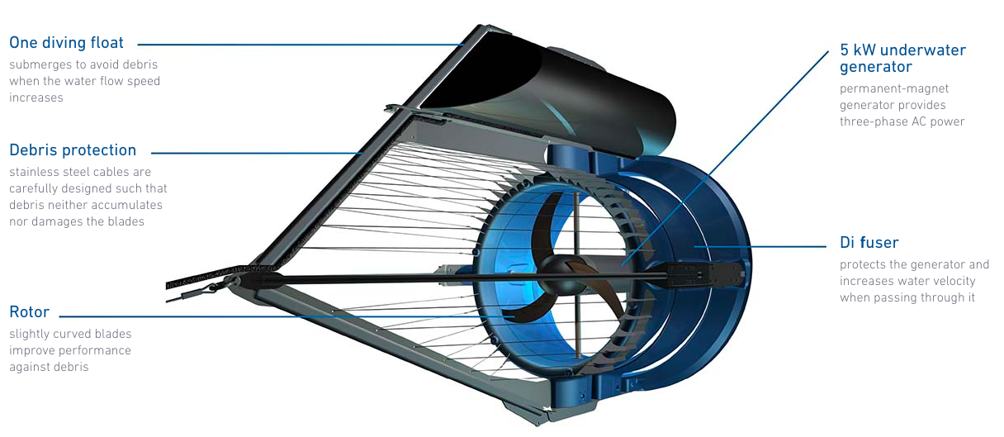
Smart-turbine floating turbine design
https://www.youtube.com/watch?v=49DhljMOa7Y
https://www.smart-hydro.de/renewable-energy-systems/hydrokinetic-turbines-river-canal/

Slide 49
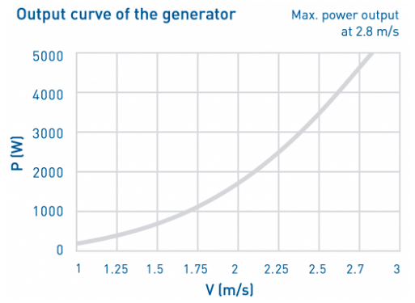
Smart turbine specifications
https://www.smart-hydro.de/renewable-energy-systems/hydrokinetic-turbines-river-canal/

Slide 50
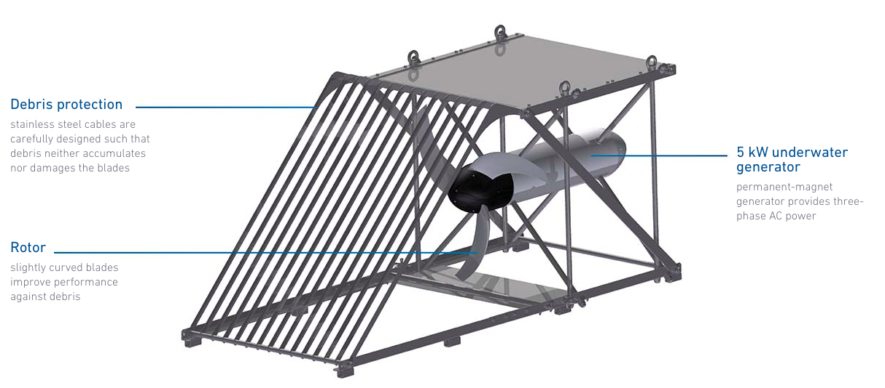
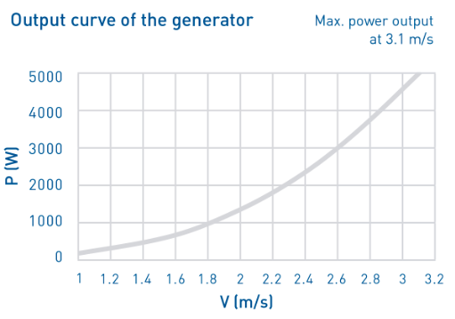
Anchored vs. floating
This version of the Smart turbine would be anchored on the riverbed and would pose less of a navigational hazard.
https://www.smart-hydro.de/renewable-energy-systems/hydrokinetic-turbines-river-canal/

Slide 51
Smart Hydro Power projects
The sweet spot for this technology is remote, rural electrification, though projects have also been done in developed countries.
https://www.smart-hydro.de/decentralized-rural-electrification-projects-worldwide/
https://www.smart-hydro.de/decentralized-rural-electrification-projects-worldwide/

Slide 52
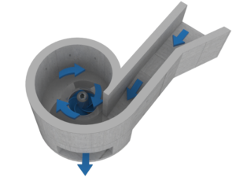
Turbulent: vortex turbines
Turbulent, a Belgian company has developed a low-velocity, in-low, vortex turbine for:
15 – 100 kW
Low flow: > 1.5 m³/s
Low head: 1.5 – 3 m
https://www.turbulent.be/

Slide 53
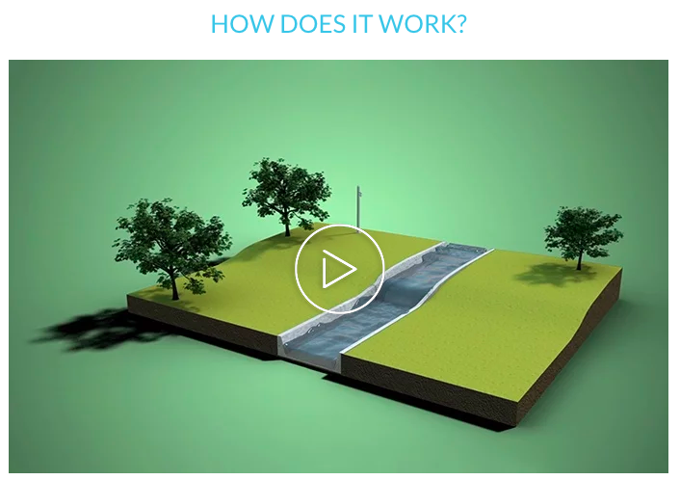
Turbulent: vortex turbines
https://www.turbulent.be/

Slide 54
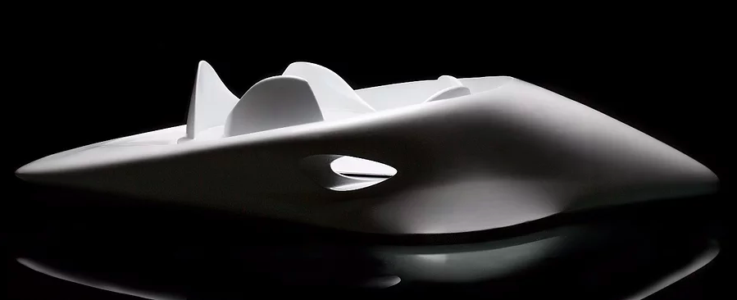
Venterra: in-stream turbine ’pod’
A Minneapolis start-up that has developed a low-velocity, in-stream, streambed, modular turbine for:
50 kW and larger via array (thus scaleable)
< 2 m depth (direct deployment)
Self-clearing
Fish safe
https://www.verterraenergy.com/

Slide 55
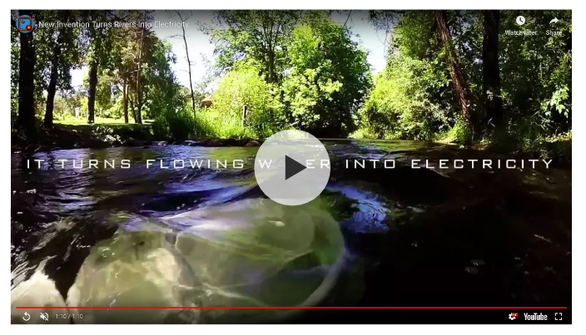
Venterra’s Volturnus
https://www.verterraenergy.com/

Slide 56
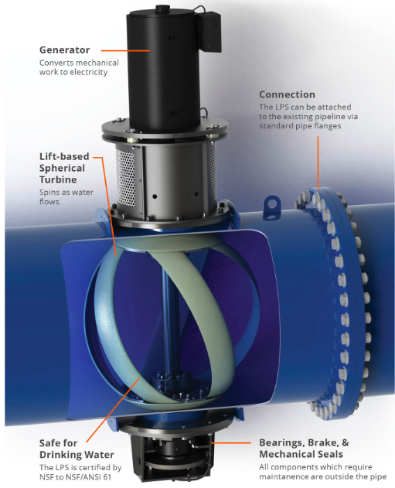
Lucid: in-pipe helical turbines
These helical turbines are designed to both step-down the pressure of municipal water supply pipes and to generate electricity.
No environmental effects
Use existing infrastructure
Portland, OR
20-year power purchase agreement
900 MWh / year
Powers 100 homes
Riverside, CA
Powers water plant during the day
Powers streetlights at night
http://lucidenergy.com/how-it-works/

Slide 57
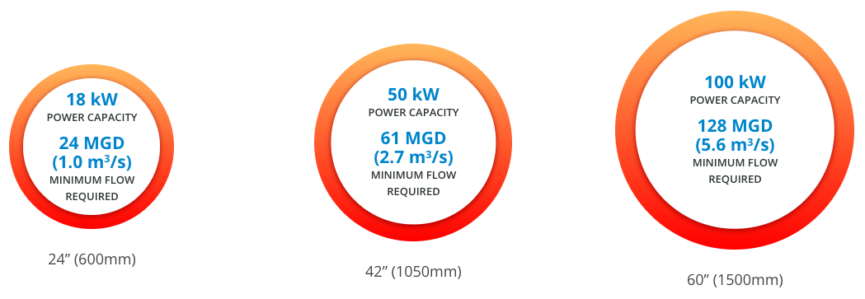
Lucid: in-pipe helical turbines
Lucid flow requirements, pipe size and power output:
http://lucidenergy.com/how-it-works/

Slide 58
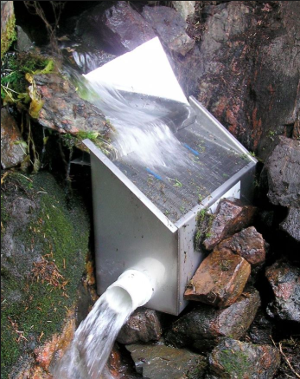
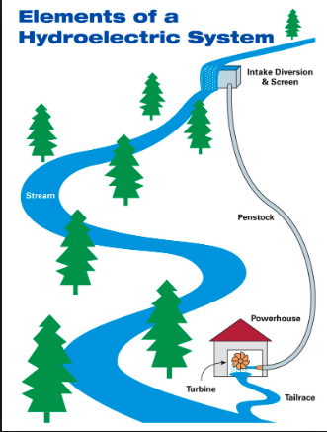
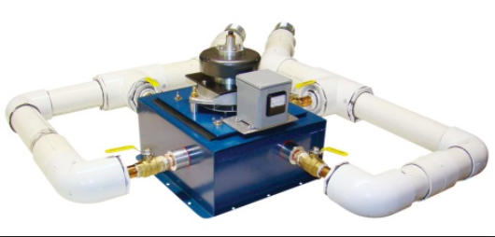
Micro-hydro at residential scale
HomePower magazine

Slide 59
7. Conventional baseload RE
7.6: Tidal power?

Slide 60
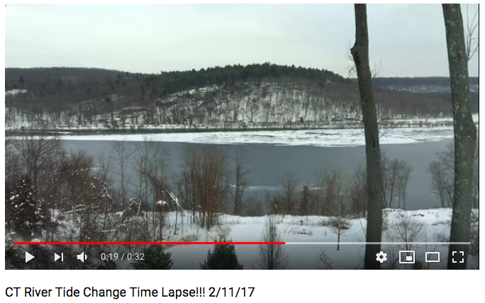
Tides: more complicated
Tides are generally more complicated that dammed hydro sources or run-of-river because:
Head and flow rate vary;
Direction of flow changes;
Salt water is more corrosive; and
Weather is often more significant and disruptive.
https://www.youtube.com/watch?v=UQb22uvrzxE
But water is 800 times more dense than air and carries more power, and tides are more predictable than wind.
Global average tidal change = 0.6 m
Renewable Energy, 2/e, Chapter 6
https://en.wikipedia.org/wiki/Tide

Slide 61
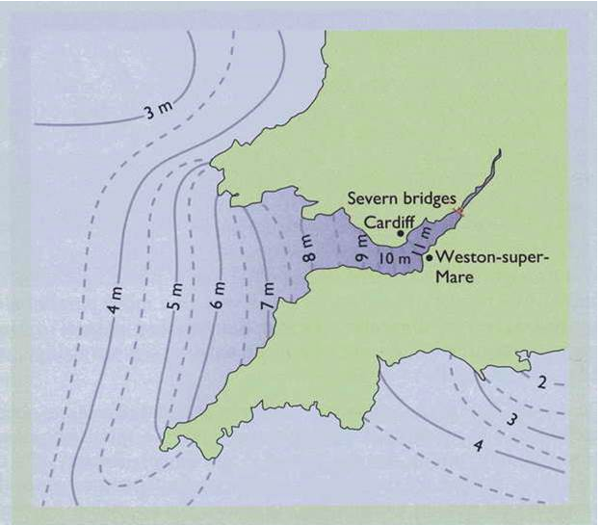
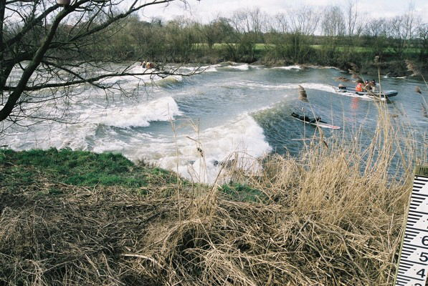
Example of extreme tidal effects
The River Servern is Britain’s longest river and forms the border between England (south) and Wales (north).
Estuary is tidal.
Funnel shaped
Resonance (constructive addition of waves) causes extremely high tidal ranges of up to 50 feet.
’bore’ or standing wave forms
9 miles
75-100miles
Renewable Energy, 2/e, Chapter 6
https://en.wikipedia.org/wiki/Severn_Estuary

Slide 62
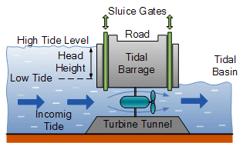
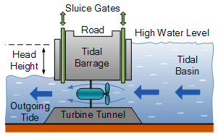
Tidal barrage
A tidal barrage is a low barrier that captures the potential energy of tidal ranges and allows energy to be harvested by turbines in openings that channel flow.
Energy is generated during both tidal flows: in and out.
Water can be held for the duration of ‘one’ tidal flow.
Flow rate is lowish, similar to very low-head hydro.
An enormous amount of water flows within 6 hours…
… so many turbines are used to harvest as much energy as possible.
Renewable Energy, 2/e, Chapter 6
http://www.alternative-energy-tutorials.com/tidal-energy/tidal-barrage.html

Slide 63
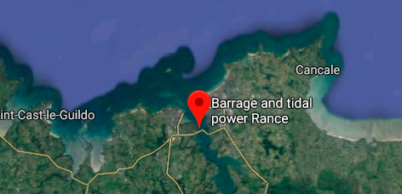
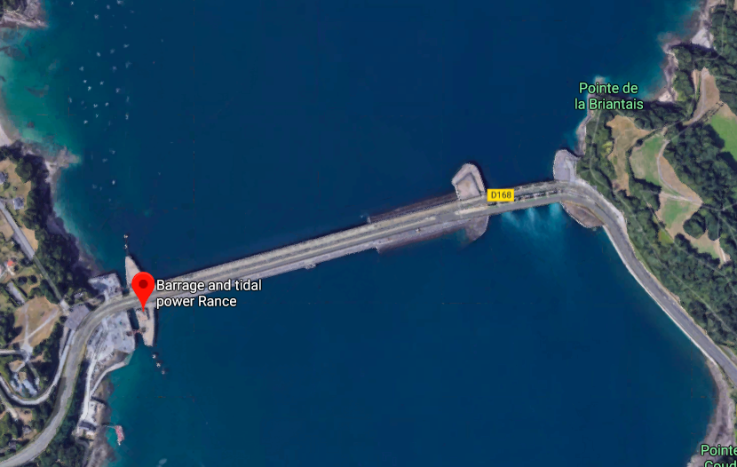
La Rance, France
500 GWh tidal barrage in the estuary of the La Rance river in Brittany, France.
Construction damaged the estuary ecosystem; some recovery.
6 gates
6 gates
24-unit power plant
& road crossing
lock
Reversible pump turbines can create pumped hydro storage.
Electricity available 90% of the time.
Renewable Energy, 2/e, Chapter 6
Google maps
https://www.edf.fr/en/the-edf-group/industrial-provider/renewable-energies/marine-energy/tidal-power

Slide 64
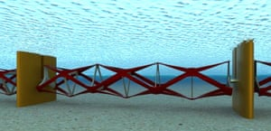
Barrage alternatives: tidal fence
A tidal fence across parts of the estuary, interrupted by passages.
Less power output with less environmental damage.
Up to 1.3 GW capacity (~ 1 nuclear plant) or ~ 1% of UK power.
6 gates
Renewable Energy, 2/e, Chapter 6
https://www.theguardian.com/environment/2015/aug/07/revolutionary-tidal-fence-set-to-trap-seas-power
https://www.treehugger.com/renewable-energy/tidal-power-alternative-to-the-severn-barrage-touted.html

Slide 65
Barrage alternatives: tidal reef
The 12-mile tidal reef is lower than a barrage with slower turbines.
Slightly lower cost than barrage.
Similar 20,000 GWh capacity
Holds back some, but not all, of tidal change, so less damage to estuary ecosystems.
Fish should be able to survive passage through slow turbines.
6 gates
Renewable Energy, 2/e, Chapter 6
http://news.bbc.co.uk/2/hi/uk_news/wales/south_east/7748431.stm
http://www.i-sis.org.uk/reefReplaceBarrage.php

Slide 66
Barrage alternatives: tidal reef
The tidal reef is a series of semi-floating caissons attached to sea-floor anchors.
Reef rises and falls with the tide.
Maintains a low, but constant, head of 2-m.
Attenuates tidal range without utterly interrupting it.
Less vulnerable to storms because of its low profile?
6 gates
Renewable Energy, 2/e, Chapter 6
http://www.i-sis.org.uk/reefReplaceBarrage.php

Slide 67
7. Conventional baseload RE
7.7: Ocean and wave power
without barrages

Slide 68
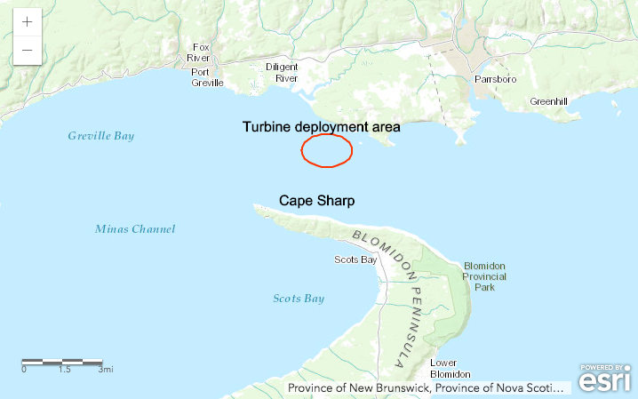
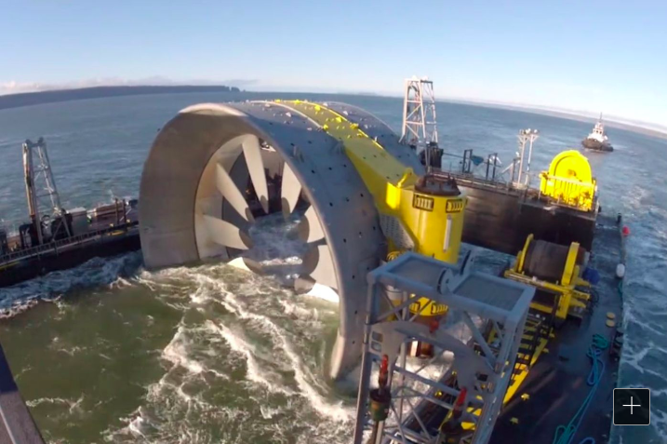
Open Energy’s turbine
The Minas channel of the Bay of Fundy has 50’ tidal range with a speed of ~ 11 mph.
Estimated at 2500 MW potentially extractable power
6 gates
Open Hydro turbine lowered to the ocean floor in a cradle. 190 feet deep.
Open turbine reverses direction with the tide.
2 MW capacity.
Fiberglass blades replaced with stronger material.
The turbine is the generator.
Liquidated by huge new parent company
Renewable Energy, 2/e, Chapter 6
http://www2.philly.com/philly/business/energy/can-this-giant-turbine-turn-the-tide-for-ocean-energy-20170901.html

Slide 69
Bladed turbines
A number of companies are using bladed tubines on pilings, floating platforms or anchored to the seabed.
Atlantis turbines shown here are 15-20 m in diameter.
6 gates
Renewable Energy, 2/e, Chapter 6
https://simecatlantis.com/services/turbines/history/
https://www.forbes.com/sites/jamesconca/2017/07/27/tidal-energy-all-renewables-are-not-created-equal/#6e5b69134f4e

Slide 70
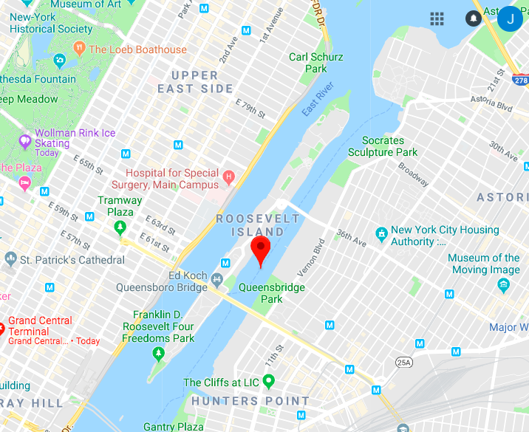
RITE project in NYC’s East River
Roosevelt Island Tidal Energy project: Verdant energy installed sea-bed turbines in the East River between Manhattan and ‘mainland’ NY.
Actually the ’East Channel’: a tidal stream.
Six turbines were installed from 2006 – 2009.
Ran for 9,000 hours.
Delivered 70 MWh.
Slow enough to avoid damage to fish.
6 gates
Renewable Energy, 2/e, Chapter 6
https://www.verdantpower.com/riteproject
https://blog.ansi.org/2016/01/tidal-power-turbines-in-east-river/#gref

Slide 71
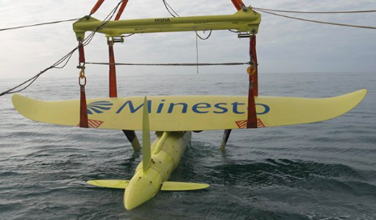
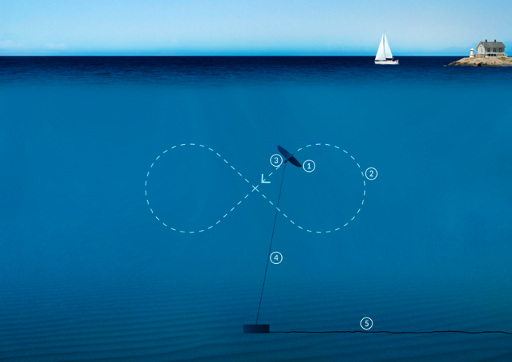
Deep Green ocean kite
A Swedish company, Minesto, has just commissioned their Deep Green ocean kite.
Designed for slow tidal or ocean currents.
Motion & speed of the kite amplifies power by a cubic factor.
6 gates
Next? Testing for power production and power take-off.
Renewable Energy, 2/e, Chapter 6
https://minesto.com/our-technology
https://www.power-technology.com/news/minesto-completes-sea-trials-dg500-marine-energy-kite/

Slide 72
Wave energy
Ocean waves are caused by air currents passing over open water, which are caused by solar energy.
Dense water concentrates solar power.
Solar power ~ 100 W/m²
Waves ~ 100 kW/m of crest length
Wave power does vary with weather conditions: North Atlantic ocean
6 gates
Condition | Period (s⁻¹) | Amplitude (m) | Power density (kW/m) | Velocity (m/s) | Wavelength (m)
storm | 14 | 14 | 1700 | 23 | 320
average | 9 | 3.5 | 60 | 15 | 150
calm | 5.5 | 0.5 | 1 | 9 | 50
Global potential?
2TW
17,500 TWh annually
Practical? 30 TWh at ~$0.05/kWh
2017: global use 22,000 TWh
Renewable Energy, 2/e, Chapter 8

Slide 73
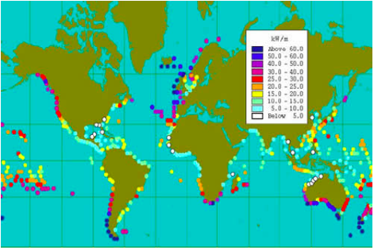
Best wave locations?
Western exposure produces the best potential because of wind direction.
Isolated islands have good potential and little conventional energy.
6 gates
Renewable Energy, 2/e, Chapter 8
http://www.geni.org/globalenergy/library/renewable-energy-resources/ocean.shtml

Slide 74
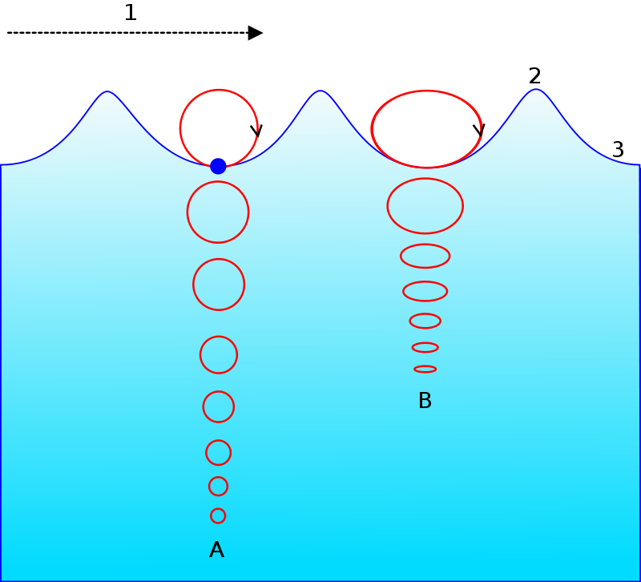
Effect of depth and shore
Wave energy causes water particles to move in elliptical paths.
Energy decreases with depth.
Practically, 95% of wave energy can be harvested between the surface and a depth of ¼ of the average wavelength.
𝝺
6 gates
Wave energy decreases closer to shore due to two factors:
𝝺/4
Friction with the shallow sea-bed.
(2) When waves break,
energy is lost;
dissipated.
Renewable Energy, 2/e, Chapter 8

Slide 75
Closer analysis of UK wave resources
A 2001 analysis looked at technical, practical and economical waver power available to the UK.
2002 UK electricity demand: 350 TWh
water depth (m) | average (GW) | average (TWh/y) | avg technical (GW) | avg technical (TWh/y) | avg practical (GW) | avg practical (TWh/y)
100 | 80 | 700 | 10 | 87 | 5.7 | 50
40 | 45 | 394 | 10 | 8 | 0.24 | 2.1
20 | 36 | 315 | 7 | 61
shore | 30 | 262 | 0.2 | 1.75 | 0.05 | 0.4
6 gates
Economically: 33 TWh/year
Renewable Energy, 2/e, Chapter 8

Slide 76
Types of wave energy devices
Wave power isn’t a new idea and there have been, and are, many different ways to harvest wave energy and convert it to electricity.
We’ll look at a few of the current technologies.
6 gates
attenuator
rotating mass
pressure differential
point absorber
oscillating surge converter
Renewable Energy, 2/e, Chapter 8
http://www.emec.org.uk/marine-energy/wave-devices/

Slide 77
Attenuator: Pelamis sea snake
The Pelamis sea snake is a floating device that faces into waves and is oscillated by them.
Joints between segments of the sea snake are flexed by the oscillating motion of the waves passing under them.
Flexion causes hydraulic rams to push high-pressure oil through hydraulic motors, driving electrical generators.
6 gates
Electricity is transmitted to shore through transmission lines.
Renewable Energy, 2/e, Chapter 8
http://www.emec.org.uk/about-us/wave-clients/pelamis-wave-power/

Slide 78
Pelamis performance
Pelamis P1 was the first wave energy device tested at scale that produced power for the national grid (2004– 2009).
750 kW capacity
Pelamis P2 was the first wave energy device ordered by a utility company.
After three years it was placed at a research center.
6 gates
Pelamis went bankrupt in 2014 due to lack of capital funding.
IP assets owned by Wave Energy Scotland.
Renewable Energy, 2/e, Chapter 8
http://www.emec.org.uk/about-us/wave-clients/pelamis-wave-power/

Slide 79
Point absorber: BOLT lifesaver
The lifesaver is a floating ring tethered to the seafloor by three cables.
A point absorber
As waves life one side of the lifesaver up, cable is pulled off of winch drums, generating power.
As that side of the lifesaver rocks back down, cable winds back onto the winch drums…. Repeat.
6 gates
Electricity can be used on site or transmitted to shore.
30 kW
56 Tons
$1.6 m
Renewable Energy, 2/e, Chapter 8
http://boltseapower.com/

Slide 80
Point absorber: CETO
CETO is a full submerged buoy that harvests wave energy.
A point absorber
steel buoyant actuator
240 kW capacity
6 gates
Pumps and generator are in the buoy.
hydualic pump (motion)
Energy cabled to shore
10,000s of hours at sea
umbilical & supports
umbilical & supports
Protected from storms
tether allows recovery without divers
Renewable Energy, 2/e, Chapter 8
https://www.carnegiece.com/wave/what-is-ceto/

Slide 81
Surge conductor: bioWAVE
bioWAVE is mounted on the seafloor and is several stories high.
A ‘pitching point absorber’
250 kW capacity
6 gates
Hydraulic pumps transfer energy to a generator
Energy cabled to shore
Lays flat in storms.
Australian trials underway
Renewable Energy, 2/e, Chapter 8
http://bps.energy/biowave

Slide 82
Wello Penguin
The Wello Penguin is anchored to the sea floor and captures the rocking motion of the waves at the surface.
A rotating mass converter
600 kW capacity
30-m length x 16-m width
6 gates
WEC-2 now making 15% more power
220 tons
Low cost (?)
WEC-1 deployed for over 18 months off of the Orkney islands, Scotland.
Supplying power to the national grid.
Survived Ophelia with 18-m waves.
Renewable Energy, 2/e, Chapter 8
https://wello.eu/the-penguin/technology/

Slide 83
Human opinion of wave power
In the UK, and elsewhere, public opinion of wind power is mixed and passions run high.
How do public opinions of wave power compare?
A study surveyed 352 people in Cornwall near a wave energy study center.
Negative visual impacts?
30.0%
6 gates
Favor the center?
81.7% for
3.4% against
Effect on surfing?
43.0% no effect
13.4% concerned
Economic benefits?
69.6%
Effect on commercial fishing?
12.5% improvement: nurseries
15.2% problematic
More employment?
73.2%
Effect on tourism?
36.1% no neg effect
29.3% positive effect
GCC?
80.9% beneficial effect
Wildlife?
49.3% concerned
Most though short-term effect
Renewable Energy, 2/e, Chapter 8
http://ec.europa.eu/environment/integration/research/newsalert/pdf/271na4_en.pdf

Slide 84
Environmental effects of wave power
Wave energy is thought to be quite environmentally benign.
On-shore facilities will have greater effects than offshore.
Near-shore
Changes in water mixing may affect food delivery, reproduction, dispersal of larvae and spores.
Unlikely that movement of sand would be significantly affected.
Estuaries are particularly sensitive.
6 gates
Offshore: hard surfaces on the bottom and cables will likely be colonized by as faux reefs.
Could introduce a rich new (but native) ecosystem.
Or could introduce non-native species.
Migratory species & marine mammals: effects as yet uncertain
Potential entanglement in cables
Avoidance of energy areas could decrease available habitat and increase difficulty of migration.
Whether noise affects marine mammals is being studied.
Will electromagnetic fields affect marine life?
Lights could affect migratory birds.
Renewable Energy, 2/e, Chapter 8
https://nnmrec.oregonstate.edu/education/effects-environment

Slide 85
7. Conventional baseload RE
7.8: What about evaporation engines?

Slide 86
Evaporation
Evaporation is the phase change of water from a liquid to gaseous physical state.
Part of Earth’s natural water cycle
Occurs at the surface: liquid/gas interface
Requires energy input
https://pmm.nasa.gov/education/water-cycle

Slide 87
The power of evaporation
If evaporation requires input of energy, how could it produce power?
A team of scientists at Columbia University have found a way to use evaporation to produce mechanical work that could be harnessed to produce electricity.
Plastic film is coated with the spores of B. subtilis.
When placed above evaporating water, the strips absorb water and elongate, changing shape and the distribution of weight.
The shift in weight causes the wheel to rotate.
During rotation, the wet strips dry and change shape, increasing spin.
Repeat
https://www.technologyreview.com/s/608949/evaporation-engines-could-produce-more-power-than-coal-with-a-huge-caveat/

Slide 88
How much power?
Evaporation occurs 24/7, so could produce baseload power.
GCC will increase rates of evaporation.
Using the ‘evaporation engine’ increases rate of evaporation.
“We could match power demand on an hourly basis about 98 percent of the time in warm and dry places, which means you don’t need an external battery to adjust for intermittency.” - Sahin (researcher)
Power production?
A 64 cm² surface of water produces 2 µW of power.
Scaled up potential?
Efficient scale up: 325 GW in the US
More than currently produced by coal (2017).
This level of power would require covering every body of water greater than 0.1 km2 (except for the Great Lakes).
Might affect climate and weather.
Some fraction of this use and output is more likely.
Evaporation from industrial and human processes have not yet been included in the power model.
https://www.technologyreview.com/s/608949/evaporation-engines-could-produce-more-power-than-coal-with-a-huge-caveat/

