Slide 1
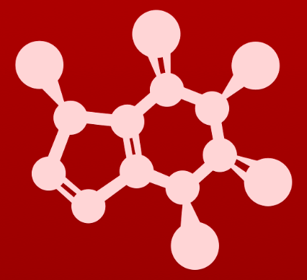
VSEPR charts (1)
sp
sp²
sp³
sp³d
sp³d²

Slide 2
VSEPR charts (2)
# atoms
bonded to the central atom
sp
sp²
sp³
sp³d
sp³d²

Slide 3
VSEPR charts (3)
# lone e- pr | # atoms bonded | e- pair geometry |  | Molecular geometry | Bond Angle (°)
0 | 2 | linear |  | linear | 180
0 | 3 | trigonal planar |  | trigonal planar | 120
1 | 2 | trigonal planar |  | bent | < 120
0 | 4 | tetrahedral |  | tetrahedral | 109.5
1 | 3 | tetrahedral |  | trigonal pyramidal | < 109.5
2 | 2 | tetrahedral |  | bent | <109.5
0 | 5 | trigonal bipyramidal |  | trigonal bipyramidal | 90, 120, 180
1 | 4 | trigonal bipyramidal |  | seesaw | 90, 120, 180
2 | 3 | trigonal bipyramidal |  | T-shaped | 90, 180
3 | 2 | trigonal bipyramidal |  | linear | 180
0 | 6 | octahedral |  | octahedral | 90, 180
1 | 5 | octahedral |  | square pyramidal | 90, 180
2 | 4 | octahedral |  | square planar | 90, 180
sp
sp²
sp³
sp³d
sp³d²
http://intro.chem.okstate.edu

